Slide 1
INFOMGT <Section> Group <#>
Proposed System Presentation

Slide 2
About the Company
Place Logo Here
Description of the company

Slide 3
About the Industry
Place PSIC Category here
Description of the industry

Slide 4
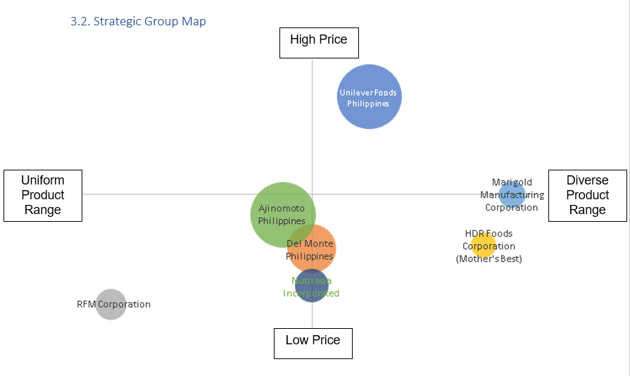
Strategic Group Map

Slide 5
Macro Environmental Analysis
Put in titles of each segment data only

Slide 6
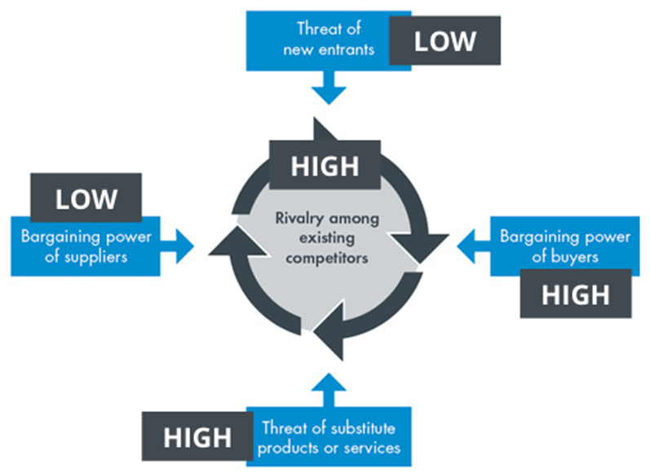
Five Competitive Forces

Slide 7
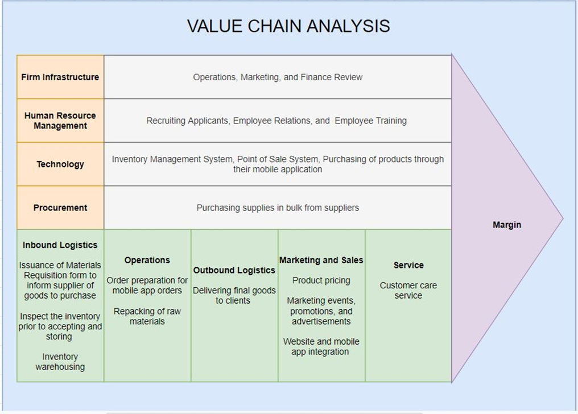
Value Chain Analysis

Slide 8
Identification of Strengths & Weaknesses
Strengths
Weaknesses

Slide 9
Identification of SBPIO
Problems
Issues

Slide 10
Identification of SBPIO (continued)
Opportunities

Slide 11
Business Process Improvements
Problems, Issues and Opportunities Addressed

Slide 12
Business Process Improvements
Functions and Feature
Function/Module | Features
Function 1: | Feature 1 – Feature 2 – Feature 3 – Feature 4 –

Slide 13
End of Presentation

