Slide 1


<Name>
<Date>

Slide 2

Outline
Executive Summary
Introduction
Methodology
Results
Conclusion
Appendix

Slide 3
Executive Summary
Summary of methodologies
Data Collection API with Webscraping
Data Wrangling
Data Analysis with SQL
Data Visualization
Interactive Visual Analytics and Dashboard
Machine Learning Predictive Analysis
Summary of all results
Success rate for launches has been increasing and SpaceX has very high rates of success with certain launches particularly from certain locations.

Slide 4
Introduction
Space X competitors cost roughly $165 million to SpaceX Falcon 9’s $60+ million figure. SpaceX will have even more of a competitive advantage with more successful launches and increased reusability.
Using information from previous launches, we can decipher the probability of future successful launches depending on the location and type of launch as well as other factors.

Slide 5

Section 1

Slide 6
Methodology
Executive Summary
Data collection methodology:
Describe how data was collected
Perform data wrangling
Describe how data was processed
Perform exploratory data analysis (EDA) using visualization and SQL
Perform interactive visual analytics using Folium and Plotly Dash
Perform predictive analysis using classification models
How to build, tune, evaluate classification models

Slide 7
Data Collection
Describe how data sets were collected.
You need to present your data collection process use key phrases and flowcharts

Slide 8
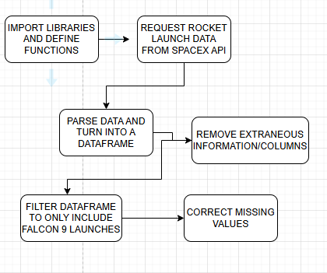
Data Collection – SpaceX API
Data was collected from the SpaceX API as seen in the flowchart to the right.
https://github.com/adroit-al/Jupyter-Notebook/blob/SpaceX-Flight/jupyter-labs-spacex-data-collection-api.ipynb

Slide 9
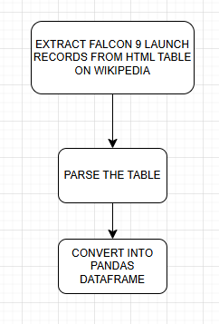
Data Collection - Scraping
Webscraping was completed using get request from an online list of Falcon 9 launches which was then converted into a dataframe
https://github.com/adroit-al/Jupyter-Notebook/blob/SpaceX-Flight/jupyter-labs-webscraping.ipynb

Slide 10
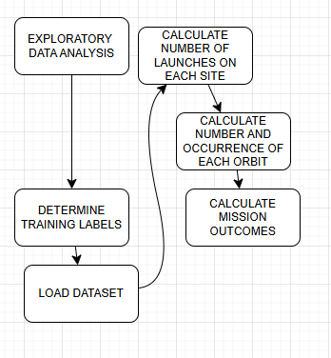
Data Wrangling
Exploratory data analysis was conducted to determine the available information, determine missing values, and datatypes some of which were numerical while others were categorical in nature. From there, the number of launches from each location was determined as well as the result of each launch.
https://pandas.pydata.org/docs/reference/api/pandas.DataFrame.dtypes.html

Slide 11
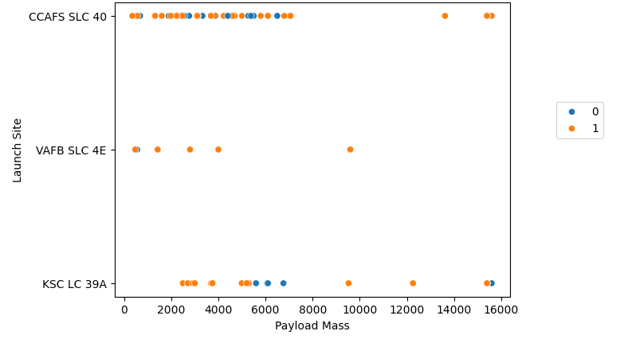
EDA with Data Visualization
Scatterplots, Bar graphs, and a lien chart were used to visualize the data, an example of which can be seen to the right.
https://github.com/adroit-al/Jupyter-Notebook/blob/SpaceX-Flight/edadataviz.ipynb

Slide 12
EDA with SQL
SQL queries were used to determine the following:
Average payload mass carried by booster version F9
Determine date of first successful landing outcome
List boosters within certain range of mass
List total number of successful and failure mission outcomes
List the month failure outcomes occurred for drone ships
Rank landing outcomes in specific date range
https://github.com/adroit-al/Jupyter-Notebook/blob/SpaceX-Flight/jupyter-labs-eda-sql-coursera_sqllite.ipynb

Slide 13
Build an Interactive Map with Folium
Markers, circles and lines were added to the Folium map
The lines were to display the distance from the launch site to the coastline and the markers of varying color showed whether each launch was a success or failure
https://github.com/adroit-al/Jupyter-Notebook/blob/SpaceX-Flight/lab_jupyter_launch_site_location.ipynb

Slide 14
Build a Dashboard with Plotly Dash
Summarize what plots/graphs and interactions you have added to a dashboard
The plots/graphs added include a pie chart to visualize the percentage of launches from the different locations and a scatter plot of the payload complete with launchsite details as well as whether it was a success or failure as well as input interaction with a slider so the user could select certain fields
These plots and interactions were added to include an interactive visual so that users could easily determine the effect of payload mass and launch location on the success rate of a launch.

Slide 15
Predictive Analysis (Classification)
First the data was standardized using a standard scalar and split into training and testing data. From there, different models were tested such a logregression, SVM, DecisionTree classifier, and KNN
Different models were tested to determine which would be best to use, however, they all performed similarly. This being the case, it is best to use the model that requires the least amount of resources.
https://github.com/adroit-al/Jupyter-Notebook/blob/SpaceX-Flight/SpaceX_Machine%20Learning%20Prediction_Part_5.ipynb

Slide 16
Results
Exploratory data analysis results
Interactive analytics demo in screenshots
Predictive analysis results

Slide 17

Section 2

Slide 18
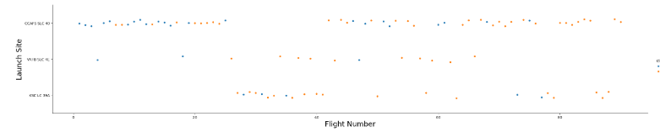
Flight Number vs. Launch Site
Early launches resulted in many failures, however, each site’s success rates improved drastically as the number of flights increased.

Slide 19
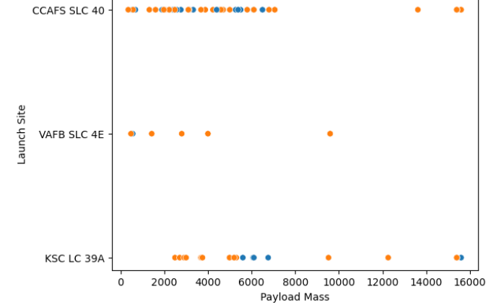
Payload vs. Launch Site
The lowest payloads had a lower chance of success with the success rate being the highest between 8,000 and 15,000kg of payload mass.

Slide 20
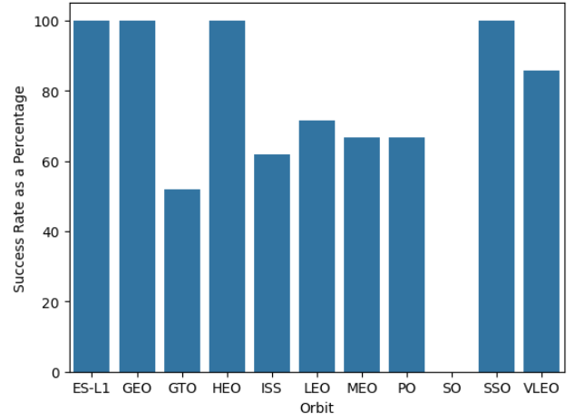
Success Rate vs. Orbit Type
ES-L1, GEO, HEO, and SSO had the highest success rates followed by VLEO with SO having no success.

Slide 21
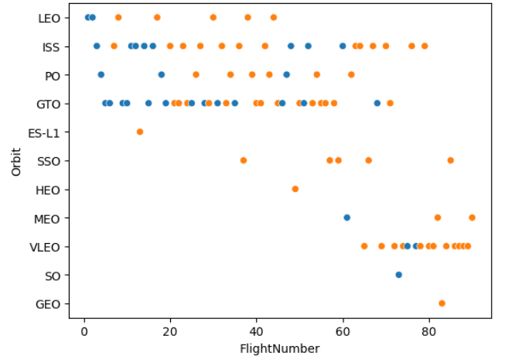
Flight Number vs. Orbit Type
LEO greatly improved with no failures after the initial flights, VLEO also saw relatively few failures.
SSO has remained significantly successful and ES-L1 has a 100% success rate but it should be noted that with more launches, the success rate will likely decrease.
Overall, there is a trend of increasing success rates as the flight number increases.

Slide 22
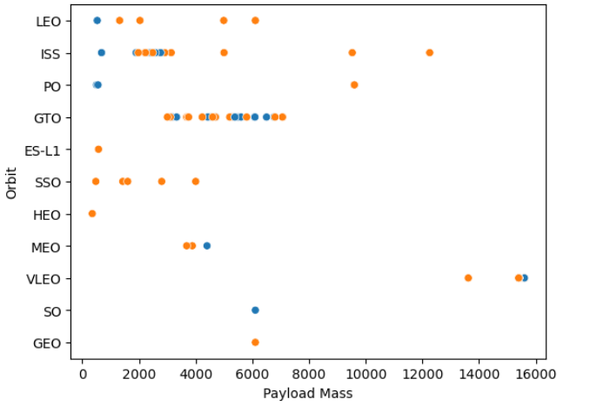
Payload vs. Orbit Type
It is unclear how significant payload mass is on the success or failure of a flight. This particularly comes into focus looking at GTO launches.

Slide 23
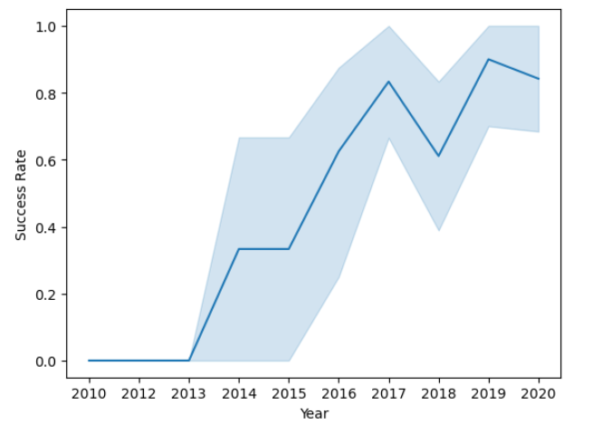
Launch Success Yearly Trend
The success rate greatly increased from 2013 to 2017 with more failures in 2018 and beyond with peaks in 2018 and 2019 around 80% and 90% success rates, respectively.

Slide 24
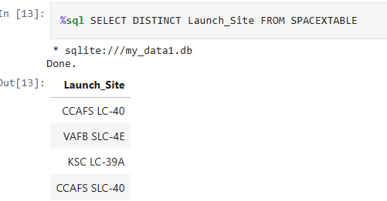
All Launch Site Names
The unique launch sites are as seen below based on the SQL query

Slide 25
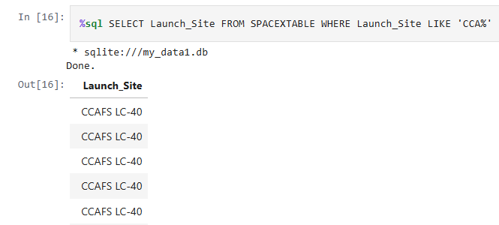
Launch Site Names Begin with 'CCA'
See 5 Launch Sites below obtained in a SQL query

Slide 26
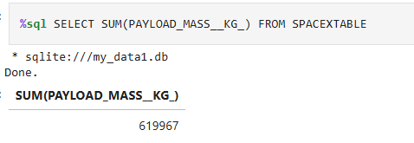
Total Payload Mass
See the sum of payload mass below which was the result of the below query

Slide 27
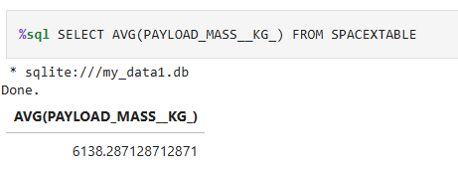
Average Payload Mass by F9 v1.1
See the average payload mass from the result of the query below.

Slide 28
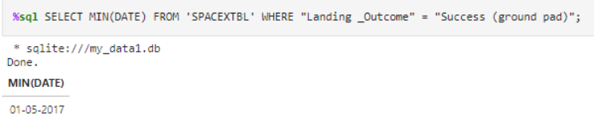
First Successful Ground Landing Date
The date was obtained using the query below.

Slide 29
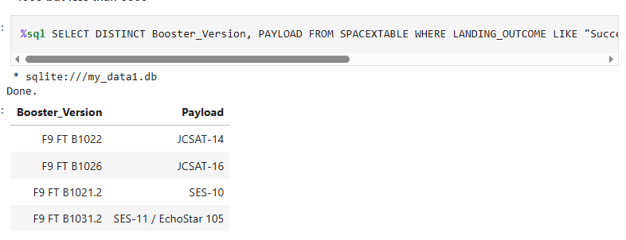
Successful Drone Ship Landing with Payload between 4000 and 6000
Successfully landed drone ships having a payload mass greater than 4000 but less than 6000 are shown using the query below.
Present your query result with a short explanation here

Slide 30
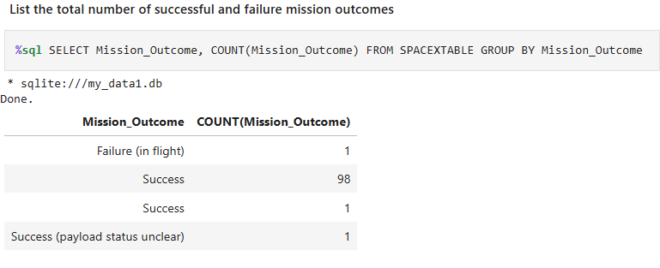
Total Number of Successful and Failure Mission Outcomes
Outcomes were obtained using the query below.

Slide 31
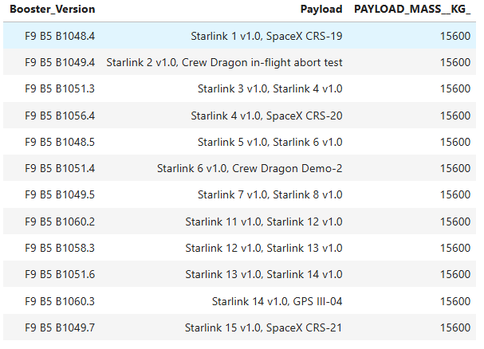
Boosters Carried Maximum Payload
Below are the boosters which have carried the maximum payloads.

Slide 32
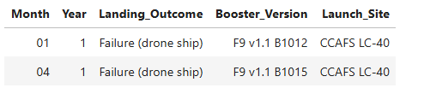
2015 Launch Records
Failed landing outcomes in drone ships as well as there booster versions and launch sites for the year 2015 can be seen below.

Slide 33
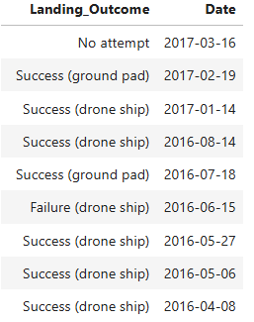
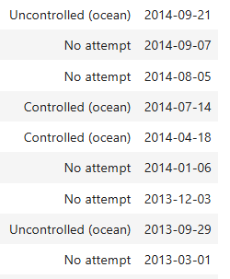
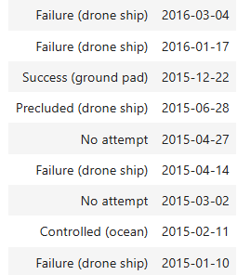
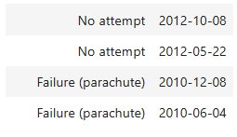
Rank Landing Outcomes Between 2010-06-04 and 2017-03-20
The following are the results in descending order by date of landing outcomes from 2017/03/20 to 2010/06/04
Present your query result with a short explanation here

Slide 34

Section 3

Slide 35
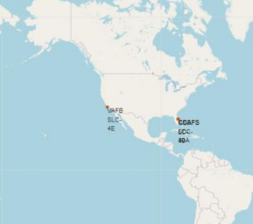
Launch Sites on Global Map
As seen from the map, the launch sites are located near the coastline and close to the equator.

Slide 36
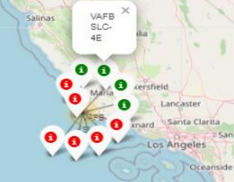
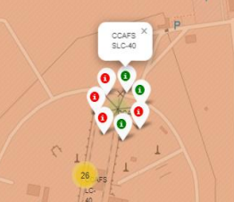
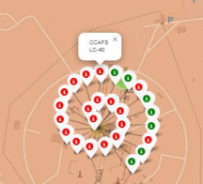
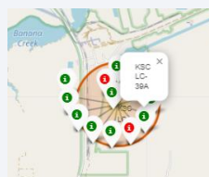
Launchsite Map and Outcomes
Launch Sites as well as outcomes. Success was much more likely in KSC LC-39A than other launch sites.

Slide 37
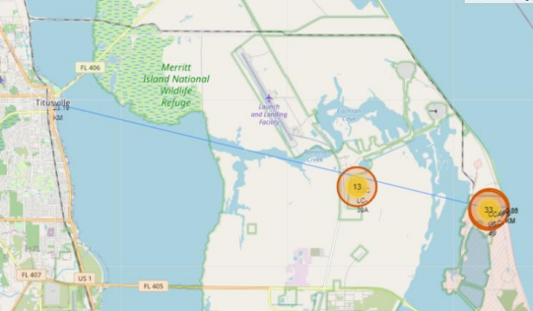
Launchsite and Proximities Map
Distance between launchsite and its proximities.

Slide 38

Section 4

Slide 39
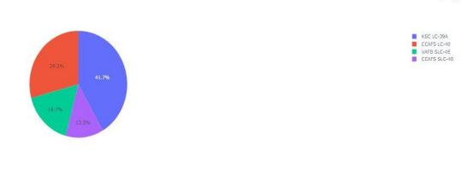
Successful Counts for Launch Sites
The launchsite with the most successful counts was KSC LC-39A followed by CCAFS LC-40

Slide 40
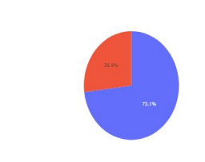
Success Rate KSC LC-39A
KSC LC-39A had the highest success rate with over 75% of launches resulting in success.

Slide 41
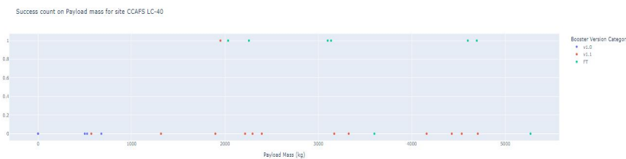
Launch Outcome by Payload
This shows the effect that payload mass and booster version had on success rate.

Slide 42

Section 5

Slide 43
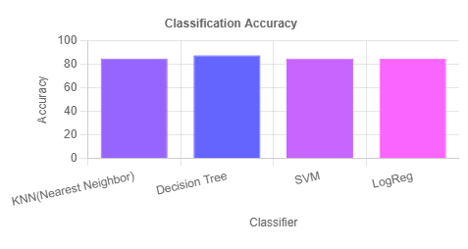
Classification Accuracy
Decision Tree was the most accurate among the classifiers.

Slide 44
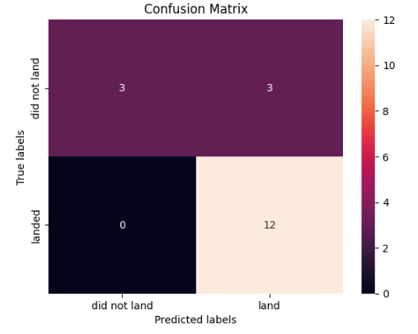
Confusion Matrix
There were no false negatives and overall the results were fairly reliable for most scenarios.

Slide 45
Conclusions
Some launch sites saw greater success than others.
The data was not sufficient to determine the reason for success or failure
ES-L1, HEO, SSO, and GEO were the most successful orbits
In general, the company saw increasing success as the flight number increased
Some of the locations had a low success rate but many of their launches were earlier. There were likely other factors besides location that caused these lower success rates.

Slide 46


