Slide 1
Index
Problem 1 - PIMA Indians Dataset (Classification problem)
Problem 2 – California Housing Dataset (Regression Problem)

Slide 2

PIMA Indians Dataset - Classification Problem

Slide 3
Problem Statement 1
Using the PIMA Indian Diabetes dataset to create a model that predicts whether or not a person has diabetes using the medical attributes provided.

Slide 4
Introduction
Background and Approach
To predict whether a person has diabetes or not, we will be using Machine Learning, based on information about the patient such as blood pressure, body mass index (BMI), age, etc.
The data was collected and made available by “National Institute of Diabetes and Digestive and Kidney Diseases” as part of the Pima Indians Diabetes Database. Several constraints were placed on the selection of these instances from a larger database. In particular, all patients here belong to the Pima Indian heritage (subgroup of Native Americans), and are females of ages 21 and above.
Python and some of its popular data science related packages have been used. First of all, we will import pandas to read our data from a CSV file and manipulate it for further use. We will also use numpy to convert out data into a format suitable to feed our classification model. We’ll use seaborn and matplotlib for visualizations. We will be using various classification algorithms to predict whether a person has diabetes or not.

Slide 5
Data Description
The data is stored in a csv file pima_indians.csv . We read the data from the dataset.
The datasets consists of several medical predictor variables and one target variable, Outcome. Columns are following :-
Pregnancies :- Number of times pregnant
Glucose:- Plasma glucose concentration a 2 hours in an oral glucose tolerance test
BloodPressure:- Diastolic blood pressure (mm Hg)
SkinThickness:- Triceps skin fold thickness (mm)
Insulin:- 2-Hour serum insulin (mu U/ml)
BMI:- Body mass index (weight in kg/(height in m)²)
DiabetesPedigreeFunction:- Diabetes pedigree function
Age:-Age in years
Outcome:- Class variable (0 or 1) 268 of 768 are 1, the others are 0
 | Pregnancies | Glucose | BP | SkinThickness | Insulin | BMI | DiabetesPedigree | Age | Outcome
0 | 6 | 148 | 72 | 35 | 0 | 33.6 | 0.627 | 50 | 1
1 | 1 | 85 | 66 | 29 | 0 | 26.6 | 0.351 | 31 | 0
2 | 8 | 183 | 64 | 0 | 0 | 23.3 | 0.672 | 32 | 1
3 | 1 | 89 | 66 | 23 | 94 | 28.1 | 0.167 | 21 | 0
4 | 0 | 137 | 40 | 35 | 168 | 43.1 | 2.288 | 33 | 1

Slide 6
Data Description
Handling the missing values-
We need to check the presence of the missing values and need to replace them with mean, median and mode. Sometimes we have null values in the form of 0 , so we need to convert them to NaN and then replace them accordingly. The missing values can be removed also but it should be less than 5 percent of the whole dataset.
#1. Handling the missing values
pima.isnull().values.any()
#2. Encoding 0 values with NaN
d = pima[['Glucose','BP','SkinThickness','Insulin','BMI']] = pima[['Glucose','BP','SkinThickness','Insulin','BMI']].replace(0,np.NaN)
d.head()
#3. Find the number of missing value
d.isnull().sum()[['Glucose','BP','SkinThickness','Insulin','BMI’]]
#4. Replace NaN to mean value
pima['Glucose'].fillna(pima['Glucose'].median(),inplace=True)
pima['BP'].fillna(pima['BP'].median(),inplace=True)
pima['SkinThickness'].fillna(pima['SkinThickness'].median(),inplace=True)
pima['Insulin'].fillna(pima['Insulin'].median(),inplace=True)
pima['BMI'].fillna(pima['BMI'].median(),inplace=True)
pima.head()
 | Glucose | BP | SkinThickness | Insulin | BMI
0 | 148.0 | 72.0 | 35.0 | NaN | 33.6
1 | 85.0 | 66.0 | 29.0 | NaN | 26.6
2 | 183.0 | 64.0 | NaN | NaN | 23.3
3 | 89.0 | 66.0 | 23.0 | 94.0 | 28.1
4 | 137.0 | 40.0 | 35.0 | 168.0 | 43.1

Slide 7
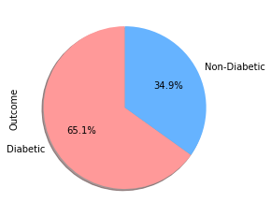
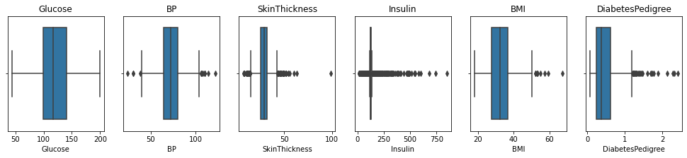
Data Visualization
Visualizing data in different type of graphs will provide us with greater insights into our data. We will explore different options on visualizing our data and find out any patterns between within it.
Visualizing the outcome column
Visualizing the outliers
#The pie chart shows that 65.1% people are diabetic and 34.9% people are non-diabetic
#The plot shows outliers present in the dataset. BP, SkinThickness, Insulin, BMI have outliers

Slide 8
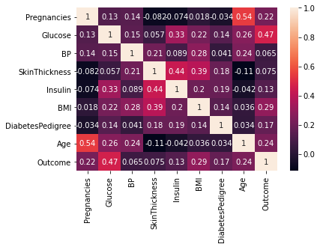
Data Visualization
In the heatmap, brighter colors indicate more correlation. As we can see from the heatmap, glucose levels, age, BMI and number of pregnancies all have significant correlation with the outcome variable. Also notice the correlation between pairs of features, like age and pregnancies, or insulin and skin thickness.
The correlation plot shows the relation between the parameters.
Glucose, Age, BMI and Pregnancies are the most correlated parameters with the Outcome.
Insulin and DiabetesPedigreeFunction have little correlation with the outcome.
BloodPressure and SkinThickness have tiny correlation with the outcome.
There is a little correlation between Age and Pregnancies, Insulin and Skin Thickness, BMI and Skin Thickness, Insulin and Glucose

Slide 9
Data Preparation
When using machine learning algorithms we should always split our data into a training set and test set. (If the number of experiments we are running is large, then we can should be dividing our data into 3 parts, namely — training set, development set and test set).
The data set consists of record of 767 patients in total. To train our model we will be using 650 records. We will be using 100 records for testing, and the last 17 records to cross check our model.
Next, we separate the label and features (for both training and test dataset). In addition to that, we will also convert them into NumPy arrays as our machine learning algorithm process data in NumPy array format.
As the final step before using machine learning, we will normalize our inputs. We will normalize the data such that each variable has 0 mean and standard deviation of 1.

Slide 10
What are the most important factors for determining whether or not someone in the dataset is diabetic ?

Slide 11
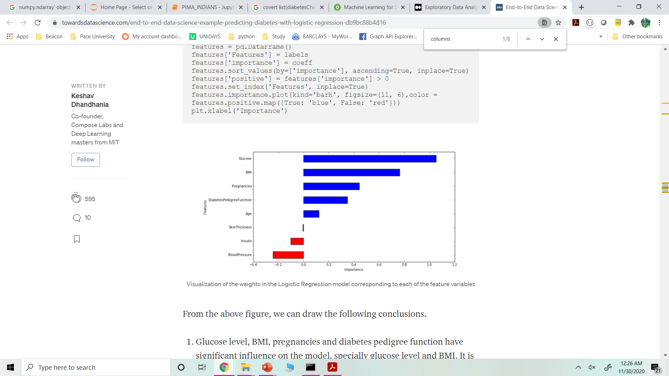
Training and Evaluating Machine Learning
Interpreting the ML Model using Logistic Regression. It provides with 78% accuracy
Glucose level, BMI, pregnancies and diabetes pedigree function have significant influence on the model, specially glucose level and BMI.
Blood pressure has a negative influence on the prediction, i.e. higher blood pressure is correlated with a person not being diabetic. (also, note that BP is more important as a feature than age, because the magnitude is higher for blood pressure).
Although age was more correlated than BMI to the output variables the model relies more on BMI. This can happen for several reasons, including the fact that the correlation captured by age is also captured by some other variable, whereas the information captured by BMI is not captured by other variables.

Slide 12
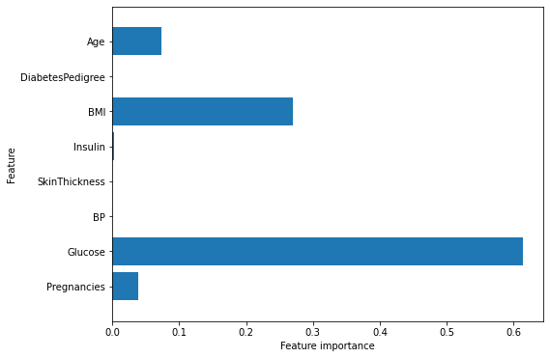
Using other classification algorithms
Decision Tree :
The accuracy on the training set is 100%, while the test set accuracy is 72% which is much worse than Logistic regression. This is an indicative that the tree is overfitting and not generalizing well to new data.
We set max_depth=3, limiting the depth of the tree decreases overfitting. This leads to a lower accuracy on the training set, but an improvement on the test set.
Accuracy on training set: 0.773
Accuracy on test set: 0.740
Feature “Glucose” is by far the most important feature as can be seen in the visualization.

Slide 13
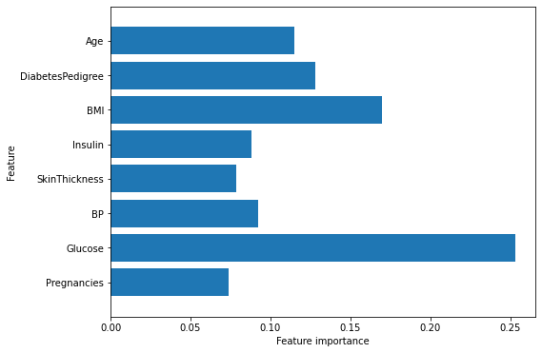
Using other classification algorithms
Random Forest:
The random forest gives us an accuracy of 78.6%, better than the logistic regression model or a single decision tree, without tuning any parameters
Similarly to the single decision tree, the random forest also gives a lot of importance to the “Glucose” feature, but it also chooses “BMI” to be the 2nd most informative feature overall.
The randomness in building the random forest forces the algorithm to consider many possible explanations, the result being that the random forest captures a much broader picture of the data than a single tree.

Slide 14
Conclusion
During our analysis, we found a accuracy of 78.6% using the random forest algorithm.
There may be still space for further analysis and optimization, for example trying different data transformations or trying algorithms that have not been tested like Support Vector Machine.
Training a machine learning model to solve a problem with a specific dataset is a try / fail / improve process. Hence, there is a scope for improvement

Slide 15
Thank You!!

