Slide 1
Enterprise Intelligence Development Project – CS666
Samiksha Mathur
MS in Computer Science
U01642707

Slide 2
Index
Problem 1 - PIMA Indians Dataset (Classification problem)
Problem 2 – California Housing Dataset (Regression Problem)

Slide 3

PIMA Indians Dataset - Classification Problem

Slide 4
Problem Statement 1
Using the PIMA Indian Diabetes dataset to create a model that predicts whether or not a person has diabetes using the medical attributes provided.

Slide 5
Introduction
Background and Approach
To predict whether a person has diabetes or not, we will be using Machine Learning, based on information about the patient such as blood pressure, body mass index (BMI), age, etc.
The data was collected and made available by “National Institute of Diabetes and Digestive and Kidney Diseases” as part of the Pima Indians Diabetes Database. Several constraints were placed on the selection of these instances from a larger database. In particular, all patients here belong to the Pima Indian heritage (subgroup of Native Americans), and are females of ages 21 and above.
Python and some of its popular data science related packages have been used. First of all, we will import pandas to read our data from a CSV file and manipulate it for further use. We will also use numpy to convert out data into a format suitable to feed our classification model. We’ll use seaborn and matplotlib for visualizations. We will be using various classification algorithms to predict whether a person has diabetes or not.

Slide 6
Data Description
The data is stored in a csv file pima_indians.csv . We read the data from the dataset.
The datasets consists of several medical predictor variables and one target variable, Outcome. Columns are following :-
Pregnancies :- Number of times pregnant
Glucose:- Plasma glucose concentration a 2 hours in an oral glucose tolerance test
BloodPressure:- Diastolic blood pressure (mm Hg)
SkinThickness:- Triceps skin fold thickness (mm)
Insulin:- 2-Hour serum insulin (mu U/ml)
BMI:- Body mass index (weight in kg/(height in m)²)
DiabetesPedigreeFunction:- Diabetes pedigree function
Age:-Age in years
Outcome:- Class variable (0 or 1) 268 of 768 are 1, the others are 0
 | Pregnancies | Glucose | BP | SkinThickness | Insulin | BMI | DiabetesPedigree | Age | Outcome
0 | 6 | 148 | 72 | 35 | 0 | 33.6 | 0.627 | 50 | 1
1 | 1 | 85 | 66 | 29 | 0 | 26.6 | 0.351 | 31 | 0
2 | 8 | 183 | 64 | 0 | 0 | 23.3 | 0.672 | 32 | 1
3 | 1 | 89 | 66 | 23 | 94 | 28.1 | 0.167 | 21 | 0
4 | 0 | 137 | 40 | 35 | 168 | 43.1 | 2.288 | 33 | 1

Slide 7
Data Description
Handling the missing values-
We need to check the presence of the missing values and need to replace them with mean, median and mode. Sometimes we have null values in the form of 0 , so we need to convert them to NaN and then replace them accordingly. The missing values can be removed also but it should be less than 5 percent of the whole dataset.
#1. Handling the missing values
pima.isnull().values.any()
#2. Encoding 0 values with NaN
d = pima[['Glucose','BP','SkinThickness','Insulin','BMI']] = pima[['Glucose','BP','SkinThickness','Insulin','BMI']].replace(0,np.NaN)
d.head()
#3. Find the number of missing value
d.isnull().sum()[['Glucose','BP','SkinThickness','Insulin','BMI’]]
#4. Replace NaN to mean value
pima['Glucose'].fillna(pima['Glucose'].median(),inplace=True)
pima['BP'].fillna(pima['BP'].median(),inplace=True)
pima['SkinThickness'].fillna(pima['SkinThickness'].median(),inplace=True)
pima['Insulin'].fillna(pima['Insulin'].median(),inplace=True)
pima['BMI'].fillna(pima['BMI'].median(),inplace=True)
pima.head()
 | Glucose | BP | SkinThickness | Insulin | BMI
0 | 148.0 | 72.0 | 35.0 | NaN | 33.6
1 | 85.0 | 66.0 | 29.0 | NaN | 26.6
2 | 183.0 | 64.0 | NaN | NaN | 23.3
3 | 89.0 | 66.0 | 23.0 | 94.0 | 28.1
4 | 137.0 | 40.0 | 35.0 | 168.0 | 43.1

Slide 8
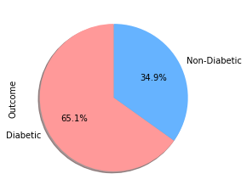
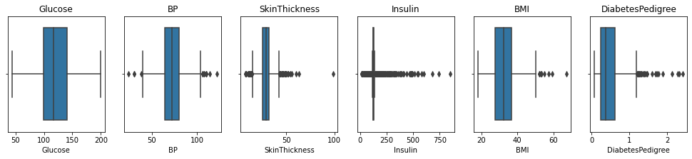
Data Visualization
Visualizing data in different type of graphs will provide us with greater insights into our data. We will explore different options on visualizing our data and find out any patterns between within it.
Visualizing the outcome column
Visualizing the outliers
#The pie chart shows that 65.1% people are diabetic and 34.9% people are non-diabetic
#The plot shows outliers present in the dataset. BP, SkinThickness, Insulin, BMI have outliers

Slide 9
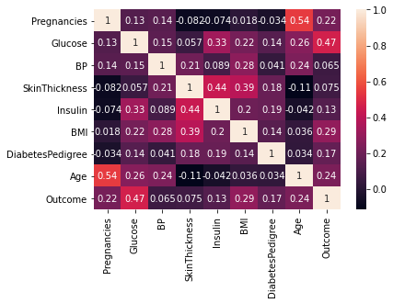
Data Visualization
In the heatmap, brighter colors indicate more correlation. As we can see from the heatmap, glucose levels, age, BMI and number of pregnancies all have significant correlation with the outcome variable. Also notice the correlation between pairs of features, like age and pregnancies, or insulin and skin thickness.
The correlation plot shows the relation between the parameters.
Glucose, Age, BMI and Pregnancies are the most correlated parameters with the Outcome.
Insulin and DiabetesPedigreeFunction have little correlation with the outcome.
BloodPressure and SkinThickness have tiny correlation with the outcome.
There is a little correlation between Age and Pregnancies, Insulin and Skin Thickness, BMI and Skin Thickness, Insulin and Glucose

Slide 10
Data Preparation
When using machine learning algorithms we should always split our data into a training set and test set. (If the number of experiments we are running is large, then we can should be dividing our data into 3 parts, namely — training set, development set and test set).
The data set consists of record of 767 patients in total. To train our model we will be using 650 records. We will be using 100 records for testing, and the last 17 records to cross check our model.
Next, we separate the label and features (for both training and test dataset). In addition to that, we will also convert them into NumPy arrays as our machine learning algorithm process data in NumPy array format.
As the final step before using machine learning, we will normalize our inputs. We will normalize the data such that each variable has 0 mean and standard deviation of 1.

Slide 11
What are the most important factors for determining whether or not someone in the dataset is diabetic ?

Slide 12
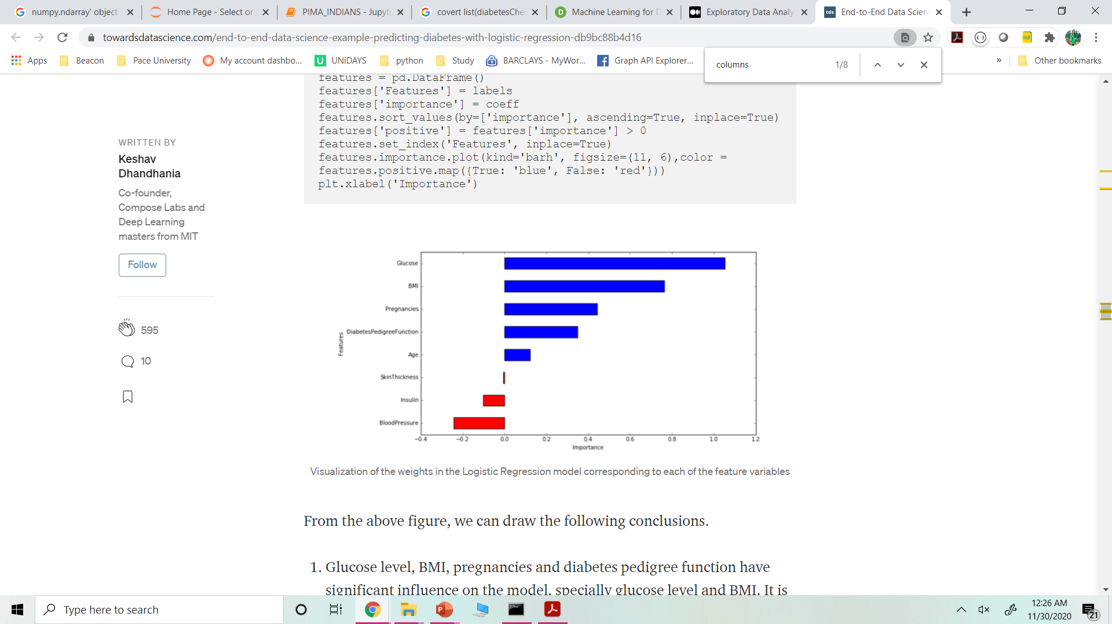
Training and Evaluating Machine Learning
Interpreting the ML Model using Logistic Regression. It provides with 78% accuracy
Glucose level, BMI, pregnancies and diabetes pedigree function have significant influence on the model, specially glucose level and BMI.
Blood pressure has a negative influence on the prediction, i.e. higher blood pressure is correlated with a person not being diabetic. (also, note that BP is more important as a feature than age, because the magnitude is higher for blood pressure).
Although age was more correlated than BMI to the output variables the model relies more on BMI. This can happen for several reasons, including the fact that the correlation captured by age is also captured by some other variable, whereas the information captured by BMI is not captured by other variables.

Slide 13
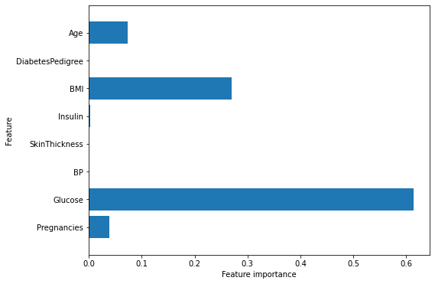
Using other classification algorithms
Decision Tree :
The accuracy on the training set is 100%, while the test set accuracy is 72% which is much worse than Logistic regression. This is an indicative that the tree is overfitting and not generalizing well to new data.
We set max_depth=3, limiting the depth of the tree decreases overfitting. This leads to a lower accuracy on the training set, but an improvement on the test set.
Accuracy on training set: 0.773
Accuracy on test set: 0.740
Feature “Glucose” is by far the most important feature as can be seen in the visualization.

Slide 14
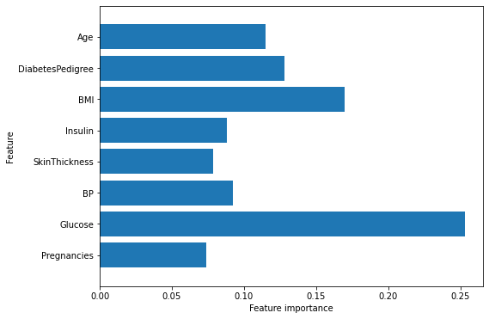
Using other classification algorithms
Random Forest:
The random forest gives us an accuracy of 78.6%, better than the logistic regression model or a single decision tree, without tuning any parameters
Similarly to the single decision tree, the random forest also gives a lot of importance to the “Glucose” feature, but it also chooses “BMI” to be the 2nd most informative feature overall.
The randomness in building the random forest forces the algorithm to consider many possible explanations, the result being that the random forest captures a much broader picture of the data than a single tree.

Slide 15
Conclusion
During our analysis, we found a accuracy of 78.6% using the random forest algorithm.
There may be still space for further analysis and optimization, for example trying different data transformations or trying algorithms that have not been tested like Support Vector Machine.
Training a machine learning model to solve a problem with a specific dataset is a try / fail / improve process. Hence, there is a scope for improvement

Slide 17
Problem Statement 2
The project aims at building a model of housing prices to predict median house values in California using the provided dataset. This model should learn from the data and be able to predict the median housing price in any district, given all the other metrics.

Slide 18
Introduction
Background and Approach
The US Census Bureau has published California Census Data which has 10 types of metrics such as the population, median income, median housing price, and so on for each block group in California. The dataset also serves as an input for project scoping and tries to specify the functional and nonfunctional requirements for it.
The Approach:
We will train our model on existing data so we are doing supervised learning
Since we need to predict housing prices we are doing regression
Output depends on many parameters so we are doing multivariate-regression
Analysis Tasks to be performed:
- Build a model of housing prices to predict median house values in California using the provided dataset.
- Train the model to learn from the data to predict the median housing price in any district, given all the other metrics.
- Predict housing prices based on median_income and plot the regression chart for it.

Slide 19
Data Description
The data is stored in a csv file housing.csv .The dataset contains 20640 observations and 10 attributes (9 predictors and 1 response). Below is a list of the variables:
longitude: A measure of how far west a house is; a higher value is farther west
latitude: A measure of how far north a house is; a higher value is farther north
housing_median_age: Median age of a house within a block; a lower number is a newer building
total_rooms: Total number of rooms within a block
total_bedrooms: Total number of bedrooms within a block
population: Total number of people residing within a block
households: Total number of households, a group of people residing within a home unit, for a block
median_income: Median income for households within a block of houses (measured in tens of thousands of US Dollars)
ocean_proximity: Location of the house with respect to ocean/sea
median_house_value: Median house value for households within a block (measured in US Dollars)
 | longitude | latitude | housing_median_age | total_rooms | total_bedrooms | population | households | median_income | median_house_value | ocean_proximity
0 | -122.23 | 37.88 | 41.0 | 880.0 | 129.0 | 322.0 | 126.0 | 8.3252 | 452600.0 | NEAR BAY
1 | -122.22 | 37.86 | 21.0 | 7099.0 | 1106.0 | 2401.0 | 1138.0 | 8.3014 | 358500.0 | NEAR BAY
2 | -122.24 | 37.85 | 52.0 | 1467.0 | 190.0 | 496.0 | 177.0 | 7.2574 | 352100.0 | NEAR BAY
3 | -122.25 | 37.85 | 52.0 | 1274.0 | 235.0 | 558.0 | 219.0 | 5.6431 | 341300.0 | NEAR BAY
4 | -122.25 | 37.85 | 52.0 | 1627.0 | 280.0 | 565.0 | 259.0 | 3.8462 | 342200.0 | NEAR BAY

Slide 20
Data Description
Handle missing values : Fill the missing values with the mean of the respective column.
housing_data = housing_data.dropna()
Encode categorical data : Convert categorical column in the dataset to numerical data. All features have numeric value except ocean_proximity. It contains categorial or discrete values not numbers
housing_data['ocean_proximity'].unique()
We need to convert string values in numeric. We can use one-hot encoding to convert ocean_proximity column to numeric form
housing_data = pd.get_dummies(housing_data, columns=['ocean_proximity’])
Standardize data : Standardize training and test datasets.
X = housing_data.drop('median_house_value', axis = 1)
Y = housing_data['median_house_value’]
#Names of features used to train the model - X.columns
Output - Index(['longitude', 'latitude', 'housing_median_age', 'total_rooms',
'total_bedrooms', 'population', 'households', 'median_income',
'ocean_proximity_<1H OCEAN', 'ocean_proximity_INLAND',
'ocean_proximity_ISLAND', 'ocean_proximity_NEAR BAY',
'ocean_proximity_NEAR OCEAN'],
dtype='object')

Slide 21
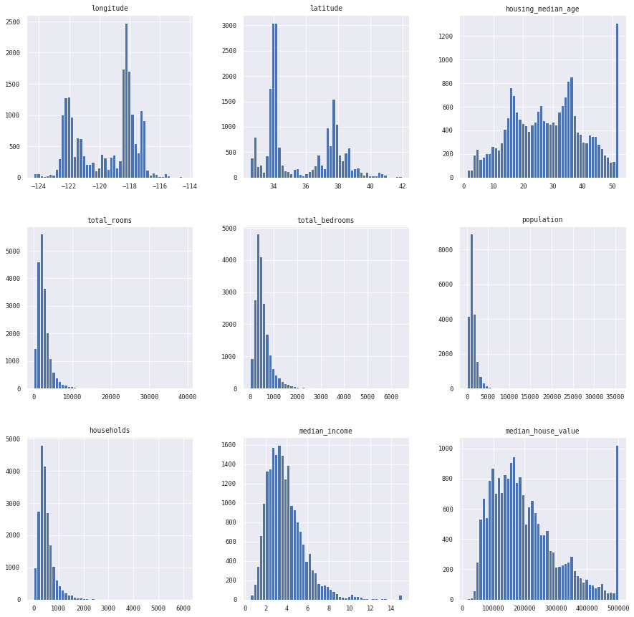
Data Visualization
households — most districts have around 100–500 households. Peak is around 4800
housing median age — not very bell-shaped, at 35 and 15 are two peaks. Max peak is at 50.
latitude — at 34 and 37 degrees of latitude are major houses
longitude — at -122 and -118 degrees are major houses
median house value — this is what we need to predict. Somewhat bell-shaped, at extreme right there is a surge. does this mean most houses are above 500,000?
median income — very bell-shaped, good distribution. There is no income above 15 so some capping has been done. Most people have income between 2–5
population — most districts have population below 3000
bedrooms — looks like most districts have between 300–600 bedrooms
total rooms — again similar to the previous two. Most districts have around 3000 rooms

Slide 22
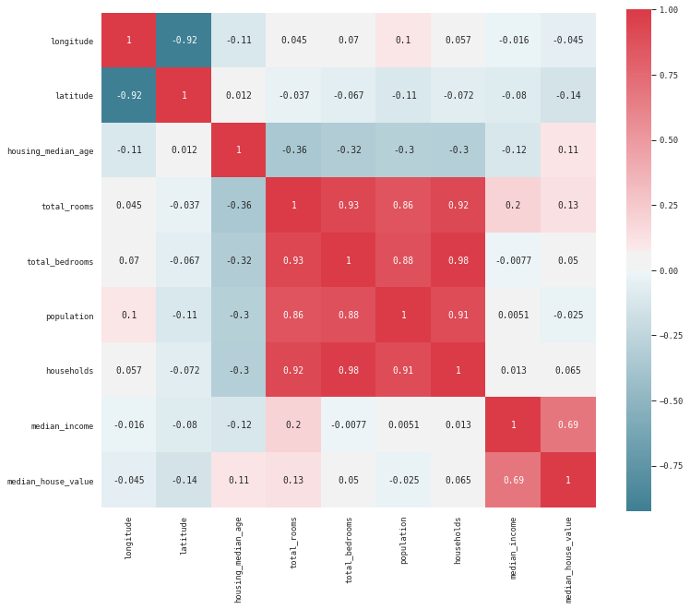
Data Visualization
housing_data_corr = housing_data.corr()
housing_data_corr
The result of corr function is the correlation b/w every pair of columns in the dataset
Correlation & statistics is a measure that indicate the extent to which 2 or more variables fluctuate together
If 2 variables move in the same direction together they are said to be positively correlated
If they move in diff. directions they are said to be negatively correlated
One thing that sticks out is the high collinearity between households and total_bedrooms, as well as households and total_rooms. While these variables are highly correlated, we believe it is best to leave them in as they are influential in the pricing of homes typically. Overall, we do not believe that collinearility will play a substantial role in influencing our models so we will be keeping all variables

Slide 23
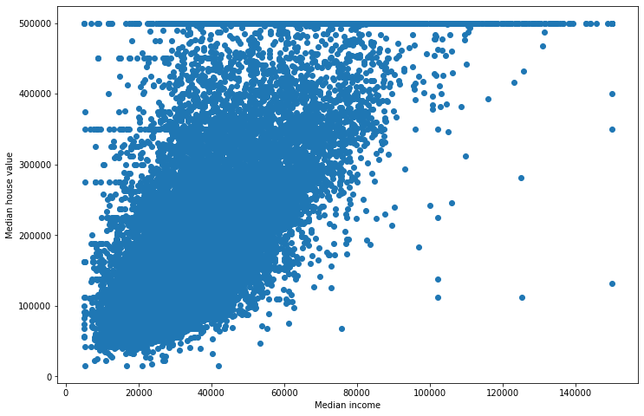
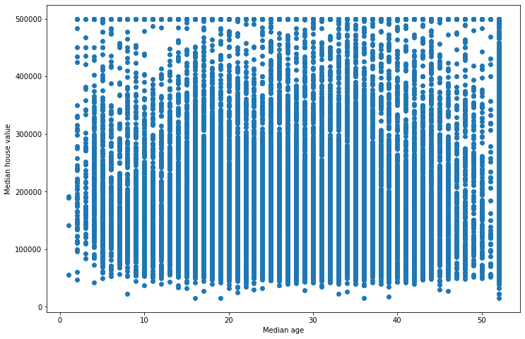
Data Visualization
Check for Outliers:

Slide 24
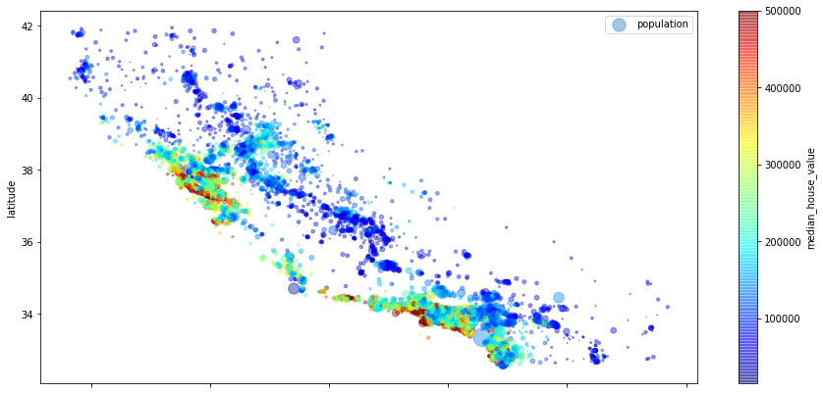
Data Preparation
Split the dataset : Split the data into 80% training dataset and 20% test dataset.
from sklearn.model_selection import train_test_split
x_train, x_test, y_train, y_test = train_test_split(X,Y, test_size =0.2)
Visualizing the training data set using a scatter plot
The radius of each circle represents the district’s population (option s)
The color represents the price (option c).
We use a predefined color map (option cmap) called jet, which ranges from blue (low values) to red (high prices)

Slide 25
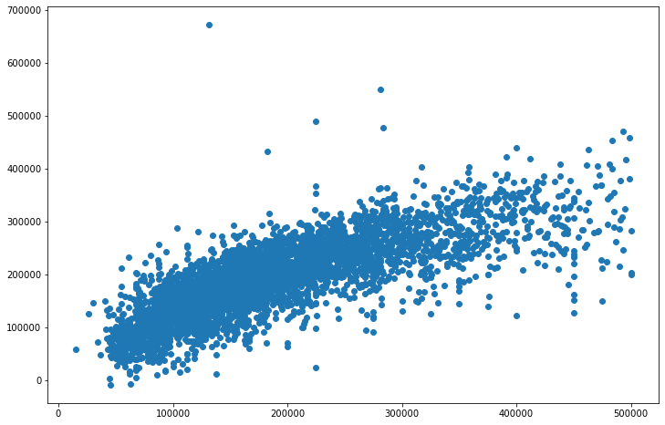
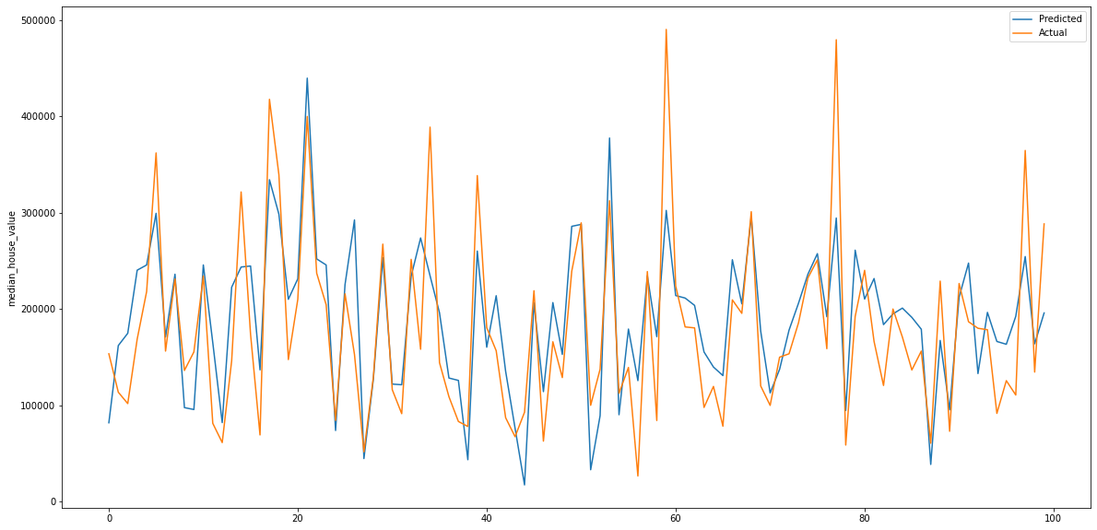
Apply Various Algorithms:
Interpreting the ML Model using Linear Regression
Perform Linear Regression on training data.
Predict output for test dataset using the fitted model.
Print root mean squared error (RMSE) from Linear Regression
The model gives r2 score of . 613129
This is an example of a model under-fitting the training data.
When this happens it can mean that the features do not provide enough information to make good predictions, or that the model is not powerful enough

Slide 26
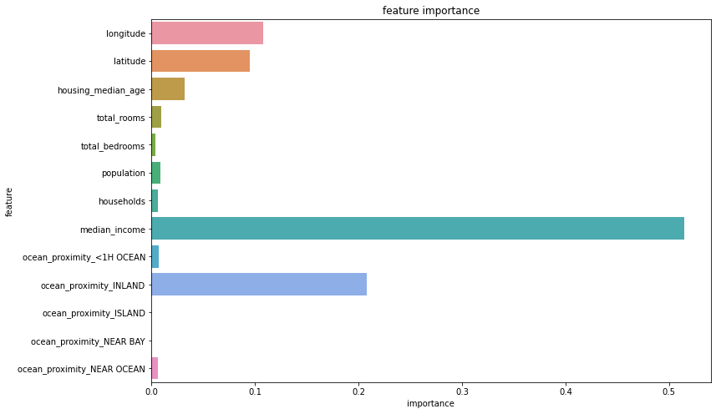
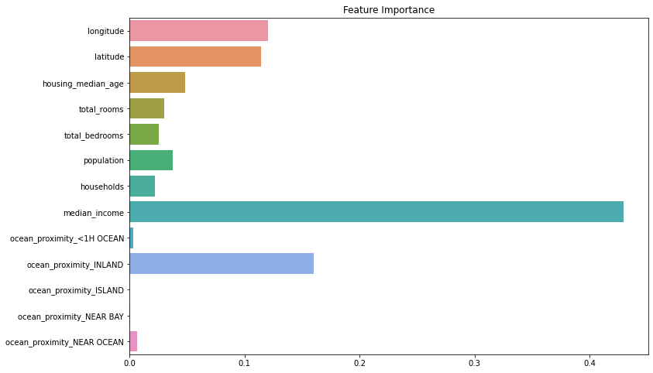
Apply Various Algorithms:
Decision Tree Regression
Random Forest Regression
Feature Importance by decision trees
Feature Importance by random forest

Slide 27
Conclusion
The random forest regressor seems to be performing better as compared to other ML Algorithms decision tree, linear regression and Ridge Regression.
However, there may be still space for further analysis and optimization, for example trying different data transformations or trying algorithms that have not been tested.
data = [reg_score, ridge_score, tree_score, forest_score]
index = ['Linear Regression', 'Ridge Regression', 'Decision Tree Regressor', 'Random Forest Regressor']
pd.DataFrame(data, index=index, columns=['Scores']).sort_values(ascending = False, by=['Scores’])
 | Scores
Random Forest Regressor | 0.740078
Decision Tree Regressor | 0.612247
Linear Regression | 0.370633
Ridge Regression | 0.369813

Slide 28
Thank You!!

