Slide 1
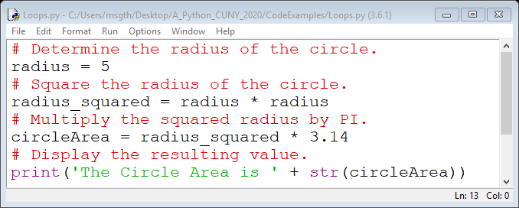
Algorithms
Once you understand the task that your program will perform, begin breaking the task down into a series of steps.
The steps in solving a problem is known as an algorithm.
EXAMPLE: Calculate the Area of a Circle
Determine the radius of the circle.
Square the radius of the circle.
Multiply the squared radius by the value of PI to determine the area.
Display the resulting value.

Slide 2
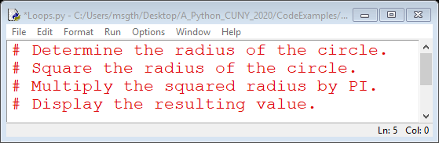
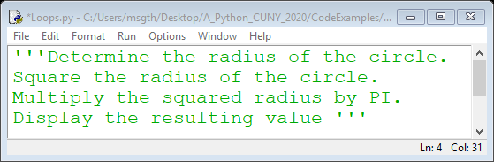
Pseudocode
It is helpful to write a program in pseudocode (fake code)before you write the actual code.
Pseudocode is an informal language that has no syntax rules and is not meant to be compiled or executed.
You can use pseudocode to create models or ‘mock ups’ of your program.
Pseudocode allows you to express a description of your model without being concerned about the exact Python syntax.
Once you have developed the model in pseudocode, you can then translate it into Python.

Slide 3
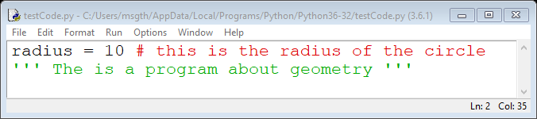
Comments
Comments are notes of explanation that document lines or sections of a program.
Comments are part of the program, but the Python interpreter ignores them.
They are intended for people who might read the source code.
There are two types of comments in Python:
# Single-Line Comment (End of Line)
‘’’‘’’ Multi-Line Comment (Doc String)

Slide 4
Variables
A variable is a name that represents a value stored in the computer’s memory.
You use an assignment statement to create a variable and make it reference a piece of data.
You cannot use a variable until you have assigned a value to it.
An assignment statement is written as:
Variable = Expression (radius = 10)
Variables can be reassigned values after an initial value is assigned.
radius = 10 (initial value of radius)
radius = 5 (new value of radius)
There are some rules when it comes to naming variables in Python:
Cannot use a Python keyword to name a variable.
A variable name cannot contain spaces.
The first character in the variable name must be a letter a-z or A-Z or an underscore (_).
After the first character you may use letters a-z or A-Z, the digits 0-9, or underscores.
Uppercase and lowercase characters are distinct.

Slide 5
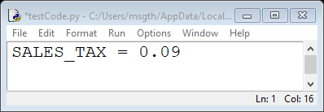
Constants
A named constant is a name that represents a value that cannot change its value during the program’s execution.
Named constants are written is all uppercase.
PI = 3.14
MY_NAME = ‘Samiksha’
Named constants allow you to make program wide changes by changing the value in one place.

Slide 6
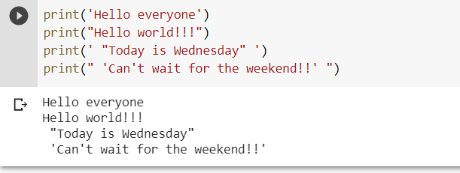
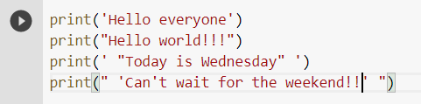
print Function and String Literals
You use the print function to display output in Python.
A function is a piece of prewritten code that performs an operation.
Python has numerous built-in functions that perform various operations.
When a string appears in the actual code of a program, it is called a string literal.
In Python code, string literals must be enclosed in quote marks.
In Python, you can enclose string literals in a set of single-quote marks (‘) or a set of double-quote marks (“).

Slide 7
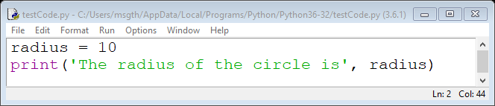
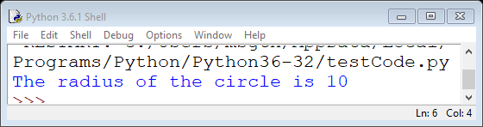
Displaying multiple items with the print Function
Python allows you to display multiple items with one use of the print function.
Items are separated by a comma.

Slide 8
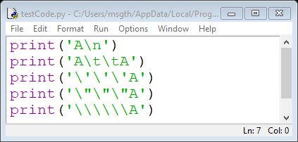
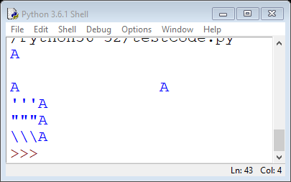
Escape Characters
An escape character is a special character that is preceded with a backslash (\), appearing inside a string literal.
When a string literal that contains a escape character is printed, the escape characters are treated as special commands that are embedded in the strings.
Escape Characters | Effect
\n | Causes the output to be advanced to the next line
\t | Causes the output to skip over to the next horizontal tab position
\’ | Causes a single quote mark to be printed
\” | Causes a double quote mark to be printed
\\ | Causes a backslash character to be printed

Slide 9
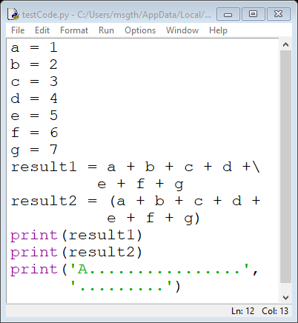
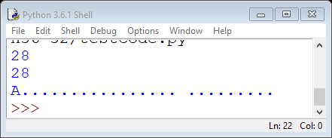
Multi-Line Statements
Most programming statements are written on one line.
If a programming statement is too long, however, you will not be able to view all of it in the IDLE editor window without scrolling horizontally.
Python allows you to break a statement into multiple lines by using the line continuation character (\).
Place the \ character at the point you want to break the statement then press the enter key.
Python also allows you to break any part of a statement enclosed in parentheses into multiple lines without using the line continuation character.

Slide 10
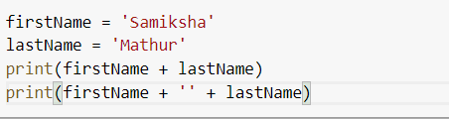
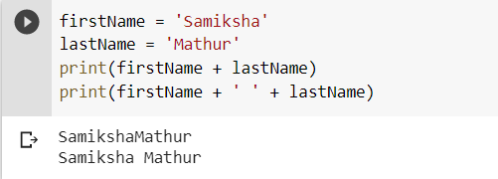
Use of Concatenation operator
When the + operator is used with two strings it performs string concatenation.
String concatenation is the joining of one string to another.

Slide 11
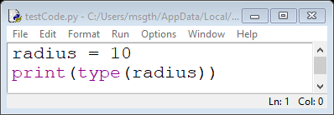
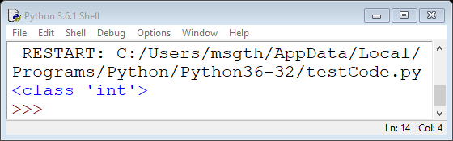
Numeric Data Types and Literals
Because different types of numbers are stored and manipulated in different ways, Python uses data types to categorize values in memory.
An integer (counting number 1, 2, 3 etc.) is classified as an int.
A real number (decimal number 1.34, 12.44, 0.87 etc.) is classified as a float.
A number that is written into a program’s code is called a numeric literal.
When the Python interpreter reads a numeric literal in a program’s code, it determines its data type according to the following rules:
A numeric literal that is written as a whole number with no decimal point is considered an int.
A numeric literal that is written with a decimal point is considered a float.
When you store an item in memory, it may sometimes may be important to know the data type of variable.

Slide 12
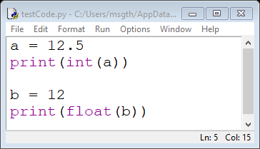
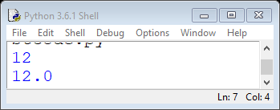
Data Type Conversion
You can explicitly change the data type of a number:
From float to an int use the int( )
From int to float use the float( )

Slide 13
Lists
A sequence is an object that holds multiple items of data, stored one after the other.
You can perform operations on a sequence to examine and manipulate the items stored in it.
There are different types of sequences in Python, two fundamental types are lists and tuples.
A List is an object that contains multiple data items.
A List is mutable…can be changed.
A List is dynamic data structure…items can be added and removed.
A Tuple is object that contains multiple data items.
A Tuple is immutable…cannot be changed.
A Tuple is a static data structure…items cannot be added or removed.

Slide 14
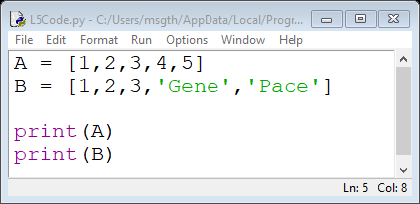
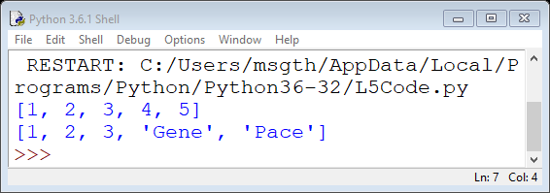
Lists
Each item stored in a list is known as an element.
A list can hold elements of different data types.
A list is delimited by brackets ‘[ ]’.
The print function can be used to display an entire list.

Slide 15
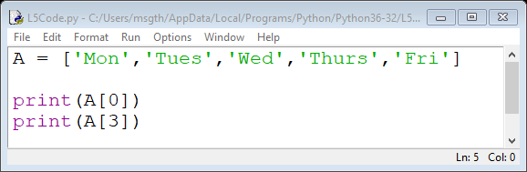
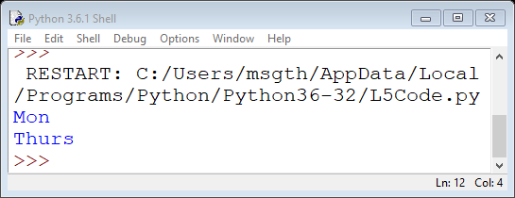
Indexing a List
You can access the individual elements in a list by referring to their index.
Consider the list A = [‘Mon’,’Tues’,’Wed’,’Thurs’,’Fri’]
We can access each individual element of the list by referring to the name of the list and the index of the element we want….this is known as Indexing.
0 | 1 | 2 | 3 | 4
‘Mon’ | ‘Tues’ | ‘Wed’ | ‘Thurs’ | ‘Fri’

Slide 16
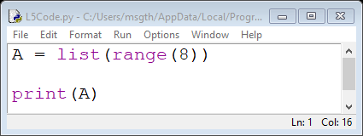
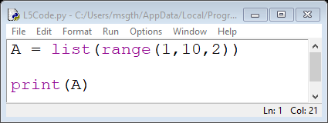
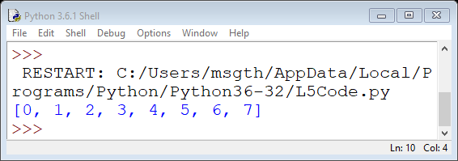
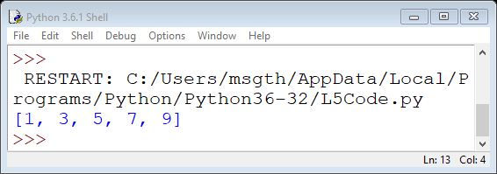
Lists
Python has a built-in list function that can convert certain types of objects to lists.
The list function is combination with the range function can be used to create a list.

Slide 17
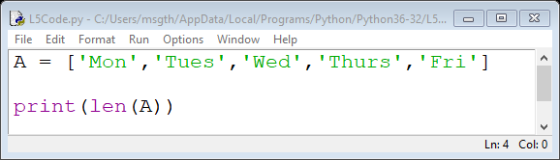
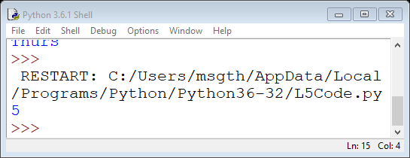
Length of a List
The length of a list is the number of elements in the list.
Python has a built-in function len that returns the length of a sequence such as a list.
Consider the list A = [‘Mon’,’Tues’,’Wed’,’Thurs’,’Fri’]
The length of A is 5 because it contains 5 elements.
0 | 1 | 2 | 3 | 4
‘Mon’ | ‘Tues’ | ‘Wed’ | ‘Thurs’ | ‘Fri’
Notice that the length of a list is 1 less than its highest index

Slide 18
List Methods
Methods are functions that are associated with an object.
A list object has many useful methods.
Some of the most commonly used are:
append(item)…add an item to the end of a list.
clear()…remove all elements from the list.
count(item)…return the number of times the specified item occurs in the list.
extend(item)…add multiple items to the end of a list.
index(item)…return the index of the first element whose value is equal to item.
insert(index, item)…insert the specified item at the specified index in the list.
pop([index])…remove the element at the specified index and return it.
sort()…sort the list in ascending order.
remove(item)…remove the first occurrence of the specified element in the list.
reverse()…reverse the order of the list.

Slide 19
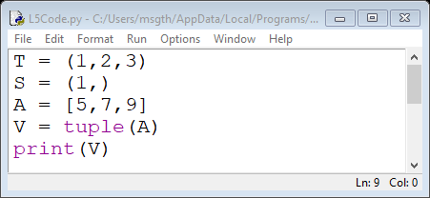
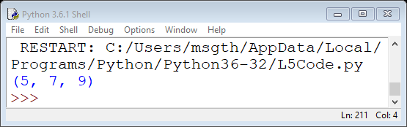
Tuples
A tuple is an immutable sequence which means its contents cannot be changed.
Tuples are delimited by parenthesis ( ).
Tuples support the same operations as lists except the ones that change the content of a list.
If you want to create a tuple with just one element you must put a comma after the element.
You can use the built-in tuple function to convert a list to a tuple.

