Slide 1
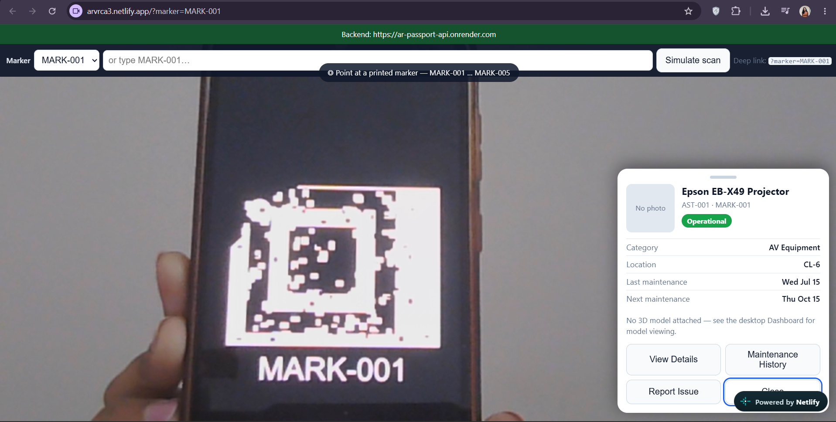
SYMBIOSIS INSTITUTE OF TECHNOLOGY, PUNE · DEPT. OF CSE · AR/VR CA-3
AR Digital Passport
for Physical Assets
Point a phone at a printed marker on any lab machine and its live record opens in the browser: status, location, service history, and a one-tap fault report that lands on the staff dashboard.
Live scan: MARK-001 resolves to the Epson projector's passport
WebAR, no app install
Node + Express API
PostgreSQL
Deployed & tested
AR SCANNER
BACKEND + DATABASE
ADMIN DASHBOARD
INTEGRATION, QA, DEPLOY
Aarohi Kondpalle
Nimita Jestin
Archisha Yadav
Rudra Khandelwal
23070122004
23070122259
23070122041
24070122513
Guide: Dr. Shwetambari Chiwhane
Notes:
Open with the hook: every machine has a story, but today that story lives in registers and chat groups. We gave each machine a digital passport. Introduce the four owners in one line each: AR scanner, backend, dashboard, integration and deployment. 60 seconds max.

Slide 2



Lab equipment has no single, scannable record
THE PROBLEM
Service history sits in paper registers
Nobody can check when the projector was last serviced without finding the right notebook.
“Which exact printer is jammed? Where is it kept? When was it last serviced? By the time we find out, a lab session is already lost.”
Faults get lost in WhatsApp groups
Complaints get buried, duplicated or never closed, with no status anyone can track.
Students do not know how to report
No clear process, so small faults stay unreported until they break a lab session.
What lab staff told us
Goal: any phone, any machine, the full record in seconds.
Notes:
Tell the lab story and pause after the quote. We spoke to staff and sat in the lab. The three pain points are records, reporting and process. Do not read the bullets, paraphrase them.

Slide 3




Every machine gets a passport you can scan
THE SOLUTION
01
02
03
STICK
SCAN
KNOW & ACT
Print a marker and stick it on the machine.
Open the scanner URL and point the camera.
The passport opens over the camera view.
One marker per asset, enforced by the database: MARK-001 belongs only to AST-001.
MindAR recognises the image inside the phone browser. Only the marker ID is sent to the server.
Status, room, last and next service. View history or report a fault in one tap.
RUNNING EXAMPLE
MARK-001
AST-001
Epson EB-X49 Projector · Computer Lab 6 · operational · 2 service records
Notes:
Use the projector as the running character through the whole talk: 'Remember MARK-001.' The audience follows one story, not five machines. The seed data has 5 assets: projector, 3D printer, oscilloscope, VR headset and AC, across 3 rooms.

Slide 4
Built, deployed and tested end to end
AT A GLANCE
< 3 s
0
5 / 5
from pointing the camera to the passport on screen
apps to install: the scanner is a web page
printed markers recognised by the live tracking test
63 / 63
7
₹0
automated checks passing across unit, API, browser and camera
integration bugs found and fixed once the parts ran together
hosting cost: Netlify, Render and Supabase free tiers over HTTPS
Notes:
Examiners remember numbers. Hit four of them: under 3 seconds, zero installs, 63 of 63 checks, 7 integration bugs fixed. Everything runs on free tiers, which matters for a college lab.

Slide 5





Two clients, one API, one source of truth
SYSTEM ARCHITECTURE
AR Scanner
PostgreSQL
DESIGN DECISIONS
HTTPS · JSON
SQL · SSL
Privacy by design
A-Frame 1.4.2 + MindAR 1.2.5
Supabase · 5 tables
Only a marker ID leaves the phone. Video stays local.
arvrca3.netlify.app
REST API
schema.sql + seed
Node 20 + Express + pg
One contract
Web Dashboard
Render · /health
Demo store
docs/API.md let four developers build in parallel.
Vanilla HTML / CSS / JS
In-memory seed fallback
Self-reporting
arvrdashboard…app
no DATABASE_URL
/health says whether the DB is up or on the demo copy.
Clients never talk to the database. Every rule lives in the API.
No hard-coded URLs
The API address is injected at deploy into env.js.
Notes:
One sentence per box. Phone and laptop are both thin clients; the Express API owns validation and talks to Postgres on Supabase. If no database URL is configured, it falls back to an in-memory copy of the seed data so the demo never dies. Stress privacy: only the marker ID is sent.

Slide 6

How the phone knows which machine it is looking at
AR TRACKING
5 marker PNGs
mindar-compiler
targets.mind
Camera frame
Match #0
GET /marker/MARK-001
MARK-001 … 005
extracts feature points
fingerprints, in git
matched in-browser
= MARK-001
→ AST-001 passport
BUILD TIME · once, on a laptop
RUN TIME · many times a second, on the phone
Two markers never tracked, so we fixed the artwork
MindAR locks on to corners and edges, not text or QR codes. MARK-001 and MARK-003 were large flat shapes with ~100 points and were never recognised.
Adding fine speckle texture inside the shapes raised them to ~270 points with the same IDs and look. MARK-002, 004 and 005 sit at 156, 242 and 218.
Notes:
Explain feature points simply: the compiler turns each marker into a list of corners and edges, saved in targets.mind. Image order matters: the first image is match #0, which the page maps to MARK-001. The redesign story shows real iteration: we measured, found the weak markers, and more than doubled their feature points.

Slide 7
One journey touches every layer of the system
PRIMARY ACCEPTANCE TEST
01
AR
02
AR
03
API
DB
04
AR
Open the scanner
Point at MARK-001
Resolve the marker
Passport appears
Phone browser asks for camera access
MindAR matches the printed image
GET /api/assets/marker/
MARK-001
Name, room, status, service dates
05
API
DB
06
API
DB
07
Dashboard
08
Dashboard
DB
Open history
Report “Lamp flicker”
Admin sees it
Set “In progress”
GET /api/assets/AST-001/
maintenance
POST /api/issues saves ISS-…
New issue on the dashboard Issues tab
PATCH …/status, persists on refresh
Notes:
This exact sequence is the project's primary acceptance test, and it is what the end-to-end script automates. Step 8 is the proof point: the status survives a refresh, so it really reached the database, not just the screen.

Slide 8




The scanner runs in any phone browser, no install
FRONTEND · AR SCANNER
Five image targets
A-Frame + MindAR track all five markers; the passport sheet slides up in under 3 s.
Camera stays private
The first screen explains camera use. Video never leaves the phone.
Works without a camera
Deep link ?marker=MARK-001 and a Simulate-scan picker as fallback.
Configurable backend
Real capture: MARK-001 on a phone screen, passport sheet open on the right
API URL can be set on the page and is saved in the browser, for LAN testing.
Notes:
Say 'no install' twice; examiners care about adoption. Mention the fallback: if the camera misbehaves, the deep link opens the same passport. Every passport has Details, History, Report and Close actions.

Slide 9
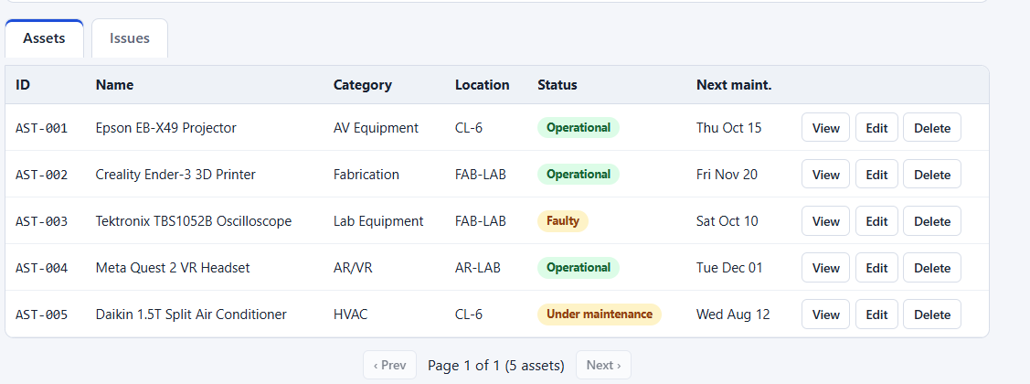


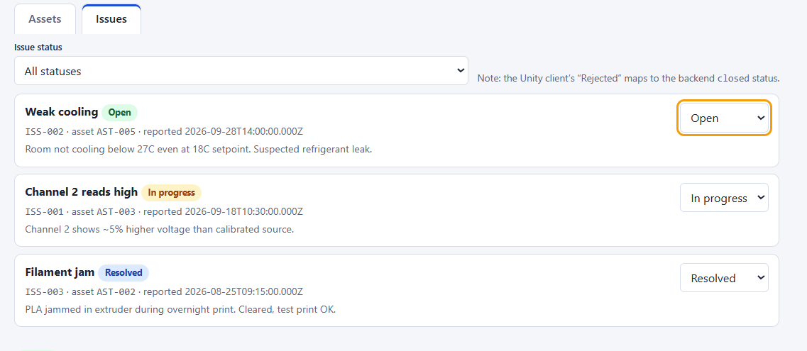


Staff triage every asset and issue from one screen
FRONTEND · ADMIN DASHBOARD
Find anything
Search by ID, name, category or room; filter by status, category and location.
Edit with guardrails
Create, edit and delete assets. Duplicate IDs or markers get a clear 409, not a crash.
Issue workflow
open → in progress → resolved or rejected. The new state survives a refresh.
Honest offline mode
If the API is down: a banner, sample data, and editing disabled until Retry.
Plain HTML, CSS and JS: no framework, no build step to break.
Notes:
Demo tip: type 'AST-00' in search to show instant filtering. Then change a complaint status, refresh, and show it sticks. That is the money moment.

Slide 10
A strict API contract with predictable errors
BACKEND · REST API
Method | Route | Purpose
GET | /api/assets/marker/:markerId | Marker → asset (the scan)
GET | /api/assets | List with status / room / category filters
GET | /api/assets/:id | One asset
GET | /api/assets/:id/maintenance | Service history
POST | /api/assets | Create asset + link marker
PATCH | /api/assets/:id | Update asset
DELETE | /api/assets/:id | Delete, history cascades
GET | /api/issues | List, filter by asset / status
POST | /api/issues | Report a fault from the phone
PATCH | /api/issues/:id/status | Move through the workflow
GET | /api/locations | Rooms
GET | /health | Liveness + DB up / down
EVERY ERROR, ONE SHAPE
{ "error": {
"code": "MARKER_CONFLICT",
"message": "Marker already
linked to another asset." } }
400
404
409
503
Bad input
Not found
Duplicate
DB down
Validated before the database is touched
IDs have a shape: AST-001 passes, ast001 does not
Status is a closed set of four values
An issue title needs 3+ characters
DB connect times out at 10 s → 503
Notes:
One concrete example: assigning MARK-001 to a second asset used to silently steal the marker. Now it runs in a transaction and returns 409 MARKER_CONFLICT. Every client can rely on the same error shape.

Slide 11
Five normalised tables, with integrity enforced by Postgres
DATA MODEL
1 : 1
asset_markers
5 rows
assets
5 rows
THE DATABASE SAYS NO
locations
3 rows
marker_id PK 'MARK-%'
One marker per asset
1 : N
id PK 'AST-%'
asset_id FK UNIQUE
UNIQUE on asset_id
id PK
location_id FK
name, floor
status CHECK
No orphans
building
last / next_maint.
maintenance_records
6 rows
Foreign keys on every link
image_url
1 : N
id PK 'MNT-%'
History follows
asset_id FK
ON DELETE CASCADE
+ admins table reserved for auth
date, type, technician
1 : N
Sane dates
issues
3 rows
next ≥ last maintenance
id PK 'ISS-%'
Safe to re-run
asset_id FK
Seed is idempotent, run twice in CI
title ≥ 3 chars, status
Notes:
Normalised design: nothing is stored twice. One room has many assets; each asset has exactly one marker, many service records and many issues. Constraints live in the database itself, so bad data cannot get in even if the server had a bug.

Slide 12
Running the parts together exposed 7 bugs unit tests missed
INTEGRATION
Unit tests passed on an in-memory store. The real journey on real Postgres and a real browser told a different story.
Impact | What users saw | Root cause | Fix
DEMO-BREAKING | Loading overlay never cleared after a scan; buttons untappable | CSS forced overlays visible, overriding the hidden flag | One CSS rule; caught by the headless browser test
DEMO-BREAKING | Camera never recognised any marker | targets.mind never compiled; 2 of 5 markers missing | Built the compiler tool, made all 5 markers
BREAKS ALL | Every request failed on a real database | SSL forced even for local Postgres | SSL for hosted DBs only
DATA DAMAGE | Editing asset B could steal MARK-001 from the projector | Upsert overwrote existing marker links | Transaction + 409 MARKER_CONFLICT
RELIABILITY | Endless spinner when the DB was down | No connection timeout | 10 s timeout → 503; /health reports DB
SPEC GAP | “Rejected” issue showed as Resolved after refresh | Status missing from server and DB | Added everywhere, with a safe migration
ERRORS | Duplicate asset ID gave a generic 500 | DB unique error not translated | 409 ASSET_CONFLICT with a reason
Notes:
This is the strongest material for the viva. Each bug only appears when the parts run together for real, which is exactly what integration testing is for. Two would have broken the live demo: markers not recognised, and an overlay blocking the buttons.

Slide 13

Every layer is tested, and the suite re-runs on production
VALIDATION
10/10
34/34
Failure cases fail gracefully
What goes wrong | What the user sees
API server down | Offline banner + sample data; edits disabled
Database unreachable | “Database unavailable” 503 within 10 s
Unknown marker | “Not linked to any asset”, page keeps working
Bad issue form | 400 with the exact reason
Empty database | Empty states, no crash
Camera denied | Explanation + manual marker picker
Unit + contract
API end to end
Jest + Supertest, no DB needed
e2e_flow.js: full journey + failure cases
14/14
5/5
Browser flow
Camera tracking
Headless Chrome clicks through the demo
Fake-camera video, real MindAR engine
CI on every push (GitHub Actions)
Contracts → unit tests → E2E on Postgres 15 → E2E in-memory. The 53 API, browser and camera checks also pass on the live URLs.
Notes:
Lead with the numbers, then the honesty. The camera test needs no phone: Chrome plays a video of each marker as a fake camera, and the real MindAR engine must recognise it and open the right passport. A real phone with printed markers is still the final check.

Slide 14





Free-tier cloud, HTTPS end to end, no secrets in git
DEPLOYMENT & SECURITY
Netlify · Scanner
arvrca3
Developer
GitHub + CI
Netlify · Dashboard
API URL injected into env.js at build
git push
ARVR_CA3
arvrdashboard
auto-deploy on push
Render · API
Supabase · DB
render.yaml
PostgreSQL
HTTPS everywhere
CORS allow-list
Secrets out of git
Defence in depth
Phones only open the camera on secure pages, and a secure page may only call a secure API.
The API accepts browser calls from our two Netlify sites only. A fake origin was tested and blocked.
The DB password lives only in Render settings. Env files are git-ignored.
API validation first, then database constraints, so bad data cannot slip through a server bug.
Notes:
Every block from the architecture lives on a free service and redeploys within a minute or two of a push. Render's free plan sleeps after 15 idle minutes, so wake /health five minutes before the demo. Security: HTTPS, CORS allow-list, secrets only in host settings, and database constraints as the last line of defence.

Slide 15


Clear about the gaps, clear on the roadmap
WHAT'S NEXT
Known limitations
Roadmap
No login yet
Role-based access + audit log
Anyone with the dashboard link can edit. The admins table is ready.
Staff vs student, and who moved each complaint.
Placeholder photos
QR fallback + 3D hotspots
Asset images point to examples; real uploads didn't make this cut.
QR when lighting is too poor for image tracking.
Real-phone pass pending
Reminders and reports
Tracking is proven on a fake camera; printed 15 cm markers next.
Service due alerts, new-fault alerts, mean time to repair.
Free-tier cold start
Production hardening
The first request after idle takes 30–60 s.
Photo upload, bulk import, rate limits, uptime checks.
Notes:
Do not apologise; frame the limits as guidance for the next team. Pick one roadmap item and pitch it with energy, for example the QR fallback for dark labs. It shows product thinking.

Slide 16

IN ONE LINE
One scan tells the machine's story.
One dashboard lets staff act on it.
TRY IT LIVE
AR scanner
arvrca3.netlify.app
Dashboard
arvrdashboard.netlify.app
Same data, same contract, no app in between. Tested end to end, live on the web, and honest about what comes next.
No camera? Open
arvrca3.netlify.app/?marker=MARK-001
Thank you. Questions?
Source
github.com/adroitathena2/ARVR_CA3
Notes:
End warm, not rushed. Invite the room to scan MARK-001 with you. Thank Dr. Chiwhane by name. Stop around 9 minutes to leave time for questions.

