Slide 1
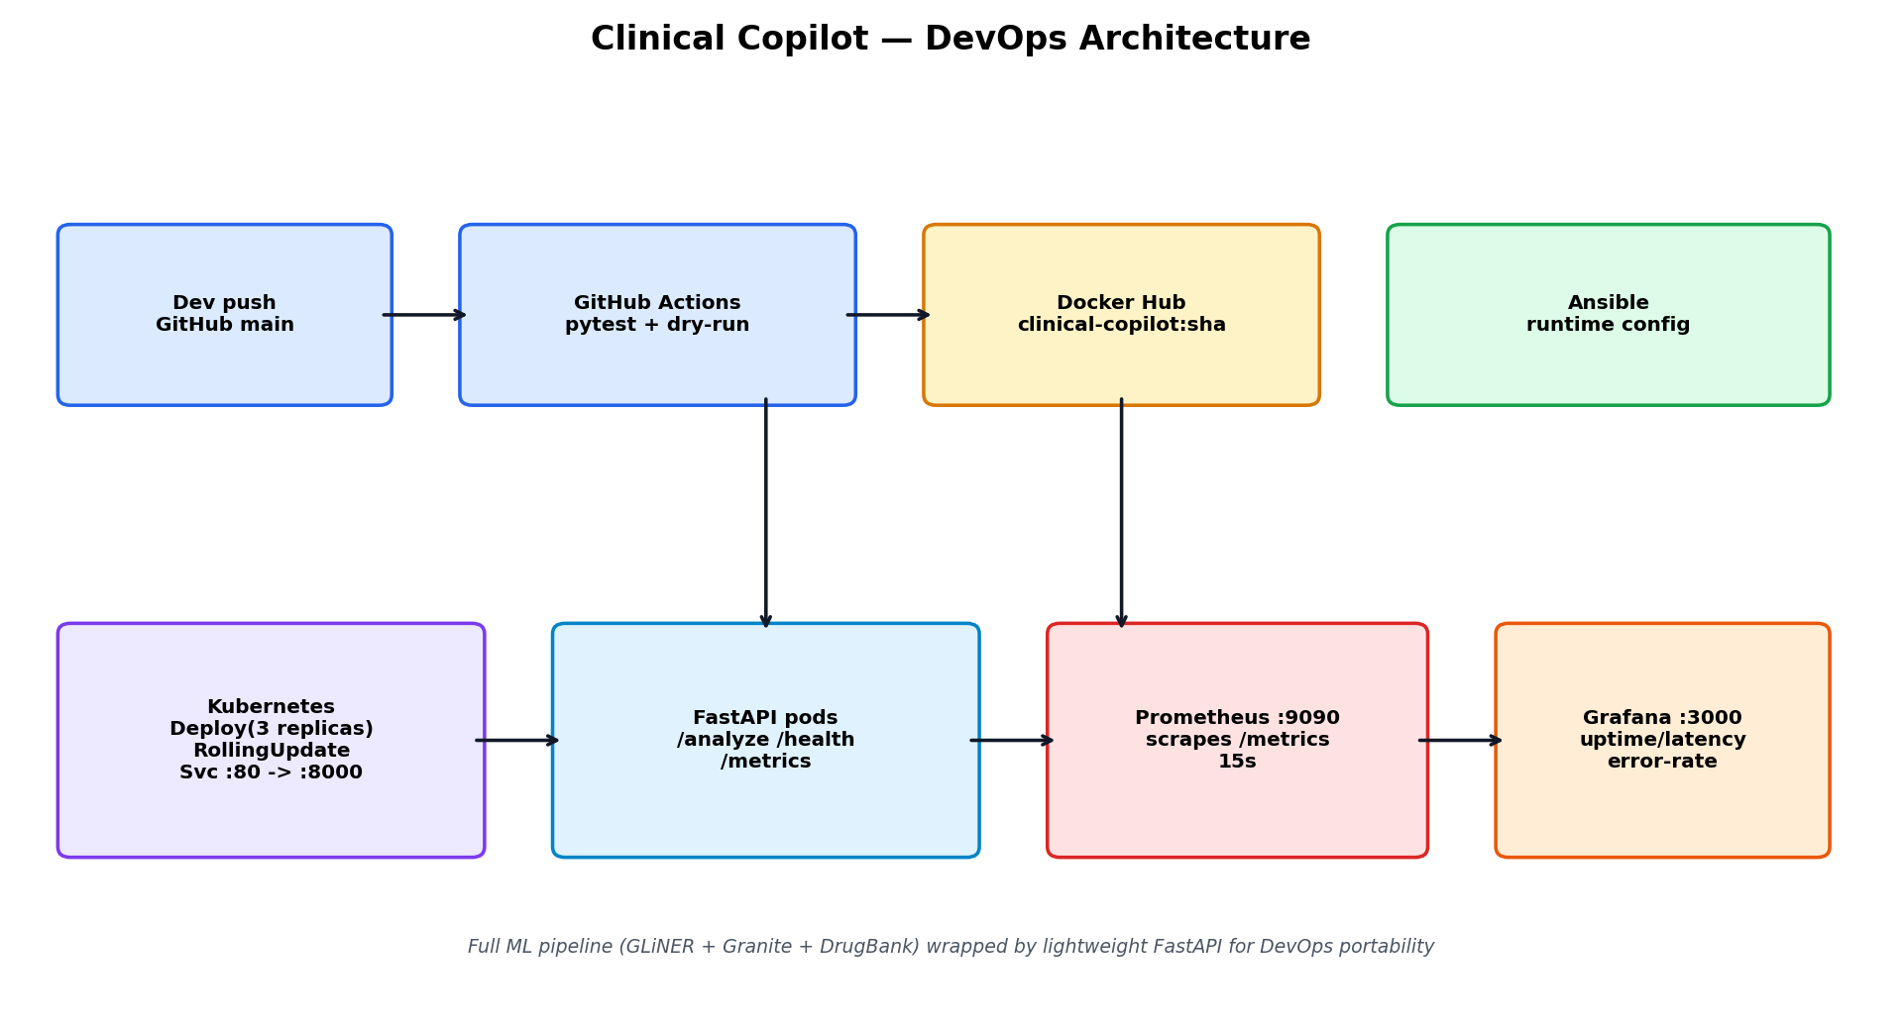
1 — Architecture (DevOps view)
• Service: FastAPI wrapper (app.py) over Clinical Copilot contract
• Deploy: Docker image -> K8s Deployment (3 replicas) + ClusterIP Service
• Config: Ansible playbook (user, venv, systemd, smoke test)
• Observe: Prometheus scrapes /metrics, Grafana dashboard

Slide 2
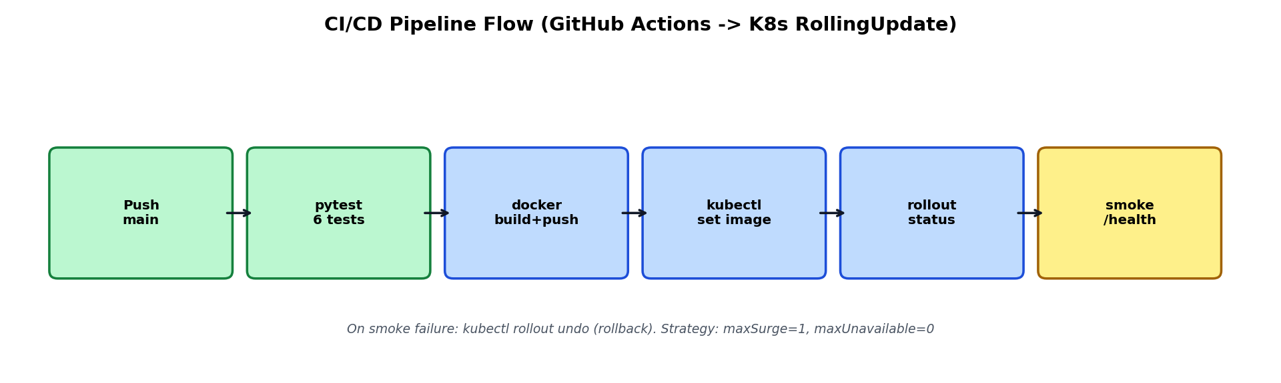
2 — Pipeline flow (GitHub Actions)
• Trigger: push to main / PR / manual
• Job test: setup-python 3.11, pytest, kubectl dry-run
• Job build-and-push: buildx + Docker Hub tags (sha + latest)
• Job deploy-staging: set image -> rollout status -> smoke /health + /analyze; fail -> rollout undo

Slide 3
3 — Containerization & orchestration
• Dockerfile: python:3.11-slim, HEALTHCHECK /health, APP_VERSION build-arg
• Deployment: RollingUpdate (maxSurge=1, maxUnavailable=0), probes, resources
• Rolling update: kubectl set image ... :2.0.0 -> rollout status
• Rollback: kubectl rollout undo + rollout history (demo script k8s/rolling-update-demo.sh)

Slide 4
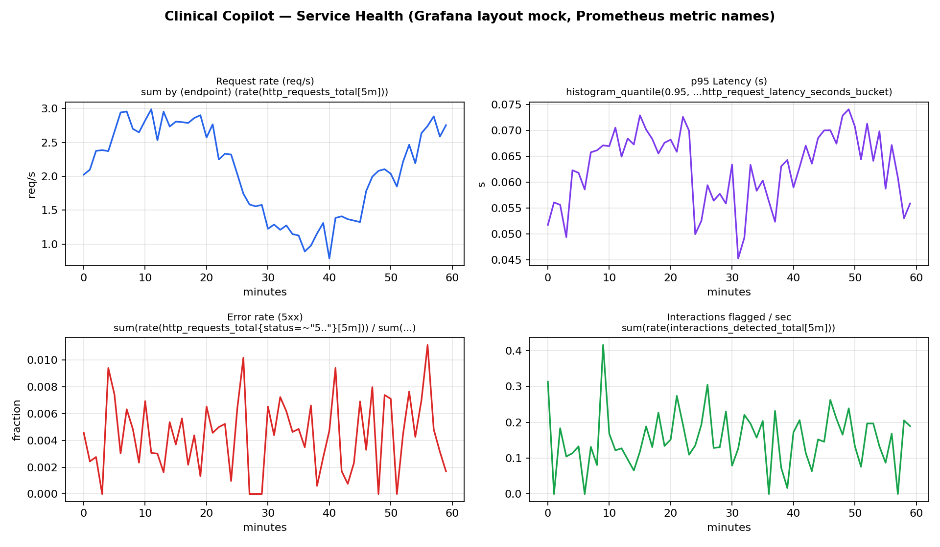
4 — Monitoring & logging
• Metrics: http_requests_total, http_request_latency_seconds, interactions_detected_total, app_uptime_seconds
• Prometheus: scrape app:8000/metrics every 15s (monitoring/prometheus.yml)
• Grafana: 5-panel dashboard (uptime, req/s, p95, 5xx rate, interactions/sec)
• Run: docker compose -f monitoring/docker-compose.monitoring.yml up

Slide 5
5 — Challenges & lessons learned
• Heavy ML (torch/GLiNER/Granite) != container-friendly -> thin FastAPI wrapper for DevOps
• Windows dev box: no Ansible binary, no Docker daemon/K8s cluster -> validated YAML + pytest + live /metrics
• Probes + zero-downtime strategy matter more than replica count for safety-critical API
• Next: sign images, gate promotion on load test, add Loki/Alertmanager + SLO alerts

