Slide 1
Cooperation Systems – Interim presentation
A. Droste, A. Machmer, A. Mantel, J. Schwede
Department for computer science
17th of January 2019

Slide 2
Our cooperation system
Collaborative support for the usage of (operation) manuals
Build your furniture together with optimized communication
Support through Augmented Reality
Different roles
“Searcher”
“Builder”

Slide 3

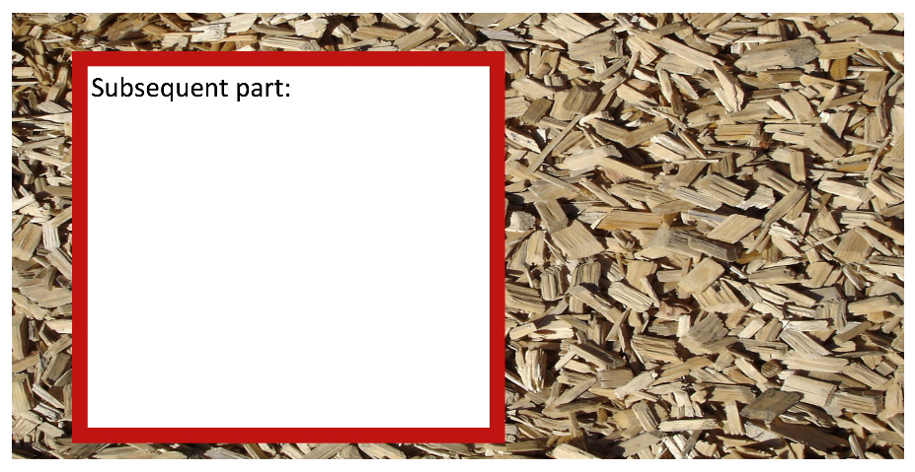
Our cooperation system (1/2)
Marker for builder (show steps to assemble)
Marker for searcher (show next parts)

Slide 4
Our cooperation system (2/2)

Slide 5
Concepts for this cooperation system
Social interaction
Roomware
Awareness
All parties are always aware of the progress and the actual following task
Synchronous bidirectional communication support
Co-located (AR shared space)
In general a symmetric system design (Exploring, working on the same content, build/assemble the furniture together (teamwork))
Can also be used in an asymmetric scenario (Helper-Expert)

Slide 6
Plan for evaluation
user studies
Questionnaires (pre/post)
How do you feel supported?
Were you always aware of the tasks of you partner?
…
Kirkpatrick Model
Reaction – Do the users need this support?
Learning – Can users work better together to build their furniture?
(Transfer) – Can they use the knowledge with different manuals?
(Results)

Slide 7
Planned improvements for the system
Improve awareness
transparency of bricks in modell to show progress

