Slide 1
Delaunay Triangulation in Parallel
Adarsh Prakash
CSE 633 : Parallel Algorithms
(Spring 2017)
Instructor: Dr. Russ Miller

Slide 2
Definition
Triangle ΔABC is a Delaunay Triangle, if no other points lie in the circumcircle formed by ΔABC.
Invalid Delaunay Δ
Valid Delaunay Δs

Slide 3
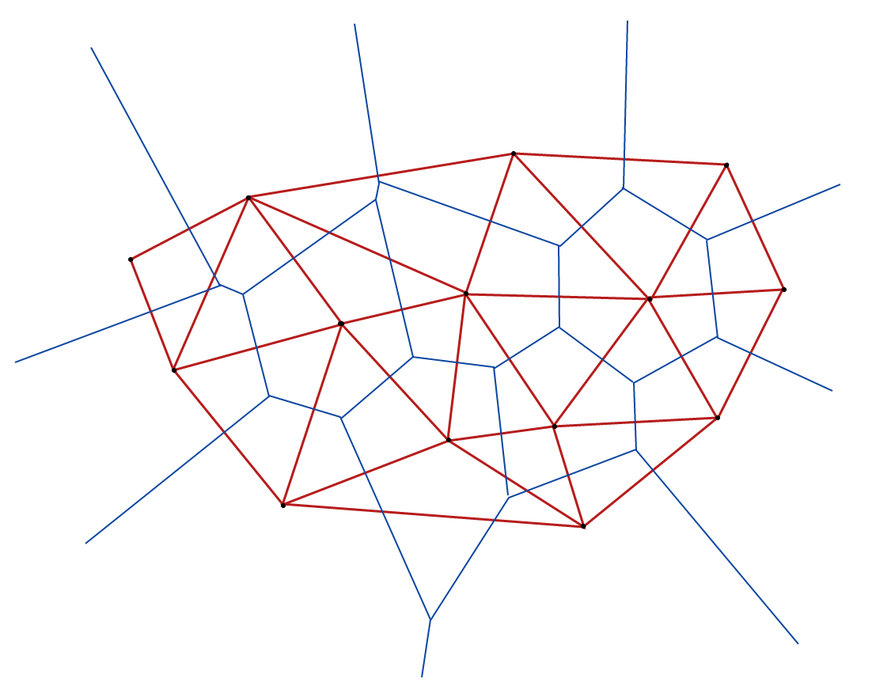
Delaunay – Voronoi: Duality
A Voronoi diagram is constructed by connecting centers of all the circumcircles formed by the Delaunay Triangles in a graph.
Delaunay Triangulation
Voronoi Diagram

Slide 4
Direct Applications
Nearest Neighbor
Graph Locality / Point Location
Surface Mapping / Reconstruction
Game Development
Motion Capture
Path Planning (Autonomous Navigation)
Physics – studying forces..
Chemistry – atomic charges..
Biology, Astrophysics and so on.

Slide 5
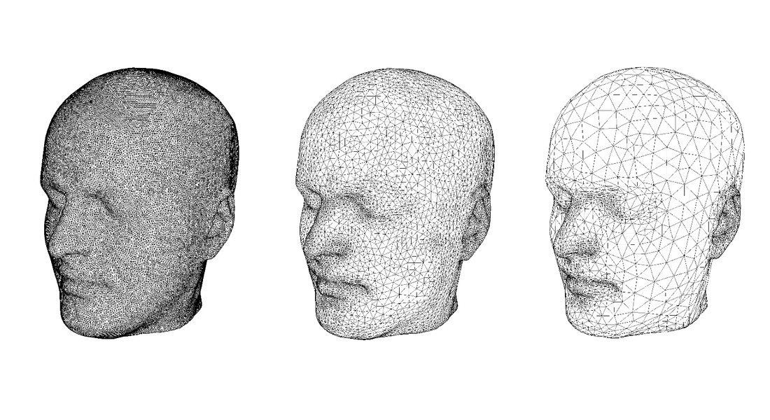
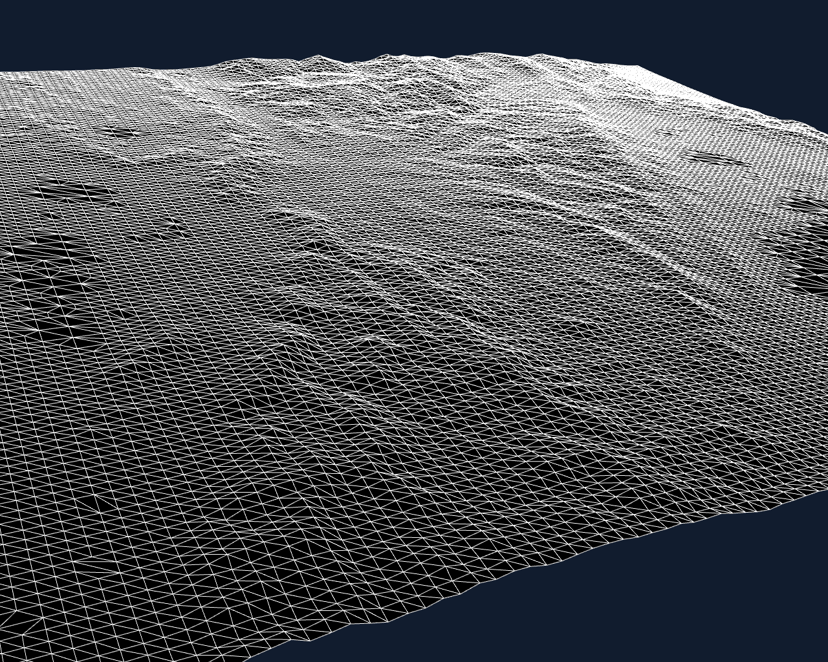

Applications

Slide 6
Algorithm
Divide-and-conquer algorithm proposed by Leonidas Guibas and Jorge Stolfi [1].
Follows closely the Voronoi construction algorithm from Shamos and Hoey [2].
Difference is it clearly describes how to make use of quad-edge data structure to avoid computation of complete hull.
Properties:
A quad-edge knows its direction (origin-destination NOT point-point)
A quad-edge maintains pointers to all edges leaving from and terminating at their origin and destination. (4-8 pointers depending on implementation)
Objective is to parallelize this algorithm.

Slide 7
Algorithm: Merge Step
L
R

Slide 8
Algorithm: Merge Step
L
R

Slide 9
Algorithm: Merge Step
L
R

Slide 10
Algorithm: Parallel Overview
Processor i
Compute Delaunay Triangulation of Local Region
Merge Incoming Region and Local Region
Send or Receive from other Processors
Repeat or exit

Slide 11
Domain Decomposition
P0
P1
P2
P3
Input space divided equally by X-Coordinate among Processors

Slide 12
Implementation
Implementation in C and MPI
Pseudo code from paper for serial version of merge – made life easier
Jobs were run on general-compute and largemem partitions of CCR
All communications are point-to-point: MPI_Send and MPI_Recv
Data send/receive happens in a single block ( as many as 31 million edges ~ 700mb)
Approx. 500 jobs to cluster

Slide 13
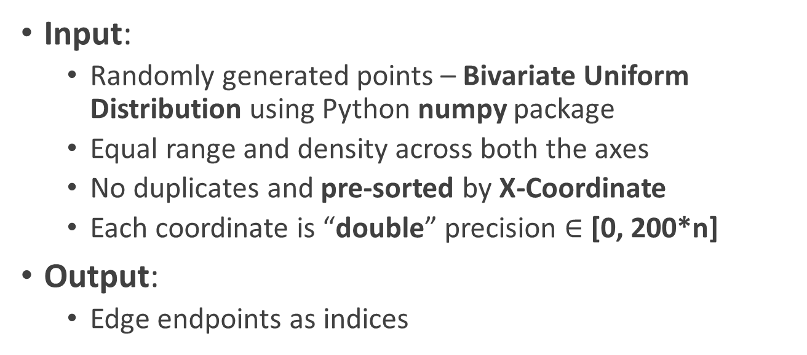
Implementation
Input:
Randomly generated points – Bivariate Uniform Distribution using Python numpy package
Equal range and density across both the axes
No duplicates and pre-sorted by X-Coordinate
Each coordinate is “double” precision $∈$ [0, 200*n]
Output:
Edge endpoints as indices
0, 162.422299106, 626335123.072
1, 235.609542392, 21674347.1286
2, 348.128895741, 545885503.786
3, 388.434040826, 160544722.935
…
0 1
0 3
0 4
0 2
…
Sample Input
Sample Output

Slide 14
Results
Run-times averaged over 3-5 jobs/runs
Time spent on reading input file and writing the results to output file is ignored
Only Computation Time (with communication cost) is used in analysis
Tried for several core-node combinations:
2 CPUs per node with shm (intranode) and tmi (internode)
1 CPU per node with dapl (internode)
1 CPU per node with tmi (internode)
Upto 32 CPUs per node with tcp (intranode) and tcp (internode) – I_MPI_FABRICS and I_MPI_FALLBACK to the rescue!
All results validated against results from standard packages:
Python (scipy.spatial.Delaunay) - faster
Matlab (triangulation)

Slide 15
Time v/s CPU (1 CPU per node – TMI)

Slide 16
Speedup v/s CPU (1 CPU per node – TMI)

Slide 17
Time v/s CPU (32 CPUs per node – TCP – no shm)

Slide 18
Speedup v/s CPU (32 CPUs per node – TCP – no shm)

Slide 19
Asymptotic Growth (8 CPUs with 1 CPU per node)

Slide 20
Conclusion
That drop in speedup for 32-cpus-per-node?
Communication Cost: Intranode < Internode
Difference is significant for TCP and hence the sudden drop
Hard Merge – High Communication Costs – No Linear Speedup
But, there is gain
Data still needs to fit into a single machine!

Slide 21
References
Primitives for the Manipulation of General Subdivisions and the Computation of Voronoi Diagrams – Guibas, L. and Stolfi, J.
Closest-Point Problems – Shamos, M.I. and Hoey, D.
On computing Voronoi diagrams by divide-prune-and-conquer – Amato, N.M. and Ramos, E.A.
Chapter 10: Computational Geometry, Algorithms – Sequential and Parallel – Miller, R. and Boxer, L.

Slide 22

Thank You
adarshpr@buffalo.edu
Binaries, scripts, code and results available at: https://github.com/adrsh18/parallel
Thanks to Dr. M Jones and CCR @ UB
| Computer Science and Engineering

Slide 23
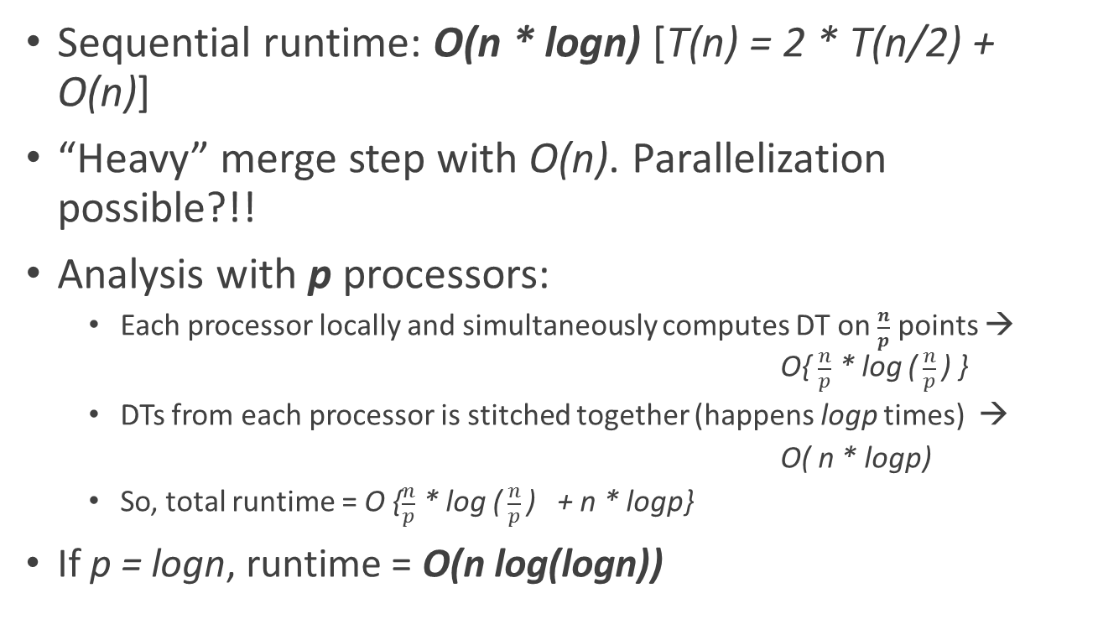
Backup: Analysis
Sequential runtime: O(n * logn) [T(n) = 2 * T(n/2) + O(n)]
“Heavy” merge step with O(n). Parallelization possible?!!
Analysis with p processors:
Each processor locally and simultaneously computes DT on $\frac{n}{p}$ points → O{ $\frac{n}{p}$ * log ($\frac{n}{p}$) }
DTs from each processor is stitched together (happens logp times) →
O( n * logp)
So, total runtime = O {$\frac{n}{p}$ * log ($\frac{n}{p}$) + n * logp}
If p = logn, runtime = O(n log(logn))

