Slide 1
Delaunay Triangulation in Parallel
Adarsh Prakash
CSE 633 : Parallel Algorithms
University at Buffalo

Slide 2
Definition
Triangle formed by points A, B & C (ΔABC) is Delaunay Triangle, if no other points lie in the circumcircle of ΔABC.
Invalid Delaunay Δ
Valid Delaunay Δs

Slide 3
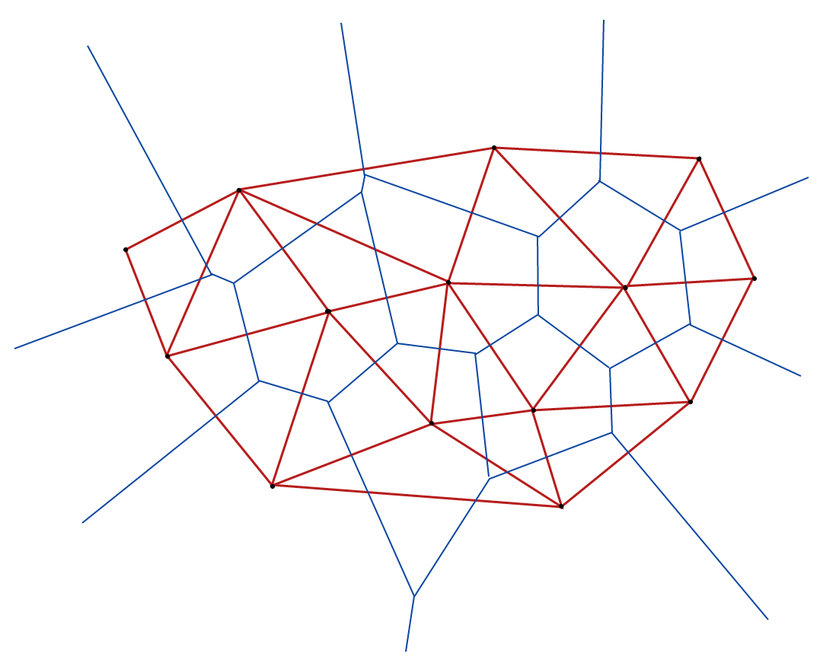
Delaunay v/s Voronoi: Duality
A Voronoi diagram is constructed by connecting the centers of all the circumcircles formed by the Delaunay Triangles in a graph.
Delaunay Triangulation
Voronoi Diagram

Slide 4
Algorithm
Divide-and-conquer algorithm proposed by Leonidas Guibas and Jorge Stolfi [1].
Follows closely the Voronoi construction algorithm from Shamos and Hoey [2].
Difference is it clearly describes how to make use of quad-edge data structure to avoid computation of complete hull.
Properties:
A quad-edge know their direction (origin-destination NOT point-point)
A quad-edges maintains pointers to all edges leaving from and terminating at their origin and destination. (4-8 pointers depending on implementation)
Plan is to parallelize this algorithm.

Slide 5
Algorithm: Merge Step
L
R
L
R
L
R

Slide 6
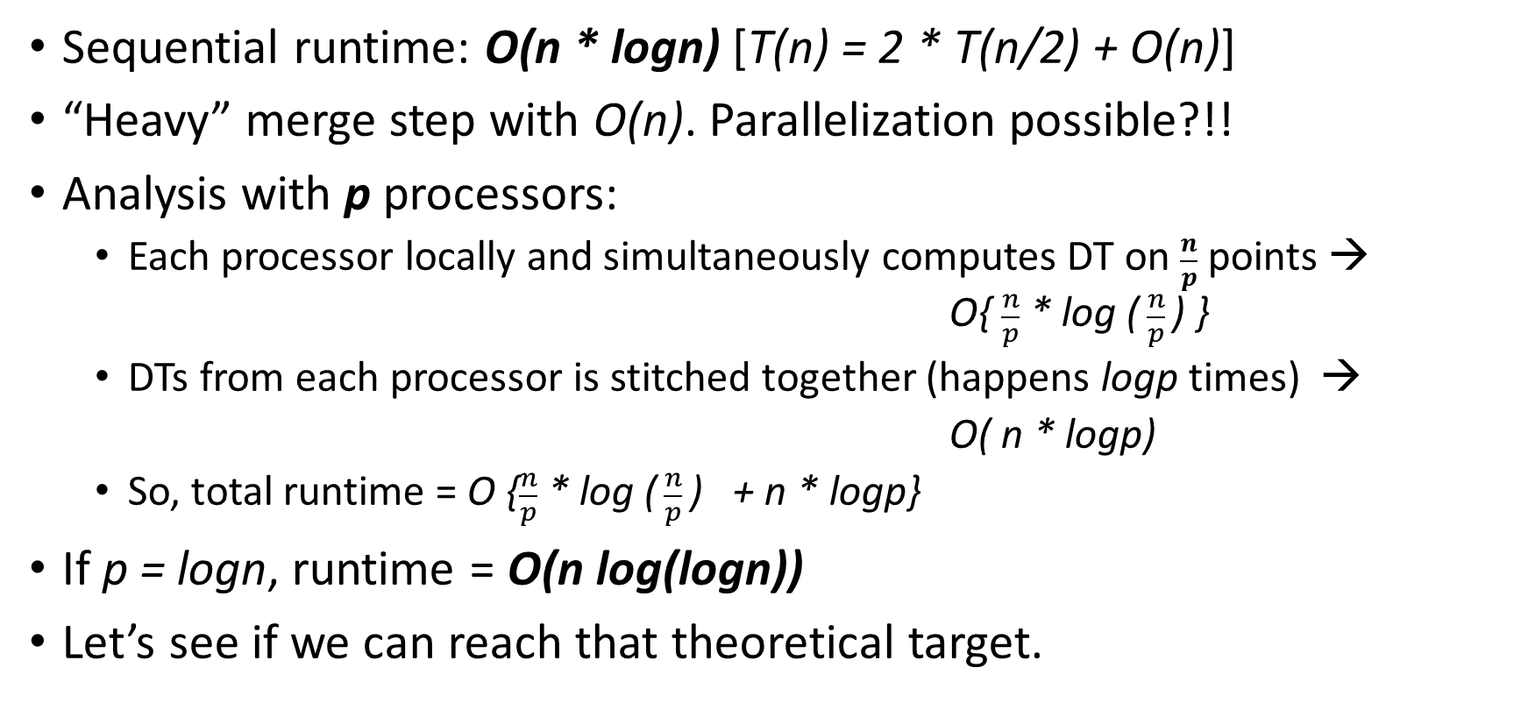
Analysis
Sequential runtime: O(n * logn) [T(n) = 2 * T(n/2) + O(n)]
“Heavy” merge step with O(n). Parallelization possible?!!
Analysis with p processors:
Each processor locally and simultaneously computes DT on $\frac{n}{p}$ points → O{ $\frac{n}{p}$ * log ($\frac{n}{p}$) }
DTs from each processor is stitched together (happens logp times) →
O( n * logp)
So, total runtime = O {$\frac{n}{p}$ * log ($\frac{n}{p}$) + n * logp}
If p = logn, runtime = O(n log(logn))
Let’s see if we can reach that theoretical target.

Slide 7
Plan
Need for scaling rules out OpenMP.
Implementation in MPI.
Input is randomly generated points following Uniform Distribution.
Preprocess input to sort by x-coordinate.
Timeline: Finish serial code by this weekend and start parallelizing.

Slide 8
References
Primitives for the Manipulation of General Subdivisions and the Computation of Voronoi Diagrams – Guibas, L. and Stolfi, J.
Closest-Point Problems – Shamos, M.I. and Hoey, D.
On computing Voronoi diagrams by divide-prune-and-conquer – Amato, N.M. and Ramos, E.A.
Chapter 10: Computational Geometry, Algorithms – Sequential and Parallel – Miller, R. and Boxer, L.

