Slide 1
Chapter 2`
PROGRAMMING WITH
8085 MICROPROCESSOR

Slide 2
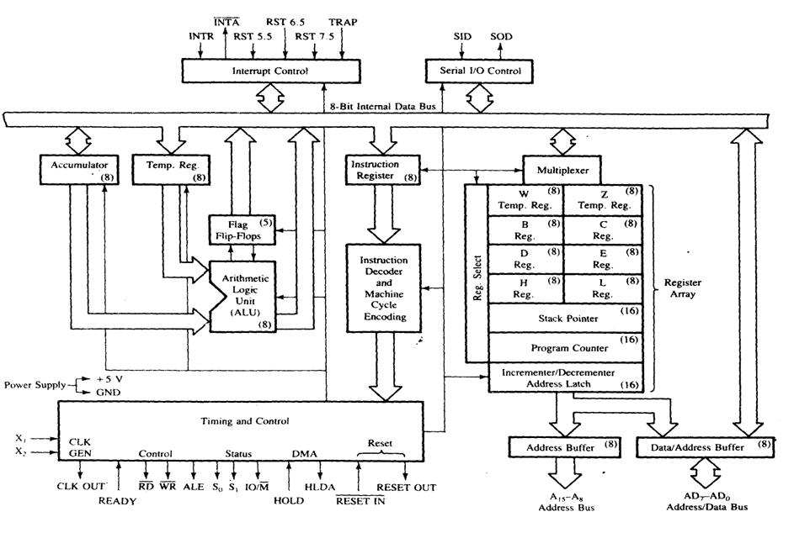
Internal Architecture of 8085 Microprocessor

Slide 3
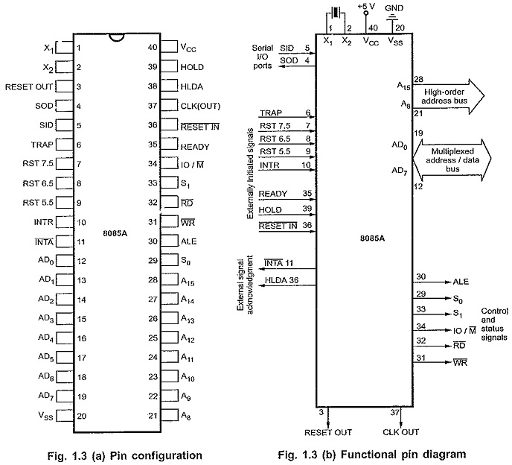
Pin diagram of 8085 microprocessor

Slide 4
Internal Architecture(Contd..)
1. ALU:-
it includes the accumulator, the temporary register, the arithmetic and logic circuits and five flags.
temporary register is used to hold data during an arithmetic/logic operation and the result is stored in the accumulator. 2. Accumulator (Register A):
used to store the 8-bit data and to perform arithmetic and logic operations .
When data is read from input port, it first moved to accumulator and when data is sent to output port, it must be first placed in accumulator.

Slide 5
Internal Architecture(Contd..)
3. Temporary registers(W & Z):
8 bit registers not accessible to the programmer.
8085A places the data into it for a brief period during program execution.
4. Instruction register(IR):
8 bit register not accessible to the programmer.
It receives the operation codes of instruction from internal data bus and passes to the instruction decoder which decodes it to know which type of operation is to be performed.
5. Register Array:
(Scratch pad registers B, C, D, E):
8 bit register accessible to the programmers.
Data can be stored upon it during program execution.
can be used individually as 8-bit registers or in pair BC, DE as 16 bit registers.

Slide 6
Internal Architecture(Contd..)
Register H & L:
8 bit registers used in same manner as scratch pad registers.
Stack Pointer (SP):
16 bit register used as a memory pointer.
points to beginning of the stack.
Program Counter (PC):
point to the memory address from which the next byte is to be fetched.
PC is incremented by one to point to the next memory location.

Slide 7
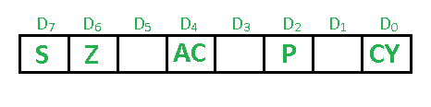
Internal Architecture(Contd..)
6. Flags:
State of flags indicates the result of arithmetic and logical operations
5 flags of 8085 are:
Sign(S) , Zero(Z) , Auxiliary Carry(AC ), Parity(P) , Carry(CY)

Slide 8
Internal Architecture(Contd..)
7. Timing and Control Unit:
synchronizes all µp operations with the clock.
generates the control signals necessary for communication between µp and peripherals. 8. Interrupt controls:
interrupt controls signals (INTR, RST 5.5, RST 6.5, RST 7.5 and TRAP) are used to interrupt a µp . 9. Serial I/O controls:
serial I/O control signals (SID and SOD) are used to implement the serial data transmission.

Slide 9
Characteristics (features) of 8085A microprocessor and its signals
8085A is a 8-bit general purpose µp capable of addressing 64K of memory.
Has 40 pins, require a +5V single power supply and can operate with a 3-MHZ, single phase clock.
Signals associated with 8085 can be classified into 5 groups:
1: Address bus:
has 16 signal lines.
split into two segments A₁₅-A₈ and AD₇-AD₀. The eight signals
A₁₅-A₈ are unidirectional and used as high order address bus. 2. Data bus:
signal lines AD₇-AD₀ are bidirectional and serve a dual purpose.
can be used as low order address bus as well as data bus.

Slide 10
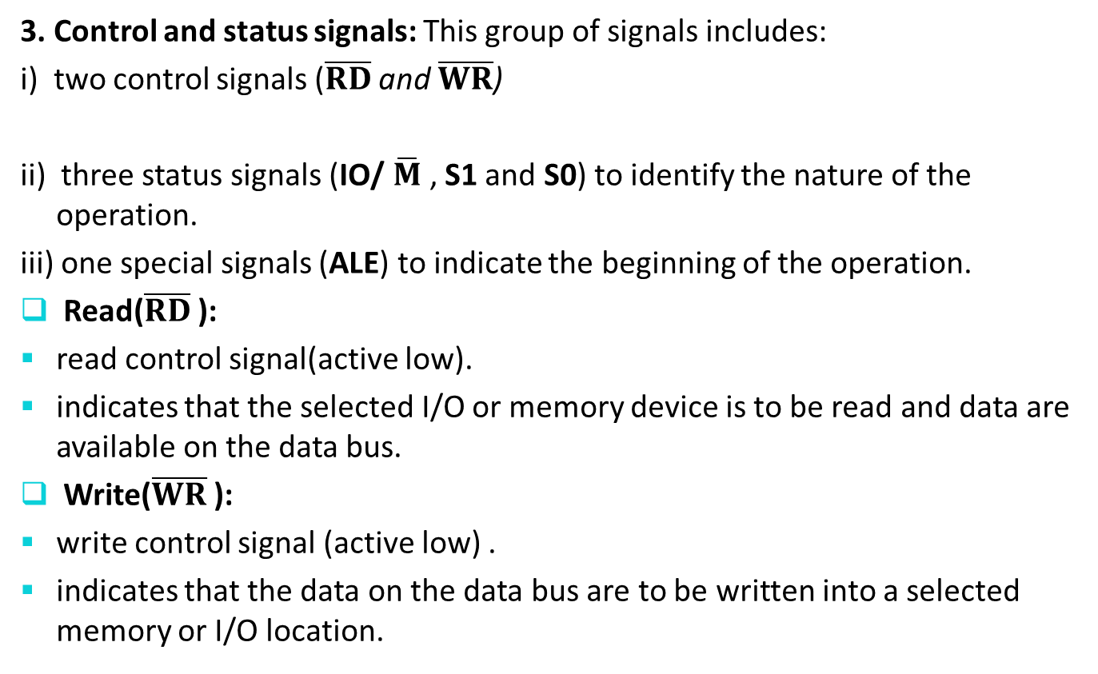
Characteristics contd..
3. Control and status signals: This group of signals includes:
i) two control signals ($\overline{RD}$ and $\overline{WR}$)
ii) three status signals (IO/$\overline{M}$ , S1 and S0) to identify the nature of the operation.
iii) one special signals (ALE) to indicate the beginning of the operation.
Read($\overline{RD}$):
read control signal(active low).
indicates that the selected I/O or memory device is to be read and data are available on the data bus.
Write($\overline{WR}$):
write control signal (active low) .
indicates that the data on the data bus are to be written into a selected memory or I/O location.

Slide 11
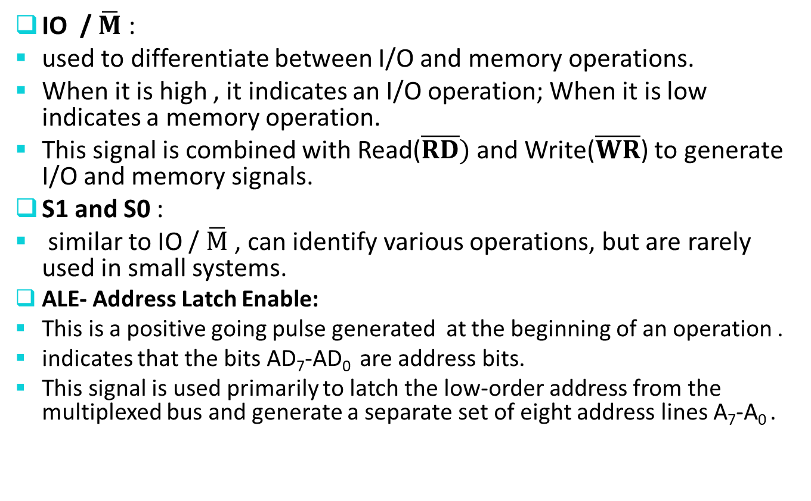
Characteristics contd..
IO /$\overline{M}$ :
used to differentiate between I/O and memory operations.
When it is high , it indicates an I/O operation; When it is low indicates a memory operation.
This signal is combined with Read($\overline{RD})$ and Write($\overline{WR}$) to generate I/O and memory signals.
S1 and S0 :
similar to IO /$\overline{M}$ , can identify various operations, but are rarely used in small systems.
ALE- Address Latch Enable:
This is a positive going pulse generated at the beginning of an operation .
indicates that the bits AD₇-AD₀ are address bits.
This signal is used primarily to latch the low-order address from the multiplexed bus and generate a separate set of eight address lines A₇-A₀ .

Slide 12
Characteristics contd
4. Power Supply and Clock frequency: -
VCC: +5V power supply
VSS: Ground reference
X1 and X2: A crystal (RC or LC network) is connected at these two pins for frequency.
CLK OUT: It can be used as the system clock for other devices.

Slide 13
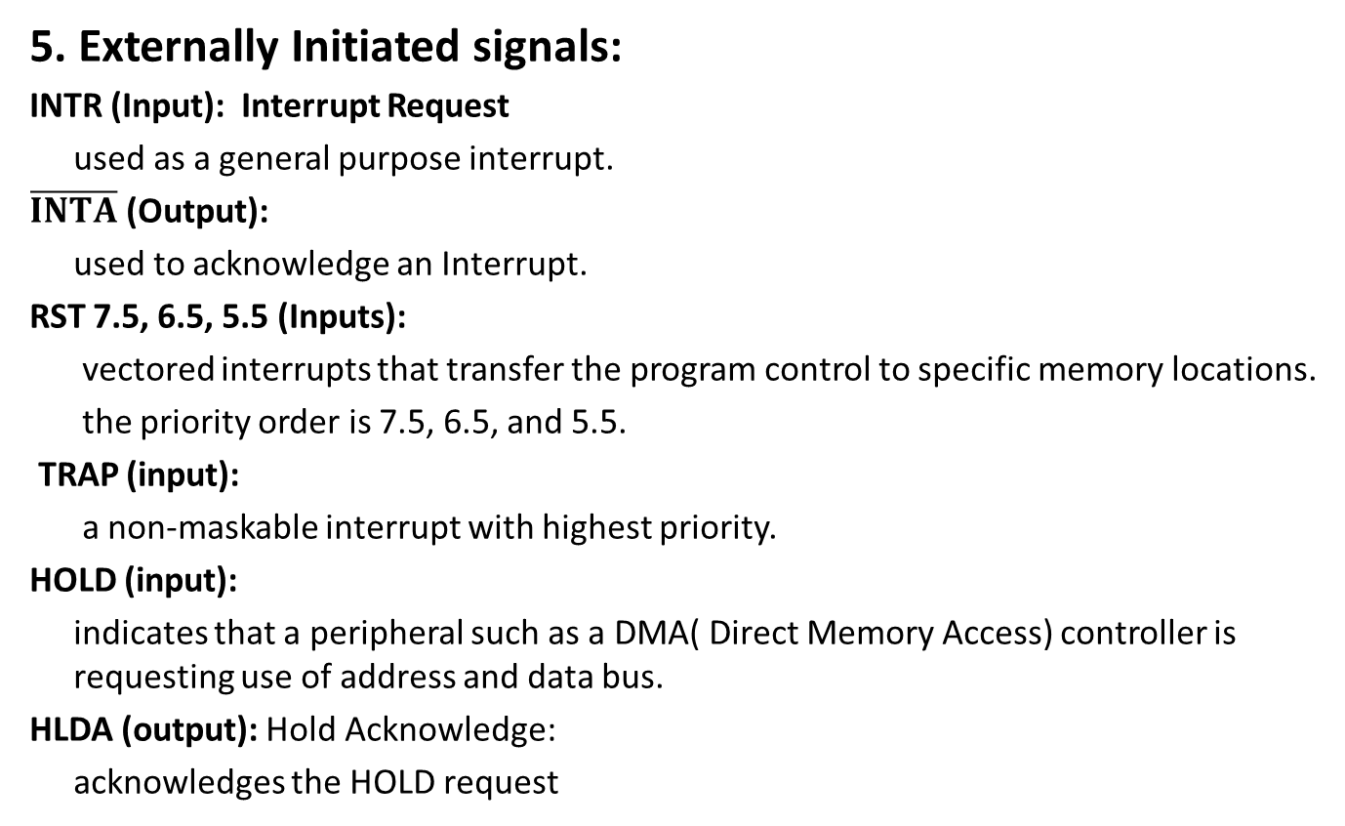
Characteristics contd..
5. Externally Initiated signals:
INTR (Input): Interrupt Request
used as a general purpose interrupt.
$\overline{INTA}$ (Output):
used to acknowledge an Interrupt.
RST 7.5, 6.5, 5.5 (Inputs):
vectored interrupts that transfer the program control to specific memory locations.
the priority order is 7.5, 6.5, and 5.5.
TRAP (input):
a non-maskable interrupt with highest priority.
HOLD (input):
indicates that a peripheral such as a DMA( Direct Memory Access) controller is requesting use of address and data bus.
HLDA (output): Hold Acknowledge:
acknowledges the HOLD request

Slide 14
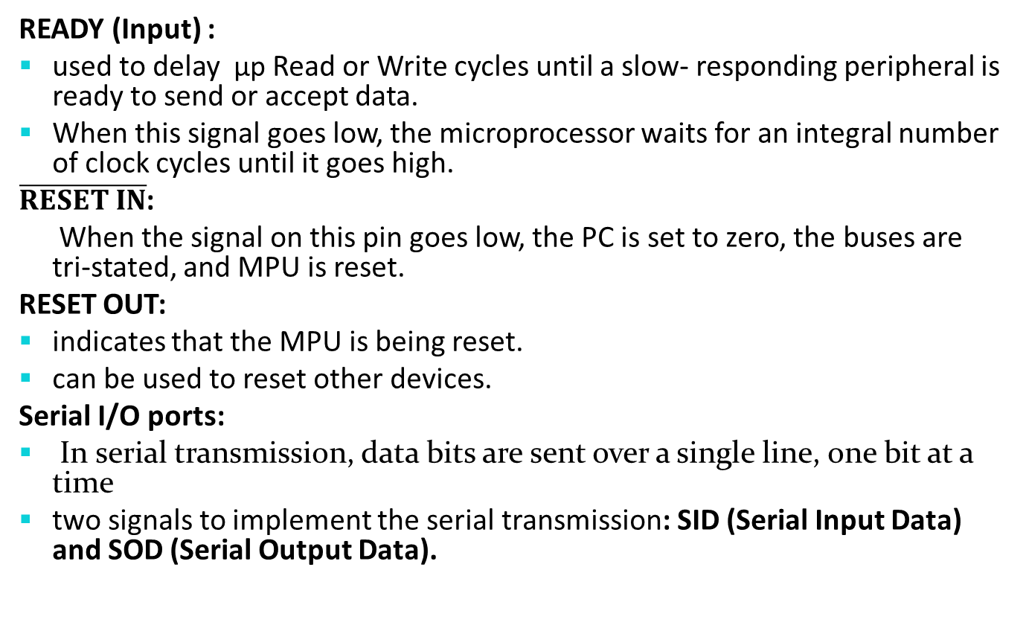
Characteristics contd..
READY (Input) :
used to delay µp Read or Write cycles until a slow- responding peripheral is ready to send or accept data.
When this signal goes low, the microprocessor waits for an integral number of clock cycles until it goes high.
$\overline{RESET IN}$:
When the signal on this pin goes low, the PC is set to zero, the buses are tri-stated, and MPU is reset.
RESET OUT:
indicates that the MPU is being reset.
can be used to reset other devices.
Serial I/O ports:
In serial transmission, data bits are sent over a single line, one bit at a time
two signals to implement the serial transmission: SID (Serial Input Data) and SOD (Serial Output Data).

Slide 15
Instruction description and format
Instruction:
A command to µp to perform given task on specified data.
Each instruction has two parts: i)Operation code (Op-Code) : the task to be performed ii)Operand or address field: the data to be operated on.
Operand may include 8-bit (or 16-bit) data, an internal register, a memory location, or an 8-bit (or 16-bit) address.

Slide 16
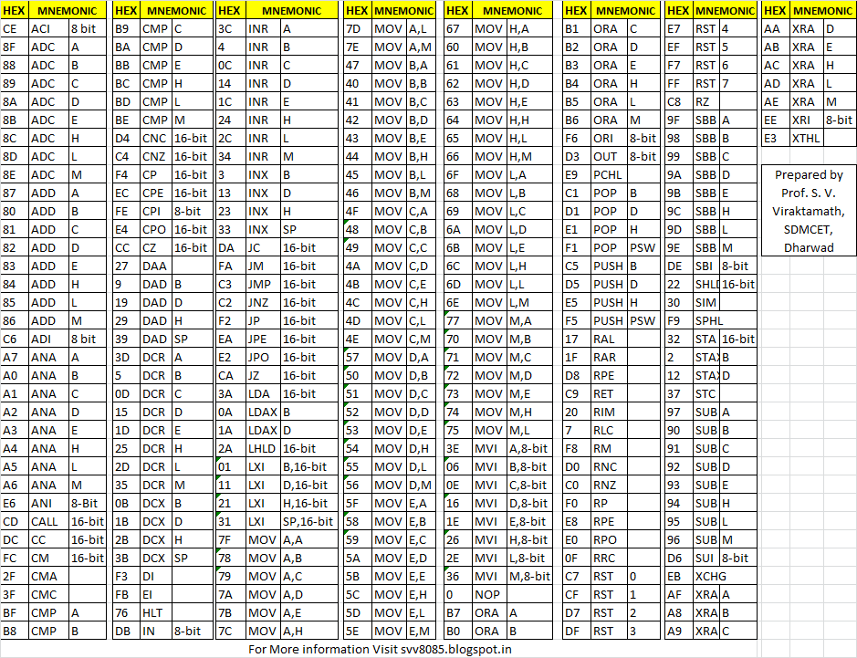
8085 A can handle at the maximum of 256 instructions( 2⁸) only but 246 instructions are used.
Instruction Sheet.
The sheet which contains all these instructions with their hex code, mnemonics, descriptions and function.

Slide 17
Depending on no. of address specified in instruction sheet, the instruction format can be classified into the categories:
1. One address format (1 byte instruction):
Here 1 byte will be Op-code and operand will be default.
E.g. ADD B, MOV A,B
2. Two address format (2 byte instruction):
Here first byte will be Op-code and second byte will be the operand/data. E.g. IN 40H, MVI A, 8-bit Data
Address Mnemonics Hex code
3050 MVI B,F2H 06
3051 F2

Slide 18
3. Three address format (3 byte instruction):
first byte will be Op-code, second and third byte will be operands/data.
2nd byte- lower order data
3rd byte – higher order data
E.g. LDA 2050 H
Loads accumulator with the contents of memory address 2050H
Address Mnemonics Hex code
1000 LDA 2050 H 3A
1001 50
1002 20

Slide 19
Classification of an instruction
8085 instruction set can be classified in to 5- different groups:
1) Data transfer group:
instructions used to transfer data from one register to another register or register to memory.
2 ) Arithmetic group:
instructions which perform arithmetic operations such as addition, subtraction, increment, decrement etc.
3) Logical group:
instructions which perform logical operations such as AND, OR, XOR,COMPARE etc.
4) Branching group:
instructions which are used for looping and branching like jump, call etc.
5) Miscellaneous group:
instructions relating to stack operation, controlling purposes such as interrupt including machine control instructions like HLT, NOP.

Slide 20
1)Data transfer group instructions:
copy data from a source location to destination location without modifying the contents of the source.
transfer of data may be between the registers or between register and memory or between an I/O device and accumulator.
none of these instructions changes the flag.
1) MOV Rd, Rs Rd ←Rs (Move register instruction) – 1 byte instruction – Copies data from source register to destination register. – Rd & Rs may be A, B, C, D, E, H &L – E.g. MOV A, B
2) MVI R, 8 bit data (Move immediate instruction) – 2 byte instruction – Loads the second byte ( 8 bit immediate data) into the register specified. – R may be A, B, C, D, E, H & L – E.g. MVI C, 53H C← 53H

Slide 21
3) MOV M, R (Move from register to memory) – Copy the contents of the specified register to memory.
Here memory is the location specified by contents of the HL register pair. – E.g. MOV M, B
4) MOV R, M (move from memory to register) – Copy the contents of memory location specified by HL pair to specified register. – E. g. MOV A, M
Let H=30H and L=58H and B=95H Let H=20H L=51H
MOV M,B MOV A,M
3055 2050
3056 2051
3057 2052
3058 2053
3059 2054
3060 2055
00
00
00
95
00
00
31
32
33
34
35
36
B
A

Slide 22
Write a program to load data 22H and 33 H to the registers B and C respectively and swap the data between them. Hint: swap with help of one unused register

Slide 23
Solution:
Mnemonics | Description
MVI B,22H | Loads 8 bit data 22H to register B
MVI C,33H | Loads 8 bit data 33H to register C
MOV A,B | Moves content of register B to register A (A=22H,B=22H)
MOV B,C | Moves content of register C to register B(A=22H,B=33H,C=33H)
MOV C,A | Moves content of register A to register B (A=22H,B=33H,C=22H)
HLT | Terminates the program

Slide 24
Data transfer instructions contd…
5) LXI R_{p}, 2 bytes data (Load register pair) – 3-byte instruction – Load immediate data to register pair – Register pair may be BC, DE, HL & SP(Stack pointer) – 1st byte- Op-code – 2nd byte – lower order data – 3rd byte- higher order data – E.g. LXI D, 4080H; D ← 40, E ← 80H
6) MVI M, data (Load memory immediate) – 2 byte instruction. – Loads the 8-bit data to the memory location whose address is specified by the contents of HL pair.
E.g. MVI M , 35H; [HL] ← 35H

Slide 25
Data transfer instructions contd…
7) LDA 16 bit address (Load accumulator direct) – 3-byte instruction – Loads the accumulator with the contents of memory location whose address is specified by 16 bit address. –E.g. LDA 3050H ; A ← [3050H]
8) LDAX Rp (Load accumulator indirect) – 1 byte instruction – Loads the contents of memory location pointed by the contents of register pair to accumulator. – E. g. LDAX B ; A ← [BC] LXI D, 8000H ; D= 80, E= 00 LDAX D ; A ← [8000]

Slide 26
Data transfer instructions contd…
9) STA 16-bit address (Store accumulator contents direct) – 3-byte instruction. – Stores the contents of accumulator to specified address – E.g. STA 3A55H ; [3A55] ← A
10) STAX Rp (Store accumulator contents indirect) – 1 byte instruction
– Store s the contents of accumulator to memory location specified by the contents of register pair.
– E. g. STAX B

Slide 27
Data transfer instruction contd
11) IN 8-bit address – 2-byte instruction – Read data from the input port address specified in the 2nd byte and loads data into the accumulator. – E. g. IN 40H ;A ←[40H] 12) OUT 8-bit address – 2-byte instruction – Copies the contents of the accumulator to the output port address specified in the 2nd byte. – E. g. OUT 40H ; [40] ← A

Slide 28
Data transfer instructions contd…
13) LHLD 16-bit address ( Load HL directly) – 3-byte instruction. – Loads the contents of specified memory location to L–register and contents of next higher location to H-register. E.g.
LHLD 9500H ; L ←[9500] , H ←[9501]
14) SHLD 16-bit address (Store HL directly) – 3-byte instruction. – Stores the contents of L-register to specified memory location and contents of H register to next higher memory location. E .g. SHLD 8500H ; [8500] ← L , [8501] ← H

Slide 29
Data transfer instructions contd…
15) XCHG (Exchange)
– Exchanges DE pair with HL pair. E. g.
LXI H, 7500H ; H= 75, L=00
LXI D, 9532H ; D=95, E=32
XCHG ; H=95, L=32 ,D=75 ,E=00
HLT

Slide 30
Addressing modes:
Instruction - op-code and operand.
operand - source only, destination only or both.
source - register, a memory or an input port.
destination - register, a memory location, or an output port.
The various format of specifying the operands are called addressing mode.
5 addressing mode:
1) Direct addressing mode
Instruction specifies the effective address as part of instruction.
Can be 2-bytes or 3-bytes with first byte op-code followed by 1 or 2 bytes
of address of data.
Also called absolute addressing.
Ex: LDA 9500H ; A ← [9500]
IN 80H ; A ← [80]

Slide 31
Addressing Modes Contd…
2) Register Direct addressing mode:
specifies the register or register pair that contains the data. E g. MOV A, B ;ADD C ; XCHG etc.
3) Register Indirect addressing mode:
the address part of instruction specifies the memory whose contents are the address of the operand. e. g. MOV R, M; MOV M, R ; STAX ; LDAX etc.

Slide 32
Addressing Mode Contd..
4) Immediate addressing mode:
the operand specifies the immediate data.
For 8-bit data, instruction size is 2 bytes and for 16 bit data, instruction size is 3 bytes. E.g. MVI A, 32H LXI B, 4567H
5) Implied or Inherent addressing mode:
this mode do not have operands. E.g. NOP: No operation HLT: Halt EI: Enable interrupt DI: Disable interrupt

Slide 33
2)Arithmetic group Instructions
Assume implicitly that accumulator is one of the operands.
Modify all flags according to the result.
Result is stored in accumulator.
1) ADD R/M
1 byte add instruction.
Adds the contents of register/memory to the contents of the accumulator and stores the result in accumulator.
If the result is greater than 8 bit , then carry flag is set.
E. g. ADD E ; A ← A + E
2) ADI 8 bit data
2 byte add immediate instruction.
Adds the 8 bit data with the contents of accumulator and stores result in accumulator.
E g. ADI B7H ; A ← A+B7H
3) SUB R/M
1 byte subtract instruction.
Subtracts the contents of specified register / memory with the contents of accumulator and stores the result in accumulator.
E. g. SUB D ; A ← A - D
4) SUI 8 bit data
2 byte subtract immediate instruction.
Subtracts the 8 bit data from the contents of accumulator stores result in
in accumulator.
E. g. SUI D3H ; A ← A-D3H

Slide 34
Arithmetic group Instructions
5) INR R/M; DCR R/M
1 byte increment / decrement instructions.
Increase / decrease the contents of register or memory by 1 respectively.
E. g. DCR B ; B=B-1 DCR M ; [HL] = [HL]-1
INR A ; A=A+1 INR M ;[HL]= [HL] +1
6) INX Rp, DCX Rp
1 byte instruction.
Increase and decrease the register pair by 1.
E.g. INX B ;BC=BC+1 DCX D ;DE=DE-1
No flags affected
7) ADC R/M (Add with Carry)
1 byte instruction
Adds the accumulator with the contents of register or memory content and previous carry. The result is stored in accumulator
E.g. ADC B ; A ← A+B+CY
8) ACI 8-bit data immediate
Adds the accumulator with 8 bit data and the previous carry . The result is stored in accumulator.
E.g. ACI 70H ; A ← A + 70+CY

Slide 35
Arithmetic group Instructions contd..
9) SBB R/M (Subtract with Borrow)
1 byte instruction.
Subtracts the contents of register or memory and borrow from the contents of accumulator and stores the result in accumulator.
e. g. SBB D ; A= A-D-Borrow
10)SBI 8 bit data (Subtract with Borrow Immediate)
2 byte instruction.
Subtracts the 8-bit immediate data and borrow from the content of the accumulator and stores the result in accumulator.
E.g. SBI 70H ; A A-70-Borrow

Slide 36
Arithmetic group Instructions contd..
11) DAD Rp(Double addition)
1 byte instruction.
Adds register pair with HL pair and store the 16 bit result in HL pair.
E. g. LXI H, 7320H
LXI B, 4220H
DAD B ; HL=HL+BC (7320+4220=B540H)
12) DAA (Decimal adjustment accumulator)
Used only after addition.
1 byte instruction.
The content of accumulator is changed from binary to two 4-bit BCD digits.
E. g MVI A, 78H ; A=78H
MVI B, 42H ; B=42H
ADD B ; A=A+B =(78H+42H)= BA H
DAA ; A=20, CY=1

Slide 37
BCD Addition
Any number larger than 9 (from A to F) is invalid and needs to be adjusted by adding 6 in binary.
Ex: Add 77 and 48
7 7= 0111 0111
+4 8= 0100 1000
1 2 5 1011 1111
+0110
1 0101
+0110 ……
CY= 1 0010 0101 25BCD

Slide 38
Examples:
Addition
MVI A, 93H
MVI C, B7H
ADD C
HLT
Subtraction
using 2’s complement.
Complement carry flag.
MVI A,97H MVI A,65H
MVI B,65H MVI B,97H
SUB B SUB B
HLT HLT
(Ans:32H,Cy=0) (Ans:32H,Cy=1)

Slide 39
3)Logical Group Instructions:
The instructions implicitly assume that the accumulator is one of the operands.
All instructions reset carry flag except for complement where flag remain unchanged.
They modify Z, P & S flags according to the data conditions of the result.
Place the result in the accumulator.
They do not affect the contents of the operand register.
1) ANA R/M (the contents of register/memory)
– Logically AND the contents of register/memory with the contents of accumulator.
2) ANI 8 bit data
– Logically AND 8 bit immediate data with the contents of accumulator.

Slide 40
Logical Instructions contd…
3) ORA R/M
– Logically OR the contents of register/memory with the contents of accumulator.
– CY and AC is reset and other as per result.
4) ORI 8 bit data
– Logically OR 8 bit immediate data with the contents of the accumulator.
– CY and AC is reset and other as per result.
Ex:
MVI A,42H
MVI B,85H
ORA B
HLT

Slide 41
Logical instructions contd..
5) XRA R/M
– Logically exclusive OR the contents of register/memory with the contents of accumulator.
6) XRI 8 bit data
– Logically Exclusive OR 8 bit data immediate with the content of accumulator.

Slide 42
Logical Instructions contd..
7)Logically Compare instructions
CMP R/M (1 byte instruction)
CPI 8 bit data ( 2 byte instruction)
– Compare the contents of register/ memory and 8 bit data with the contents of accumulator.
– Status is shown by flags.
Case | CY | Z
1. [A]<[R/M] or 8 bit data | 1 | 0
2. [A=[R/M] or 8 bit data | 0 | 1
3. [A]>[R/M] or 8 bit data | 0 | 0

Slide 43
Logical instructions contd..
8. Logically Rotate Instructions
used in multiply and divide operations and for serial data transfer.
i) RLC(Rotate Accumulator Left)
– Each bit is shifted to the adjacent left position. Bit D7 becomes D0.
– The carry flag is modified according to D7.
ii) RAL: Rotate accumulator left through carry
– Each bit is shifted to the adjacent left position. Bit D7 becomes the carry bit and the carry bit is shifted into D0.
– The carry flag is modified according to D7.
CY
D7 | D6 | D5 | D4 | D3 | D2 | D1 | D0
CY
D7 | D6 | D5 | D4 | D3 | D2 | D1 | D0

Slide 44
Logical instruction contd…
iii) RRC: rotate accumulator right
– Each bit is shifted right to the adjacent position. Bit D0 becomes D7.
– The carry flag is modified according to D0.
iv) RAR: Rotate accumulator right through carry
– Each bit is shifted right to the adjacent position. Bit D0 becomes the carry bit and the carry bit is shifted into D7.
CY
D7 | D6 | D5 | D4 | D3 | D2 | D1 | D0
CY
D7 | D6 | D5 | D4 | D3 | D2 | D1 | D0

Slide 45
Logical instructions contd..
9)CMC(Complement Carry):
-1-byte instruction
-Complements carry flag
10)STC(Set Carry Flag):
-1-byte instruction
-Sets carry flag to 1
11) CMA(Complement Accumulator):
-1-byte instruction
-Complements the content of accumulator
-no other flags are affected

Slide 46
Some problems:
Assume A=AAH ;CY=0
Before instruction RLC,
A=
After 1st RLC instruction,
A=55H,Cy=1
After 2nd RLC instruction,
A=AAH; Cy=0
8 bit rotation
CY=0
1 | 0 | 1 | 0 | 1 | 0 | 1 | 0
CY=0
1 | 0 | 1 | 0 | 1 | 0 | 1 | 0
CY=1
0 | 1 | 0 | 1 | 0 | 1 | 0 | 1

Slide 47
Some problems
Assume A=AAH, CY=0
-After 1st RAL: A=?,CY=?
-After 2nd RAL: A=?, CY=?
9 bit rotation
Assume A=81H, Cy=0
-After 1st RRC: A=?,CY=?
-After 2nd RRC: A=?, CY=?
-After 1st RAR: A=?,CY=?
-After 2nd RAR: A=?, CY=?

Slide 48
Data Masking
Setting or resetting certain bits without affecting other bits.
Setting bits:
Logical OR instruction is used
Done by Oring particular bit with logic 1 and
other bits with 0.(OR masking)
Ex: Assume A=B2H=1011 0010.
If we want to set Do and D3 bit, we should OR accumulator value with
0000 1001= 09H
MVI A,B2H
ORI 09H
HLT
o/p : A=BBH
A | B | O/P
0 | 0 | 0
0 | 1 | 1
1 | 0 | 1
1 | 1 | 1
B2H: 1 0 1 1 0 0 1 0 09H: 0 0 0 0 1 0 0 1 Oring: 1 0 1 1 1 0 1 1

Slide 49
Contd..
Resetting bits:
Logical AND instruction is used
Done by ANDing particular bit with logic 0
and other bits with logic 1(AND masking)
Ex: Assume A=B2H=1011 0010.
If we want to reset D1 and D4 bit, we should AND accumulator value with
1110 1101= EDH
MVI A,B2H
ANI EDH
HLT
o/p : A=A0H
A | B | O/P
0 | 0 | 0
0 | 1 | 0
1 | 0 | 0
1 | 1 | 1
B2H: 1 0 1 1 0 0 1 0 EDH: 1 1 1 0 1 1 0 1 Anding: 1 0 1 0 0 0 0 0 :A0H

Slide 50
Complementing bits
A | B | O/P
0 | 0 | 0
0 | 1 | 1
1 | 0 | 1
1 | 1 | 0
Logical XOR is used.
Done by XORing particular bit with 1 and
Other bit with 0.(XOR masking)
Ex: Assume A=B2H=1011 0010.
If we want to complement D3 and D7 bit, we should XOR accumulator value with
1000 1000= 88H
MVI A,B2H
XRI 3AH
HLT
o/p : A=3AH
B2H: 1 0 1 1 0 0 1 0 88H: 1 0 0 0 1 0 0 0 Xoring: 0 0 1 1 1 0 1 0

Slide 51
Assume register D contains A6H.WAP to set D0 bit, reset D1 and D7 bits and complement D4 and D5 bits.
MVI D,A6H
MOV A,D
ORI 01H
ANI 7DH
XRI 30H
MOV D,A
HLT
D7 | D6 | D5 | D4 | D3 | D2 | D1 | D0
1 | 0 | 1 | 0 | 0 | 1 | 1 | 0 | =A6H
0 | 0 | 0 | 0 | 0 | 0 | 0 | 1 | =01H
0 | 1 | 1 | 1 | 1 | 1 | 0 | 1 | =7DH
0 | 0 | 1 | 1 | 0 | 0 | 0 | 0 | =30H

Slide 52
4. Branching Group Instructions:
instruct the microprocessor to go to a different memory location and continue executing machine codes from that new location.
allow the microprocessor to change the sequence of a program, either unconditionally or under certain test conditions.
3 groups:
Jump instructions
Call and return instruction
Restart instruction

Slide 53
Branching instructions contd…
1) Jump Instructions:
3 byte instruction.
can be categorized as:
i) Unconditional jump
ii) Conditional jump
i)Unconditional Jump (JMP):
JMP 16 bit address
enables the programmer to set up continuous loops without depending on any type of conditions.
E.g. JMP 4000H
Loads program counter by with 4000H jumps to this memory location.
The jump location can also be specified using a label or name.

Slide 54
Branching instructions contd…
2050 MVI A, 00H
2052 MVI B,00H
2054 ADD B
2055 INR B
2066 JMP 2054H
2069 HLT
MVI A, 00H
MVI B,00H
L1: ADD B
INR B
JMP L1
HLT
MVI A, 00H
MVI B,00H
Name: ADD B
INR B
JMP Name
HLT

Slide 55
Branching Instructions contd…
2)Conditional Jump:
allow the microprocessor to make decisions based on certain conditions indicated by the flags(carry, zero, sign and parity)
Mnemonics Description
JC 16 bit address/label Jump on carry (if CY=1)
JNC 16 bit address/label Jump on if no carry (if CY=0)
JZ 16 bit address/label Jump on zero (if Z=1)
JNZ 16 bit address/label Jump on if no zero (if Z=0)
JP 16 bit address/label Jump on positive (if S=0)
JM 16 bit address/label Jump on negative(minus) (if S=1)
JPE 16 bit address/label Jump on parity even (if P=1)
JPO 16 bit address/label Jump on parity odd (if P=0)

Slide 56
Problem
WAP to move 10 bytes of data from location 4500 H to 6500H.
MVI B, 0AH ; Counter
LXI H,4500H ;Source
LXI D,6500H ;Destination
repeat:MOV A, M
STAX D
INX H ; Increment the HL pair by 1
INX D ;Increment the DE pair by 1
DCR B
JNZ repeat
HLT
4500H
11
22
33
44
55
66
77
88
99
AA
6500H
4509H
6509H

Slide 57
Problem
WAP to transfer 30 data starting from 8500 to 9500H if data is odd else store FEH.
MVI B, 1EH
LXI H, 8500H
LXI D, 9500H
L2: MOV A, M
ANI 01H
JNZ L1 ; If data is odd then go to L1.
MVI A, FEH
JMP L3
L1: MOV A, M
L3: STAX D
INX D
INX H
DCR B
JNZ L2
HLT
45= 0100 0101 01H= 0000 0001 Anding: 0000 0001

Slide 58
2)Call and return instructions
Subroutine is a group of instructions that perform a subtask.
A subroutine is written as a separate unit apart from the main program and the microprocessor transfers the program execution sequence from main program to subroutine whenever it is called to perform a task.
After the completion of subroutine task microprocessor returns to main program.
Before implementing the subroutine, the stack must be defined which is used to store the memory address of the instruction in the main program that follows the subroutines call.

Slide 59
CALL and RET instruction
1) Unconditional Subroutine Instructions:
i. CALL 16 bit address/label
– 3 byte instruction.
– Saves the contents of program counter on the stack pointer. Jumps unconditionally to the memory location specified by 16 bit address/label
ii. RET
– Returns from the subroutine unconditionally.
– Inserts the contents of stack pointer to program counter.

Slide 60
2)Conditional Subroutine instructions:
i)Conditional Call
Program is transferred to the subroutine if the condition is met.
ii) Conditional Return:
The sequence returns to the main program if the condition is met.
Conditional Call
Mnemonics Description
CC 16 bit address/label Call on carry (if CY=1)
CNC 16 bit address/label Call on if no carry (if CY=0)
CZ 16 bit address/label Call on zero (if Z=1)
CNZ 16 bit address/label Call on if no zero (if Z=0)
CP 16 bit address/label Call on positive (if S=0)
CM 16 bit address/label Call on negative(minus) (if S=1)
CPE 16 bit address/label Call on parity even (if P=1)
CPO 16 bit address/label Call on parity odd (if P=0)

Slide 61
Conditional Return
Mnemonics Description
RC 16 bit address/label Return on carry (if CY=1)
RNC 16 bit address/label Return on if no carry (if CY=0)
RZ 16 bit address/label Return on zero (if Z=1)
RNZ 16 bit address/label Return on if no zero (if Z=0)
RP 16 bit address/label Return on positive (if S=0)
RM 16 bit address/label Return on negative(minus) (if S=1)
RPE 16 bit address/label Return on parity even (if P=1)
RPO 16 bit address/label Return on parity odd (if P=0)

Slide 62
WAP to add two numbers using subroutine.
8000 MVI B,4AH
8002 MVI C,A0H
8004 CALL 9000H ;SP=8007H; PC=9000H
8007 MOV B,A
8008 HLT
9000 MOV A,B
9001 ADD C
9002 RET

Slide 63
3. Restart Instruction:
-8085 stores the contents of PC on SP and transfers the program to the restart location.
-are part of interrupt process.
-1 byte instructions.
RESTART INSTRUCTION HEX CODE CALL LOCATION IN HEX
RST 0 C7 0000H
RST 1 CF 0008H
RST 2 D7 0010H
RST 3 DF 0018H
RST 4 E7 0020H
RST 5 EF 0028H
RST 6 F7 0030H
RST 7 FF 0038H

Slide 64
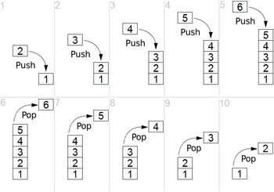
5. Miscellaneous Group Instructions:
STACK
-defined as a set of memory location in R/W memory, specified by a programmer in a main memory.
-These memory locations are used to store binary information temporarily during the execution of a program.
-follows(LIFO)Last In First Out
LXI SP, 16 bit address.
-loads SP with 16 bit address

Slide 65
Stack instructions:
1. PUSH Rp/PSW (Store register pair on stack)
– 1 byte instruction.
– Copies the contents of specified register pair or Program Status Word (accumulator and flag) on the stack.
– Stack pointer is decremented and content of high order register is copied. Then it is again decremented and content of low order register is copied.
2. POP Rp/PSW (retrieve register pair from stack)
– 1 byte instruction.
– Copies the contents of the top two memory location
of the stack into specified register pair or program status word.
– A content of memory location indicated by SP is copied into low order register and SP is incremented by 1. Then, the content of next memory location is copied into high order register and SP is incremented by 1.

Slide 66
Problem:
LXI SP,2099H
LXI H,4201H
PUSH H
:
:
:
POP H
HLT
PUSH H
POP H
A
00 | 00
00 | 00
00 | 00
42 | 01
2099
F
01
42
x
01
42
-
B
C
D
E
2097
2097
H
L
2098
2098
SP
2099
2099
SP=2097
SP=2099

Slide 67
Problem
LXI SP, 1FFFH
LXI H, 9320H
LXI B, 4732H
LXI D, ABCDH
MVI A, 34H
PUSH H
PUSH B
PUSH D
PUSH PSW
POP H
POP B
POP D
POP PSW
HLT
Suppose Flag(F)= 10H initially.

Slide 68
10
34
CD
AB
32
47
20
93
-
1FF7
1FF8
1FF9
1FFA
1FFB
1FFC
1FFD
1FFE 1FFF
BEORE EXECUTION H= 93 L= 20 B= 47 C=32 D= AB E=CD A= 34 F= 10
AFTER EXECUTION H= 34 L=10 B=AB C=CD D= 47 E=32 A= 93 F=20

Slide 69
Contd..
3. XTHL – exchanges top of stack (TOS) with HL
4. SPHL – move HL to SP
5. PCHL – move HL to PC
Some instructions related to interrupt
DI – Disable Interrupt
EI – Enable interrupt
SIM – Set Interrupt Mask
RIM – Read Interrupt Mask

Slide 70
End of Chapter 2

