Slide 1
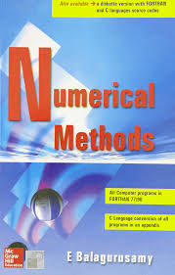
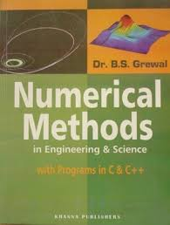
References
Prepared By: Anju Khanal

Slide 2
Numerical Methods
Chapter: 1. Introduction, Approximation & Errors of computation
What is Numerical Methods?
Why do we need Numerical Methods?
Applications of Numerical Methods.
What is Approximation?
What is Error? Explain its type.

Slide 3
What is Numerical Methods?
Introduction
Numerical Methods are extremely powerful problem solving tools.
Generate reliable solutions to mathematical problems.
Numerical Methods
Numerical methods are techniques by which mathematical problems are formulated so that they can be solved with arithmetic and logical operations.

Slide 4
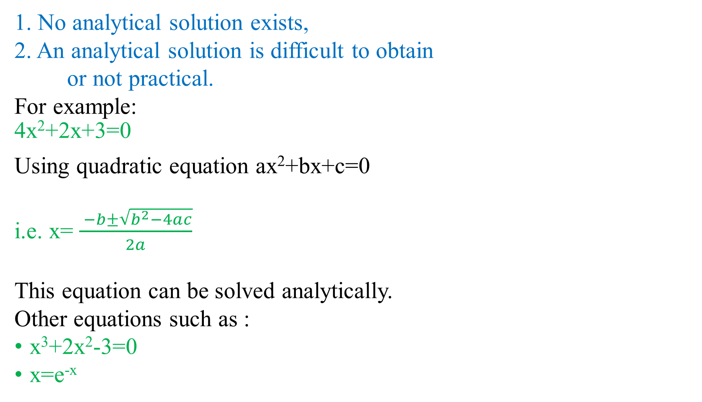
Why do we need Numerical Methods?

Slide 5
Applications of Numerical Methods.
Usually used in computer science for root algorithm.
It is used to determine profit and loss in the company.
Used for multidimensional root finding.
Network simulation.
Train & traffic signal.
Weather prediction.
Build up algorithm.

Slide 6
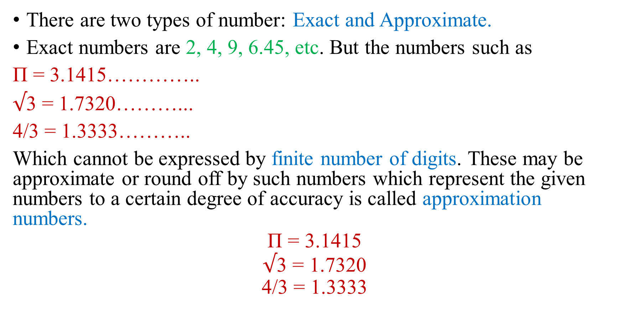
What is Approximation?

Slide 7
What is Error?
An error represents inaccuracy & imprecision of a numerical calculation or computation.
Errors in computation
Deviation of approximated value from actual value.

Slide 8
Types of Errors
Inherent Errors:
Errors which are already present in the statement of a problem before its solution.
Such errors arise either due to the given data being approximate or due to the limitations of mathematical tables, calculators or the digital computers.
It can be minimized by taking better data or by using high precision(clear detailed) computing aids.
2. Rounding Errors:
It occur from the process of rounding off the number during the computation.

Slide 9
This error can be reduced by changing the calculation procedure so as to avoid subtraction of nearly equal numbers or division by small numbers.
3. Truncation Errors:
Truncation errors are caused by using approximate results or on replacing an infinite process by a finite one.
Example:
e^{x} = 1+x+x²/2! +x³/3! +x⁴ /4! +…….+∞ = x (say)
Replaced by:
e^{x} = 1+x+x²/2! +x³/3! = x’ (say)
Then the truncation error is,
x - x’

Slide 10
4. Absolute , Relative & Percentage Errrors:
If x is the true value of a quantity and x’ is its approximate value,
then |x-x’| is called the absolute error and is denoted by ,
E_{a} = |x-x’|
Relative error is defined by,
E_{r =} |x-x’/x|
Percentage Error is defined by,
E_{p} = 100 *|x-x’/x|

Slide 11
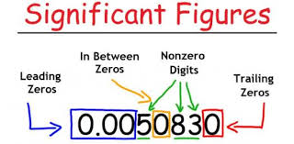
Significant Digits/Significant Figures
Most valuable digits in a given number is called significant figure.

Slide 12
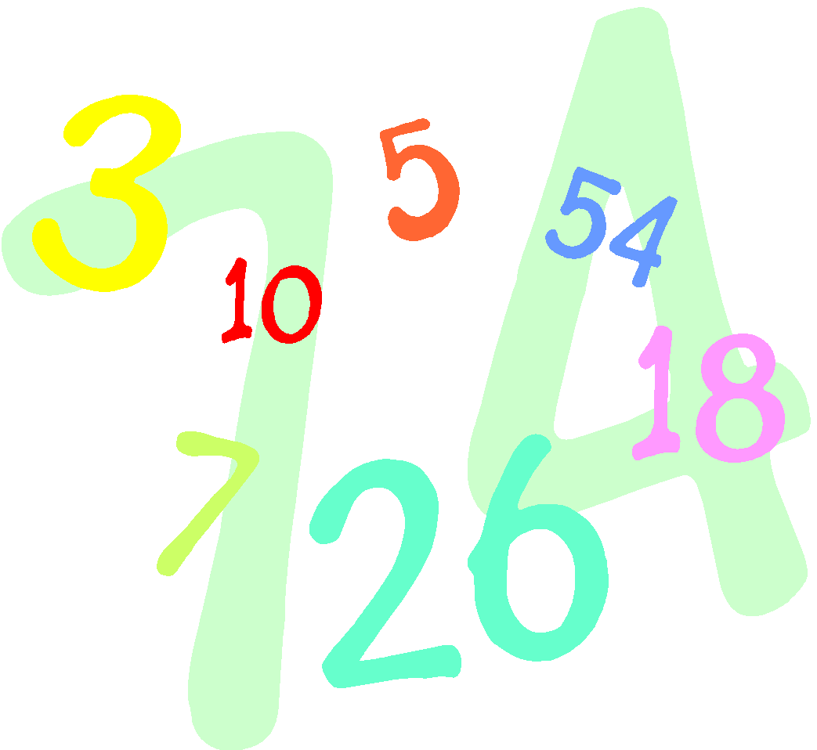

THERE ARE QUITE A FEW RULES
THAT DETERMINE HOW MANY
SIGNIFICANT DIGITS A
MEASUREMENT HAS. YOU WILL
NEED TO MEMORIZE THESE RULES.

Slide 14
RULE 1: If a number contains no zeros, all of the digits are significant.
How many significant
digits are in each of the
following examples?
a) 438
b) 26.42
c) 1.7
d) .653
Answers:
3
4
2
3

Slide 15
RULE 2: All zeros between two non zero digits are significant.
How many significant digits are in each of the following examples?
a) 506
b) 10,052
c) 900.431
Answers:
3
5
6

Slide 16
RULE 3: All zeros on left of decimal and right of decimal are not significant when the number is less than one.
How many significant digits are in each of the following examples?
a) 0.06
b) 0.0047
c) 0.005
Answers:
1
2
1

Slide 17
RULE 4:When number is greater than one with decimal then all zeros on right side of decimal and left of the decimal will be significant figure.
How many significant digits are in each of the following examples?
a) 2.020200
b) 3.00540
c) 1.0230
Answers:
7
6
5

Slide 18
RULE 5: A number without decimal, all zeros on right side will not be a significant figure but when it comes from measurement then such zeros are significant.
How many significant digits are in each of the following examples?
a) 1000
b) 1000kg
c) 2000
d) 2000kg
Answers:
1
4
1
4

Slide 19

Practice Problems
How many significant digits are in
each of the following examples?
1) 47.1
2) 9700. Answers:
1
2
1
3) 0.005965000
4) 560
5) 0.0509
6) 701.905
7) 50.00
8) 50.012
9) 0.000009
10) 0.0000104
Answers:
3
4
7
2
3
6
4
5
1
3

Slide 20
Determining Significant Digits When Rounding
689.7
0.0072
4000
4 x 10⁻¹
8800
309.00
7) .105
1) 689.683 grams (4 significant digits)
2) 0.007219 (2 significant digits)
3) 4009 (1 significant digit)
4) 39.21 x 10⁻¹ (1 significant digit)
5) 8792 (2 significant digits)
6) 309.00275 (5 significant digits)
7) .1046888 (3 significant digits)

Slide 21
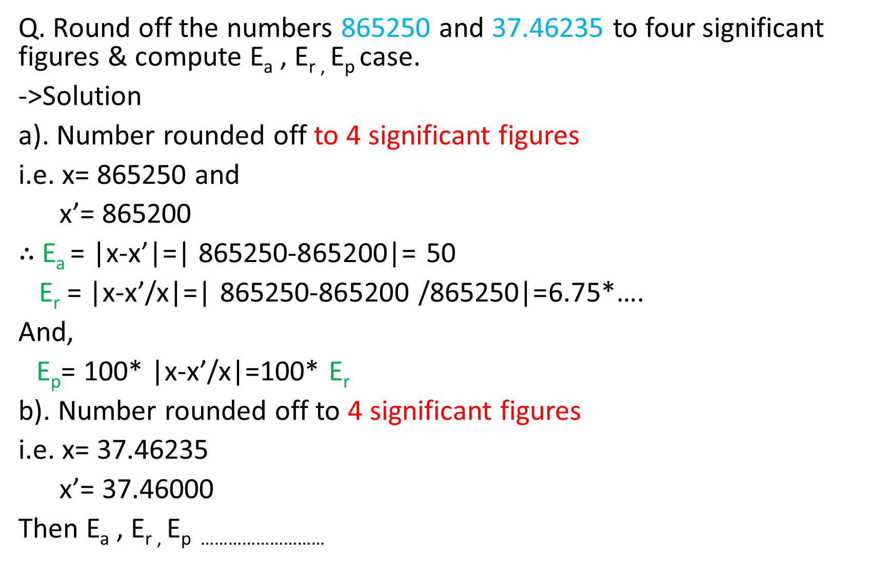

Slide 22
Assignments
Q. Uses & importance of computer programming in numerical methods.
Q. Discuss the necessity of NM in the field of science and engineering in this modern age of computers.

Slide 23
The End

