Slide 1
3D Viewing

Slide 2
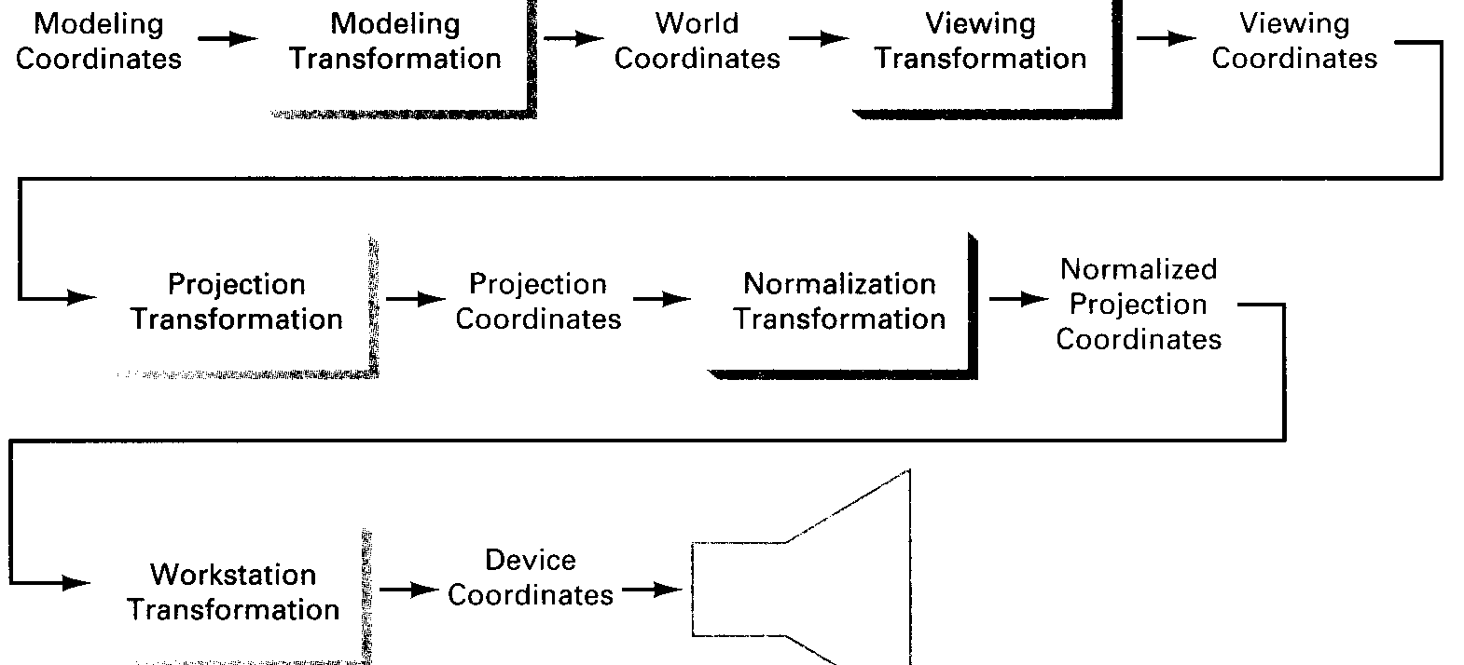
Transformation Pipeline

Slide 3
3D Viewing Pipeline
Modeling coordinates
Construct World Coordinate Scene Using Model-Coordinate Transformations
Modeling coordinates
Construct World Coordinate Scene Using Model-Coordinate Transformations
World coordinates
3D pipeline
Convert World Coordinates to Viewing Coordinates
World coordinates
Convert World Coordinates to Viewing Coordinates
Viewing coordinates
Projection Transformation
Viewing coordinates
2D pipeline
Projection coordinates
Transform Viewing Coordinates to Normalized Coordinates
Transform Viewing Coordinates to Normalized Coordinates
Normalized coordinates
Normalized coordinates
Map Normalized Coordinates to Device Coordinates
Map Normalized Coordinates to Device Coordinates
Device coordinates
Device coordinates

Slide 4
Introduction to View Transformation
Viewing Transformation is the mapping of coordinates of points and lines that form the picture into appropriate coordinates on the display device.
World coordinate system (WCS) is the cartesian co-ordinate system where we define the picture to be displayed.
A finite region in the WCS is called the Window.
The corresponding coordinate system on the display device where the image of the picture is displayed is called the physical coordinate system.
Mapping the window onto a subregion of the display device called the viewport is called the Viewing Transformation.
Normalized device coordinate (NDC) is the display area of the virtual display device corresponding to a unit square.
The lower left corner is the origin of the coordinate system.
Mapping the window in the world coordinate space to viewport in NDC space is called the Normalization Transformation, N.

Slide 5


. Window to viewport transformation

Slide 6
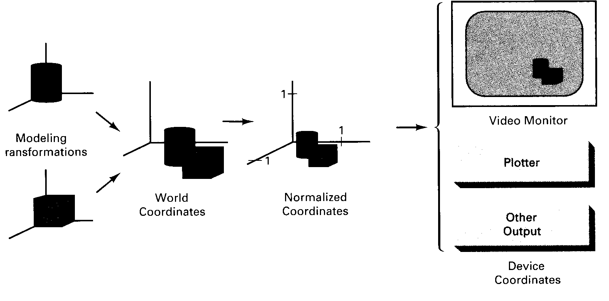
From Object Model to Display Device

Slide 7
View Transformation
A 3D scene can be viewed from any position in 3D space.
A "synthetic" camera positioned and oriented in 3D space can be used to describe the viewing, and the part of the image or scene to be viewed
It has the following three principal ingredients.

Slide 8
View plane
The window is defined in this plane.
The origin of this plane which defines the position of the eye or camera is called the view reference point e=(ex,ey,ez) .
A unit vector to this plane is the view plane normal N.
Another vector called the viewup vector V_{up} is a unit vector perpendicular to N .

Slide 9
View coordinate system
Usually a left handed system called the UVN system is used.
V, the y-axis of the view coordinate system is the perpendicular projection V_{up} of on the view plane.
U, the x-axis of the view coordinates, is orthogonal to V and N i.e. U=V X N
Positive U and V are to the right and up-direction from eye's point of view.
N is the z-axis of the view coordinate. It increases in positive direction with depth of a point from the eye.

Slide 10
Viewing Coordinate Parameters
We call the viewing coordinate frame uvn, where u, v and n are three orthogonal vectors.
Let
p₀ be the view coordinate origin.
p_{ref} be the look-at point in the scene.
N be the vector from p_{ref} to p₀.
Then n is the unit vector in the direction of N.
Let v be the unit vector in the view up direction V.
Vector u is perpendicular to v and n, where u = v x n.
Usually, the user specifies p₀ and p_{ref}, and the view up vector V.
An eye defined within this system.

Slide 11
Viewing Coordinate Parameters
Usually, users don’t give precise V exactly perpendicular to N.
Therefore, we use the following method to find u, v and n.
v
N
n =
|N|
V x n
u =
|V|
u
v = n x u
n

Slide 12

Let a=(ax,ay,az) be the look-at-point.
For perspective views, the view plane normal as a unit vector from eye to a ``look-at point'' is given by:
The view up vector is the tilt (rotation) of the head or camera.
For parallel views it is convenient to think of the view plane normal as determining the direction of projection.

Slide 13
Viewing a 3D world
World coordinate frame
Display plane
Camera position (or eye point, view point, viewing position)

Slide 14
Transformation from World to Viewing Coordinates
Suppose that the viewing coordinates are specified in world coordinates. We need to transform each vertex specified in world coordinates to view coordinates.
1. Translate viewing-coordinate origin to world coordinate origin
2. Apply rotation to align u, v and n with the world x, y and z axes.

Slide 15
Transformation Matrices
1. Translation:
If the view reference point is specified at world position (x_{0,} y_{0,} z₀ ), this point is translated to World origin with the matrix transformation:
1 0 0 -x₀
0 1 0 -y₀
0 0 1 -z₀
0 0 0 1

Slide 16
2. Rotation:
The composite rotation matrix for viewing transformation is then:
R=
u₁ u₂ u₃ 0
v₁ v₂ v₃ 0
n₁ n₂ n₃ 0
0 0 0 1

Slide 17
View Coordinate System (Another Approach)
An object in world coordinate space, whose vertices are (x,y,z) can be expressed in term of view coordinates (u,v,n)
Translate the view reference point e to the origin
Rotate about world coordinate y axis to bring the view coordinate axis into the yz plane of world coordinates
Rotate about the world coordinate x axis until the z axes of both systems are aligned
Rotate about the world coordinate z axis to align the axis with the y
Reflect relative to the xy plane, reversing sign of each z coordinate to change into a left-handed coordinate system
The Viewing Transformation is:
V= T. R(y).R(x).R(z).F

Slide 18
Projections

Slide 19
Viewing and projection
Objects in WC are projected on to the view plane, which is defined perpendicular to the viewing direction along the z_{v}-axis. The two main types of projection in Computer Graphics are:
parallel projection
perspective projection

Slide 20
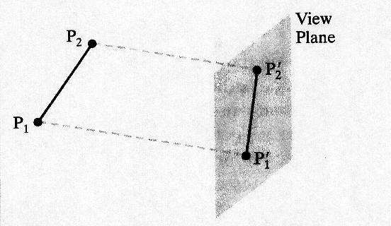
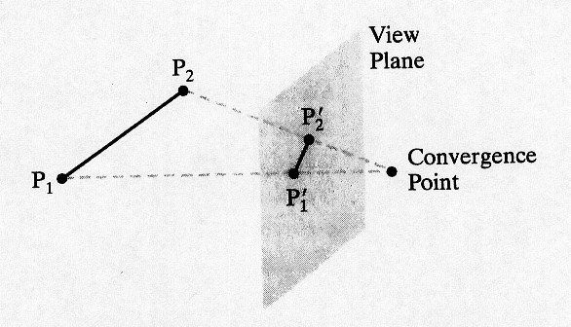
Projection illustrations
Parallel projection
All projection lines are crossing the view plane in parallel; preserve relative proportions
Perspective projection
Projection lines are crossing the view plane and converge in a projection reference point (PRP)

Slide 21
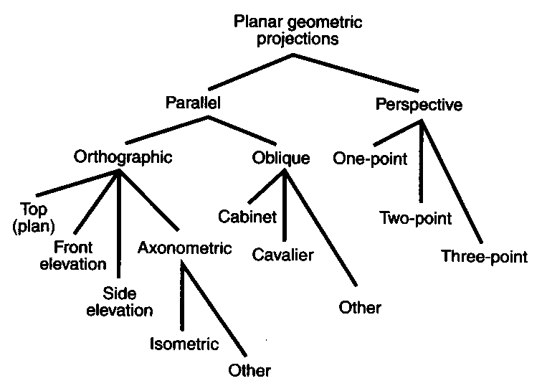
Overview of projections

Slide 22
Parallel projection
Two different types are used:
Orthographic
most common
projection perpendicular to view plane
Oblique
projection not perpendicular to view plane
less common

Slide 23
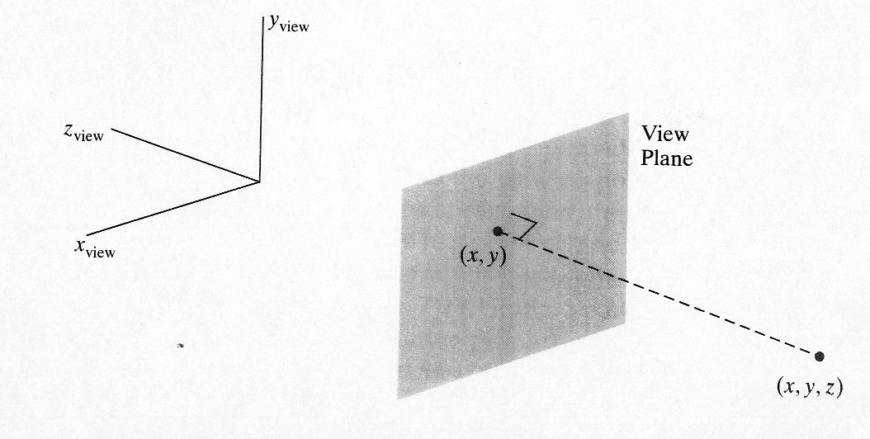
Orthographic projection
Assume view plane at z_{vp} (perpendicular to the z_{v}-axis) and (x_{v},y_{v},z_{v}) an arbitrary point in VC
Then x_{p} = x_{v}
y_{p} = y_{v}
z_{p} = z_{vp} (z_{v} is kept for depth purposes only)

Slide 24
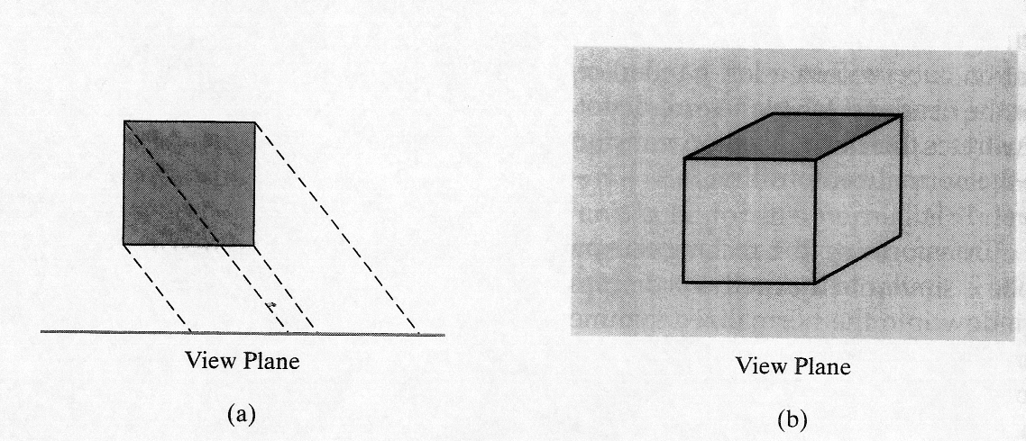
Oblique projection
When the projection path is not perpendicular to the view plane.
A vector direction is defining the projection lines
Can improve the view of an object

Slide 25
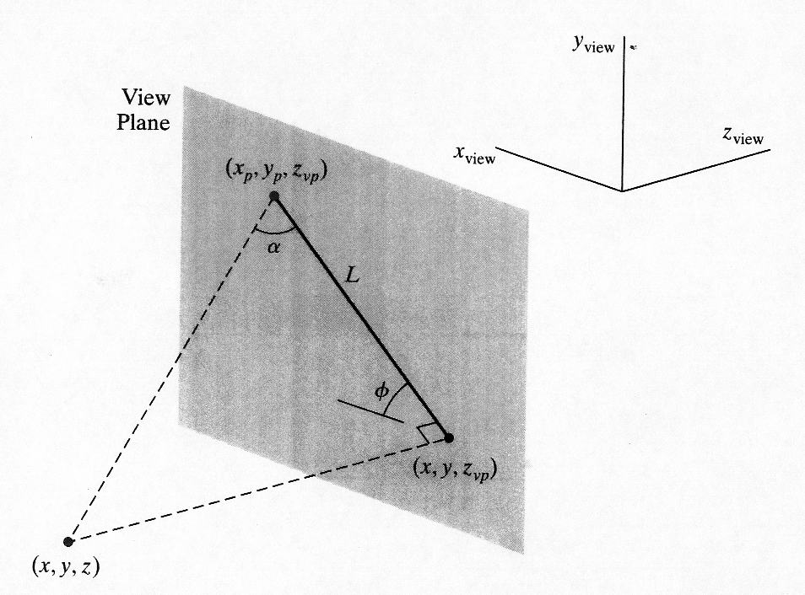
Oblique projection, cont’d
An oblique parallel projection is often specified with two angles, α (0-90°) och φ (0-360°), as shown below

Slide 26
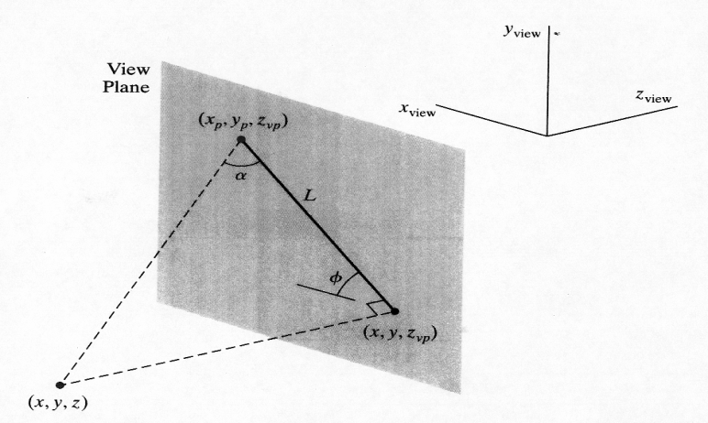
Oblique formula (from fig.)
Assume (x,y,z) any point in VC (cp. x_{v},y_{v},z_{v})
cos φ=(x_{p}-x)/L => x_{p}=x+L.cos φ
sin φ =(y_{p}-y)/L => y_{p}=y+L. sin φ
Also tan α=(z_{vp}-z)/L, thus L=(z_{vp}-z)/tan α= =L₁(z_{vp}-z), where L₁=cot α
Hence
x_{p} = x + L₁(z_{vp} - z).cos φ
y_{p} = y + L₁(z_{vp} - z).sin φ
Observe: if orthographic projection, then L₁=0

Slide 27
Cavalier and Cabinet
When
tan α = 1 then the projection is called Cavalier (α = 45°)
tan α = 2 then the projection is called Cabinet (α ≈ 63°)
φ usually takes the value 30° or 45°

Slide 28
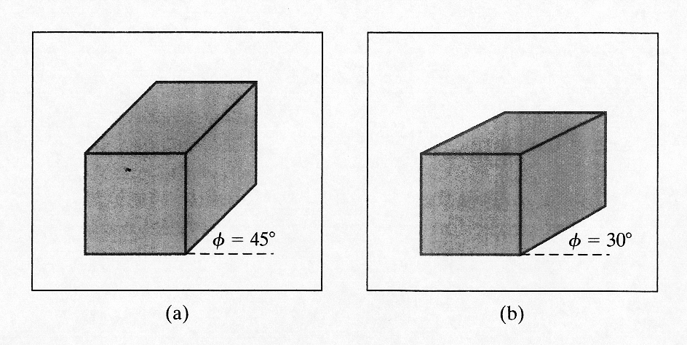
Cavalier, example

Slide 29
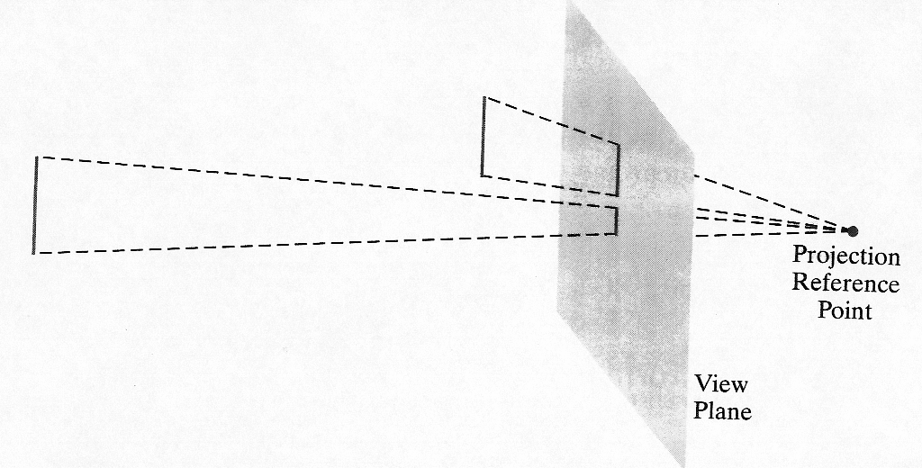
Perspective projection

Slide 30
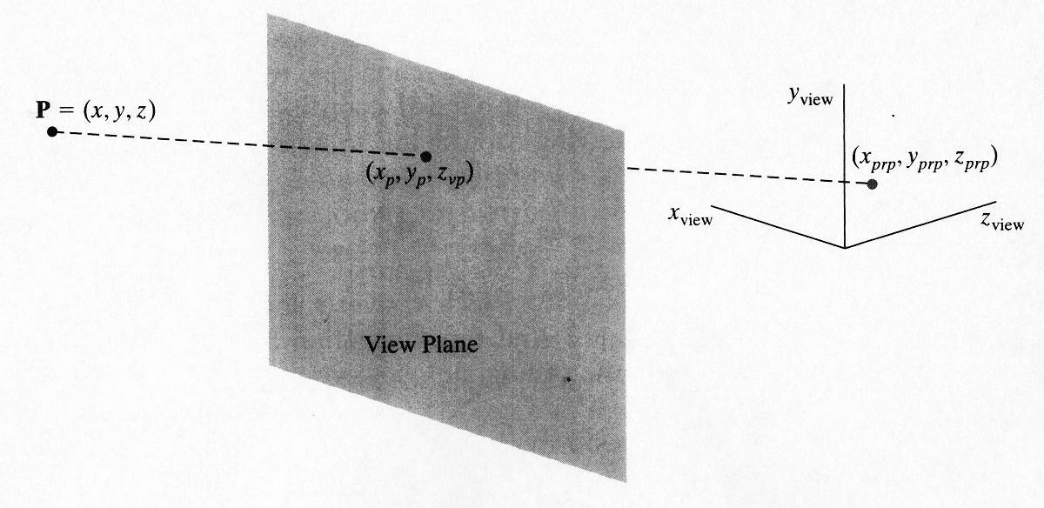
A general approach
Equations describing co-ordinate positions along the pojection line in parametric form:
x = x – u.(x - x_{prp})
y = y – u.(y - y_{prp})
z = z – u.(z - z_{prp}),
at z=z_{vp}, u=(z_{vp} – z) / (z_{prp} – z)
=>

Slide 31
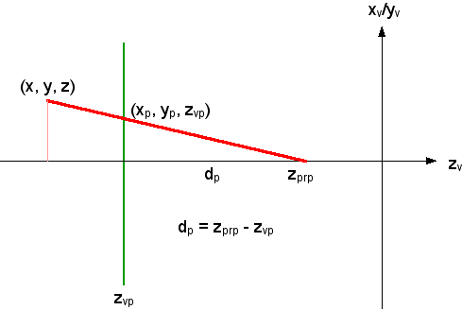
Special case: PRP on the z_{v}-axis

Slide 32
Special cases
Various restrictions are often used, such as:
PRP on the z_{v}-axis => x_{prp}=y_{prp}=0
PRP in the VC origin => x_{prp}=y_{prp}=z_{prp}=0
view plane in the x_{v}y_{v}-plane => z_{vp}=0
view plane in the x_{v}y_{v}-plane and PRP on the z_{v}-axis =>x_{prp}=y_{prp}=z_{vp}=0

Slide 33
THE END

