Slide 1
Compare properties of detected ripples depending on the threshold
21 sessions

Slide 2
DETECTOR x PROPERTIES

Slide 3
Mean value of properties per session

Slide 4
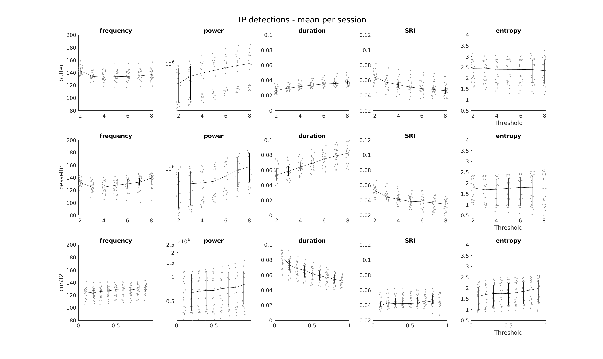

Slide 5
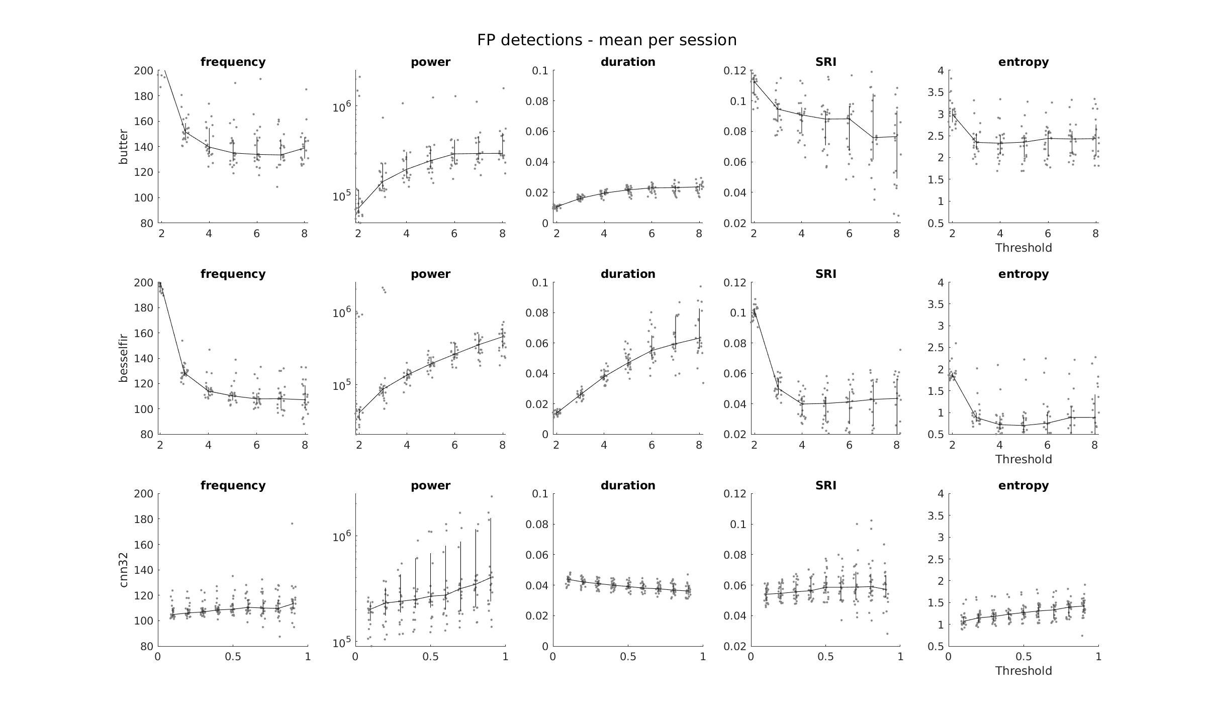

Slide 6
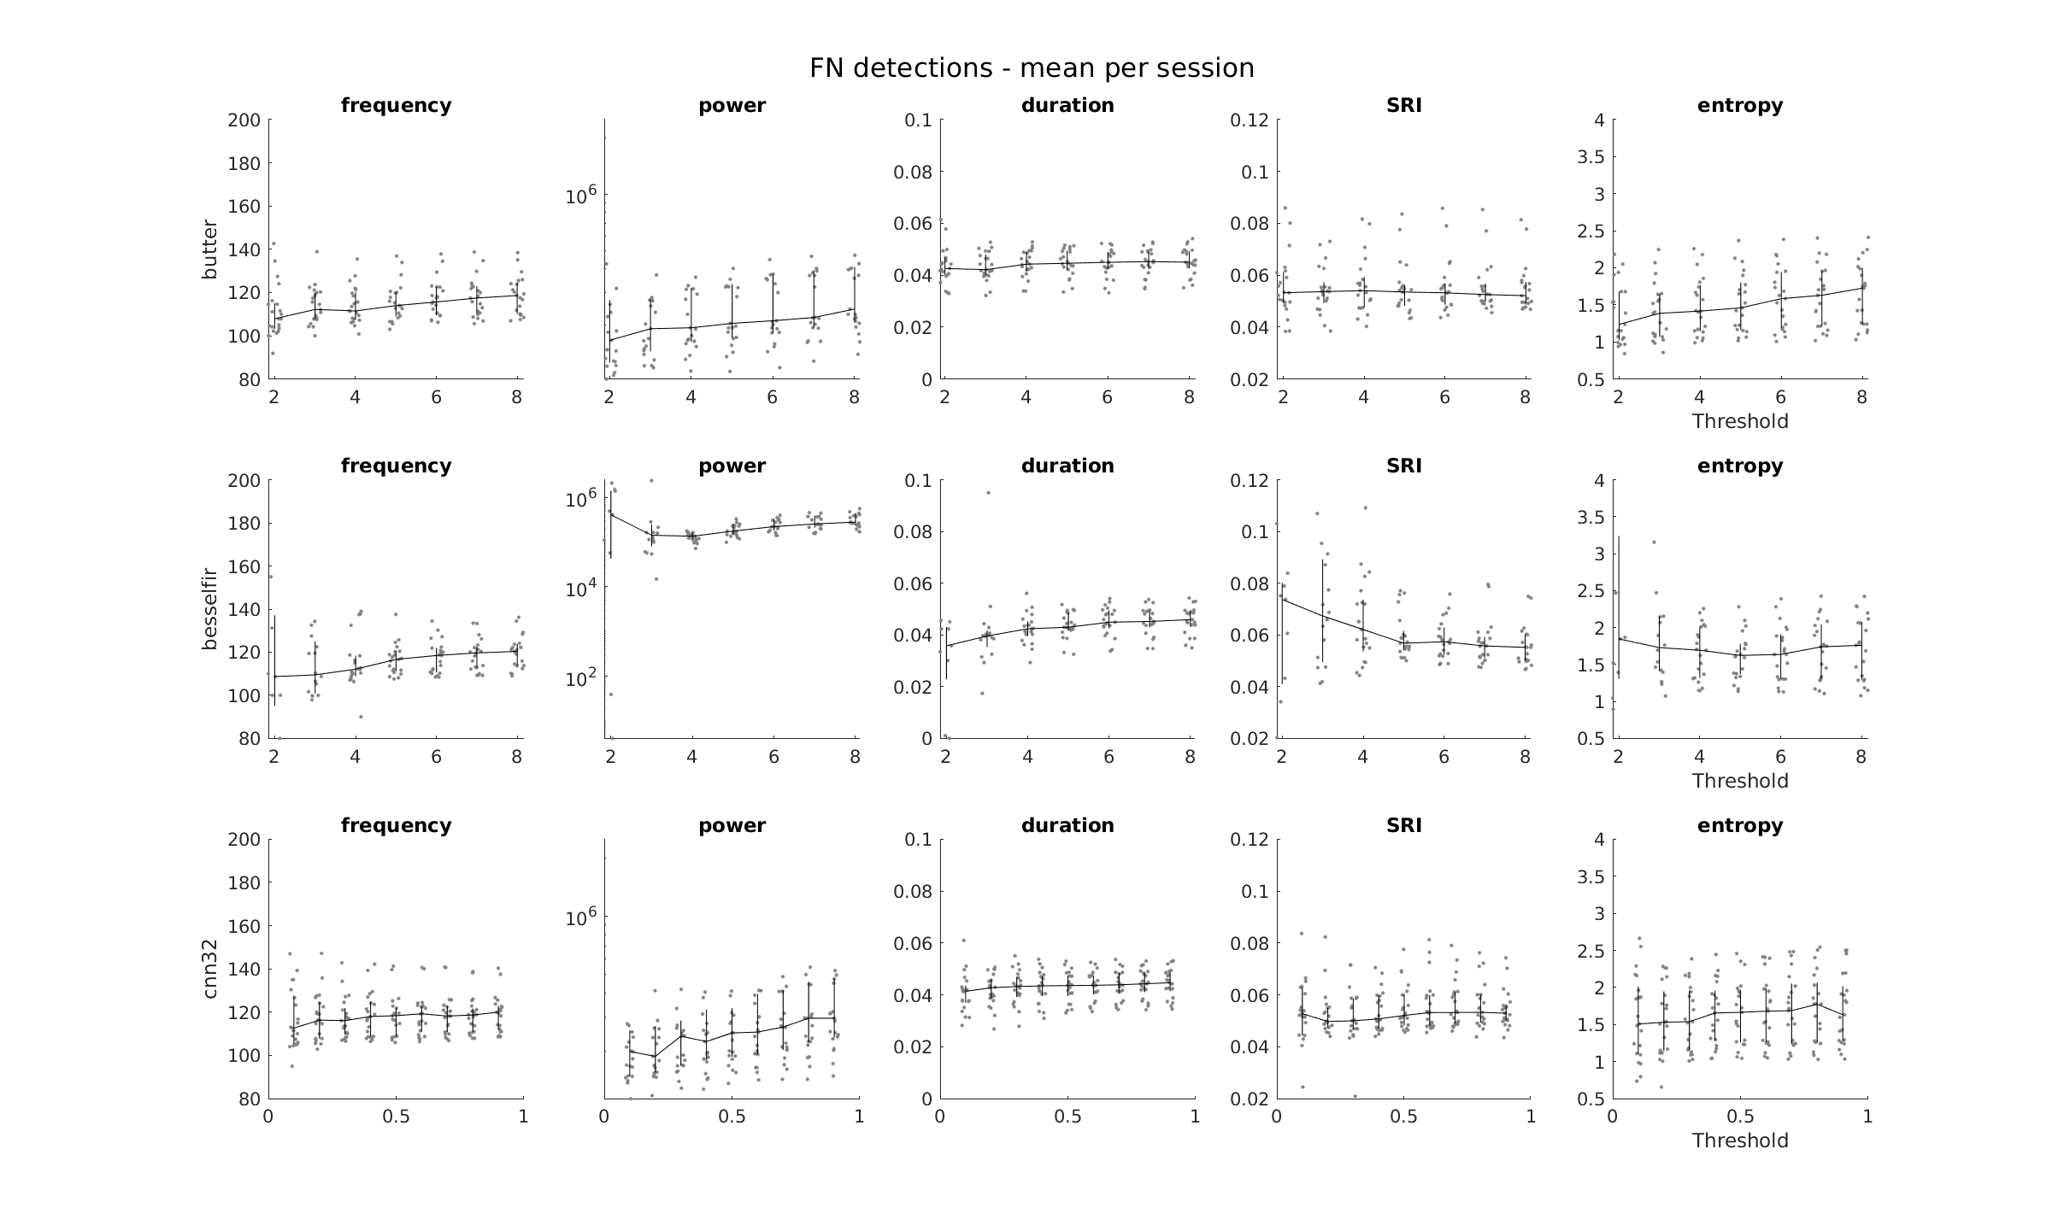

Slide 7
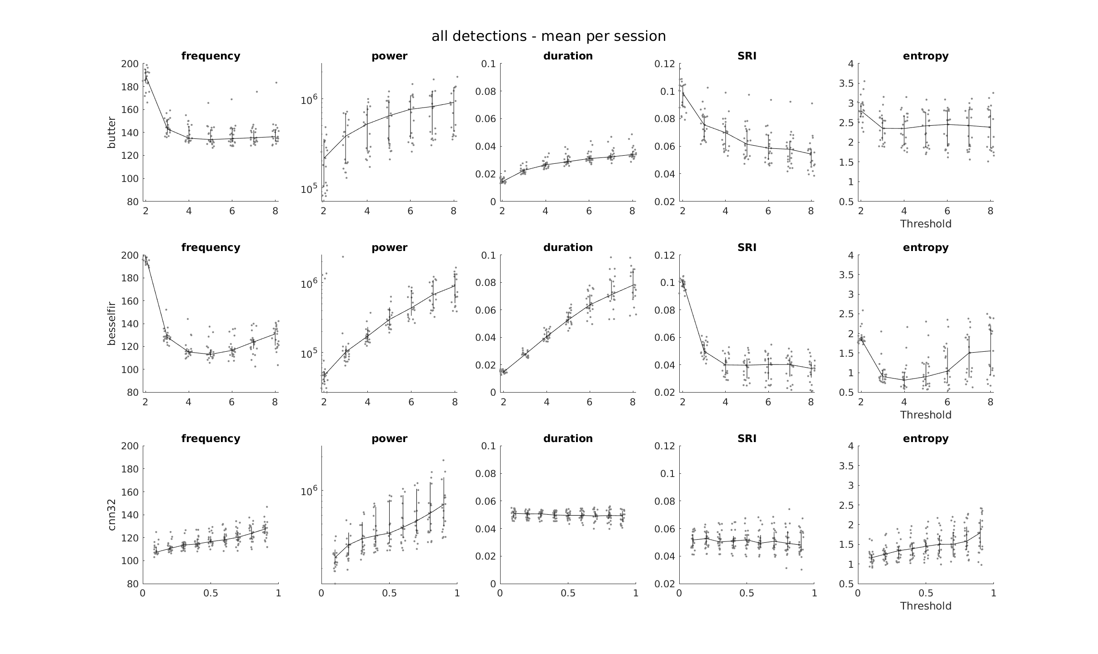

Slide 8
Median value of properties per session

Slide 9
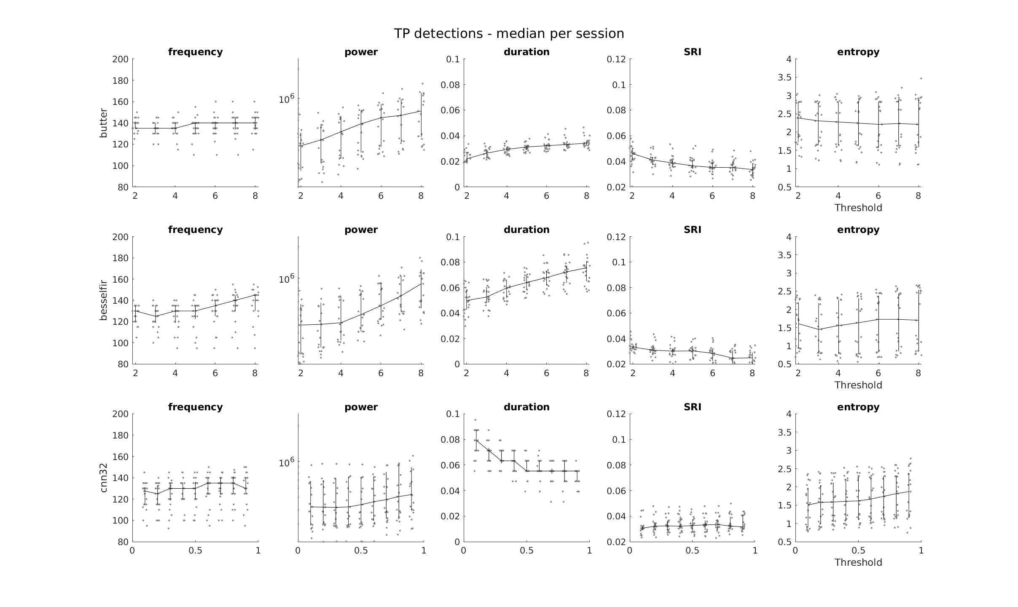

Slide 10
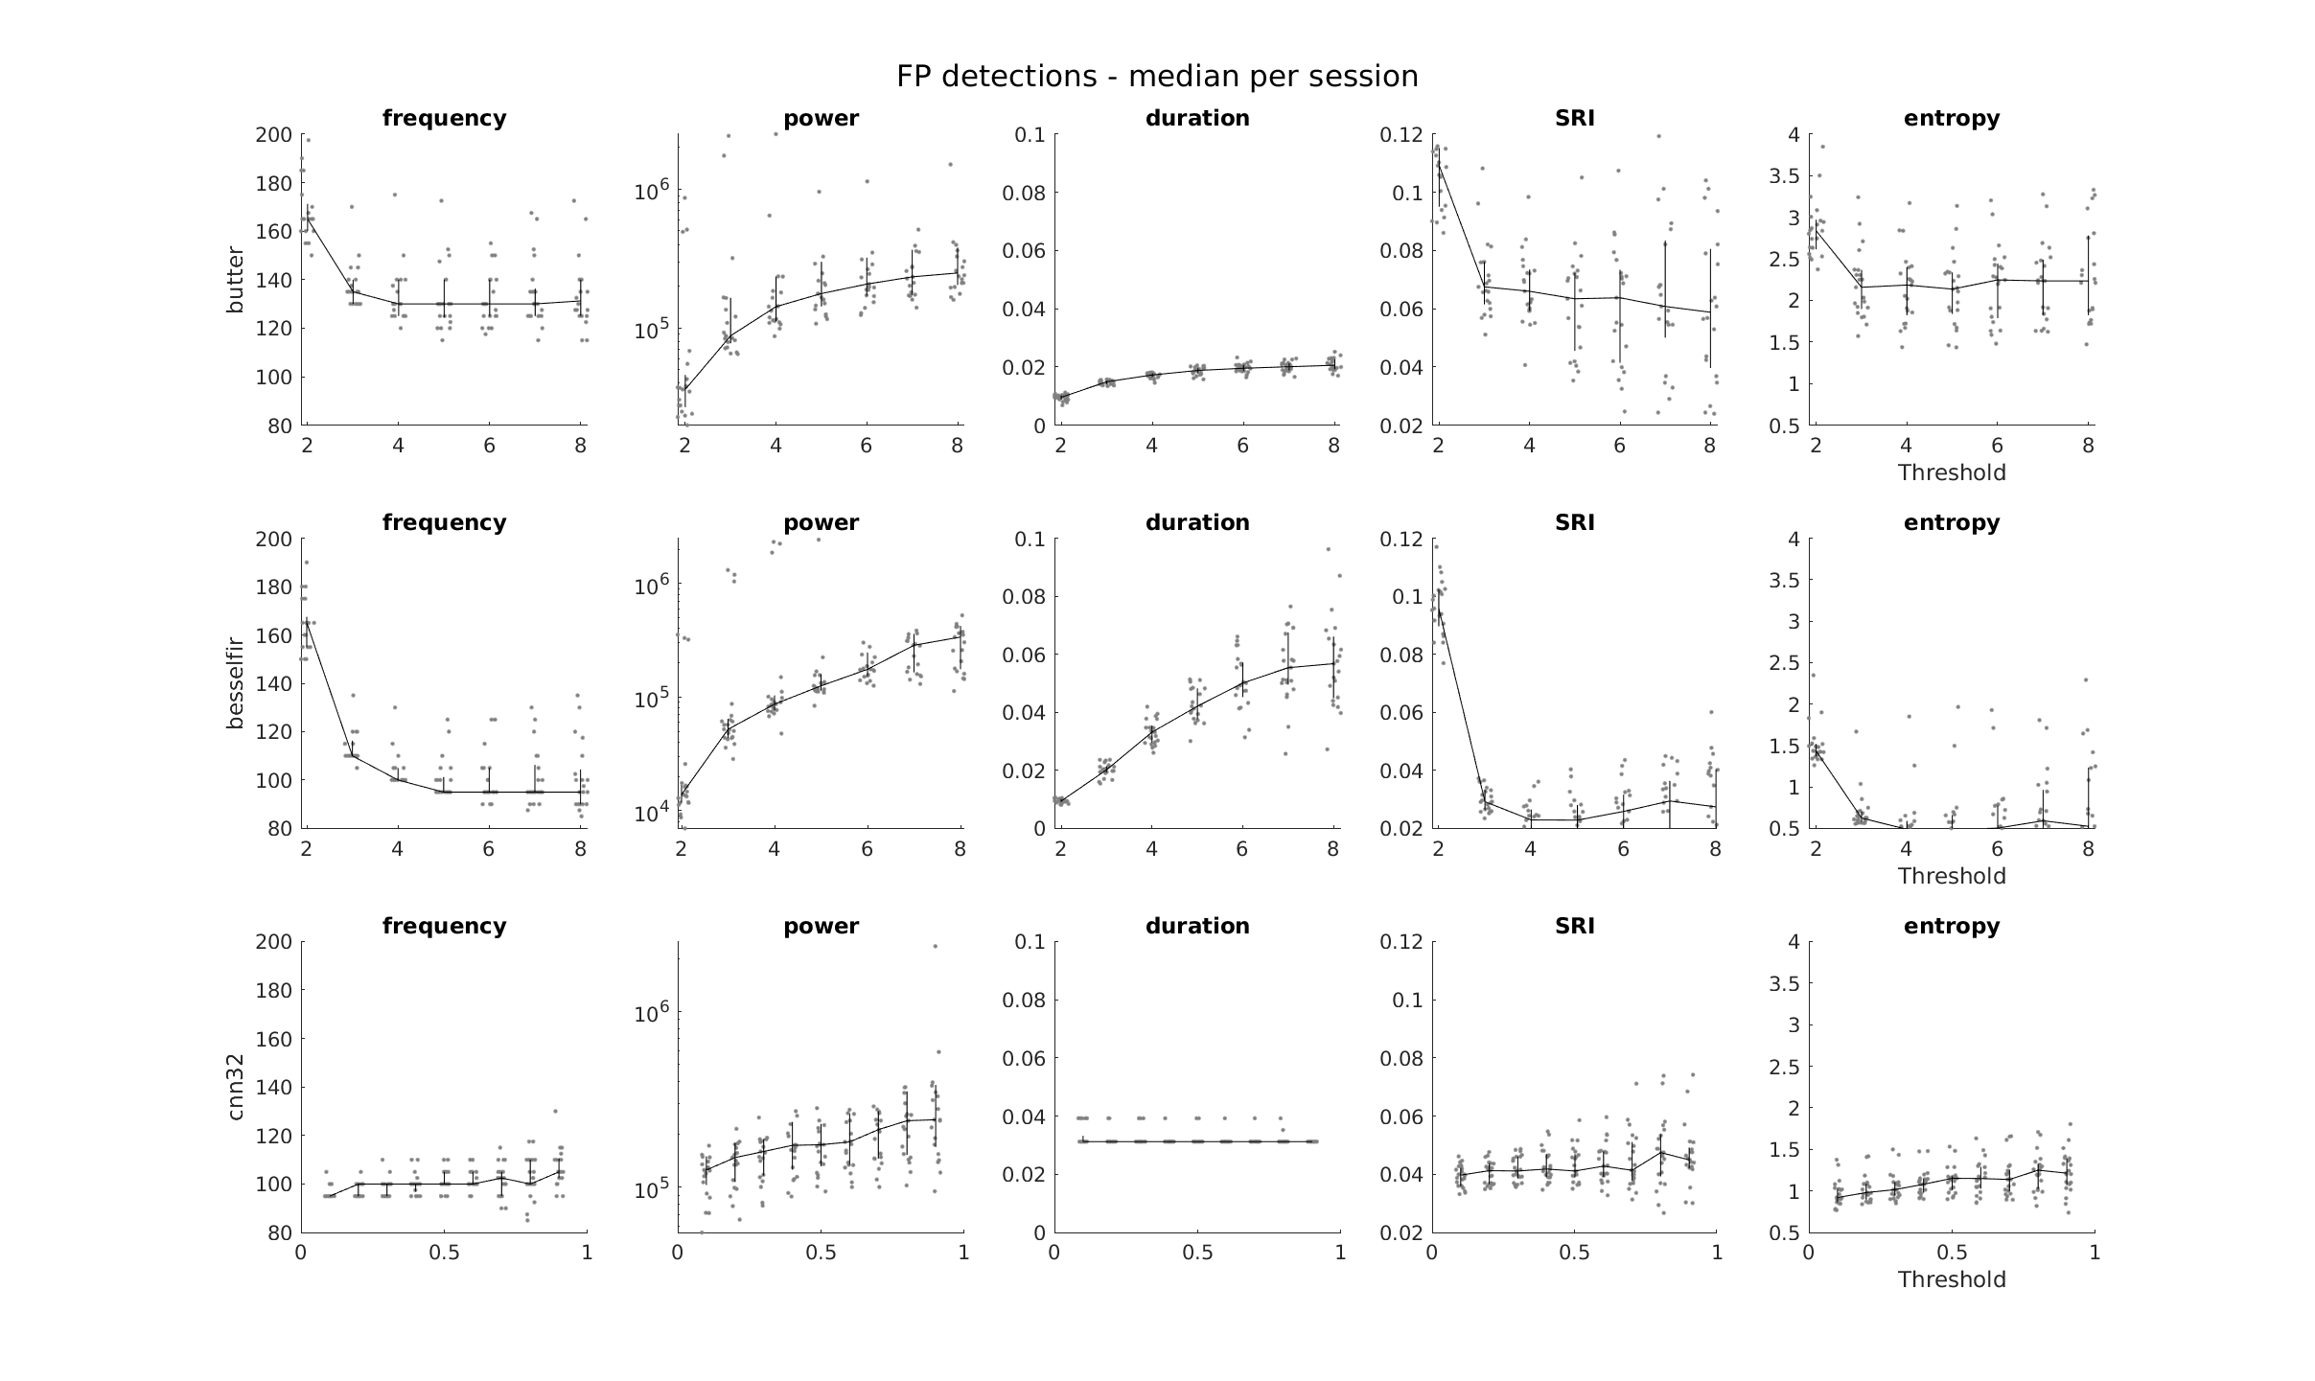

Slide 11
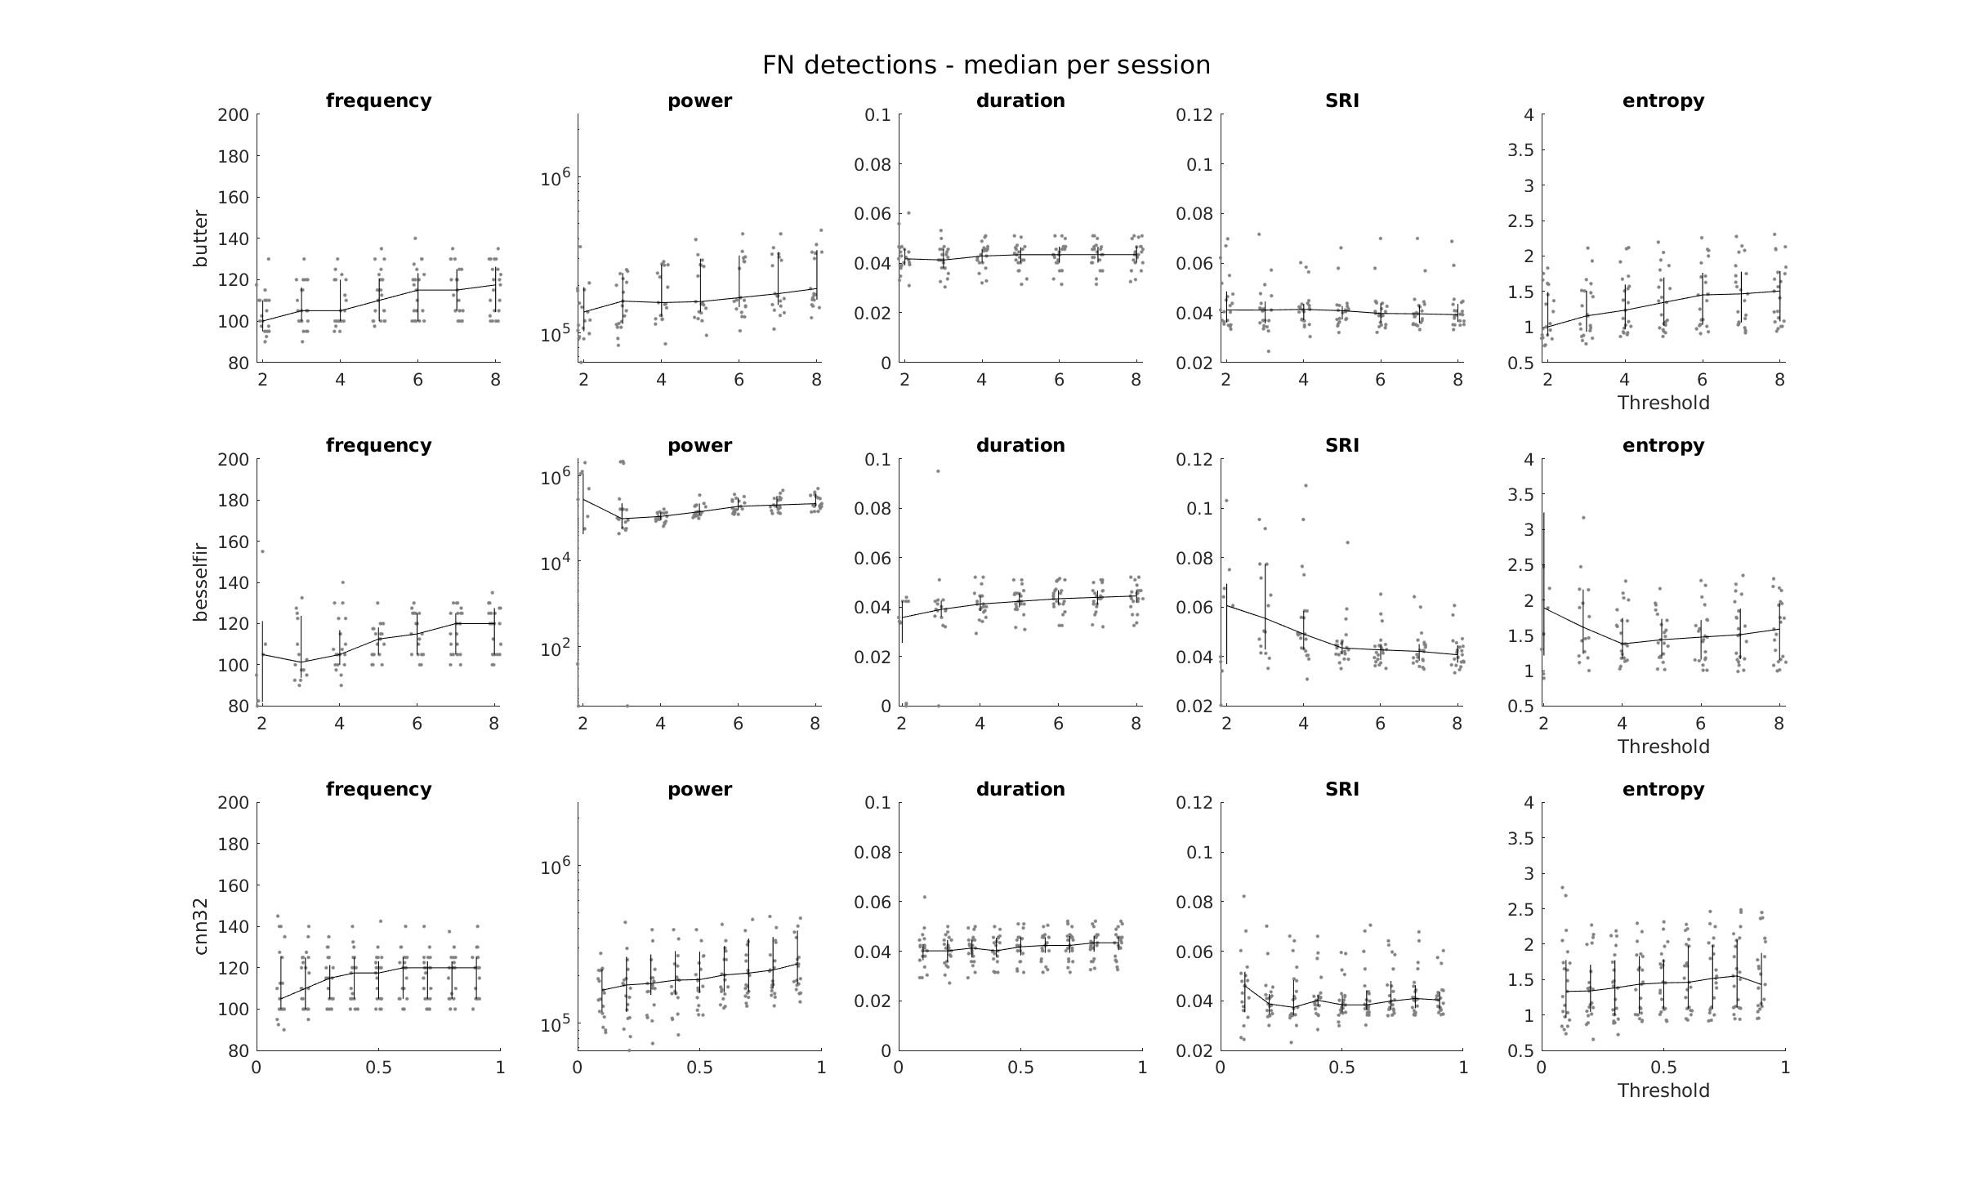

Slide 12
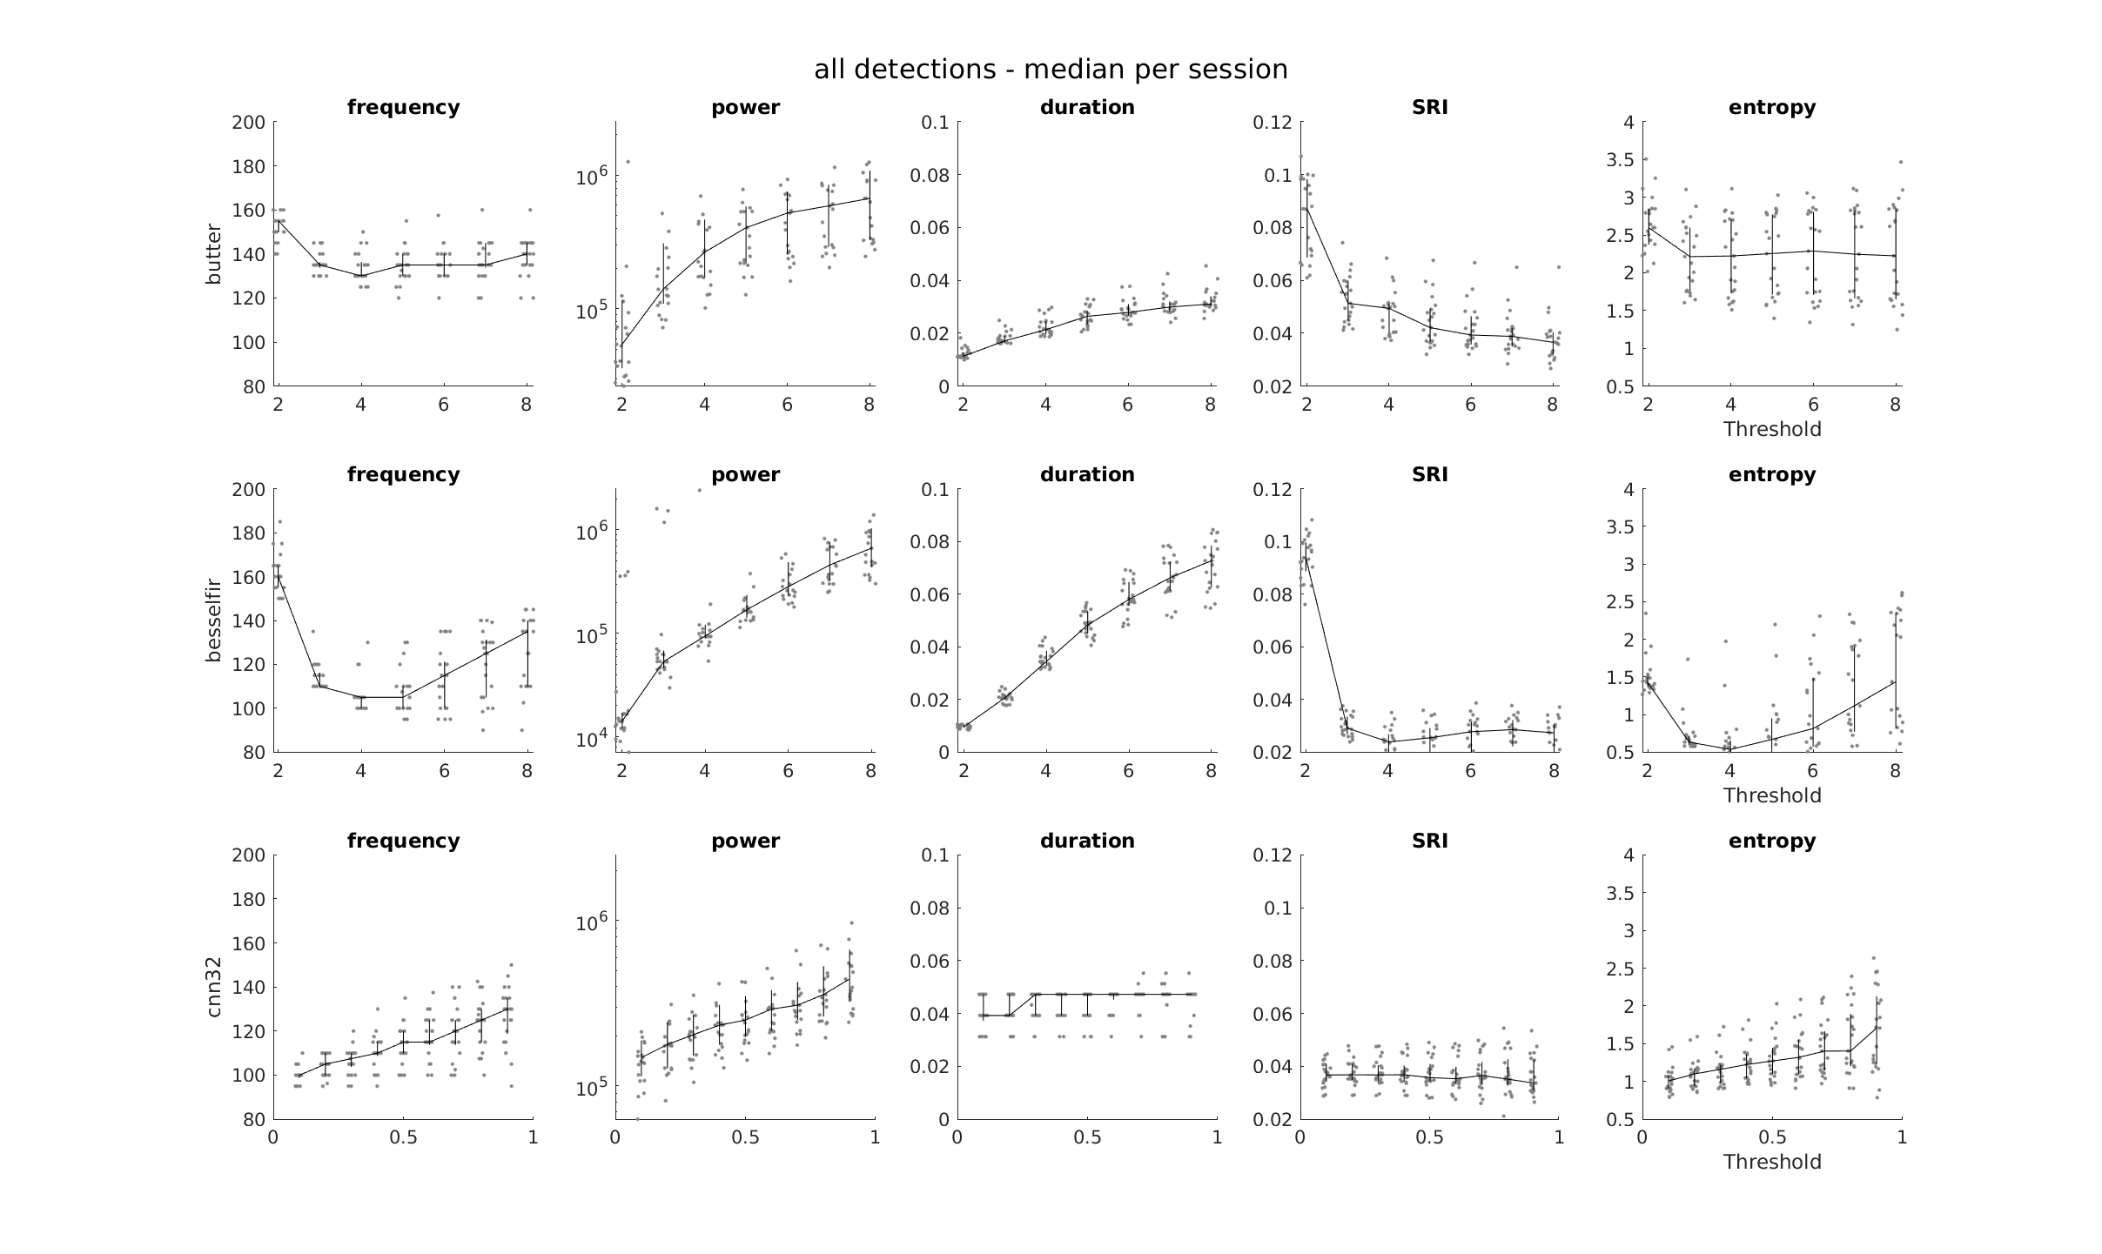

Slide 13
Statistics

Slide 14
PROPERTIES x DETECTOR

Slide 15
Mean value of properties per session

Slide 16
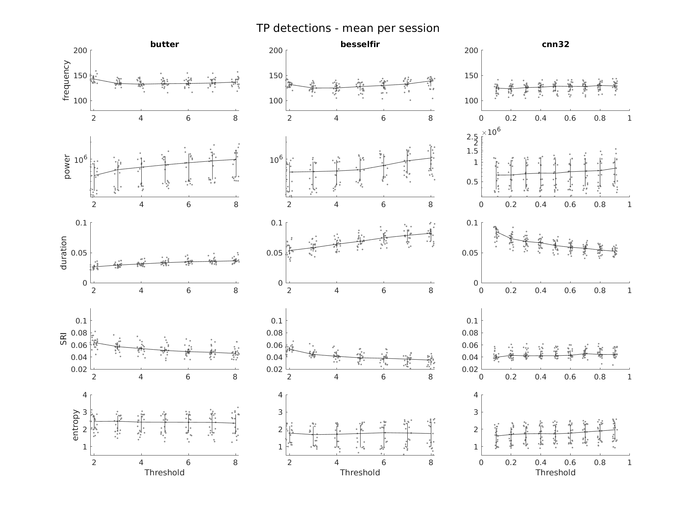

Slide 17
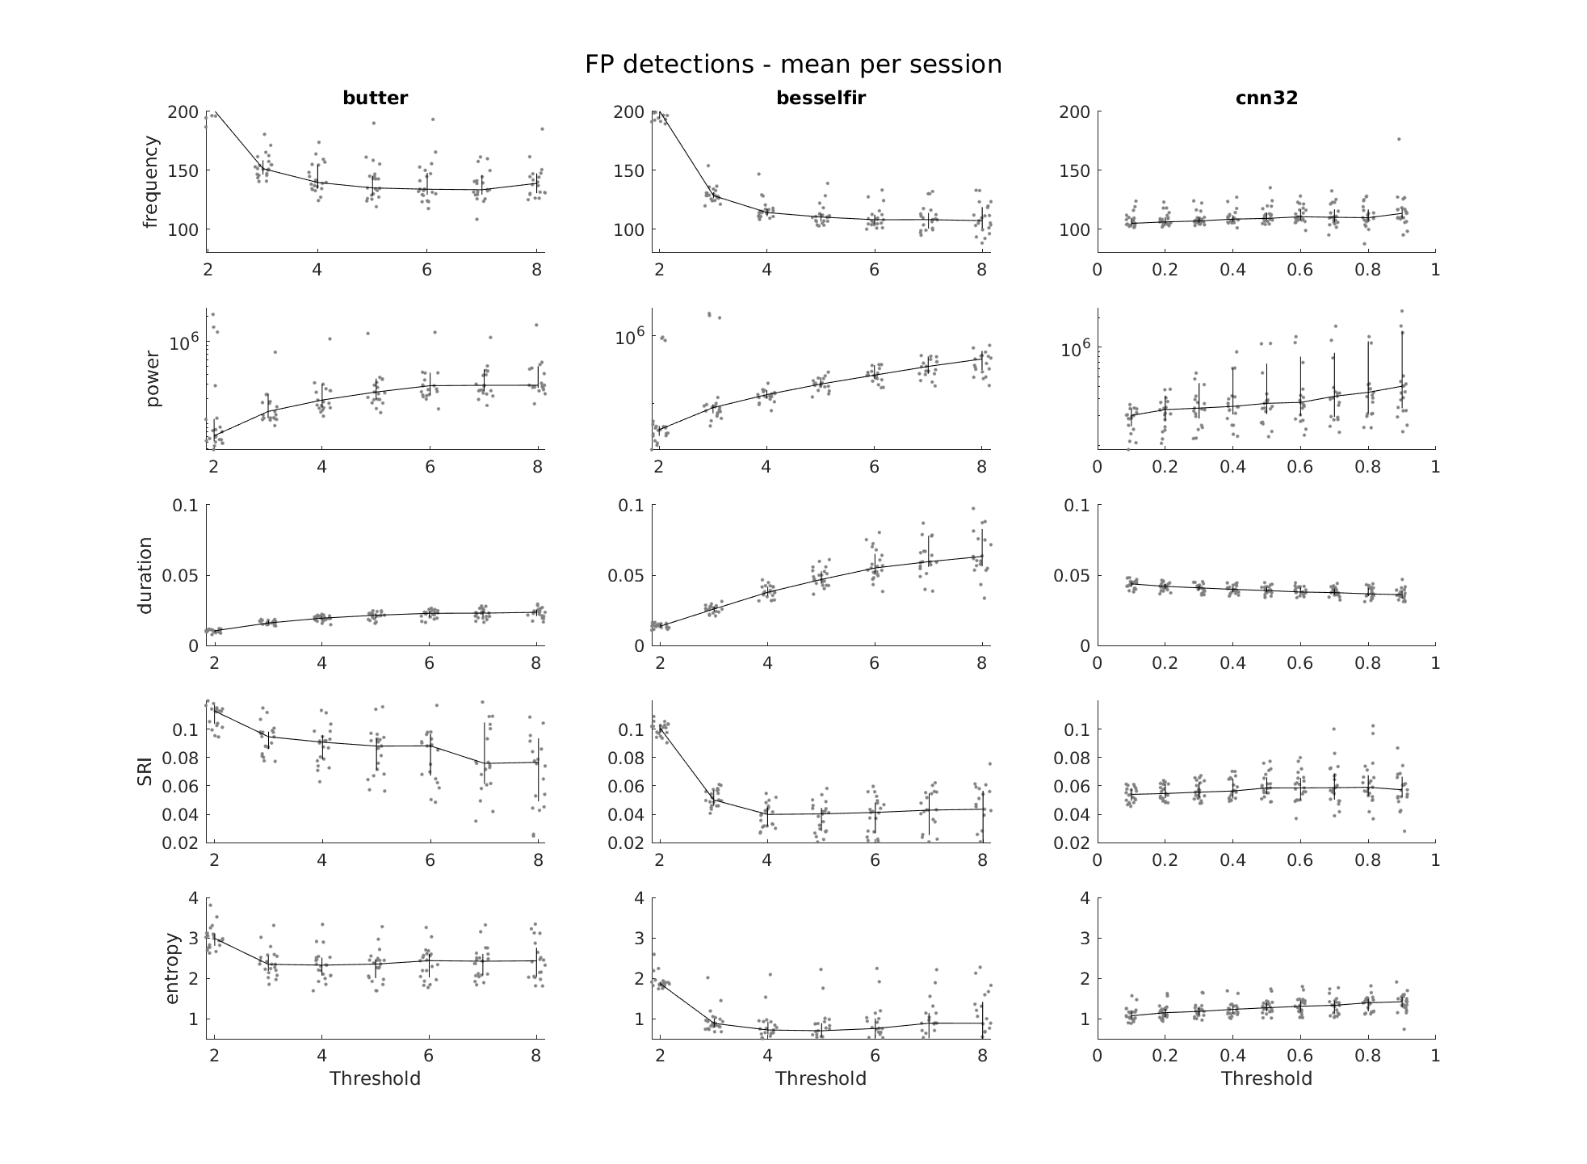

Slide 18
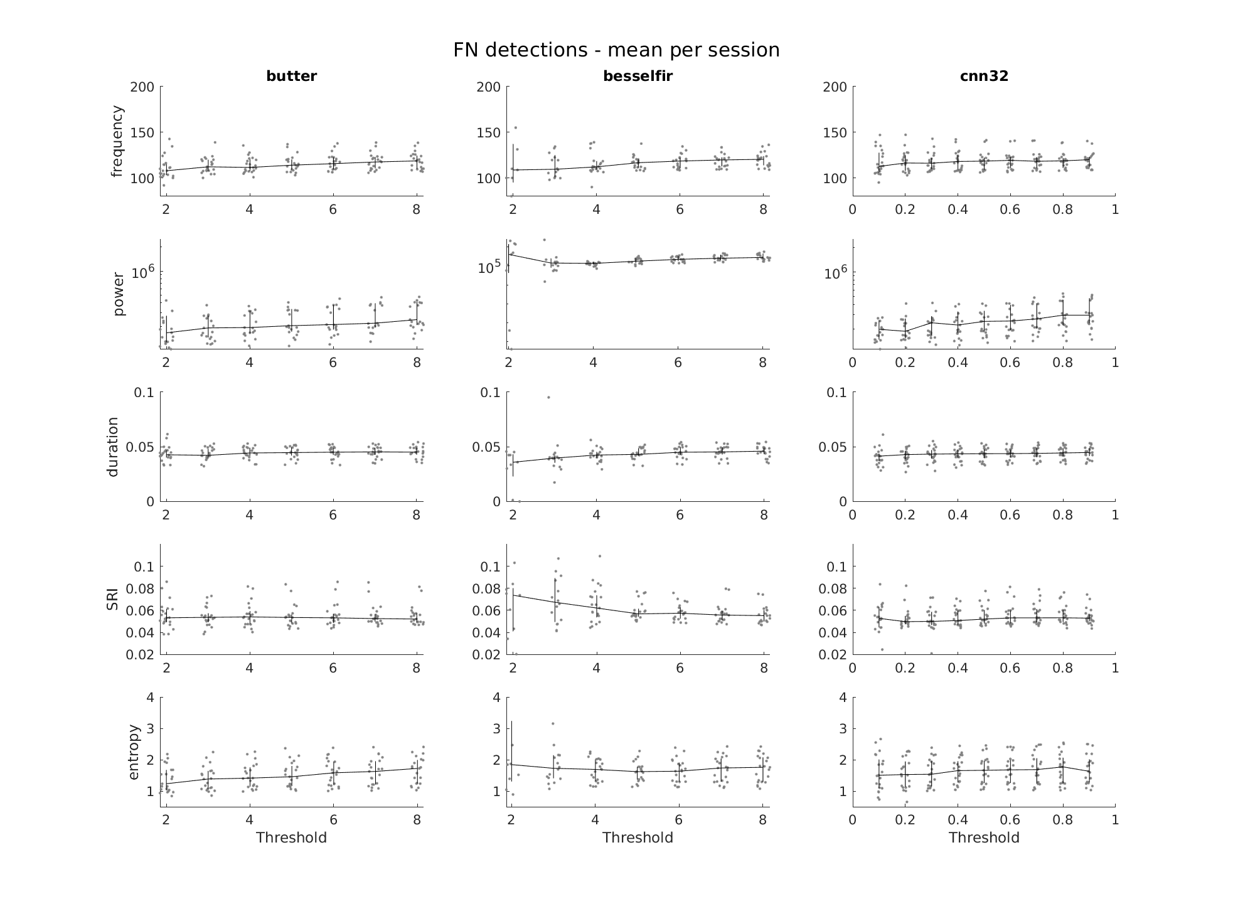

Slide 19
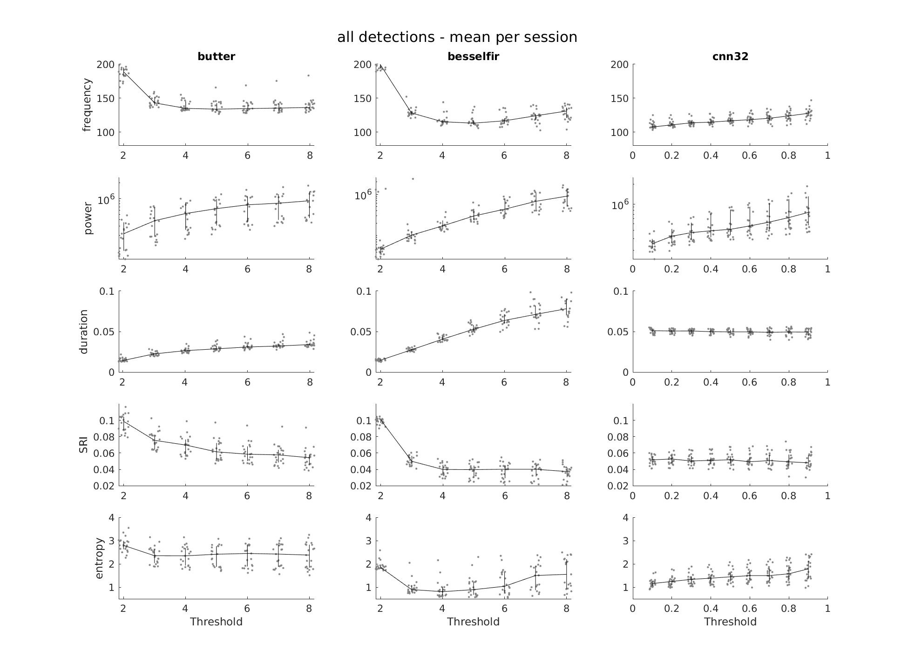

Slide 20
Median value of properties per session

Slide 21
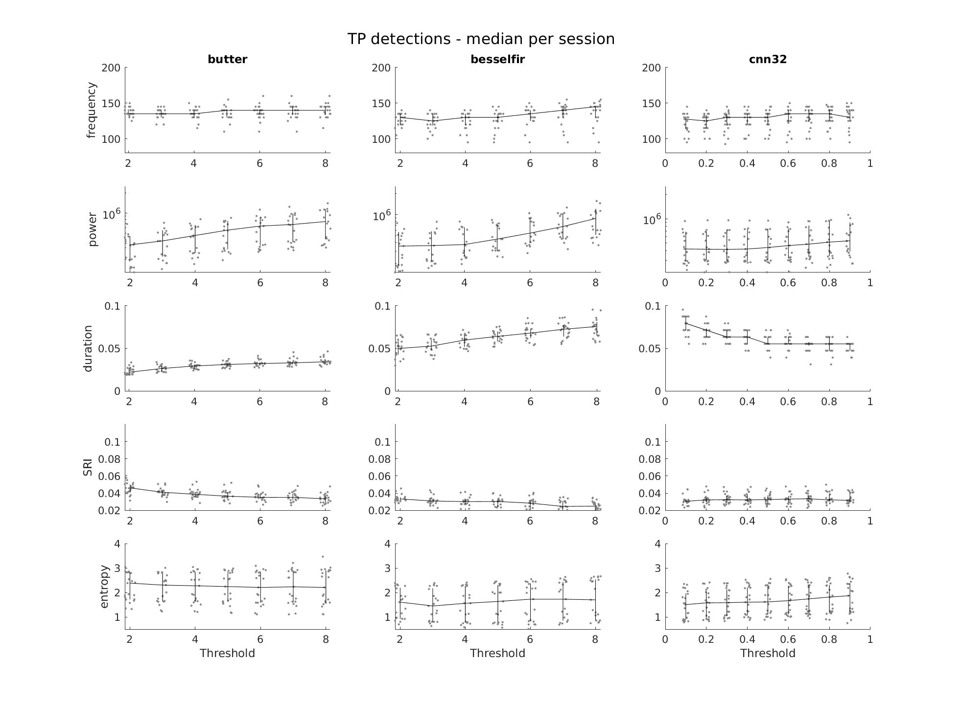

Slide 22
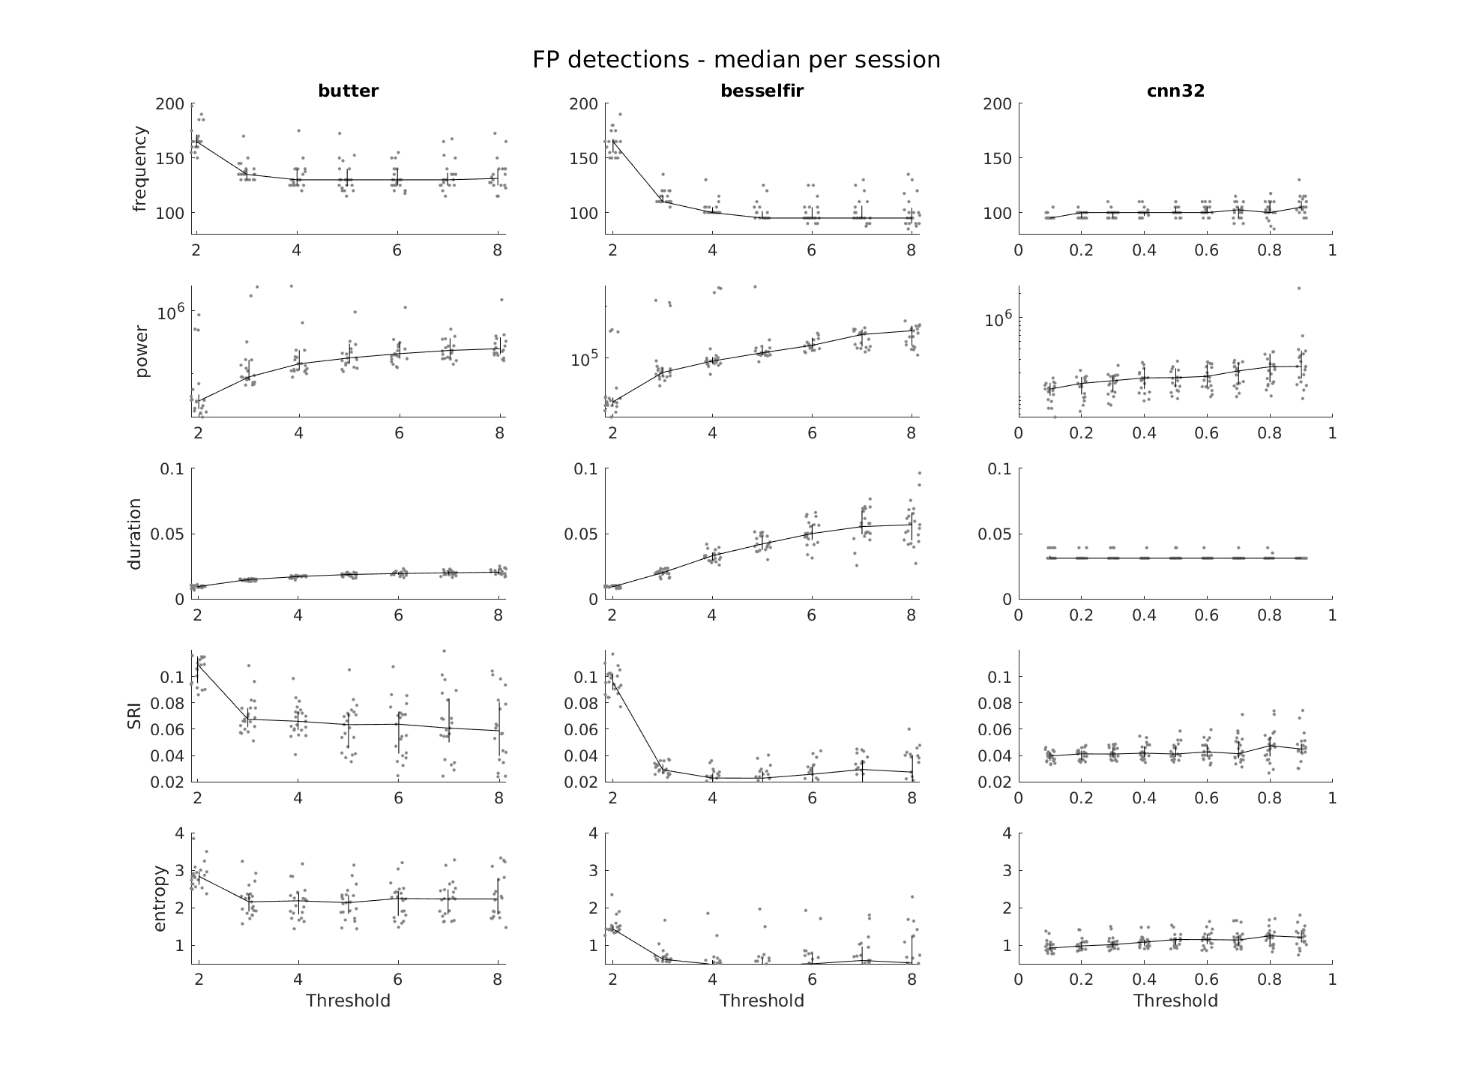

Slide 23
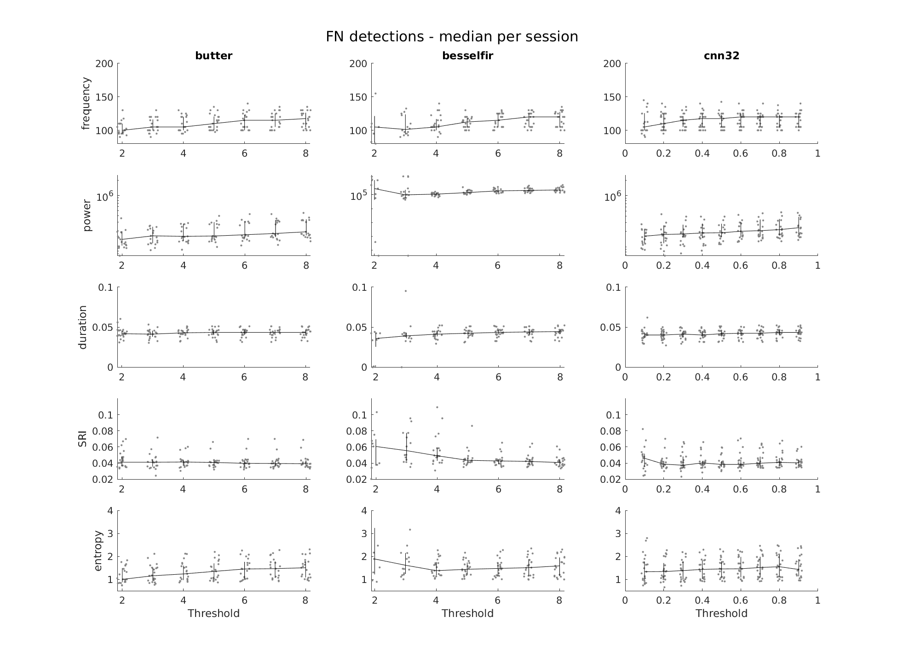

Slide 24
