Slide 1
Compare properties of detected ripples depending on the threshold
21 sessions

Slide 2
Mean value of properties per session

Slide 3
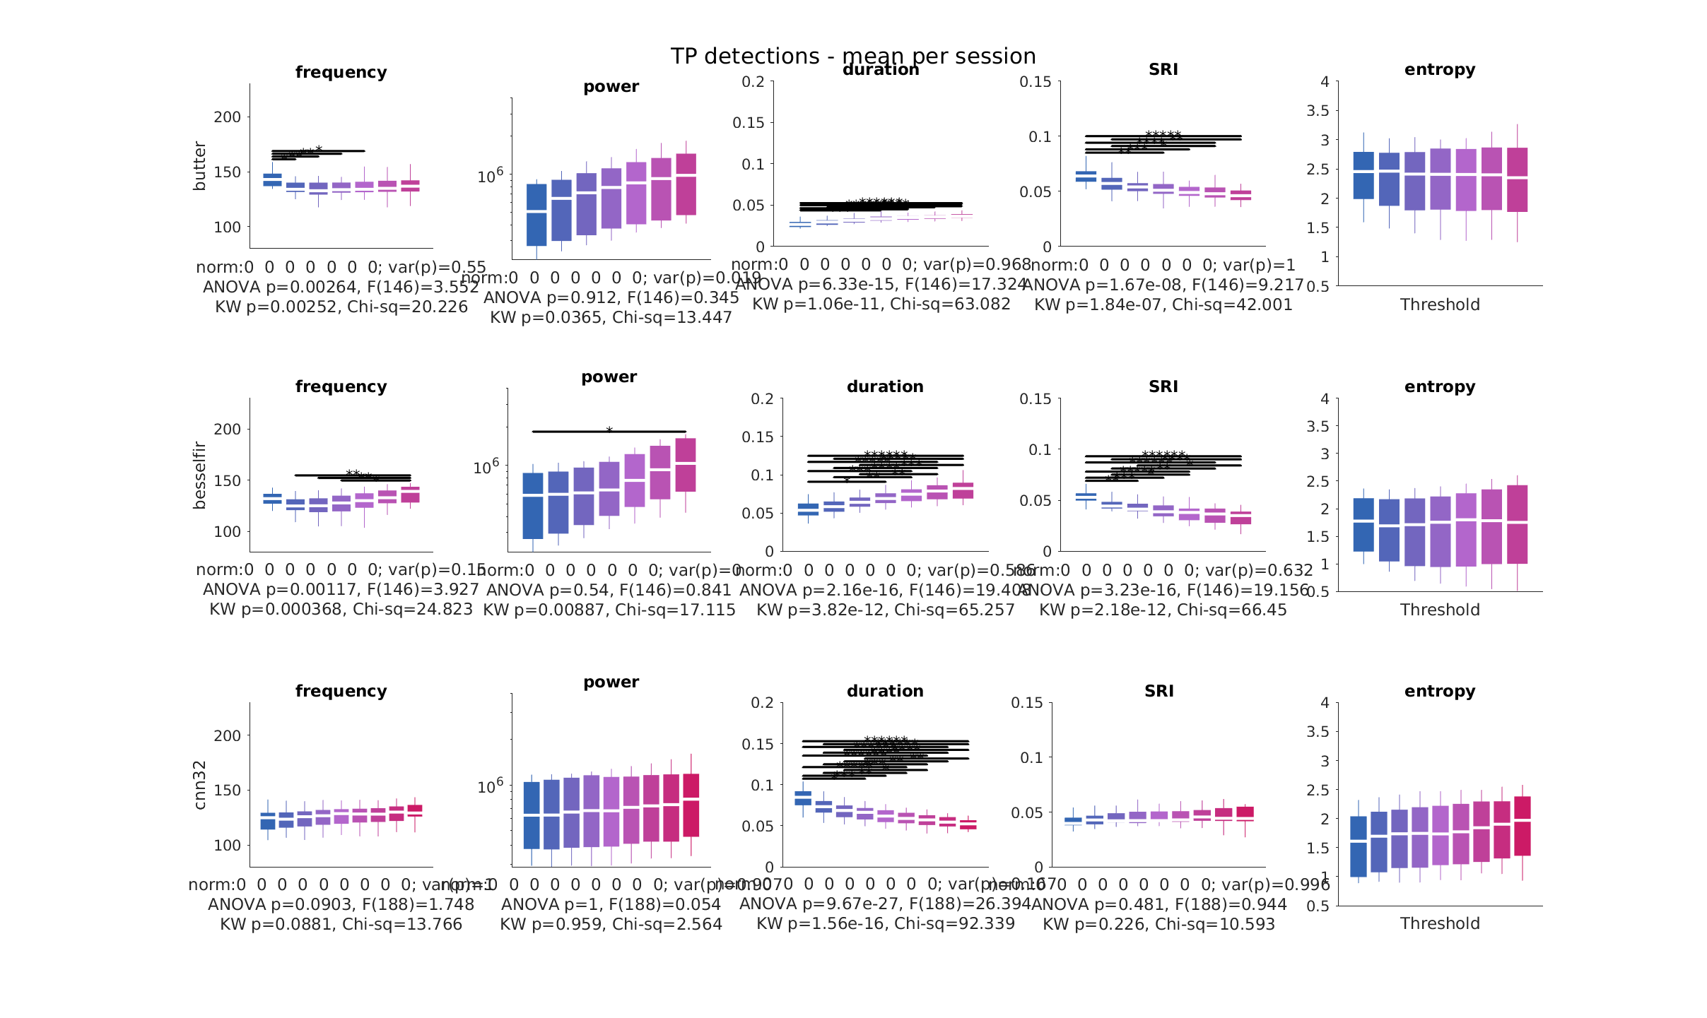

Slide 4
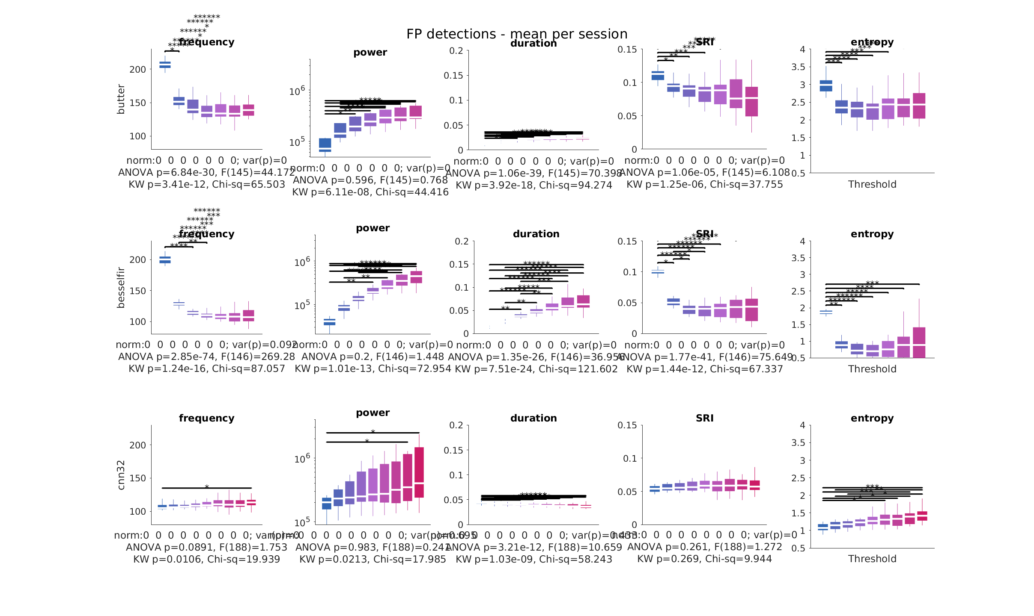

Slide 5
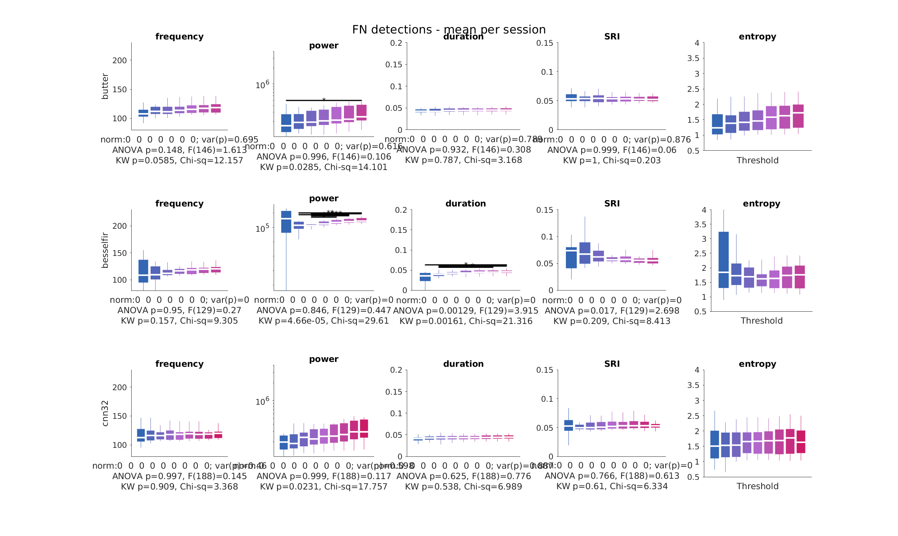

Slide 6
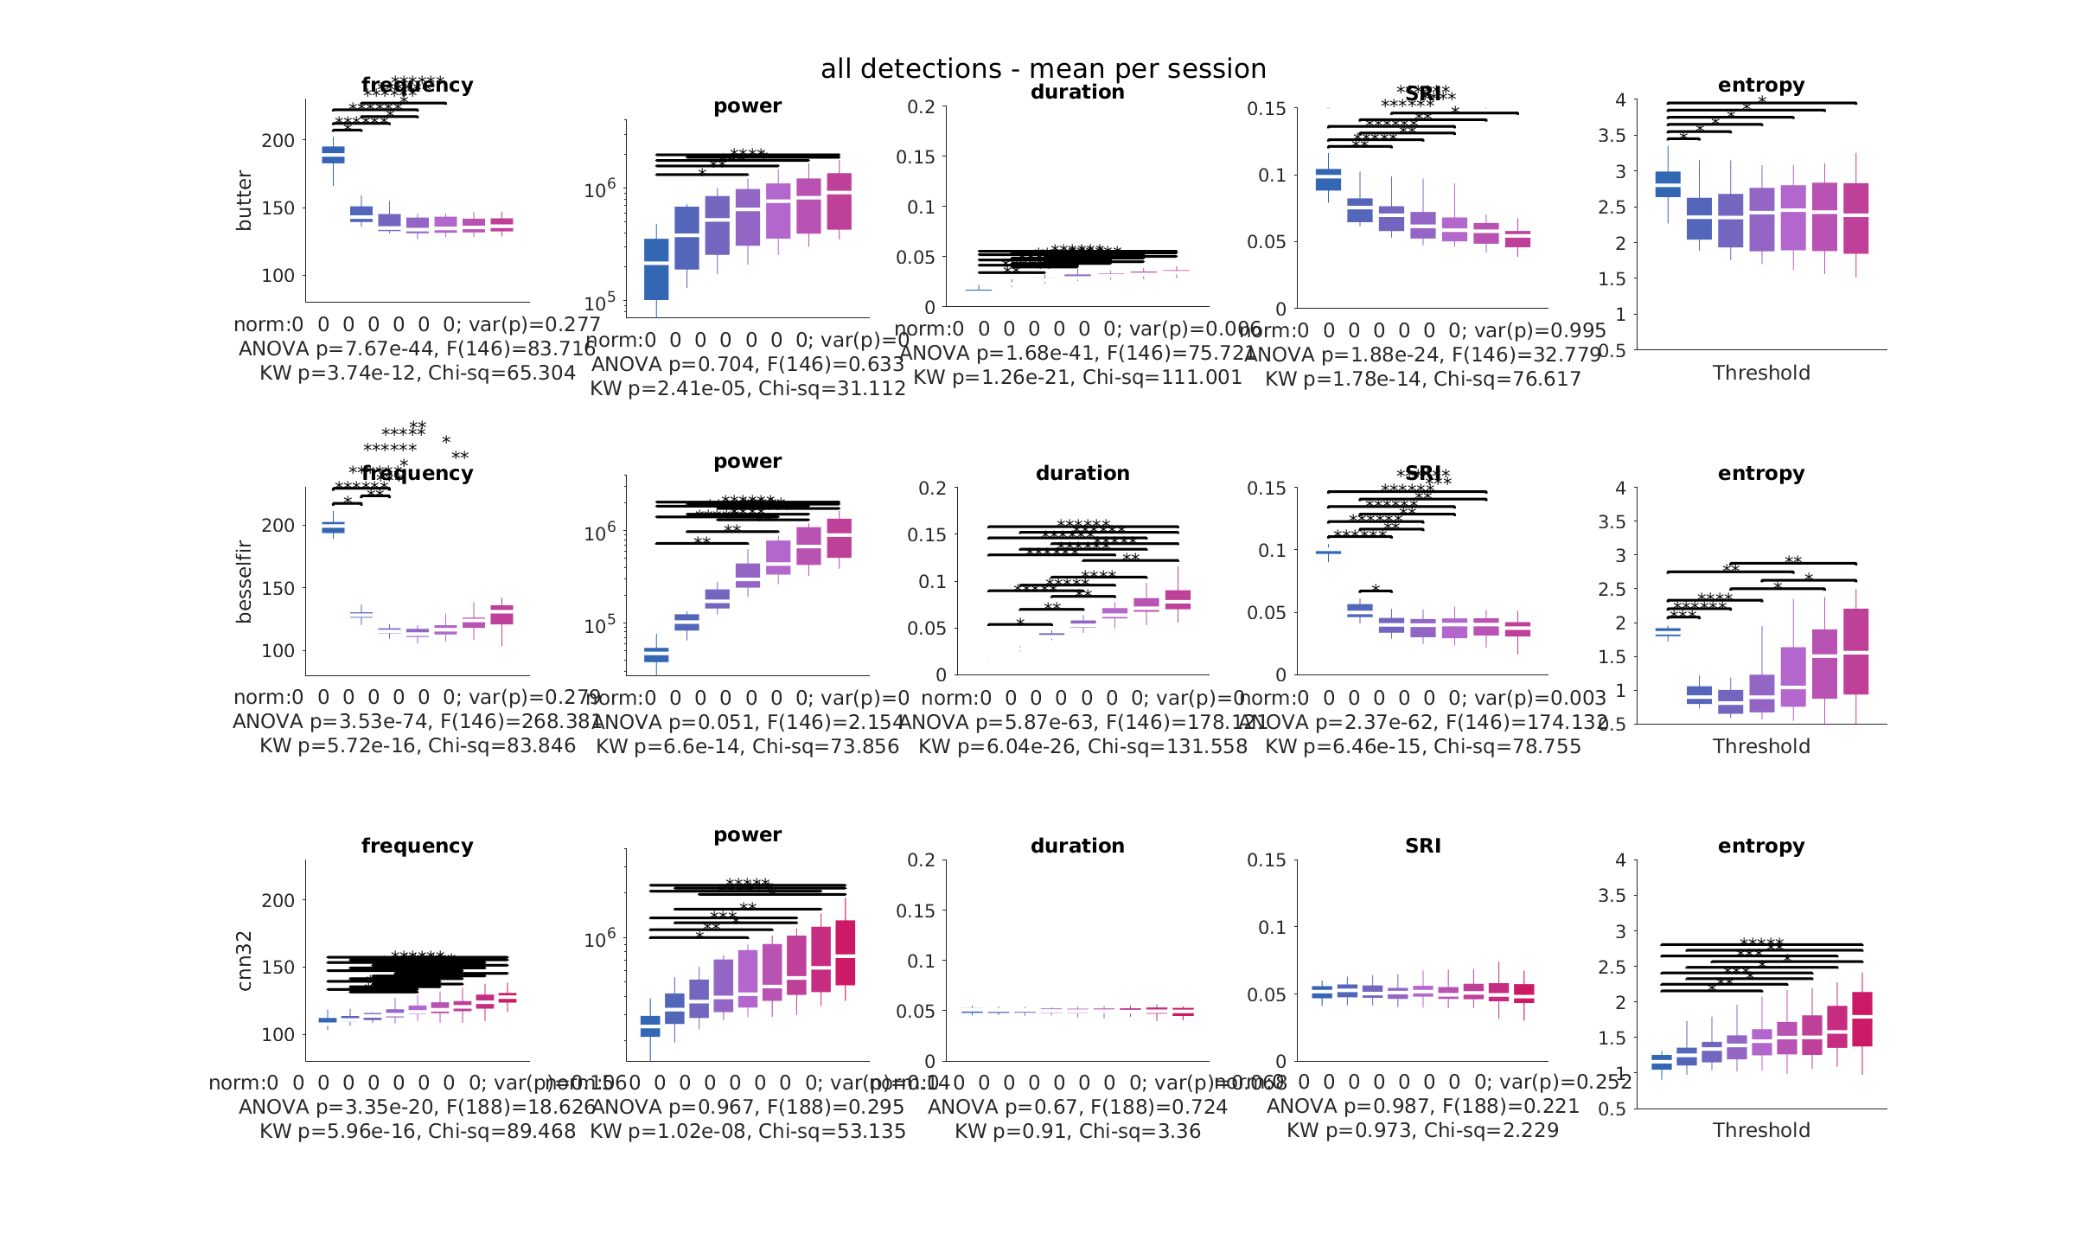

Slide 7
All thresholds together

Slide 8

butter
bessel
cnn32

Slide 9


Slide 10


Slide 11


Slide 12
Good thresholds together
Filters: 4 to 6 SD
CNN: 0.6 to 0.8

Slide 13


Slide 14


Slide 15


Slide 16


Slide 17
Median value of properties per session

Slide 18
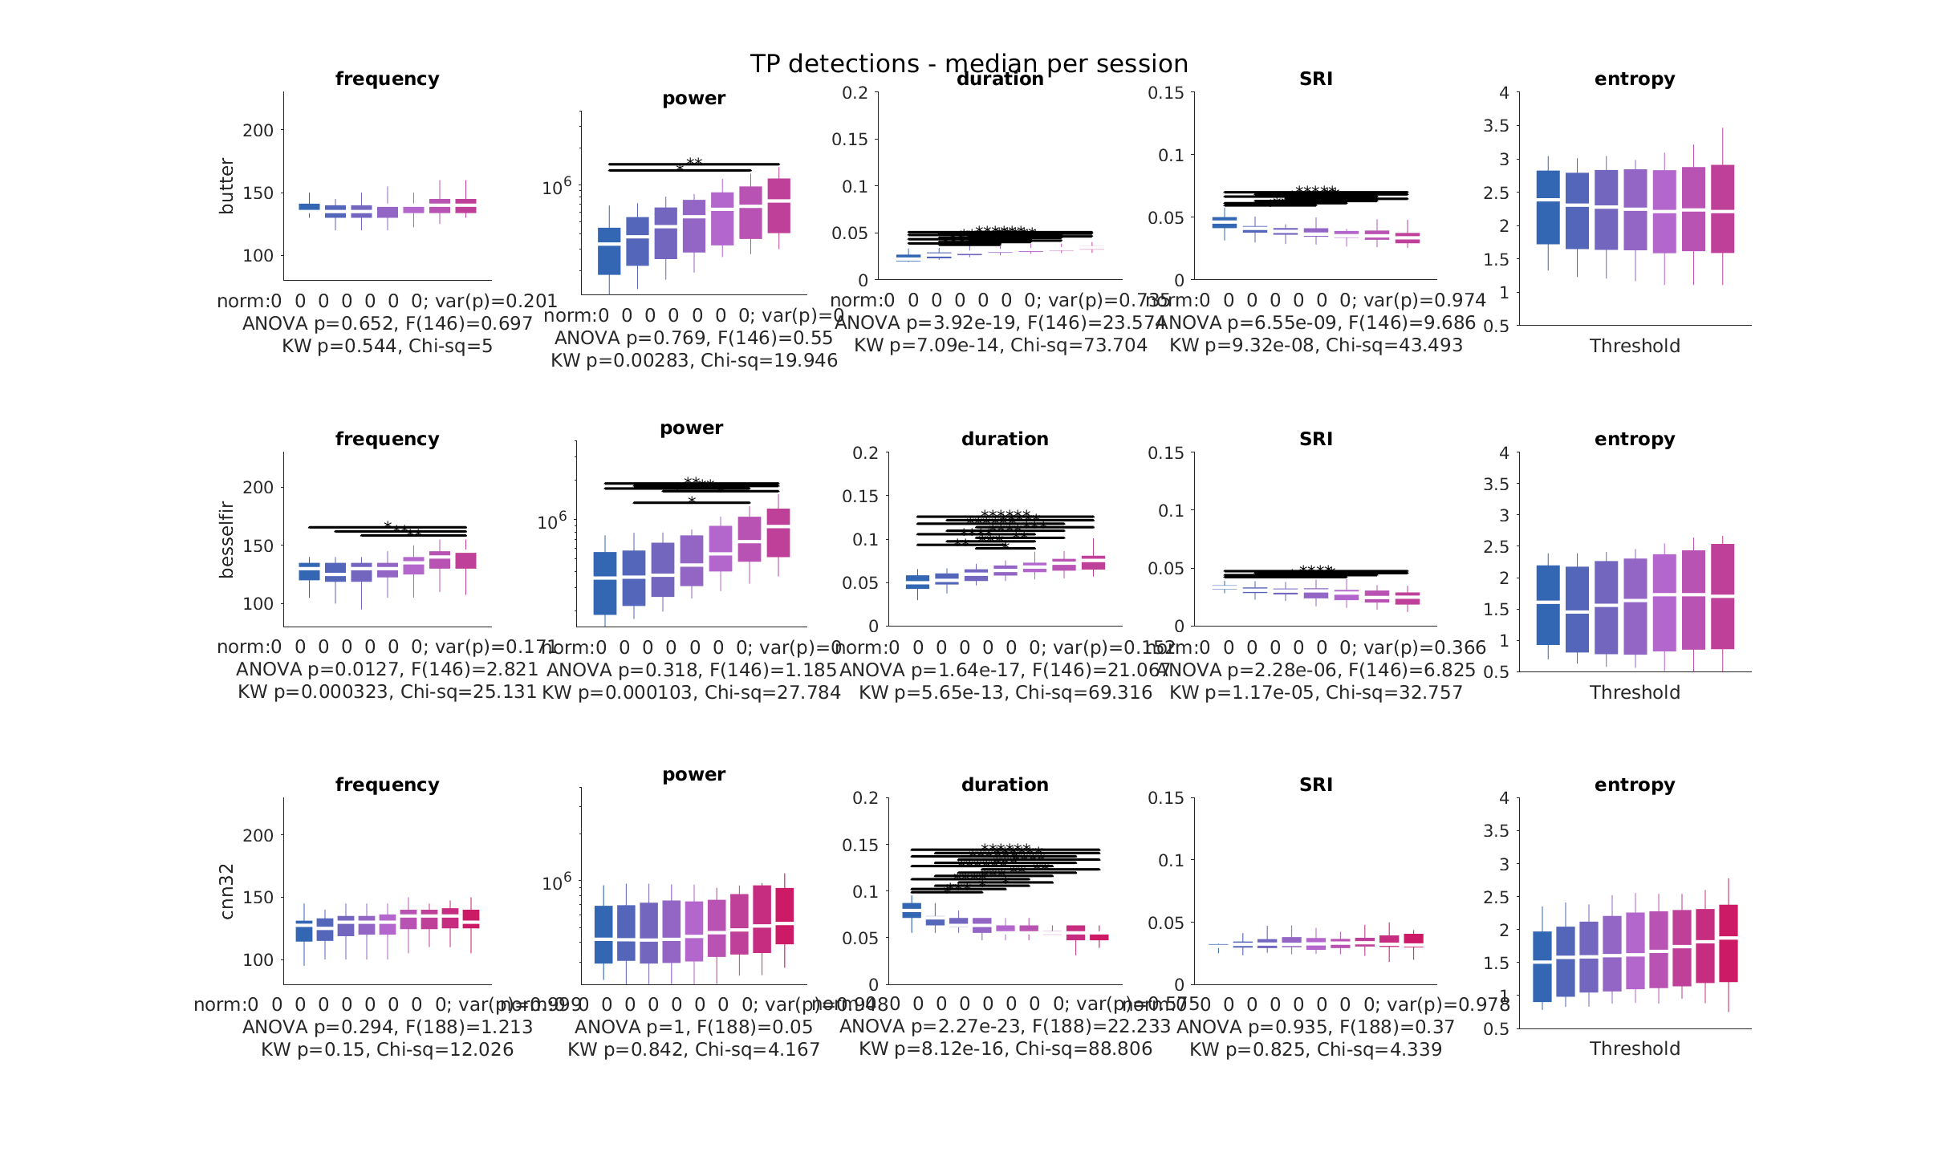

Slide 19
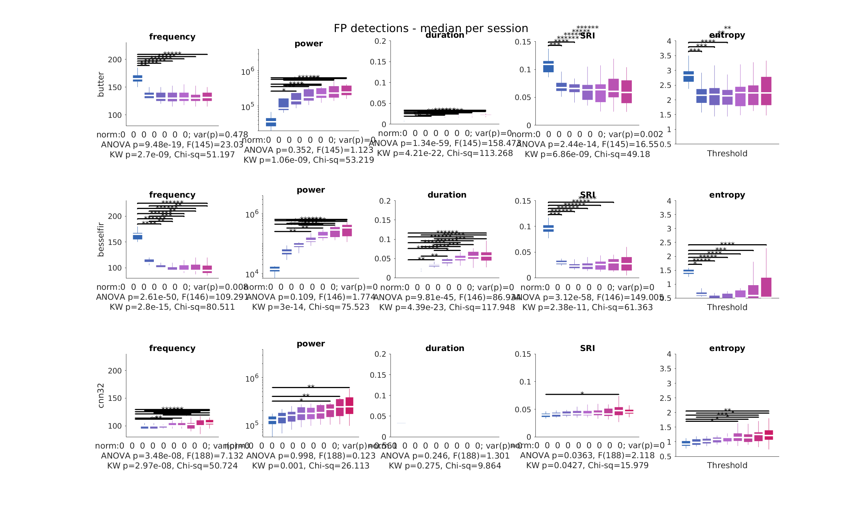

Slide 20
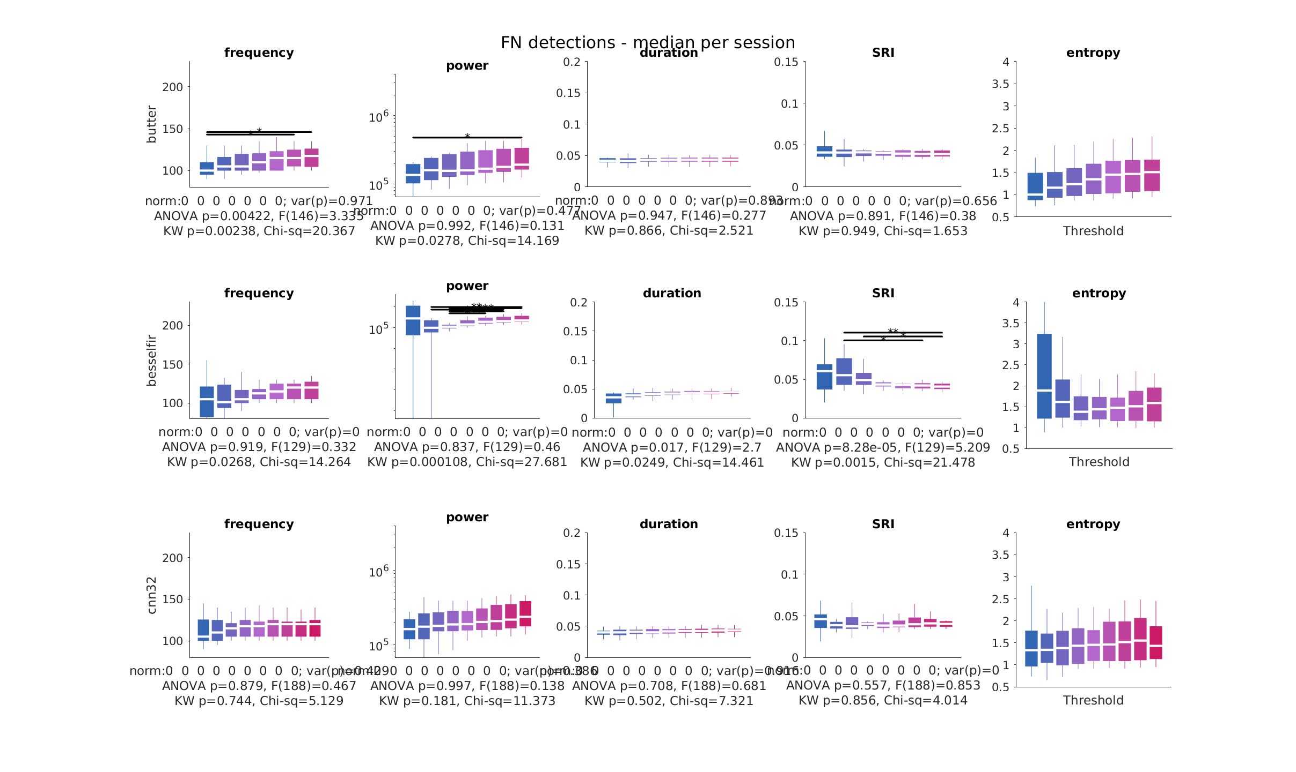

Slide 21
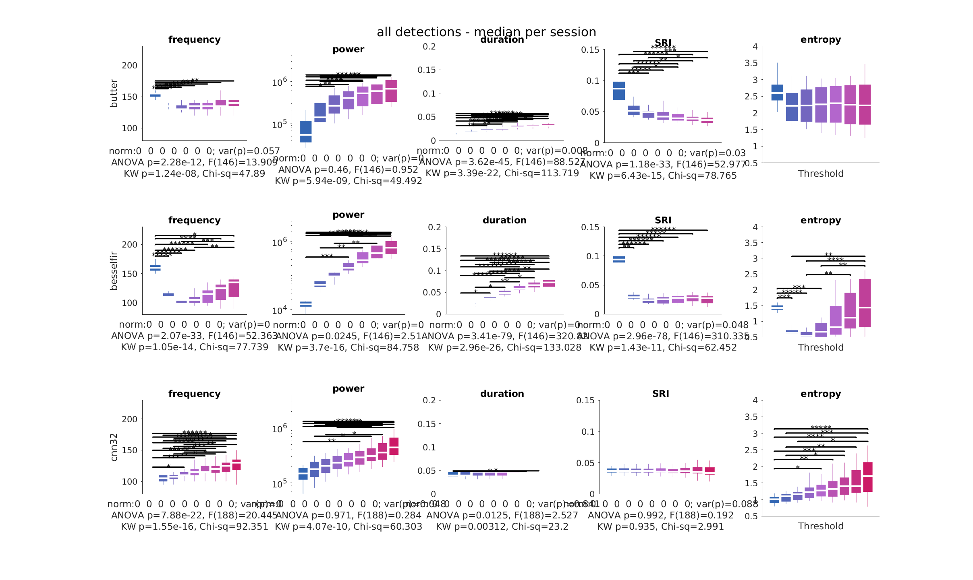

Slide 22
All thresholds together

Slide 23

butter
bessel
cnn32

Slide 24


Slide 25


Slide 26


Slide 27
Good thresholds together
Filters: 4 to 6 SD
CNN: 0.6 to 0.8

Slide 28


Slide 29


Slide 30


Slide 31


