Slide 1

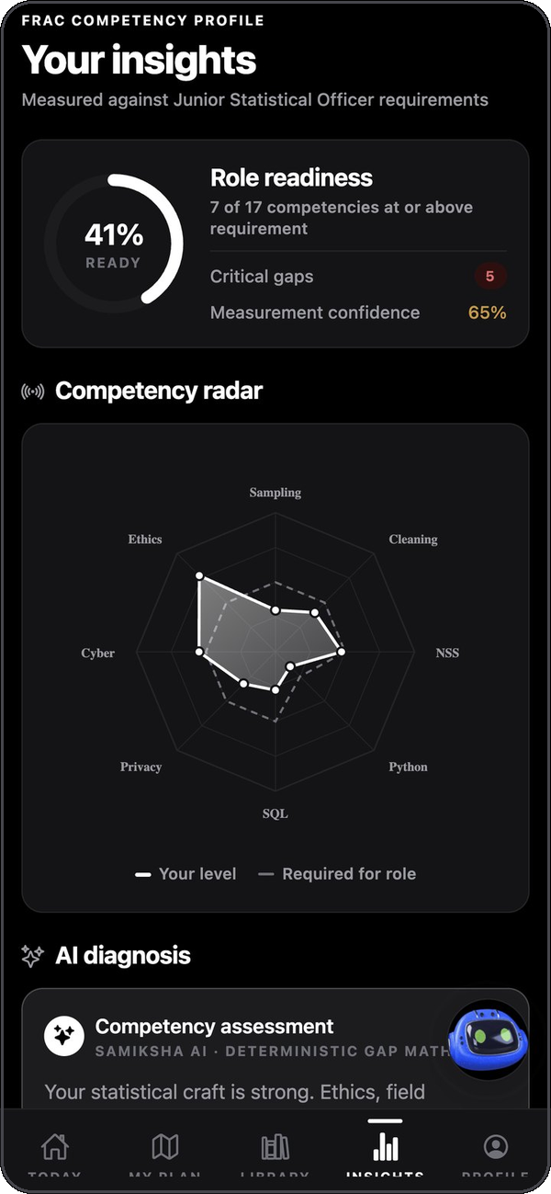

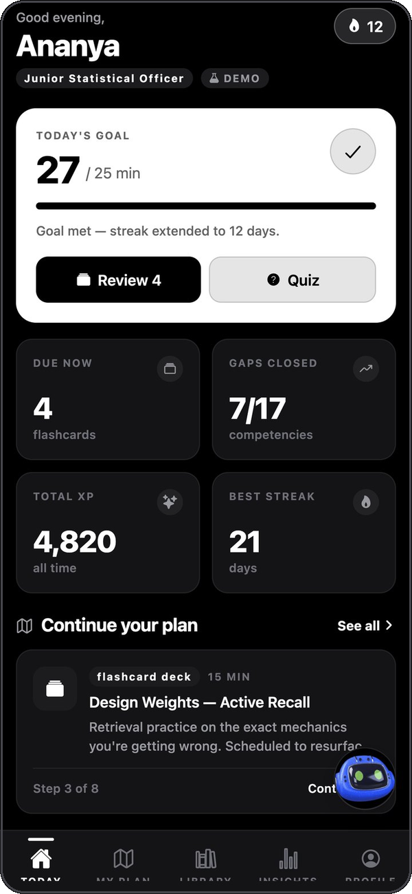
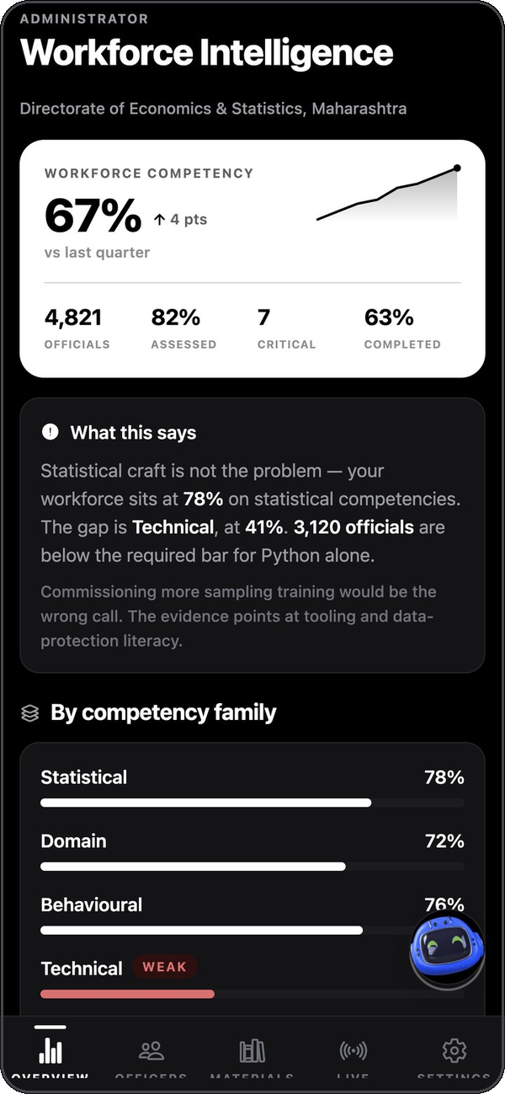
SMART INDIA HACKATHON 2026 · SIH26101 · MoSPI
Samiksha
AI-enabled capacity building for India's Official Statistical System
Measures every officer against the FRAC competencies their post requires, closes the gaps through iGOT Karmayogi and grounded practice from department material — and gives them AI agents that know where they are weak.
Officer app
Admin app
AI Workspace
Samiksha AI
Notes:
Samiksha — "review" or "assessment" in Hindi — answers SIH26101 from MoSPI.
In one sentence: it finds each statistical officer's competency gaps against their post, teaches exactly what is missing using iGOT Karmayogi courses and quizzes generated from department material, and gives them AI agents for repetitive analytical work — while recording what they delegate as evidence about their skills.
Deliverables: Officer and Administrator Android apps, two no-account demo apps, a Windows AI Workspace, and a secured Supabase backend. Everything shown is running software; screenshots are from the live app.

Slide 2






THE PROBLEM
Capacity building that cannot see the gap
SIH26101 · MoSPI
Skills are shifting
Gaps are self-reported
“Develop an AI enabled learning platform that identifies competency gaps, recommends personalized training through integration with the iGOT Karmayogi ecosystem, and capable of generating Quizzes and MCQs from uploaded learning materials to strengthen capacity building in India's Official Statistical System.”
Python, SQL, GIS and the DPDP Act are now expected alongside sampling and estimation.
Nominations and forms — and people systematically misjudge their own skill.
Training is generic
MCQs are hand-written
Large catalogues, but no order and no link to an individual's gap.
Few assessments exist; handbooks and circulars are read once and forgotten.
No workforce view
AI does work, not learning
Enrolment counts, not where a directorate is collectively weak.
Productivity rises while capability — and dependency — stay invisible.
Thousands of officers across MoSPI, NSO, NSSTA and every state DES produce the figures behind budgets, monetary policy and welfare.
The statement hides two AI engines × two audiences — most solutions build only half.
Samiksha · SIH26101
02
Notes:
The statement bundles two AI engines — skill intelligence (profile → gaps → iGOT recommendations) and an assessment engine (uploads → MCQs) — and two audiences, learners and administrators. A quiz generator or a dashboard alone answers a quarter of it.
Key pain points: skills needed are shifting to technical and digital governance; gap identification relies on self-report; recommendations are generic and ignore prerequisites; assessments are costly to author; administrators cannot see where the workforce is weak; and AI tools, where used, raise output without raising capability.
Design requirements we derived: defensible (explainable from evidence), honest about uncertainty, grounded, private by construction, provisioned accounts only, people decide, affordable and sovereign, works on Android in the field.

Slide 3




THE SOLUTION
Two halves that feed each other — the loop is the point
LEARN · MOBILE APP
THE COMPETENCY LOOP
DO · AI WORKSPACE
Measure & teach
Delegate & do
Measured gaps → agent prompt
Role → FRAC competency requirements
Adaptive test & quizzes → evidence
SQL gap arithmetic with confidence
Prerequisite-aware plan via iGOT Karmayogi
Quizzes, flashcards, mock tests from material
Misconceptions, calibration, AI tutor
Data Quality · Data Analyst · Report Assistant
Own computer: browser, terminal, files, desktop
Same sign-in as the mobile app
Told the officer's gaps before every run
Explains the step that matters
Every run ends at a draft — people decide
“You delegated 23 Python tasks this month — closing this gap gives that work back.”
Delegations by competency → evidence
Samiksha
Samiksha Admin
Demo apps
Samiksha Workspace
Officer app · Android
Administrator app · Android
Both journeys, no account
AI agents · Windows
Principles Evidence over opinion · Deterministic core, AI at the edges · Agents draft, people decide · One identity everywhere
Samiksha · SIH26101
03
Notes:
Learning measures each officer against their post's FRAC requirements and teaches what's missing. The Workspace gives them AI agents for repetitive analysis. The loop joins them in both directions: agents are told where the officer is weak and explain the step that matters, and every delegation is recorded against a competency.
Why it matters: an agent that just does the work makes the platform better at the officer's job and worse at its purpose. Repeated delegation of work the officer can't yet do is stronger evidence of a gap than any test score — it is the gap costing autonomy every week.
Four products from one platform: Officer app, Admin app, two demo apps for evaluation without accounts, and the Windows Workspace. Supabase is the single source of identity: the same credentials open phone and desktop.

Slide 4
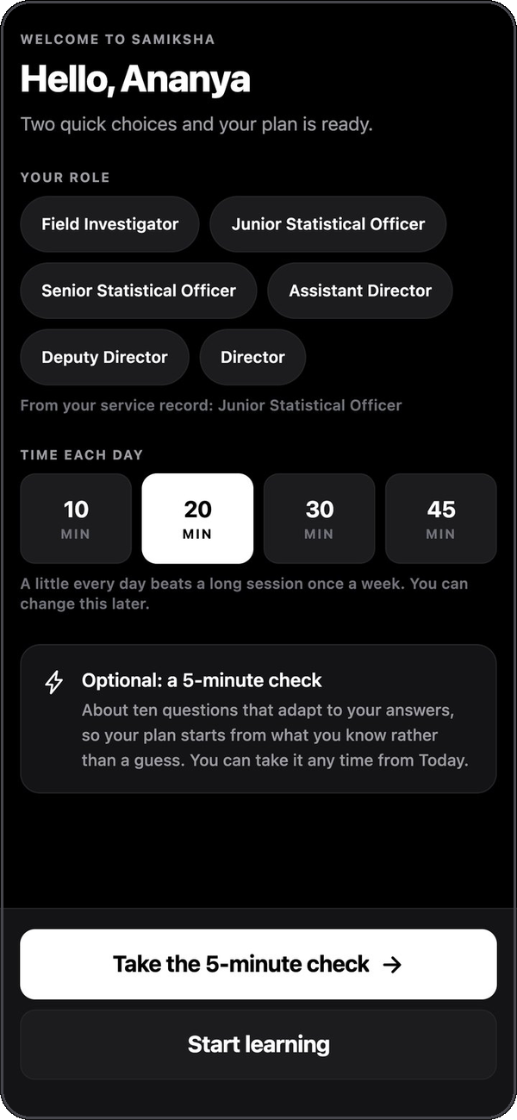
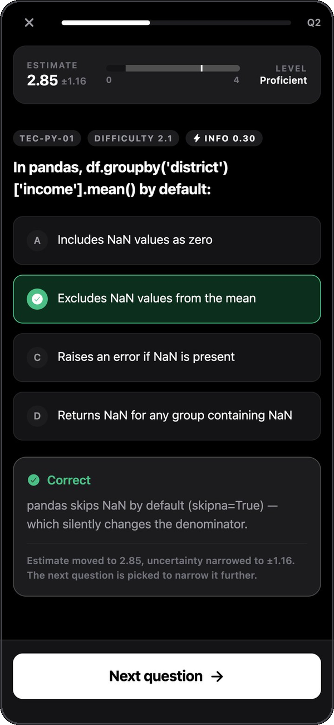
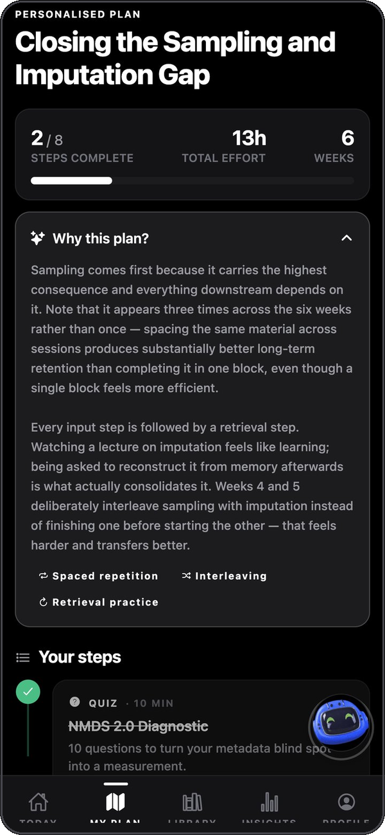
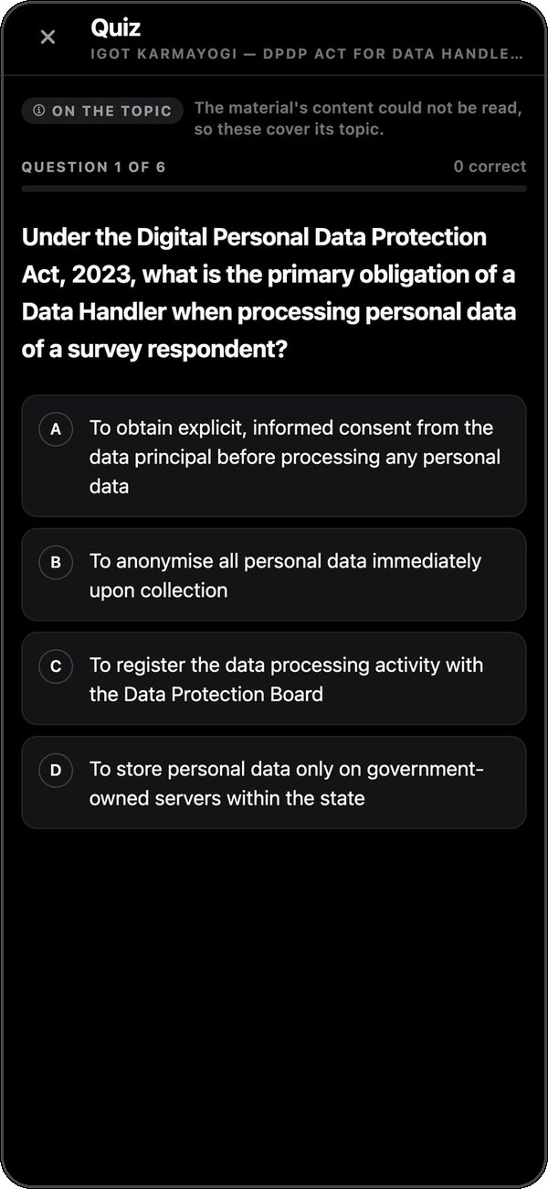

HOW IT WORKS · THE OFFICER
Measured, planned, practised — in minutes a day
1 Two-tap onboarding
2 Adaptive diagnostic
3 Competency profile
4 Personalised plan
5 Practise on material
Account provisioned against an employee ID; confirm role & daily goal.
IRT picks the most informative question; uncertainty band narrows live.
Readiness, radar vs role requirement, AI diagnosis, misconceptions.
iGOT courses sequenced by prerequisites, each step with its reason.
Quiz, flashcards or mock test written from department material.
Samiksha · SIH26101
04
Notes:
Walk through Ananya Deshmukh, Junior Statistical Officer, DES Maharashtra.
1. Onboarding is one screen: an administrator already provisioned her account with department and service years. She confirms her post and daily minutes. Self-rating was removed — it's the least reliable evidence.
2. The adaptive test uses 2-parameter Item Response Theory: each item maximises information at her current ability estimate; the band (e.g. 2.85 ± 1.16) narrows; it stops when precise — typically 8–13 questions, about half a fixed test.
3. Insights: 41% role readiness, 5 critical gaps, 65% measurement confidence. Radar across all four families, AI diagnosis explaining the SQL-computed gaps, "What you believe instead" misconceptions, and "What you can learn next" — the prerequisite-ready frontier.
4. My Plan: 6-week plan built from iGOT/NSSTA courses, videos, quizzes, flashcard decks and reflection — spaced, interleaved, retrieval after every input, never out of prerequisite order.
5. Library: department material becomes a quiz, flashcards or 15-question timed mock test; the screen discloses whether questions come from the document itself or only a video description.
Also: FSRS-6 spaced review with interval previews, confidence-rated quizzes with calibration, Samiksha AI tutor behind the mascot.

Slide 5
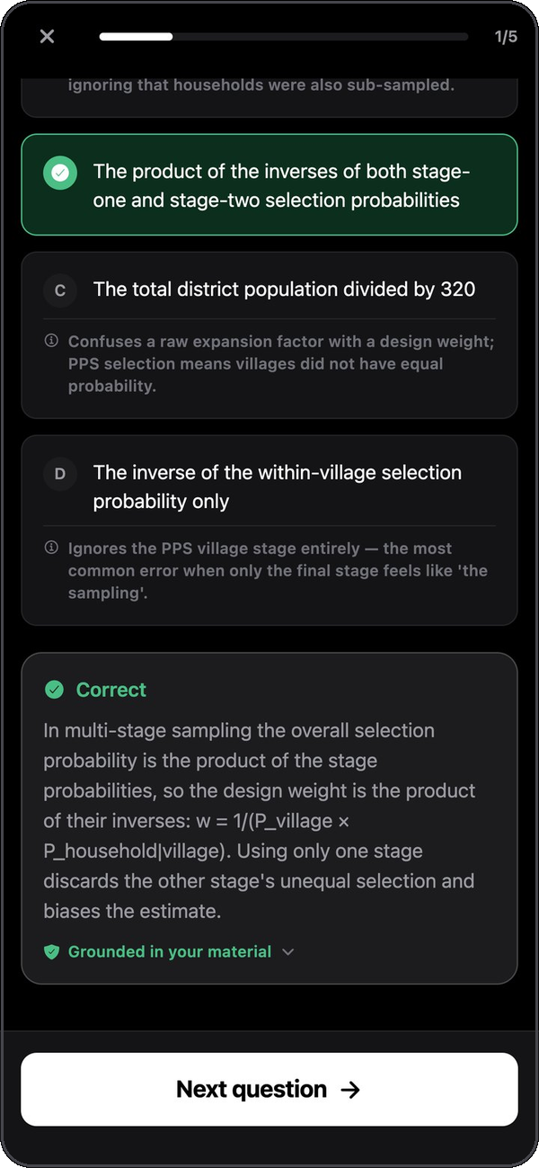
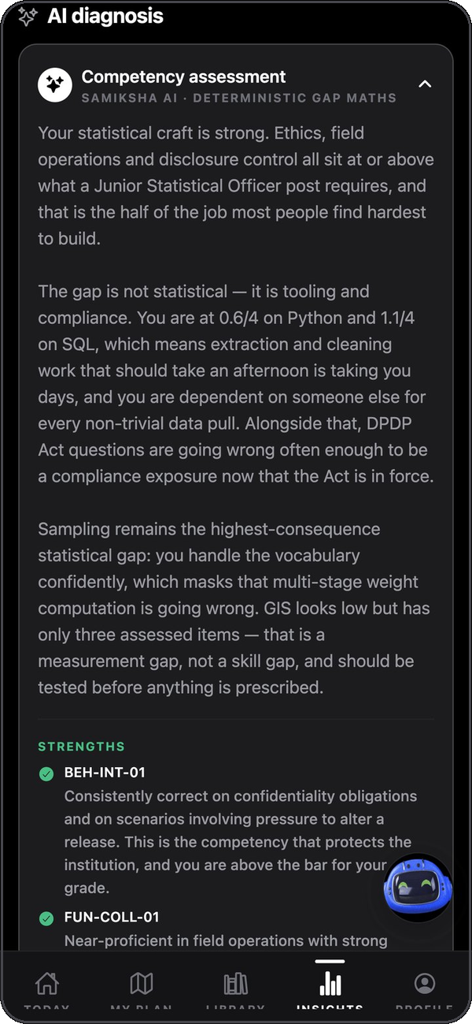

ASSESSMENT & GAP ENGINES
Trustworthy by construction: the maths is not the model's
Gap analysis is SQL — AI only explains it
priority = max(0, required − score) × weight × criticality × (0.5 + 0.5·confidence)
Reproducible and auditable. Low confidence means “assess first”, not “train” — no budget spent on unmeasured skills.
Grounded MCQs from any upload
Upload
Extract text
Chunk + embed
Strict JSON
Verify quote
Page-cited
Every question quotes its source verbatim; the quote is checked in the document and mapped to a page or slide. Each distractor names the misconception it encodes.
IRT adaptive test
FSRS-6 review
Prerequisite graph
≈ half the questions
matches reference intervals
learnable next, not biggest gap
Misconception tracking
Confidence calibration
Bloom spread
which wrong answer, not just wrong
overconfidence named
apply · analyse · evaluate
Feedback: rationale & source
AI diagnosis of computed gaps
Samiksha · SIH26101
05
Notes:
Judges often ask "isn't the gap just the AI's opinion?" No — recompute_competency_gaps() is a SQL function. Two officers with identical records get identical gaps. The model writes the explanation.
Scores update with each answer using a decaying learning rate; confidence = n/(n+8). Low-confidence gaps are damped, so the system says "assess this" rather than "train this".
Hallucination control is mechanical: strict JSON schema (shape guaranteed), verbatim quote verification with normalisation and fuzzy fallback, structural checks, page/slide citation, grounding rate reported. Difficulty recalibrates from real responses.
Learning science: 2PL IRT adaptive testing (θ on the 0–4 proficiency scale, max-information item selection, Newton–Raphson update, precision stop); FSRS-6 verified against the reference implementation interval-for-interval; prerequisite DAG with readiness — rank = priority × (0.25 + 0.75·readiness); distractor-level misconception events; confidence captured before reveal with calibration error; Bloom distribution targeting higher-order thinking.

Slide 6
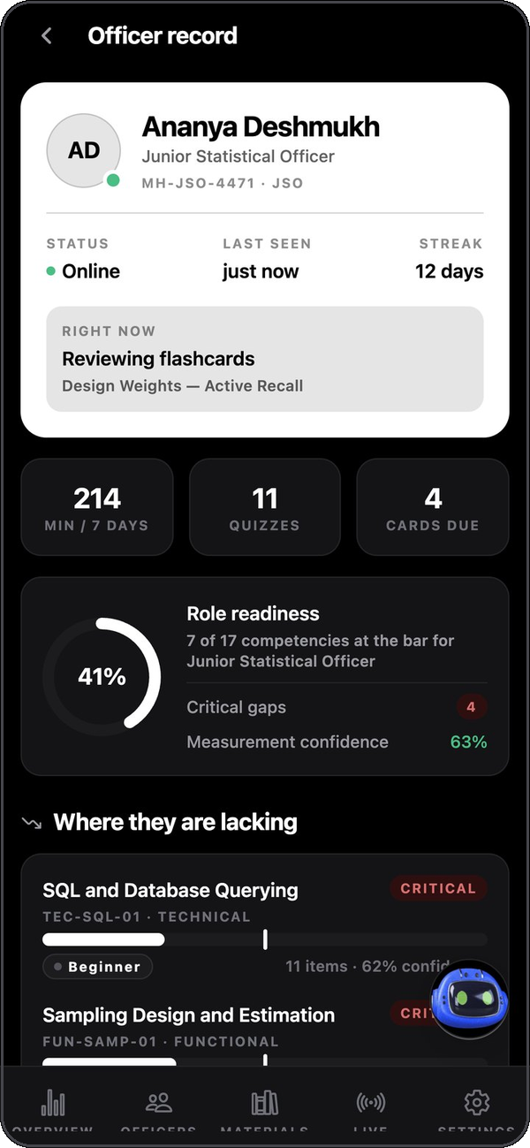
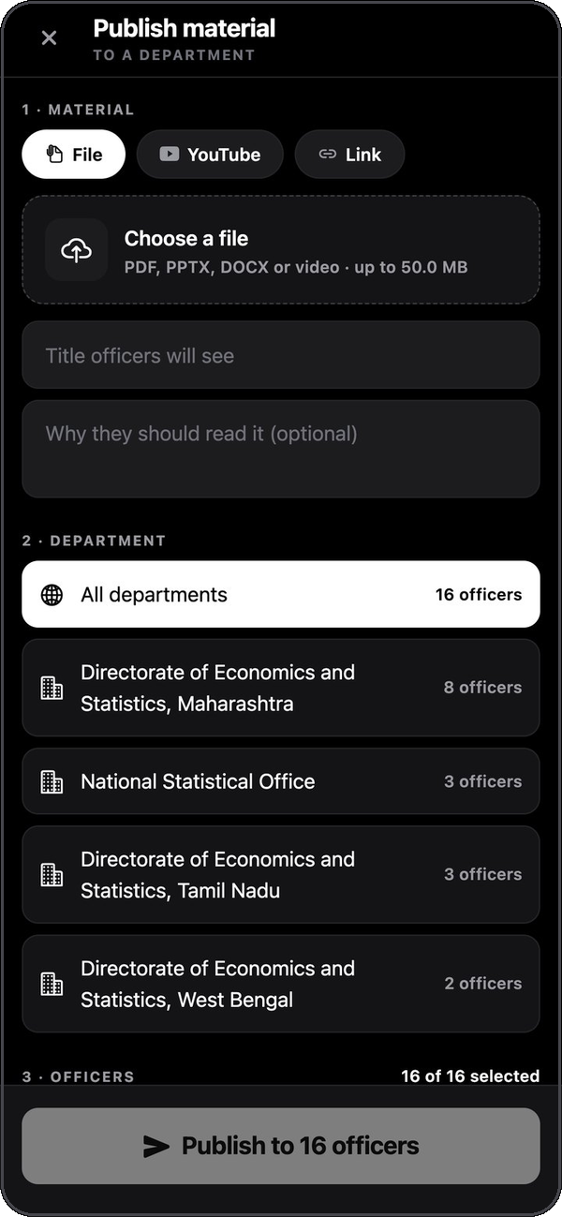
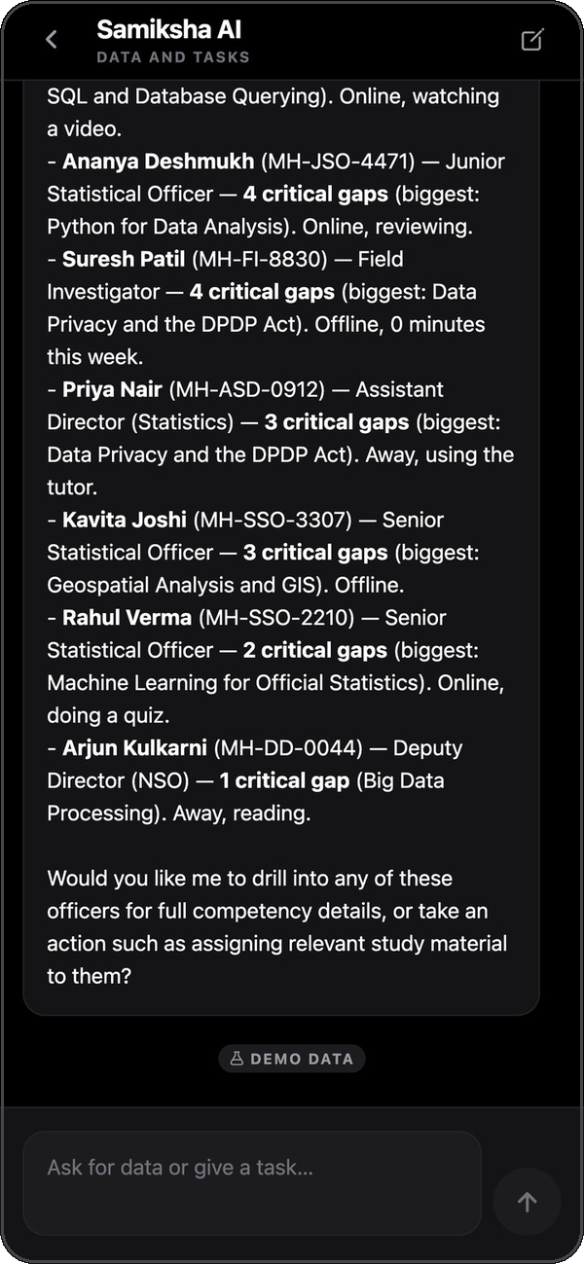



HOW IT WORKS · THE ADMINISTRATOR
See the workforce, not just enrolments
Workforce Intelligence
Where the directorate is weak, how many officials are below the bar, quarterly trend — aggregate by construction.
Roster & officer record
Presence, ranked gaps, repeated misconceptions and the prescribed next step on one screen.
Publish study material
PDF, slides, docs, video or links to a department or named officers; open rates tracked.
Samiksha AI operator
Asks for live data; publishing or account changes come back as actions to confirm.
Provisioned accounts only
Created against verified employee IDs; reset, deactivate, reactivate.
Workforce Intelligence
Officer record
Publish to officers
Samiksha AI · live data
Samiksha · SIH26101
06
Notes:
The administrator app is a separate application, chosen by the server-side role. The Ministry's questions are aggregate: where is the workforce weak, how many officials does it affect, which training should we commission, and is it working?
Dashboard (demo data): workforce competency 67%, +4 points; statistical craft strong at 78% but technical at 41% with 3,120 officials below the bar for Python — so more sampling training would be the wrong purchase.
The underlying view groups before returning rows; individuals can't be identified from Workforce Intelligence. Staff can open records within their own organisation for training management.
Live board: heartbeat presence with realtime push; 2 min silent = away, 10 = offline, so a phone losing signal can't stay "online".
Publishing: per-officer assignment so exceptions (officers on deputation) are explicit; the Materials tab shows recipients and how many opened it.
Samiksha AI operator: 6 read tools (overview, departments, officers, officer detail, gap summary, materials) and 5 action tools (publish link, assign material, create officer, activate/deactivate, reset password). Actions return a proposed-action card and run only on confirmation.

Slide 7
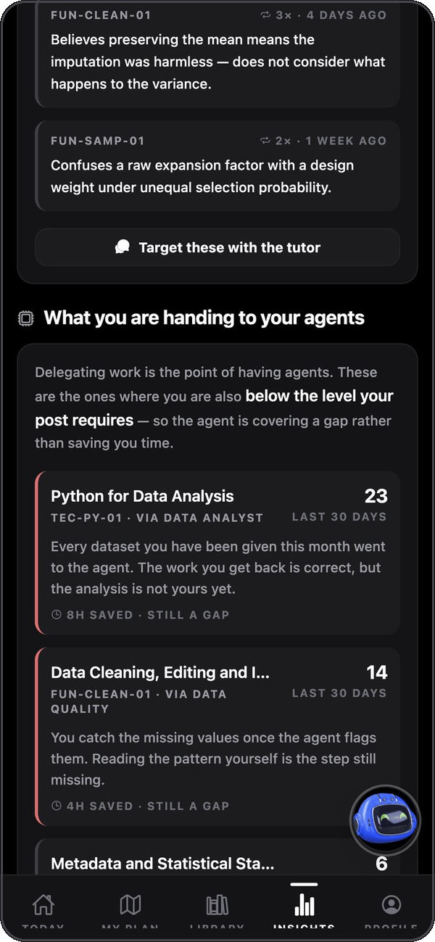

THE AI WORKSPACE
Delegation becomes evidence about competency
Data Quality
Data Analyst
Report Assistant
FUN-CLEAN-01 · FUN-QUAL-01
TEC-PY-01 · FUN-ANAL-01 · FUN-SAMP-01 · TEC-SQL-01
FUN-META-01 · FUN-DISS-01 · BEH-COM-01
Missing-data patterns, duplicates, units, implausible values. Proposes fixes — never repairs silently.
Applies design weights, computes indicators and tables; asks before assuming SRS.
Drafts against approved templates; every figure traceable; never sends onward.
EVERY RUN
1
2
3
4
Same sign-in
Gaps loaded
Work + teaching
Delegation logged
Credentials proved against Supabase; one user ID
Post, gaps & strengths into the system prompt
Explains the step where the officer is weak
Run recorded against the agent's competency
v_officer_dependency joins delegation volume to the measured gap. Delegating what you can already do scores zero — that is good delegation. Delegating what your post needs you to do is shown to the officer as “What you are handing to your agents”.
Samiksha · SIH26101
07
Notes:
The Workspace is a multi-service app (web, API, worker, sandbox supervisor, Electron desktop) where each officer has persistent agents with memory, routines and their own Linux computer — browser, terminal, files, desktop — in a Docker container.
No onboarding: the three starter agents are provisioned server-side at first sign-in, each mapped to FRAC competencies. Every instruction ends at a draft, because official statistics are published under a person's name.
Identity bridge: every Workspace sign-in is proved against Supabase first, and the local row reconciled; the Supabase user ID is reused, so an admin's password reset or deactivation on the phone takes effect on the next desktop sign-in. SIGNUPS_ENABLED=false.
Half one of the loop: before each run the officer's post, top gaps and strengths are read (best-effort, cached 5 minutes — a reporting lookup must never fail a run) and put into the system prompt.
Half two: completing a run writes agent_delegations. The officer sees e.g. "Python for Data Analysis — 23 tasks in 30 days via Data Analyst, 8h saved, still a gap." Verified against live data: a real officer's twelve gaps rendered into the agent prompt.

Slide 8


ARCHITECTURE & SECURITY
One source of truth, no secrets on the device
Samiksha mobile app
Samiksha Workspace
Security & governance
React Native 0.86 · Expo 57 · TypeScript
Officer · Admin · 2 demo variants · web build
Electron · React 19 · API · worker
Sandbox supervisor · agent computers (Docker)
Only the public anon key ships in the APK
JWT · RLS
sign-in · gaps · delegations
server secrets in Vault; env sync refuses leaks
SUPABASE · SINGLE SOURCE OF TRUTH
Row Level Security on all 42 tables
deny-by-default, 75 explicit policies
Auth · Storage
Postgres + pgvector
Edge Functions
No self-registration
Provisioned accounts
Private materials bucket
Realtime presence
42 tables · 75 RLS policies
Gap, ZPD, IRT in SQL
Vault secrets
10 functions: assistant, study,
quiz, material, tutor, path,
diagnose, cards, videos, users
accounts tied to verified employee IDs
Aggregate-only workforce views
individuals not identifiable
Agents draft, people decide
AI actions need confirmation
YouTube Data API
iGOT Karmayogi
Samiksha AI engine
Every AI call audited
tokens, cost, latency, outcome
Metadata + official player
Real API contract · simulator ⇄ live
DeepSeek V4 Flash · open-weight · local option
DPDP-ready sovereignty path
open-weight model can run on-prem
Samiksha · SIH26101
08
Notes:
Three deployable parts in one repository: mobile/ (Expo), workspace/ (pnpm monorepo), supabase/ (15 migrations, 10 Edge Functions).
The APK is decompilable, so it holds only the public URL and anon key. Row Level Security is the real boundary. scripts/sync-env.mjs refuses to sync if a server secret carries the EXPO_PUBLIC_ prefix. The model key lives in Supabase Vault, readable only by the service role — rotated with one SQL statement.
Database hardening: auth.uid() wrapped in a select so it evaluates once per statement; security-invoker functions with empty search_path; EXECUTE revoked from anon/public; admin views aggregate before returning rows.
Edge Functions: assistant (Samiksha AI), study (practice), process-material, generate-quiz, generate-flashcards, diagnose-competency, generate-path, tutor (RAG), curate-videos, admin-users (verifies admin role from DB before touching input).
Embeddings: gte-small (384-d) built into the edge runtime — no third-party embedding API. Retrieval via pgvector.
Operations: node scripts/start.mjs brings everything up — finds the LAN address and writes it everywhere it must agree, generates secrets, checks the model server. Release pipeline builds four signed APKs and the Windows installer on every tag.

Slide 9





AI MODEL CHOICE
Why DeepSeek V4 Flash: open weights, built to be fine-tuned
Easy to fine-tune
Sovereign hosting
FINE-TUNING ROADMAP
The training data is already being collected
Open weights under a permissive licence — LoRA / QLoRA adapters on MoSPI & NSSTA manuals, SQAF, NMDS and trainer-approved questions. Closed API models can't be adapted this way.
The same model, base or fine-tuned, can run on NIC / MeghRaj infrastructure — officer data never leaves India (DPDP Act, 2023).
1
Collect
Audit log · grounded questions · misconceptions · edits
~1M-token context
Cost at workforce scale
2
Adapt
LoRA on the public MoSPI / NSSTA corpus
A whole 150-page handbook in one call — no chunk-stitching, no contradictory questions across chunks.
≈ US$0.09 per million input tokens: a 20-question quiz from a full PDF costs under a cent. Efficient mixture-of-experts design.
3
Supervise
SFT on trainer-approved quizzes, diagnoses, plans
4
Align
Preference tuning from trainer corrections
Strict JSON & tool calling
No lock-in
5
Evaluate
Grounding rate · schema validity · calibrated difficulty
Grammar-constrained output guarantees shape; tools power the administrator operator.
One gateway, one env var. A local model path through Ollama is already proven for offline / on-prem.
6
Deploy
Government cloud, same gateway, zero app changes
Samiksha · SIH26101
09
Notes:
One pinned model everywhere — mobile Edge Functions and Workspace agents. Officers only ever see "Samiksha AI".
Why this model:
• Open weights → easy to fine-tune with parameter-efficient methods on our domain corpus; a closed API model can't be adapted or pinned the same way.
• Sovereignty: can be hosted on NIC / MeghRaj so data stays in India — relevant to the DPDP Act.
• Efficient "Flash" mixture-of-experts: low inference cost and cheap adapter training.
• Very long context: whole handbooks in one call.
• Cost: ~$0.09 per million input tokens — per-officer, on-demand generation is viable for a workforce of tens of thousands.
• Strict JSON schema and tool calling.
• Swappable: MODEL_PRIMARY / PI_DEFAULT_MODEL; local Ollama path proven.
The fine-tuning dataset is a by-product of operation: ai_generations logs every call; questions carry source quotes, grounding flags and observed difficulty; distractor rationales and misconception events; trainer edits become preference data; review_logs enable FSRS weight optimisation.
Safety regardless of model: deterministic maths, strict schemas, mechanical grounding, disclosed sources, hedged and retried calls, audit, confirm-before-act.
If asked about scanned PDFs: pages with implausibly little text escalate to vision OCR when a vision model is configured, otherwise rejected with a clear message — never silently indexed as empty.

Slide 10
DELIVERED · IMPACT · NEXT
Running today, honest about what comes next
39
6
42
10
5
FRAC competencies
across 4 families
posts, Field Investigator
to Director
tables under
Row Level Security
server-side AI &
admin functions
installable apps
per release
Built & verified
Stated plainly
Roadmap
Identity bridge — one login, phone & desktop
IGOT
Pilot
Competency loop in both directions
Real contract, simulator → go live
One state DES · live iGOT · trainer review of questions
Adaptive assessment · FSRS review
FRAC
Grounded quizzes with page citations
Reconstructed → official import
Scale
AI practice from any department material
MODEL
Fine-tuned model on government cloud · languages · offline sync
Samiksha AI for officers & administrators
Base weights → fine-tuned
Ecosystem
Both dashboards · publishing · live presence
LANGUAGE
Karmayogi passbook sync · training-impact evaluation · CPI / ASI / PLFS agent templates
Signed APKs + Windows installer per release
English UI → Hindi & regional
“The measure of success is not how much work the AI does, but how much more capable each officer becomes.”
github.com/adryxportfolio/sih2026
Releases · documentation · source
Samiksha · SIH26101
10
Notes:
What is running today, verified: the Supabase identity bridge; the competency loop in both directions; agent provisioning; adaptive assessment; FSRS review; quiz flow with page citations; AI practice (quiz, flashcards, mock test) from any assigned material; Samiksha AI for officers (tutor) and administrators (operator with confirm-before-act); both dashboards; department publishing; live presence; the release pipeline producing four signed APKs and the Windows installer.
Quality: mobile typecheck clean; workspace checks 20 passing; FSRS-6 identical to reference intervals; IRT parity between app and SQL.
Limitations, stated honestly: iGOT uses a simulator built on Karmayogi's documented production contract (one env var to go live once credentials are issued); the FRAC dictionary is reconstructed from published MoSPI/NSSTA/SQAF/NMDS material; FSRS uses population weights until enough reviews exist; IRT discrimination is held constant; the base model isn't fine-tuned yet; agent computers need Docker on the host; interface is English.
Likely questions: scale (set-based SQL, serverless functions, cached extraction, sub-cent quizzes); poor connectivity (on-device FSRS/IRT, offline demo builds, local model option); privacy (RLS, aggregate views, no secrets in APK, sovereign model path).

