Slide 1

Analysis of Household Spending Priorities from Demographics
Classification-Based Insight from Public Expenditure Data

Slide 2
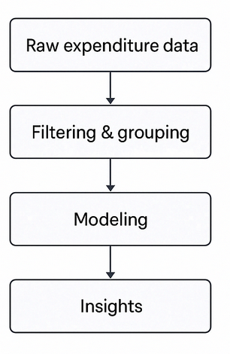
Introduction
Project goal: Predict the dominant spending category for a household group
Question: Can we identify what households prioritize in their spending using only high-level demographic features?
Dataset: Public Canadian household expenditure survey — includes average spending by category across demographic groups (source: Kaggle ^{[1]})
[1] https://www.kaggle.com/datasets/aradhanahirapara/expense-pattern-income-vs-expensefamilyagearea/data
Notes:
Project overview

Slide 3
Approach: From Raw Data to a Structured Classification Problem
Dataset had 15+ fine-grained spending categories
Filtered for valid records (non-aggregate, no missing income)
Grouped similar categories into 5 meaningful macro-groups:
· Housing · Food · Household Goods
· Household Services · Personal & Other
Dominant category: with the highest average expense
Features: Income (numeric), Region, Age Group (one-hot encoded)
Task: Multi-class classification

Slide 4
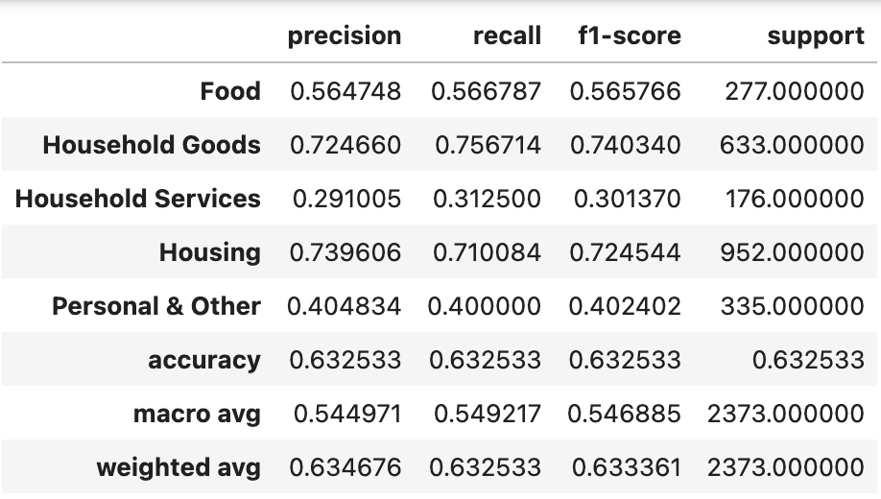
Approach: Model
Model: Random Forest Classifier
Performance: Accuracy: 63.3%, Macro F1: 0.55
Model clearly distinguishes essential vs discretionary spending patterns

Slide 5
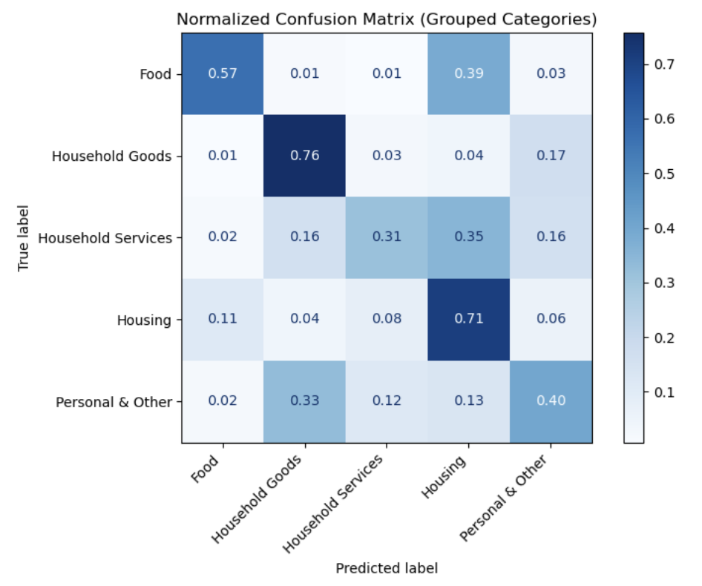
Key findings: Confusion Matrix
Normalized confusion matrix shows high confidence on major classes (Housing and Household Goods)
Lower recall where spending behavior is less predictable from available features

Slide 6
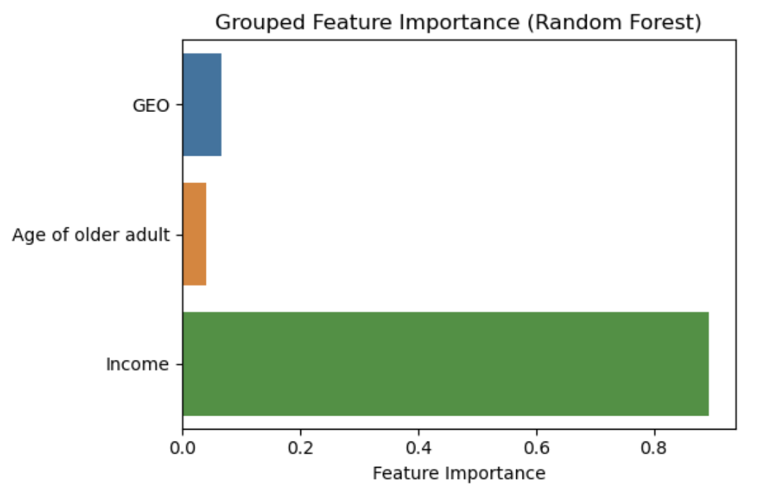
Key findings: Feature Importance
Income dominates model decisions
GEO adds modest regional nuance (e.g., housing patterns)
Age group adds little signal in this context

Slide 7
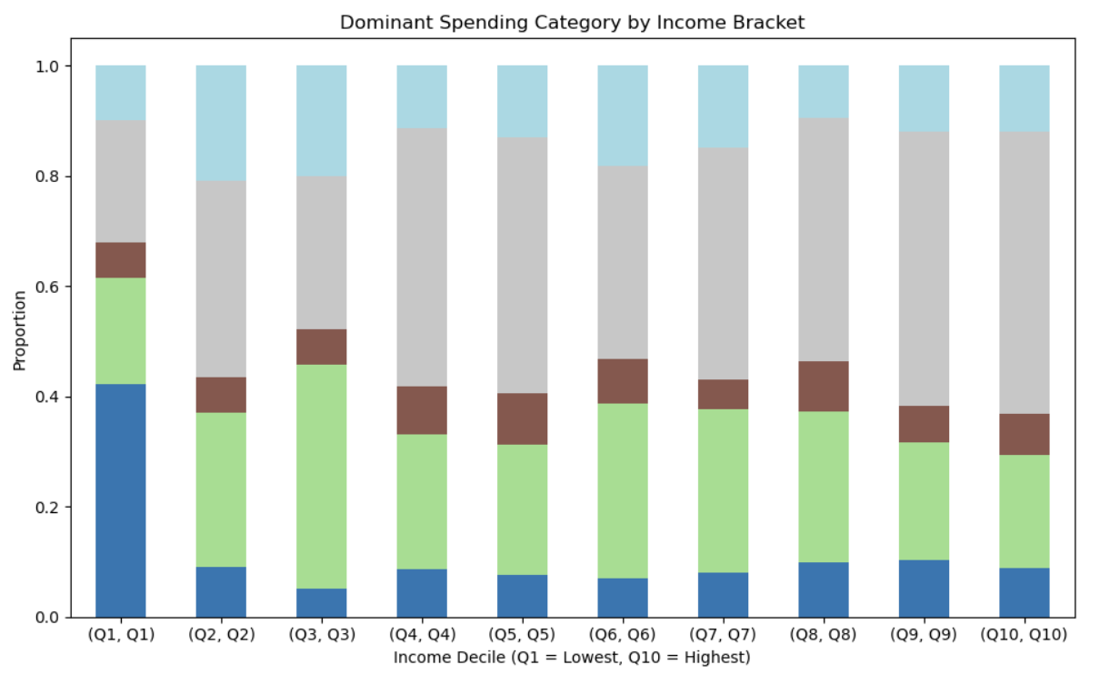
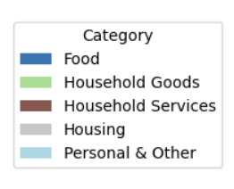
Income & Spending Behavior
Food is most common in the lowest income decile (Q1)
Housing becomes increasingly dominant at higher income levels
No strong shift toward discretionary categories as income rises

Slide 8
Conclusion & Next Steps
We can predict dominant spending from the 3 features with good accuracy--Even coarse, privacy-safe features like income, region, and age can reveal structural spending priorities
Economic capacity (income) is the primary driver
This analysis may allow governments or businesses to:
Segment populations based on likely needs
Prioritize interventions (e.g., rental assistance, utility subsidies)
Tailor marketing without invasive personal data
Next steps:
Add behavioral/lifestyle features (urban/rural, household size), explore richer survey data or simulation frameworks
Incorporate temporal trends to understand how priorities shift over time

