Slide 1
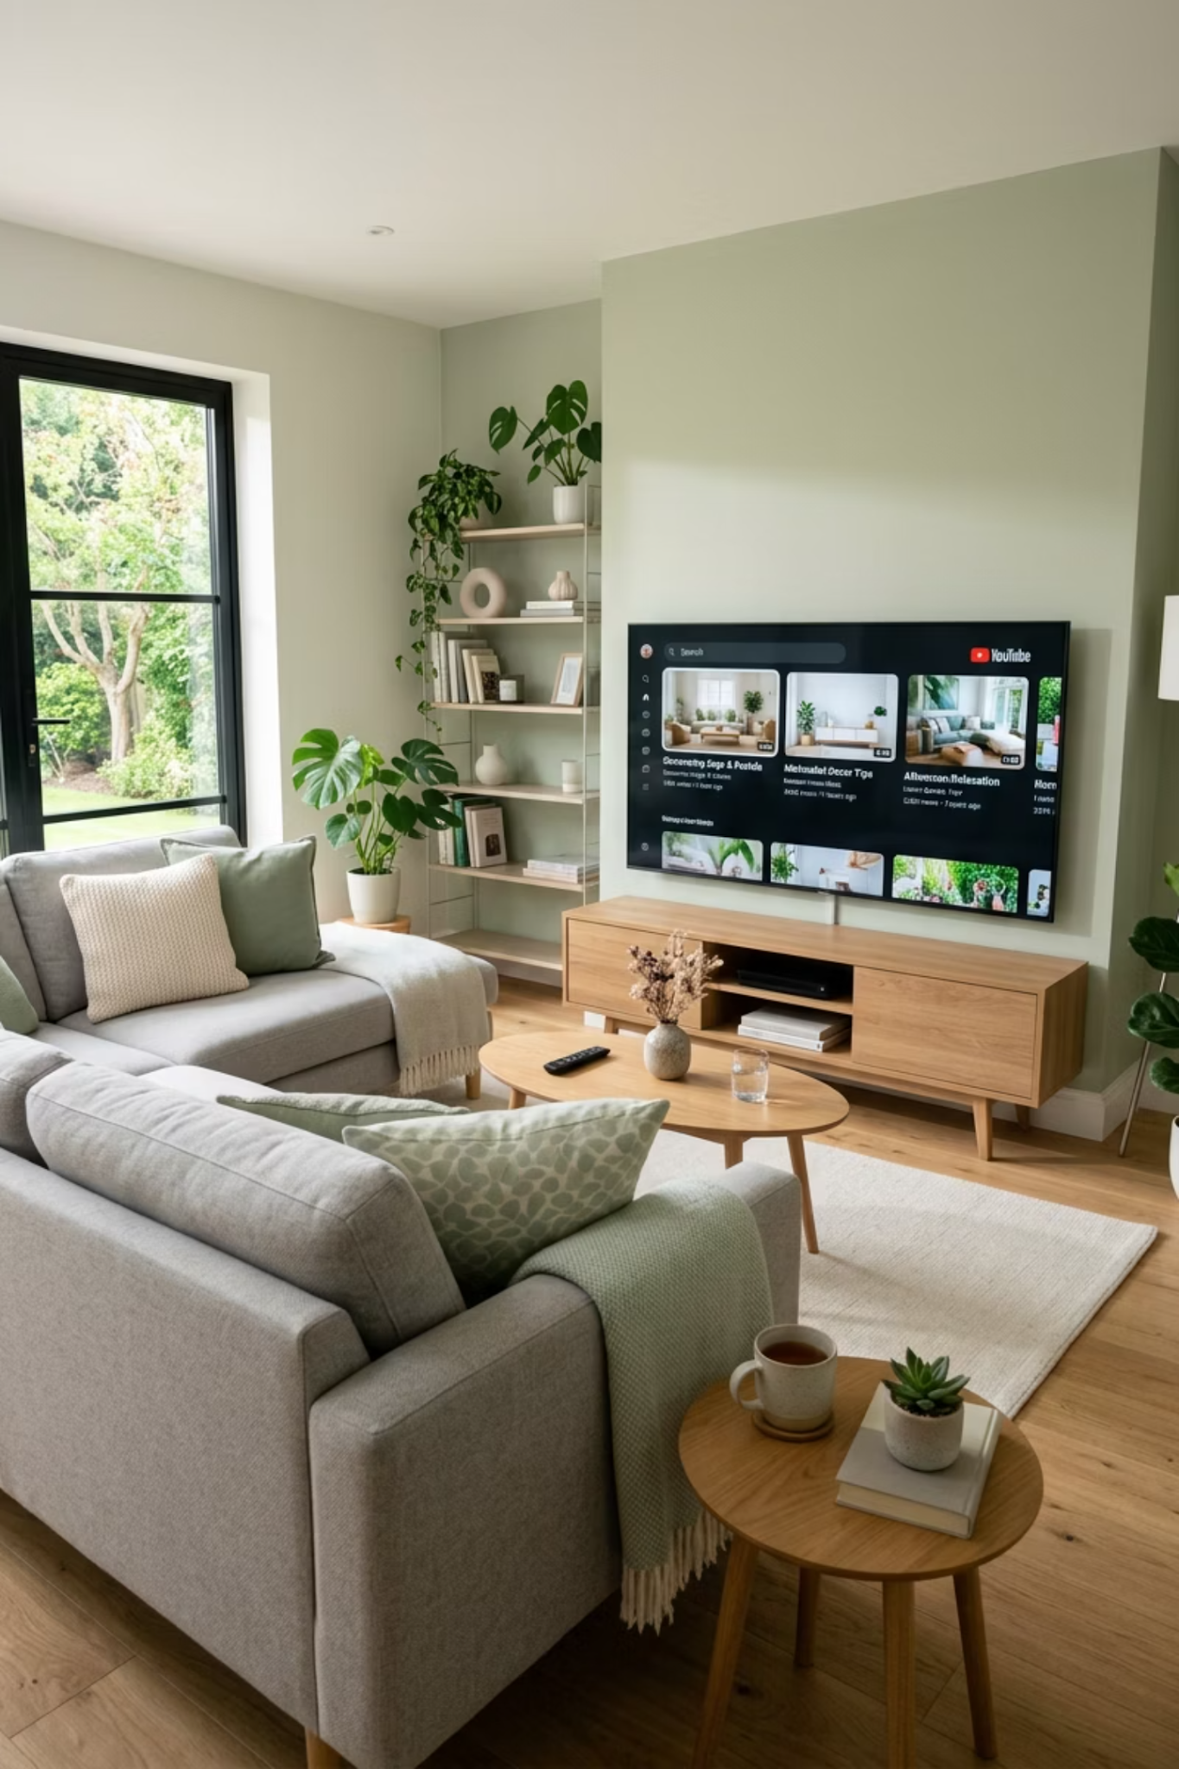

PREMIUM STREAMING (CTV / OTT) PROPOSAL
Monarch Home Services
Enterprise TV Advertising.
Direct Publisher Costs. Zero Markups.
How CAMP Digital connects big-screen streaming to booked home service calls across Monarch’s five-city Central California footprint.
INVESTMENT
FLIGHT
EST. IMPRESSIONS
$20,000 / month
30 days · AUG 2026
1,900,000
Google Premier Partner · Microsoft Elite Partner · Prepared for Monarch Home Services
Notes:
Proposal cover. Campaign facts from the Monarch Home Services Media Plan workbook (August 2026): 30-day flight, 1,900,000 estimated impressions across two ad groups. Investment $20,000 = $18,000 in-market + $2,000 remarketing; matches the workbook TOTAL.

Slide 2
THE SHIFT
Homeowners Left Cable. Traditional Agencies Kept the Markups.
Today's homeowners spend more time on streaming platforms than on traditional cable. Most CTV providers still sell that audience as a black-box media buy — layered fees, hidden markups, fragmented reporting.
Traditional cable & broadcast
CTV / premium streaming
Buying unit
Dayparts and programs
Households and audiences
Geography
The entire DMA
City and ZIP-code footprint
Targeting
Age and gender demographics
In-market intent, CRM, retargeting
Commitment
Large upfront commitments
Monthly, fully scalable
Measurement
Panel-based estimates
Impression-level delivery reporting
Waste
Paying for viewers you can't serve
Spend confined to your service area
WHAT THIS MEANS FOR MONARCH HOME SERVICES
Monarch does not need to buy three California DMAs to advertise on television. The plan in this deck buys five specific Central Valley and Central Coast cities — the same big screen, none of the waste.
CAMP Digital · Premium Streaming Media Plan · Monarch Home Services · August 2026
2

Slide 3
AUDIENCE STRATEGY
The Living Room Opportunity: A Branding Layer Above Search
Homeowners move seamlessly across devices. Search captures demand that already exists — CTV reaches the household earlier, before the failure happens.
01
02
03
Connected TV
Demand Gen & Social
Search, LSA & Website
AWARENESS · PRE-NEED
CONSIDERATION
CAPTURE
Reaches the household on the living-room screen weeks or months before a furnace quits or an AC unit fails in a 105-degree Central Valley August.
Re-engages CTV-exposed households across YouTube, Gmail and Discover with the same message and value proposition.
Converts the demand that CTV created — at a lower cost, because the brand is already familiar.
KEY TAKEAWAY
The upper-funnel branding layer warms the audience before the emergency — driving brand lift and improving the efficiency of every lower-funnel search dollar Monarch already spends.
CAMP Digital · Premium Streaming Media Plan · Monarch Home Services · August 2026
3

Slide 4
INVENTORY QUALITY
Not All Video Impressions Are Television Impressions
"Online video" and "premium streaming" are priced similarly and perform nothing alike. The difference is the screen, the format and the environment the ad runs in.
Standard digital video
Premium CTV / OTT
The screen
Phone or desktop, in-feed, partial view
Living-room television, full screen
The format
Skippable after ~5 seconds, scroll-away
Non-skippable ad pods inside programming
The sound
Muted by default
Sound-on by default
The environment
Long-tail sites, UGC and gaming apps
Licensed, brand-safe programming
The viewer
Lean-forward and distracted
Lean-back, attentive, often co-viewed
The report
Aggregated, often opaque placements
Named app-level placement and CPM detail
HOW WE PROTECT THE DIFFERENCE
CAMP Digital actively excludes non-video desktop display domains — gaming and long-tail sites — from delivery, so budget stays inside genuine streaming environments rather than drifting into cheap web video.
CAMP Digital · Premium Streaming Media Plan · Monarch Home Services · August 2026
4

Slide 5
INVENTORY ACCESS
The Same Big-Screen Placements as National Brands
Direct access to premium streaming inventory — full-screen, non-skippable, sound-on advertising delivered on television screens inside premium content environments.
PREMIUM STREAMING ENVIRONMENTS
Hyper-local by design
YouTube Select
Hulu
Disney+
Max
Delivery is confined to your active service footprint — down to specific cities and ZIP codes, not the whole DMA.
Paramount+
Peacock
Roku Channel
Samsung TV Plus
Unbiased placement
Options across both the Microsoft and Google networks, chosen on performance rather than on which inventory we happen to resell.
Pluto TV
Tubi
ESPN
Prime Video
Television-grade recall
Full-screen, sound-on exposure on the household TV builds significantly stronger recall than mobile advertising alone.
BOUGHT DIRECT, NOT RESOLD
Every environment above is purchased through the Microsoft or Google engines at publisher cost — the same inventory national advertisers buy, without a reseller standing between Monarch and the impression.
CAMP Digital · Premium Streaming Media Plan · Monarch Home Services · August 2026
5

Slide 6
PRICING MODEL
100% Working Media. Zero Hidden Tech Taxes.
Media is purchased directly through the ad engines at transparent CPM-based pricing, with a flat monthly management fee that keeps our incentives aligned with campaign outcomes.
TRADITIONAL CTV MODELS
THE CAMP DIGITAL MODEL
—
Hidden platform markups and unknown inventory fees
✓
100% of media budget goes to buying impressions
—
Layered reseller margins that shrink working media
✓
Flat monthly management fee, disclosed up front
—
Obscured placement and performance reporting
✓
Direct access to placement, CPM and delivery reporting
MONARCH’S MONTHLY MEDIA
THIRD-PARTY MARKUPS
ESTIMATED IMPRESSIONS
$20,000
$0
1,900,000
NET USD, working media
No reseller margin in the buy
Across two targeted ad groups
CAMP Digital · Premium Streaming Media Plan · Monarch Home Services · August 2026
6

Slide 7
WHY CAMP DIGITAL
Two Premier Partner Networks. One Accountable Team.
Our dual-engine architecture pairs brand demand creation with demand capture. We match the engine to the objective rather than to whatever inventory we are obligated to sell.
ELITE PARTNER
PREMIER PARTNER
Microsoft Advertising
Google Premier CTV
Max · Hulu · Roku · Samsung TV Plus · Paramount+ and more
YouTube TV · YouTube Select · Max · Peacock · Hulu · Paramount+ and more
•
Unique audience signals including LinkedIn profile targeting by company and industry
•
Living-room dominance across YouTube Select and premium partners
•
Impression-Based Remarketing built from streaming exposure
•
Direct integration with Google Demand Gen for warm re-engagement
•
In-market audience curation from Bing search and click behavior
•
Real-time intent capture across YouTube, Gmail and Discover
RECOMMENDATION FOR MONARCH HOME SERVICES
Launch on the Microsoft Audience Network — the only engine in the pair that curates both in-market pools this plan buys, with Impression-Based Remarketing included. Google Premier stays the scale path once August establishes a baseline.
CAMP Digital · Premium Streaming Media Plan · Monarch Home Services · August 2026
7

Slide 8
ILLUSTRATIVE MODEL
What a $20,000 Local CTV Month Can Look Like
Illustrative modeling for a 30-day, $20,000 CTV campaign in a five-city footprint of roughly 390,000 households. Example figures for planning discussion — not historical client results.
IMPRESSIONS DELIVERED
HOUSEHOLDS REACHED
AVERAGE FREQUENCY
VIDEO COMPLETION RATE
COST / COMPLETED VIEW
1,904,000
272,000
7.0x
96.7%
$0.011
30-day flight
69.7% of the footprint
Per household / month
1,841,000 completed views
Below a $0.03 CPCV bid
ILLUSTRATIVE PREMIUM PLATFORM MIX · SHARE OF IMPRESSIONS
BLENDED CPM
$10.50
CTV SHARE OF IMPRESSIONS
94.6%
DELIVERY INSIDE FOOTPRINT
97.9%
Illustrative example only. Figures are internally consistent planning estimates built to show the scale, reach and completion quality a local CTV campaign can produce. They are not actual campaign results for Monarch Home Services or any other advertiser.
CAMP Digital · Premium Streaming Media Plan · Monarch Home Services · August 2026
8
Notes:
Illustrative only. Internal consistency: 272,000 households x 7.0 frequency = 1,904,000 impressions; 1,841,000 completed views / 1,904,000 = 96.7% VCR; $20,000 / 1,841,000 = $0.011 CPCV; $20,000 / 1,904,000 x 1,000 = $10.50 CPM. Platform mix sums to 1,904,000.

Slide 9
PART TWO
Built for Monarch Home Services
Everything that follows is drawn from the Monarch Home Services media plan — the audiences we buy, the five California cities we buy them in, the impressions that investment delivers, and what is included at no additional cost.

Slide 10
PROACTIVE STRATEGY
Reaching Homeowners Before the Breakdown Happens
Traditional TV buys target generic demographics. Our strategy positions Monarch in front of the household before the service need occurs, building familiarity and trust early.
LAYER 1
LAYER 2
LAYER 3
LAYER 4
Geographic precision
Two in-market pools
Custom intent from PPC
First-party CRM & retargeting
Delivery restricted to Monarch’s five named California service cities — no spend outside the territory the trucks can reach.
Microsoft in-market Home & Garden plus Building Construction & Maintenance — residential demand and the trade audience, in one buy.
Custom intent audiences built from Monarch’s own performing keyword data, so CTV reaches households already showing category demand.
Site visitors and CRM segments retargeted on the big screen, keeping Monarch present with households that already know the brand.
THE PRE-NEED ADVANTAGE
A homeowner who already recognizes Monarch does not shop the category when the AC quits in a 108-degree Bakersfield afternoon — they call the name they know. That is the difference between competing on price at the moment of failure and owning the decision before it.
CAMP Digital · Premium Streaming Media Plan · Monarch Home Services · August 2026
10

Slide 11
GEOGRAPHIC TARGETING
Five Cities. Three DMAs. Zero Wasted Impressions.
Delivery is confined to the California cities Monarch actively services — bought by name, one city at a time, rather than as a Fresno–Visalia or Bakersfield DMA broadcast buy.
Bakersfield, CA
Bakersfield DMA
COMMUNITIES TARGETED
5
Visalia, CA
Fresno–Visalia DMA
Named city-level geo targets
Fresno, CA
Fresno–Visalia DMA
DEVICE SCOPE
Cross Device
Paso Robles, CA
Santa Barbara–SLO DMA
CTV-led, cross-screen
FLIGHT LENGTH
San Luis Obispo, CA
Santa Barbara–SLO DMA
30 Days
August 2026
WHY THIS MATTERS
A DMA broadcast buy would scatter impressions across three separate California markets, most of them in front of households Monarch cannot profitably serve. City-level CTV targeting spends the same dollars only where the trucks already run.
CAMP Digital · Premium Streaming Media Plan · Monarch Home Services · August 2026
11

Slide 12
THE PROPOSAL
The Monarch Home Services Premium Streaming Plan
One campaign, two ad groups, each with individual targeting — built to create demand at the top of the funnel and recapture it at the bottom.
NETWORK
PLACEMENT
AD UNITS
FLIGHT
DEVICE
PRICING
Microsoft Audience Network
CTV / OTT
:05 – :90
30 days
Cross Device
CPCV · $0.03 est. bid
Ad group | Targeting | Est. impressions | Monthly investment | Implied CPM
In-Market — Relevant Audiences | Home & Garden + Building Construction & Maintenance | 1,800,000 | $18,000 | $10.00
Remarketing — Site Visitors | Remarketing list — prior site visitors | 100,000 | $2,000 | $20.00
Total | 1 campaign / 2 ad groups | 1,900,000 | $20,000 | $10.53
READ THIS ALONGSIDE THE GEOGRAPHY
1,800,000 in-market impressions build the brand across five California cities; 100,000 remarketing impressions keep Monarch in front of households that have already visited the site. Every dollar of the $20,000 is working media.
All impressions are estimates and are not guaranteed; pricing is dynamic based on market demand. All dollars are NET USD. Implied CPM is derived from monthly investment ÷ estimated impressions.
CAMP Digital · Premium Streaming Media Plan · Monarch Home Services · August 2026
12
Notes:
Source: Monarch Home - Media Plan worksheet. In-market line: 1,800,000 impressions / $18,000 (row 6). Remarketing line: 100,000 impressions / $2,000 (row 9). Workbook TOTAL cell M18 reads $20,000, which agrees with the sum of both line items. Implied CPMs are derived, not quoted in the workbook.

Slide 13
REACH & FREQUENCY
What 1,900,000 Impressions Actually Delivers
Impressions are the unit we buy; reach and frequency are what the household experiences. These scenarios show how the same 1,900,000 impressions resolve at different exposure levels.
UNIQUE DEVICES REACHED AT EACH AVERAGE FREQUENCY
IN-MARKET SHARE OF DELIVERY
94.7%
1,800,000 of 1,900,000 impressions build new reach; the rest keep prior site visitors warm
HOW WE MANAGE IT
Frequency is managed in-flight. Too low and the brand never registers; too high and impressions pile onto the same households instead of finding new ones. We cap and rebalance weekly to hold delivery in the productive middle.
PLANNING NOTE
Scenarios are arithmetic on the plan’s own estimate — 1,900,000 impressions divided by average frequency — not a guaranteed reach forecast. Actual reach depends on inventory availability across the five-city footprint and is reported against these benchmarks every month.
CAMP Digital · Premium Streaming Media Plan · Monarch Home Services · August 2026
13
Notes:
Scenarios are 1,900,000 plan impressions divided by average frequency: 4.0x = 475,000; 5.0x = 380,000; 6.0x = 316,700; 7.0x = 271,400. In-market share = 1,800,000 / 1,900,000 = 94.7%.

Slide 14
INCLUDED AT NO ADDITIONAL COST
Two Assets Monarch Keeps — Both Unlocked at Launch
The plan includes added-value components that most CTV vendors either charge for or simply do not offer. At 1.9M impressions, Monarch qualifies for both from day one.
ADDED VALUE 01
ADDED VALUE 02
Impression-Based Remarketing
Ad Effectiveness Study
Every household exposed to Monarch’s streaming ad is assembled into a remarketing list — usable across Search, Performance Max, Display, Native and Online Video.
Formal measurement of search lift, impact on the consumer decision journey and multi-touch attribution, correlated to Microsoft Audience Network ad exposure.
The audience built by the TV campaign becomes a targeting asset for every other channel Monarch runs.
Requires approximately 1.5M impressions in a 30-day period — this plan delivers an estimated 1.9M.
THRESHOLD CLEARED
The brand lift study is unlocked at launch
AUGUST PLAN
STUDY THRESHOLD
1.9M
1.5M
The August plan delivers an estimated 1,900,000 impressions in a 30-day window — above the roughly 1.5M the Ad Effectiveness Study requires. Monarch qualifies for formal search-lift and multi-touch attribution measurement from the very first flight, at no additional cost.
CAMP Digital · Premium Streaming Media Plan · Monarch Home Services · August 2026
14
Notes:
Key change vs. a smaller plan: at an estimated 1.9M impressions in a 30-day window the campaign clears the ~1.5M threshold the Ad Effectiveness Study requires, so both added-value components are available from the first flight rather than at a later scale step.

Slide 15
BUSINESS OUTCOME
Building Brand Demand Lowers Your Cost Per Lead
CTV creates top-of-mind trust; Search PPC captures the appointment when the repair is needed. Managed together, the two get cheaper — not more expensive.
1
2
3
4
Household sees the ad
Audience is captured
Message is reinforced
Search converts cheaper
Full-screen, sound-on exposure on the living-room television inside premium programming.
The exposed household enters an Impression-Based Remarketing list at no additional cost.
Demand Gen re-engages the same household across YouTube Shorts, Discover and Gmail.
When the failure happens, the brand is already familiar — lifting click-through and lowering acquisition cost.
WHY THIS COMPOUNDS
Awareness and demand capture managed by one team on one audience graph removes duplicated spend between channels, improves search efficiency, and lowers long-term customer acquisition cost. Run separately, the two compete for the same household twice.
CAMP Digital · Premium Streaming Media Plan · Monarch Home Services · August 2026
15

Slide 16
ACCOUNTABILITY
Reporting Built for Service Business Decisions
One reporting environment covering delivery, engagement and the downstream business signals that tell you whether the television spend is working.
01
02
03
Full placement visibility
Branded search lift
Business outcomes
Exact streaming networks, app-level placements and CPMs — so you can see precisely which environments the budget bought.
Growth in branded query volume tracked against the flight, the clearest early signal that television exposure is registering.
Website engagement and lead trends monitored alongside delivery, tying media activity to booked calls rather than to impressions alone.
BUDGET OPTIMIZATION IN FLIGHT
Protecting premium streaming delivery
Our optimization process actively excludes domains that capture non-video desktop display impressions — gaming sites and long-tail web inventory — so budget stays directed at high-value streaming environments. Filtering that traffic out secures stronger engagement and produces clean, transparent environment tracking.
CAMP Digital · Premium Streaming Media Plan · Monarch Home Services · August 2026
16

Slide 17
CAMPAIGN ROADMAP
From Market Analysis to Living Room Screens
An enterprise-grade four-step activation process, sequenced against Monarch’s 30-day August 2026 flight.
STEP 1
STEP 2
STEP 3
STEP 4
Service Footprint Audit
Inventory Validation
Creative Alignment
Launch & Measurement
Pre-flight · Week 1
Pre-flight · Week 2
Pre-flight · Week 2
Days 1–30 · August
We review Monarch’s active service ZIP codes and existing search performance benchmarks.
We forecast eligible premium impressions available inside the five-city footprint.
We organize Monarch’s :15 and :30 TV spots and vertical video assets against the :05–:90 ad unit spec.
Campaign activates; we track net new customers, revenue growth and acquisition cost alongside delivery.
WHAT WE NEED FROM MONARCH HOME SERVICES
Approved service ZIP code list, existing :15 / :30 video assets (or a creative brief if new spots are required), and website access for the retargeting tag. Everything else is handled by CAMP Digital.
CAMP Digital · Premium Streaming Media Plan · Monarch Home Services · August 2026
17

Slide 18
THE RECOMMENDATION
What Monarch Home Services Receives for $20,000 a Month
✓
1,900,000 estimated premium CTV/OTT impressions over a 30-day flight
MONTHLY INVESTMENT
$20,000
✓
Delivery confined to five named California cities across three DMAs
NET USD · 100% working media · fully scalable
✓
Two in-market audience pools plus prior-site-visitor retargeting
✓
Direct-to-engine buying — no reseller markup on any impression
NEXT STEP
✓
Impression-Based Remarketing and the Ad Effectiveness Study, both included
Complimentary local CTV audit
✓
App-level placement, CPM and completion reporting every month
A real-time inventory forecast across Monarch’s five California cities, confirming the streaming audience supports a sustained television presence — before a dollar is committed.
Ready to own the big screen in your service territory?
Request Your Free CTV Audit
All impressions are estimates and are not guaranteed. Pricing is dynamic based on market demand. All dollars are NET USD.

