Slide 1
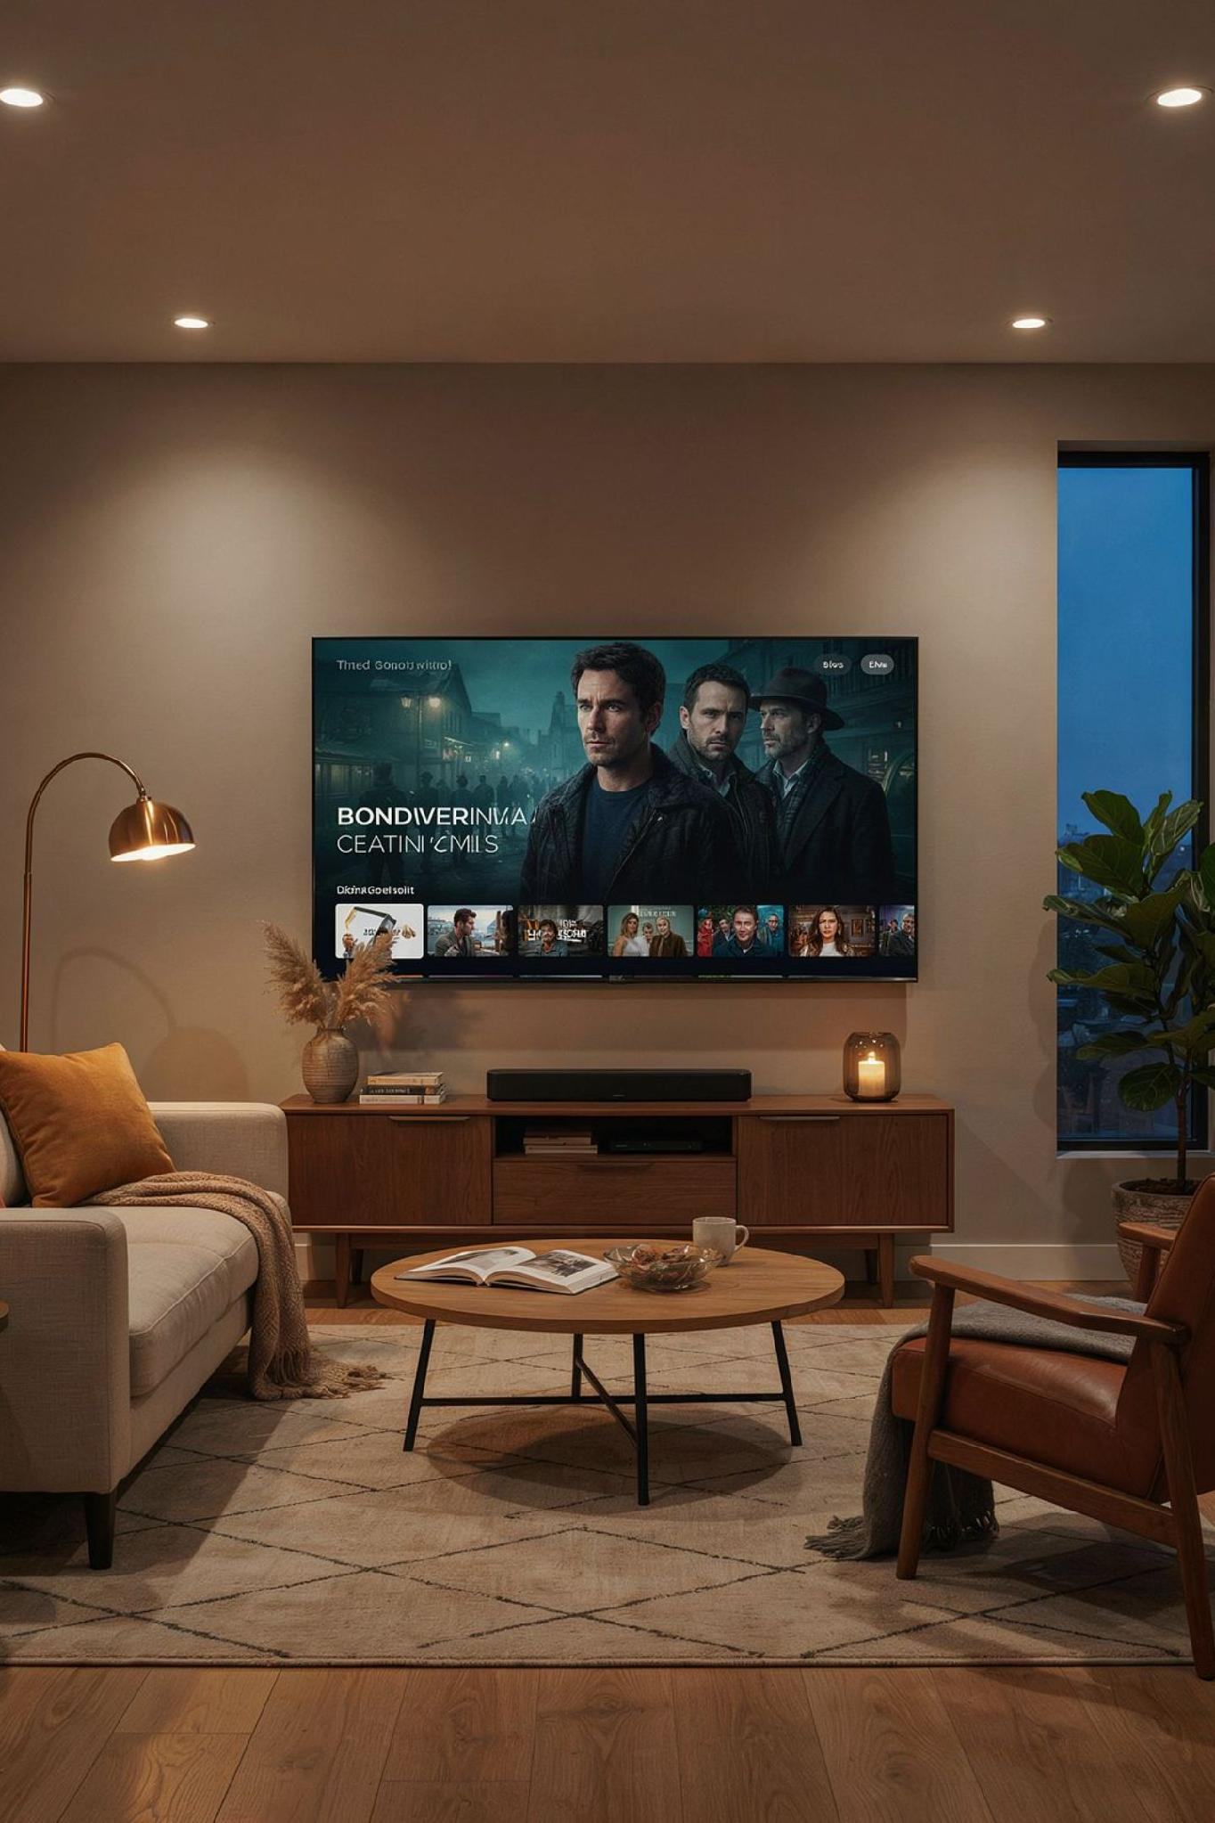
CAMP DIGITAL
Enterprise TV Advertising. Direct Publisher Costs. Zero Markups.
How CAMP Digital connects big-screen streaming to booked home service calls.
Google Premier Partner
Microsoft Elite Partner
Institutional-grade access to top-tier streaming inventory
Direct publisher costs — zero media markups added
Platform Agnostic
Strategy tailored to your trade, territory, and goals

Slide 2
Homeowners Left Cable. Traditional Agencies Kept the Markups.
The Legacy Programmatic Model
The CAMP Digital Direct Model
Multiple middlemen — platforms like The Trade Desk or Xander — add hidden tech fees, inflating CPMs to $25–$35+ with black-box reporting and zero transparency on where your dollars land.
Direct buying through Google and Microsoft Ads engines. 100% of your media spend goes straight to buying impressions inside your local service territory — no intermediaries, no hidden fees.
Your local homeowners spend their evenings on streaming platforms — not cable. Your advertising strategy should follow them there.
CAMP DIGITAL
02

Slide 3
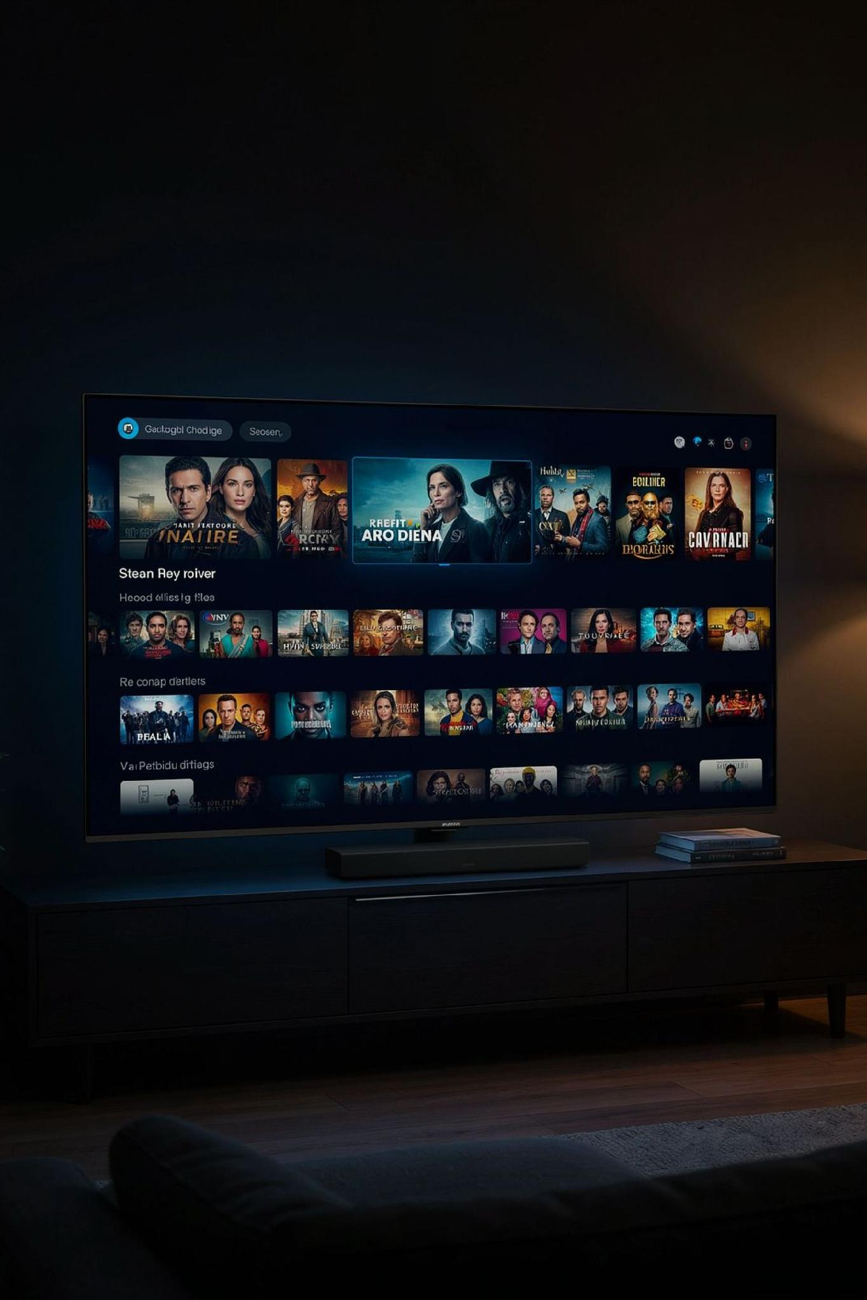
The Same Big-Screen Placements as National Brands. Zero Middlemen.
Premium Publisher Access
Zip-Code & DMA Precision
Full-screen, non-skippable living-room TV ads across Max, Hulu, Disney+, Roku, Paramount+, YouTube TV, Peacock, Samsung TV+, Sling, and Tubi.
Hyper-local targeting ensures your ads only air inside your active plumbing, HVAC, or electrical service footprint.
Unbiased Platform Access
Agnostic placement across both Microsoft Advertising and Google Ads networks — we optimize for your results, not platform commissions.
CAMP DIGITAL
03

Slide 4
Two Premier Partner Networks. Tailored to Your Specific Goals.
Microsoft Advertising CTV
Google Ads / YouTube Premier CTV
Inventory
Roku, Max, Hulu, Disney+, Paramount+, Pluto TV, Sling
YouTube Select, YouTube TV, Disney+, Max, Paramount+, Hulu
Core Advantage
In-market intent signals, LinkedIn household demographics, CPCV bidding
Real-time Google Search & Maps intent, unified frequency capping
Synergy
IMBR retargets TV viewers across Bing Search, Display & Native
Direct integration with Demand Gen and Google Search PPC
Because CAMP is platform-agnostic, we build the strategy around your business model — not around a single ecosystem's incentives.
CAMP DIGITAL
04

Slide 5




Reaching Homeowners Before Emergency Breakdowns Happen.
Beyond Basic IP Targeting
Traditional TV buys target generic age groups. CAMP targets active home service intent — households already searching for solutions online.
Pre-Need Brand Familiarity
Active Homeowner Search
Intent Signal Captured
Living Room TV Ad
Build trust before an emergency breakdown occurs. When a pipe bursts at midnight, your brand is the first name they call — because they've already seen you on TV.
CAMP DIGITAL
05

Slide 6
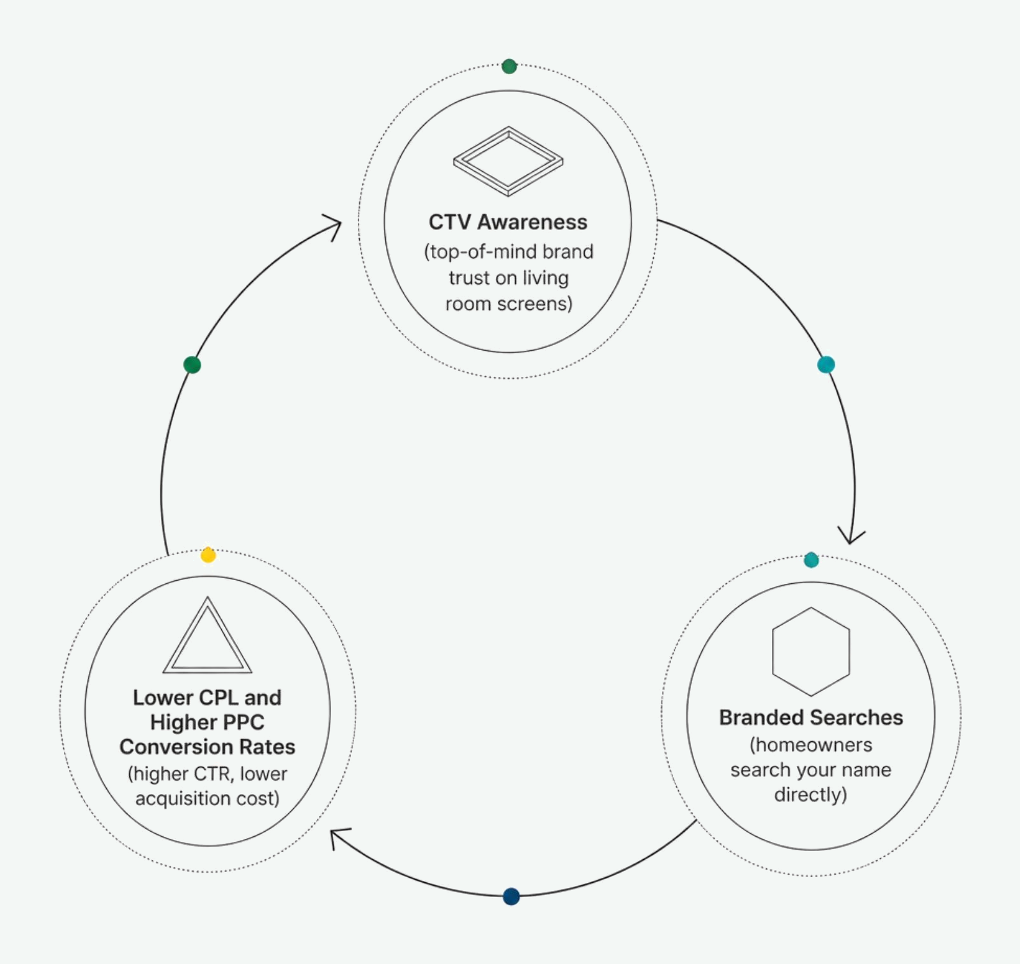
Building Brand Demand to Lower Your PPC Cost-Per-Lead.
Search & TV Working Together
CTV creates top-of-mind trust. Search PPC captures the appointment when the repair is needed. Together, they compound your results.
Cross-Channel Retargeting
Microsoft IMBR: Retarget TV viewers with follow-up Search, Native, or Display ads
Google Demand Gen: Re-engage warm streaming audiences across YouTube Shorts, Gmail, and Discover
CAMP DIGITAL
06

Slide 7

Real-World Proof: High-Impact Local Reach at Unbeatable CPMs.
27-DAY ALPHA FLIGHT — PRONTO PLUMBING PILOT
986K
$8.80
Targeted Impressions
CTV CPM
Delivered inside the core service territory
vs. $15–$25 industry benchmark
92.4%
98.5%
Big-Screen Spend
Geographic Precision
Concentrated on living room connected TVs
Impressions delivered within the active service footprint
CAMP DIGITAL
07

Slide 8

100% Working Media. Zero Hidden Tech Taxes.
Traditional Marked-Up Agency Model
CAMP Flat-Fee Transparent Model
Percentage-of-spend management fees (8%–15%)
Net publisher CPMs — the exact rate charged by the ad exchange
Hidden CPM markups layered on top of publisher rates
Flat monthly management fee with no media spend cut
Incentivized to grow your media spend, not your ROI
Low account minimums with no multi-month lock-in
Opaque reporting — you never see the real CPM
Complete spend visibility across every channel and placement
Our incentive is making your campaign work — not burning media budget to inflate a commission check.
CAMP DIGITAL
08

Slide 9

Complete Reporting Built for Service Business Accountability.
Full Placement Visibility
Detailed reporting on exact streaming networks — Hulu, Roku, Max, Tubi, and more — with CPMs and Video Completion Rates (VCR) broken out by placement.
Proactive Placement Filtering
Continuous optimization excludes non-video display, mobile app clutter, and low-value gaming impressions — keeping 100% of spend on living room TV screens.
Search & Brand Lift Tracking
Measure increases in branded search volume, direct website traffic, and view-through lead conversions.
CAMP DIGITAL
09

Slide 10



Matching the Right Network to Your Local Market Goals.
DEPLOY MICROSOFT ADS CTV WHEN…
DEPLOY GOOGLE PREMIER CTV WHEN…
Maximum Completed View Volume
Living-Room Dominance
Cost Per Completed View (CPCV) bidding drives efficient full-watch delivery
YouTube TV and YouTube Select (top 1% channels) deliver premium connected TV reach
Cross-Channel Retargeting
Full Google Ecosystem Pairing
Re-engage TV viewers across Bing Search and Display via Impression-Based Remarketing
Direct integration with Demand Gen, Google Maps, and Search PPC campaigns
Higher-Income Homeowner Targeting
Real-Time Search Intent
LinkedIn household demographics pinpoint specific residential ownership profiles
Capture active Google searchers across local markets with unified frequency control
CAMP DIGITAL
10

Slide 11



From Market Analysis to Living Room Screens in 4 Steps.
Service Audit
Inventory Check
Creative Align
Launch & Measure
If you have existing video creative, CAMP can validate your market's streaming inventory and launch a hyper-targeted campaign in days — no months-long production cycle required.
CAMP DIGITAL
11

Slide 12




Ready to Own the Big Screen in Your Service Territory?
Request a complimentary local CTV audit — no commitment required. Here's what you'll receive:
Impression Forecast
Platform Allocation
Real-time streaming volume for your exact service zip codes
Recommended Google vs. Microsoft mix for your trade and territory
Projected CPMs
Expected local CPMs and completed view counts before you commit a dollar
Contact your CAMP Digital strategist today to build your custom CTV strategy — and see your market's inventory before spending a single dollar.
CAMP DIGITAL
12

