Slide 1
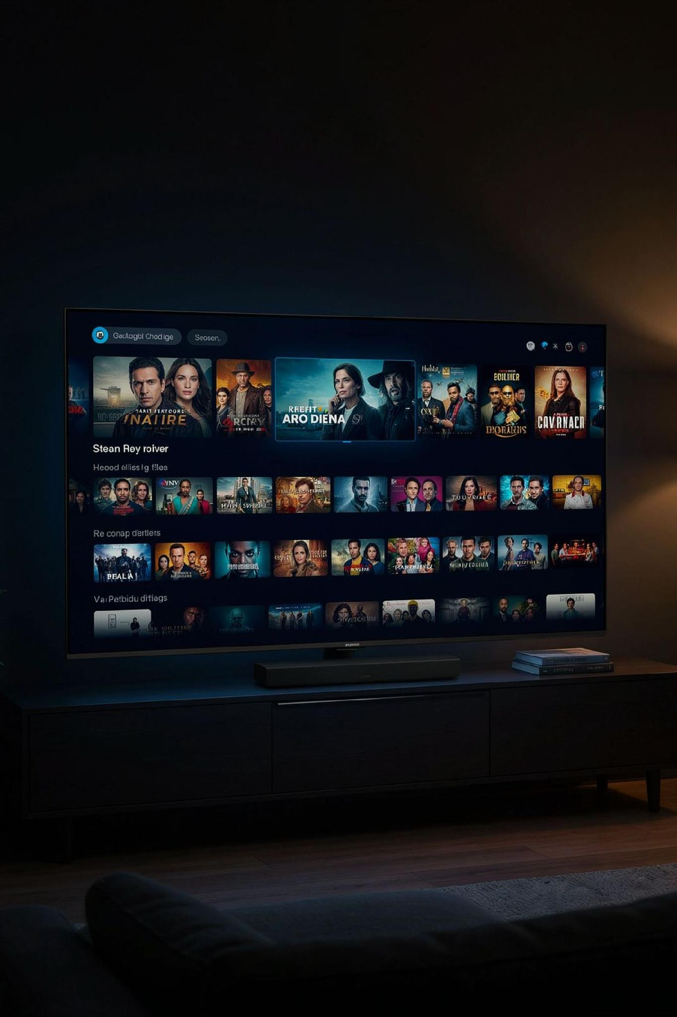
The Same Big-Screen Placements as National Brands. Zero Middlemen.
Premium Publisher Access
Zip-Code & DMA Precision
Full-screen, non-skippable living-room TV ads across Max, Hulu, Disney+, Roku, Paramount+, YouTube TV, Peacock, Samsung TV+, Sling, and Tubi.
Hyper-local targeting ensures your ads only air inside your active plumbing, HVAC, or electrical service footprint.
Unbiased Platform Access
Agnostic placement across both Microsoft Advertising and Google Ads networks — we optimize for your results, not platform commissions.

Slide 2
Building Brand Demand to Lower Your PPC Cost-Per-Lead.
CTV Awareness
Search & TV Working Together
(top-of-mind brand trust on living room screens)
CTV creates top-of-mind trust. Search PPC captures the appointment when the repair is needed. Together, they compound your results.
Cross-Channel Retargeting
Microsoft IMBR: Retarget TV viewers with follow-up Search, Native, or Display ads
Google Demand Gen: Re-engage warm streaming audiences across YouTube Shorts, Gmail, and Discover
Lower CPL and Higher PPC Conversion Rates
Branded Searches
(higher CTR, lower acquisition cost)
(homeowners search your name directly)

Slide 3
INVENTORY ACCESS
The Same Big-Screen Placements as National Brands
Direct access to premium streaming inventory — full-screen, non-skippable, sound-on advertising delivered on television screens inside premium content environments.
PREMIUM STREAMING ENVIRONMENTS
Hyper-local by design
YouTube Select
Hulu
Disney+
Max
Delivery is confined to your active service footprint — down to specific cities and ZIP codes, not the whole DMA.
Paramount+
Peacock
Roku Channel
Samsung TV Plus
Unbiased placement
Options across both the Microsoft and Google networks, chosen on performance rather than on which inventory we happen to resell.
Pluto TV
Tubi
ESPN
Prime Video
Television-grade recall
Full-screen, sound-on exposure on the household TV builds significantly stronger recall than mobile advertising alone.
BOUGHT DIRECT, NOT RESOLD
Every environment above is purchased through the Microsoft or Google engines at publisher cost — the same inventory national advertisers buy, without a reseller standing between Tri Peaks and the impression.
CAMP Digital · Premium Streaming Media Plan · Tri Peaks Air · July 2026
5

Slide 4
PRICING MODEL
100% Working Media. Zero Hidden Tech Taxes.
Media is purchased directly through the ad engines at transparent CPM-based pricing, with a flat monthly management fee that keeps our incentives aligned with campaign outcomes.
TRADITIONAL CTV MODELS
THE CAMP DIGITAL MODEL
—
Hidden platform markups and unknown inventory fees
✓
100% of media budget goes to buying impressions
—
Layered reseller margins that shrink working media
✓
Flat monthly management fee, disclosed up front
—
Obscured placement and performance reporting
✓
Direct access to placement, CPM and delivery reporting
TRI PEAKS' MONTHLY MEDIA
THIRD-PARTY MARKUPS
ESTIMATED IMPRESSIONS
$10,000
$0
850,000
NET USD, working media
No reseller margin in the buy
Across two targeted ad groups
CAMP Digital · Premium Streaming Media Plan · Tri Peaks Air · July 2026
6

Slide 5
INCLUDED AT NO ADDITIONAL COST
Two Assets Tri Peaks Keeps Beyond the Impressions
The plan includes added-value components that most CTV vendors either charge for or simply do not offer.
ADDED VALUE 01
ADDED VALUE 02
Impression-Based Remarketing
Ad Effectiveness Study
Every household exposed to Tri Peaks' streaming ad is assembled into a remarketing list — usable across Search, Performance Max, Display, Native and Online Video.
Formal measurement of search lift, impact on the consumer decision journey and multi-touch attribution, correlated to Microsoft Audience Network ad exposure.
The audience built by the TV campaign becomes a targeting asset for every other channel Tri Peaks runs.
Requires approximately 1.5M impressions within a 30-day period to run.
THE SCALE PATH
Unlocking the brand lift study
JULY PLAN
STUDY THRESHOLD
850K
1.5M
The July plan delivers an estimated 850,000 impressions. The study requires roughly 1.5M in a 30-day window, so it becomes available as the program scales — worth revisiting once the first flight establishes a delivery and completion baseline.
CAMP Digital · Premium Streaming Media Plan · Tri Peaks Air · July 2026
15

Slide 6
GEOGRAPHIC TARGETING
12 Communities. Zero Wasted Impressions.
Delivery is confined to the Front Range communities Tri Peaks actively services — bought by name, one city at a time, rather than as a Denver DMA broadcast buy.
Arvada
Aurora
Bailey
COMMUNITIES TARGETED
12
Named city-level geo targets
Broomfield
Golden
Littleton
DEVICE SCOPE
42+ inch TV Screens
Lone Tree
Longmont
Louisville
CTV-led, cross-screen
Thornton
Westminster
Wheat Ridge
FLIGHT LENGTH
30 Days
July 2026
WHY THIS MATTERS
A Denver DMA broadcast buy scatters impressions across the whole metro, most of them in front of households Tri Peaks cannot profitably serve. City-level CTV targeting spends the same dollars only where the trucks already run.
CAMP Digital · Premium Streaming Media Plan · Tri Peaks Air · July 2026
12

Slide 7
THE PROPOSAL
The Tri Peaks Air Premium Streaming Plan
One campaign, two ad groups, each with individual targeting — built to create demand at the top of the funnel and recapture it at the bottom.
NETWORK
PLACEMENT
AD UNITS
FLIGHT
DEVICE
PRICING
Microsoft Audience Network
CTV / OTT
:05 – :90
30 days
Cross Device
CPCV · $0.03 est. bid
Ad group | Targeting | Est. impressions | Monthly investment | Implied CPM
In-Market — Relevant Audiences | Home & Garden + Building Construction | 800,000 | $9,000 | $11.25
Remarketing — Site Visitors | Remarketing list — prior site visitors | 50,000 | $1,000 | $20.00
Total | 1 campaign / 2 ad groups | 850,000 | $10,000 | $11.76
READ THIS ALONGSIDE THE GEOGRAPHY
800,000 in-market impressions build the brand across 12 Front Range communities; 50,000 remarketing impressions keep Tri Peaks in front of households that have already visited the site. Every dollar of the $10,000 is working media.
All impressions are estimates and are not guaranteed; pricing is dynamic based on market demand. All dollars are NET USD. Implied CPM is derived from monthly investment ÷ estimated impressions.
CAMP Digital · Premium Streaming Media Plan · Tri Peaks Air · July 2026
13
Notes:
Source: Tri Peaks Air - Media Plan worksheet. In-market line: 800,000 impressions / $9,000. Remarketing line: 50,000 impressions / $1,000. Line items total $10,000 NET; the workbook TOTAL cell M18 reads $9,000 because its formula =SUM(M6:M8) covers only the in-market row. Implied CPMs derived, not quoted in the workbook.

Slide 8

THE RECOMMENDATION
What Tri Peaks Air Receives for $10,000 a Month
✓
850,000 estimated premium CTV/OTT impressions over a 30-day flight
MONTHLY INVESTMENT
$10,000
✓
Delivery confined to 12 named Front Range communities
NET USD · 100% working media · fully scalable
✓
Two in-market audience pools plus prior-site-visitor retargeting
✓
Direct-to-engine buying — no reseller markup on any impression
NEXT STEP
✓
Impression-Based Remarketing audience, included at no extra cost
Complimentary local CTV audit
✓
App-level placement, CPM and completion reporting every month
A real-time inventory forecast across Tri Peaks' 12 communities, confirming the streaming audience supports a sustained television presence — before a dollar is committed.
Ready to own the big screen in your service territory?
Request Your Free CTV Audit
All impressions are estimates and are not guaranteed. Pricing is dynamic based on market demand. All dollars are NET USD.

