Slide 1
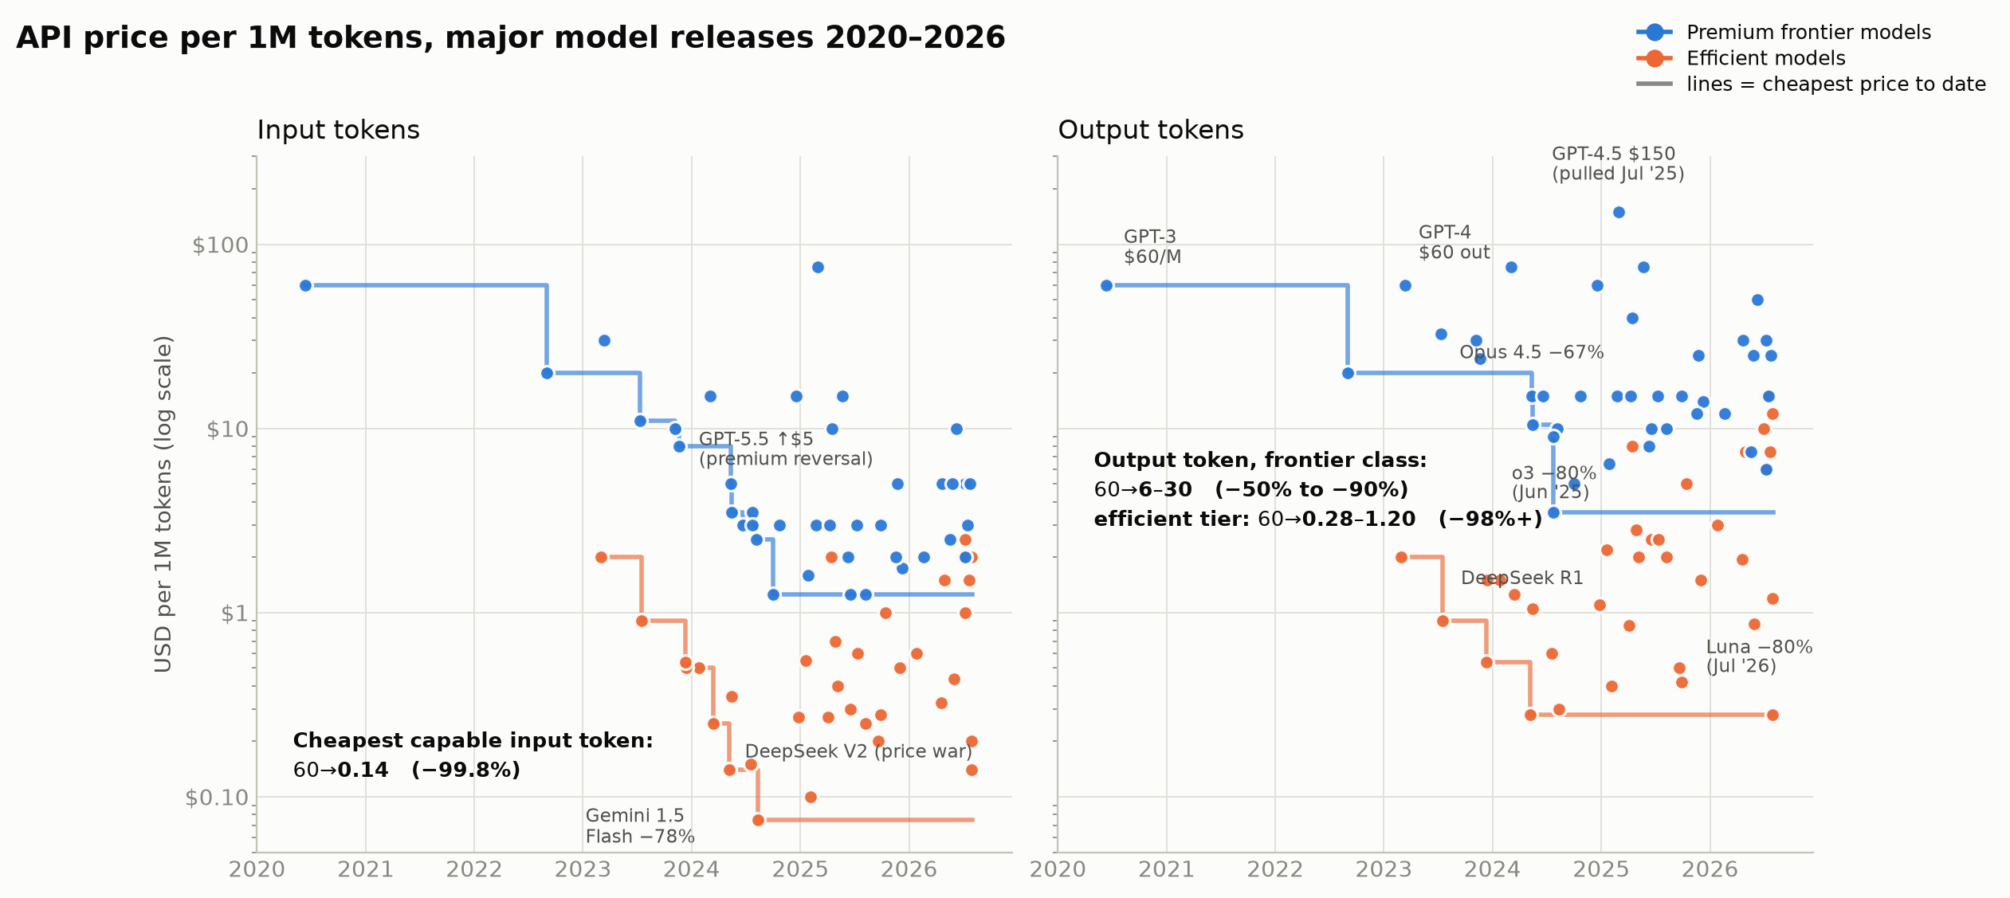
The Cost Collapse
How quickly has the cost of accessing capable AI fallen?
−99.25%
blended price of a capable token: GPT-3 $60.00 (2020) → GPT-5.6 Luna $0.45 per 1M tokens (Jul 2026)
133×
cheaper in 6 years — before batch (−50%) and cached-input (−90%) discounts, which make it steeper
−80%
GPT-5.6 Luna price cut on Jul 30, 2026, three weeks after launch — verified via OpenAI + CNBC
Read: every dot is a model's list price at launch or reprice (log scale — each gridline is 10× cheaper). The floor falls relentlessly; premium flagships (GPT-5.5, Fable 5) ticked back up in 2026 even as any fixed capability level kept getting cheaper.
Prices: official vendor announcements & pricing pages, cross-checked Aug 2, 2026 (OpenRouter, Artificial Analysis, llm-stats, CNBC). Full per-point sources: data/models.csv + SOURCES.md.
Notes:
Every dot is a published API list price per million tokens; the axis is logarithmic, so each gridline down is 10x cheaper. Three things to land. First, the floor: GPT-3 cost $60 per million tokens in 2020; today GPT-5.6 Luna costs 45 cents blended, and DeepSeek serves near-frontier models at 14 cents input. That's a 99%+ collapse in six years. Second, the cuts are events, not drift: o3 fell 80% in one day in June 2025, Anthropic cut the Opus tier 67% in November 2025, and OpenAI cut Luna 80% three weeks after launch in July 2026 — that Luna claim is verified against OpenAI's own announcement and CNBC. Third, honesty note: premium flagship list prices reversed upward in 2025-26 (GPT-5.2 through 5.5 quadrupled input price; Fable 5 opened a $10/$50 tier). The right mental model: the price of the BEST model is roughly flat-to-up; the price of ANY GIVEN capability level collapses. All figures are standard-tier list prices — batch and caching discounts make the real decline steeper.

Slide 2
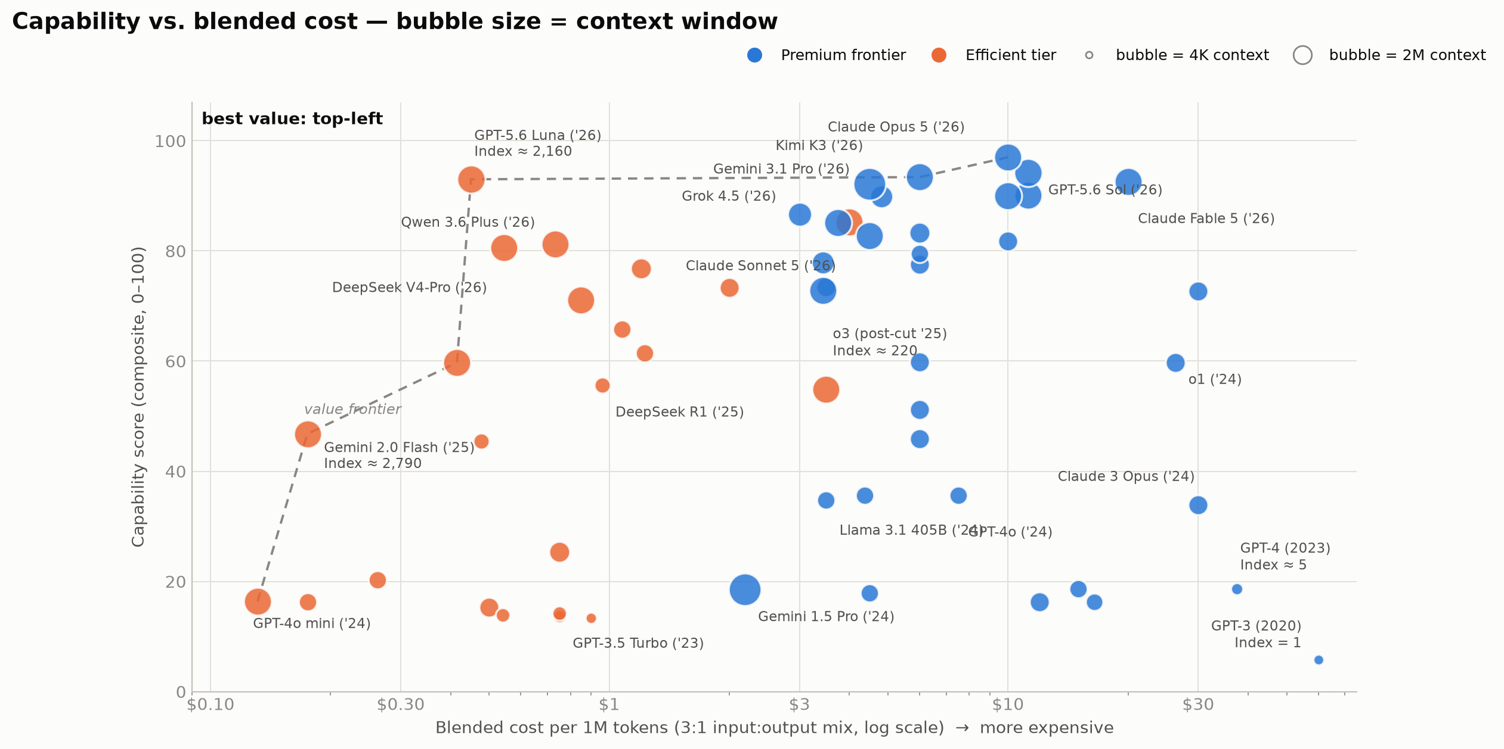
Intelligence per Dollar
How many times more capability does one dollar buy today?
2,790×
more intelligence per dollar than GPT-3 — best-value model (Gemini 2.0 Flash, Feb 2025)
2,160×
GPT-5.6 Luna (Jul 2026): 93-point capability at $0.45 per 1M tokens
≈300×
even the premium frontier tier (Grok 4.5, Claude Opus 5) buys ~300× more capability per dollar
Index method: capability = composite of GPQA-Diamond (normalized above the 25% chance floor) and SWE-bench Verified; pre-2023 models chained from MMLU at the GPT-4 overlap. Index = capability ÷ blended $/1M tokens, GPT-3 (2020) = 1. Estimates flagged in the dataset; benchmark saturation makes recent gains conservative.
Benchmarks: vendor model cards, GPQA paper (Rein et al. 2023), llm-stats/BenchLM Aug-2026 snapshots; AA Intelligence Index versions NOT mixed. Methodology: SOURCES.md §3–4.
Notes:
This is the value map: capability up the y-axis, blended cost across the x-axis on a log scale, bubble size is the context window. Best value is top-left. The capability score is a documented composite: GPQA-Diamond — PhD-level science questions, normalized above the 25% guessing floor — averaged with SWE-bench Verified, the standard real-world coding benchmark. Older models that predate those tests are chained in from MMLU at the GPT-4 overlap point and flagged as estimates. GPT-3 sits bottom-right: index 1. GPT-4 in 2023 bought 5x more intelligence per dollar. Today's value frontier — DeepSeek V4-Pro, Qwen 3.6, GPT-5.6 Luna — sits top-left at 1,000 to 2,800x. One dollar buys roughly three orders of magnitude more measured capability than in 2020, and about 300x more even if you insist on a premium frontier model. Caveat to volunteer if asked: benchmarks are saturating at the top, so if anything this understates recent gains; and reasoning models bill hidden thinking tokens, so per-task costs fall somewhat less than per-token prices.

Slide 3
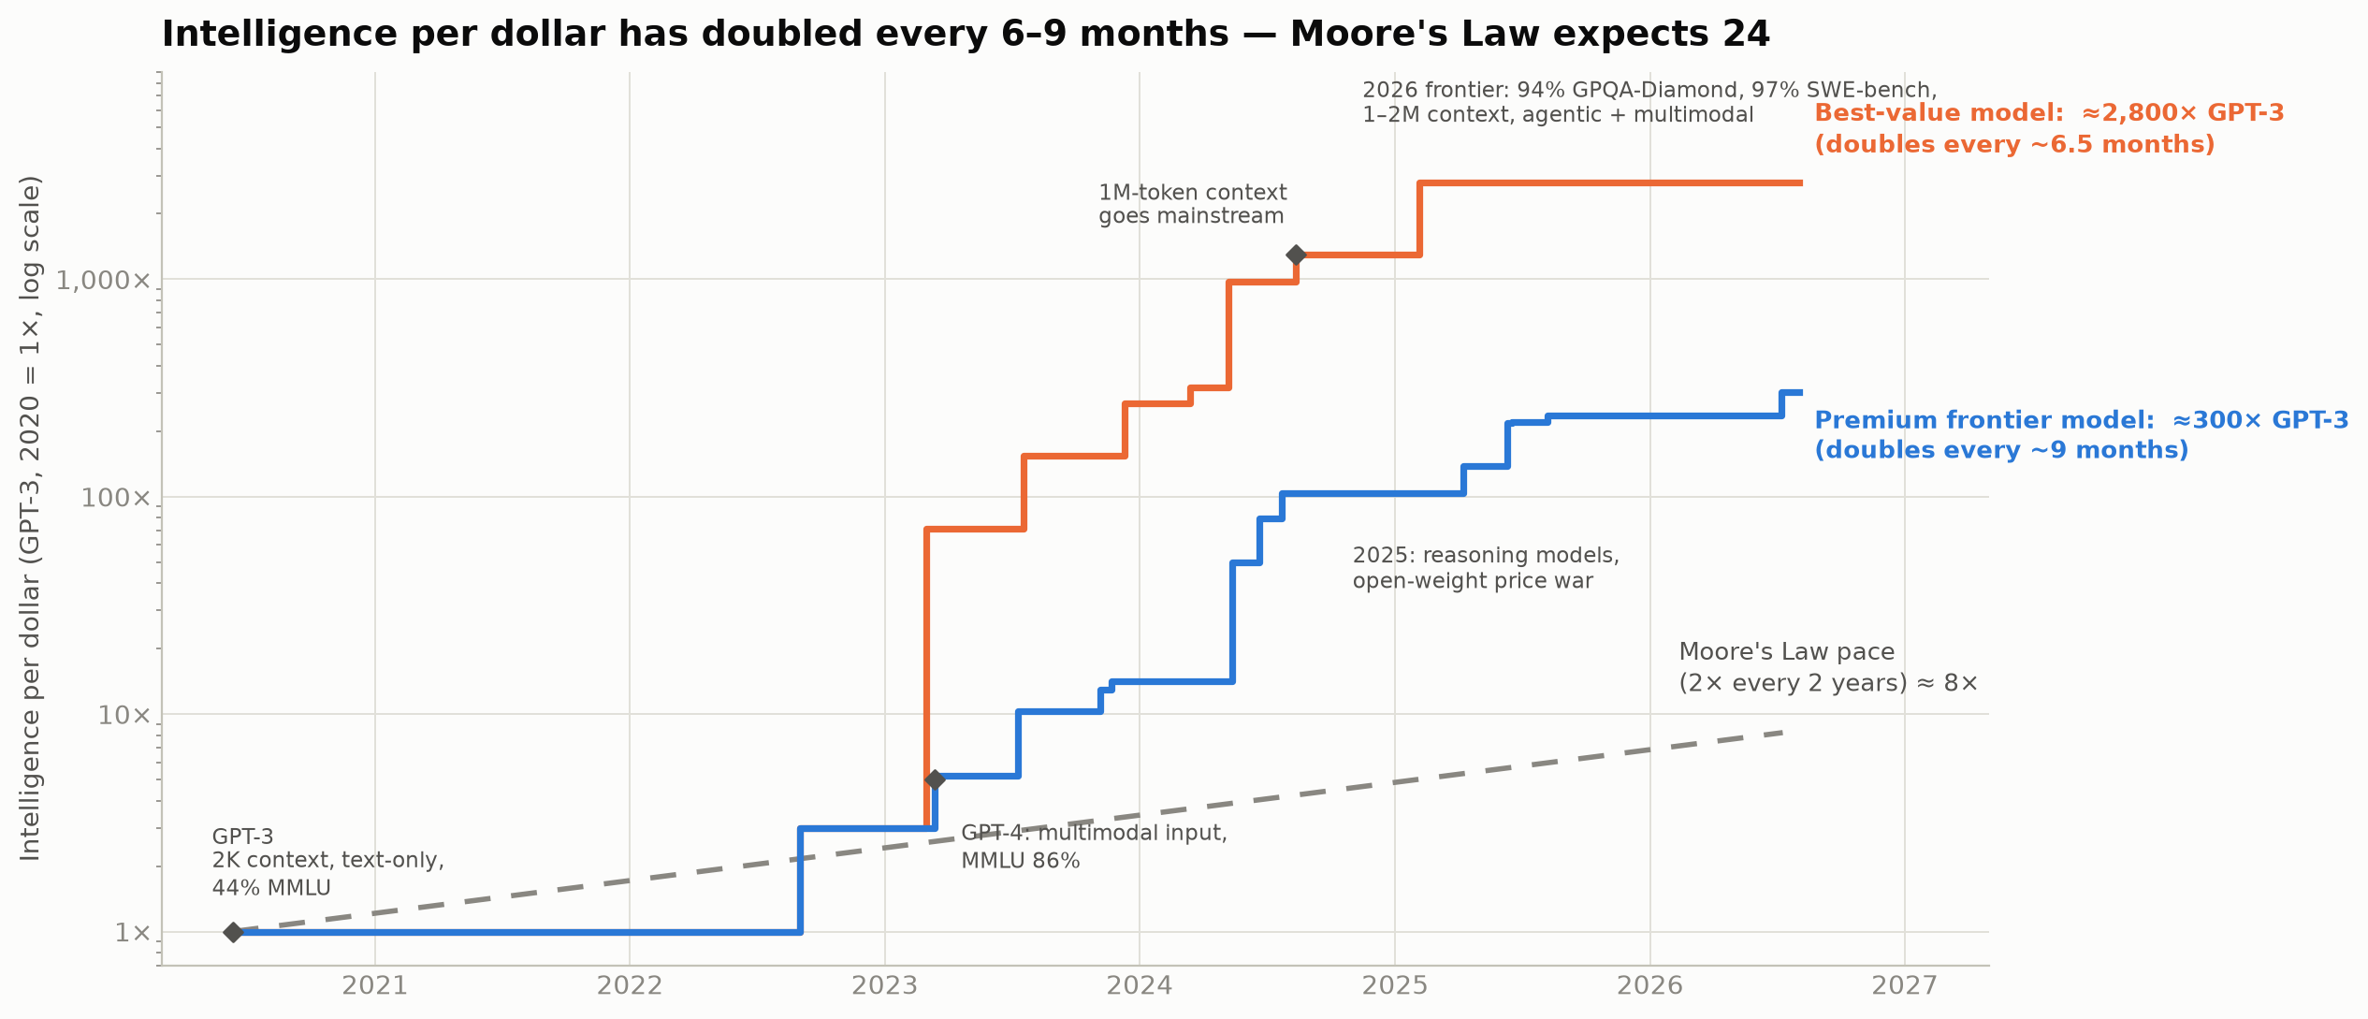
The Super Moore's Law
AI doesn't literally follow Moore's Law — but capability per dollar is currently compounding ~3× faster than Moore's pace.
1 −99%+
total cost decline: $60 → $0.45 per 1M blended tokens (133×); GPT-3-class capability ~1,000× cheaper (a16z)
2 ~2,800×
improvement in capability per dollar since GPT-3 (best-value tier); ≈300× at the premium frontier
3 ~6–9 mo
doubling time of AI capability per dollar — vs 24 months for the Moore's Law benchmark (≈8× over the same six years)
Corroboration: Epoch AI: constant-capability inference prices fell 9–900×/yr (median ~50×). a16z: ~10×/yr. Stanford HAI: GPT-3.5-class cost fell 280× in 18 months. MIT FutureTech: 5–10×/yr. Our 6–9-month doubling is the conservative end.
Index envelopes computed from data/models.csv (best index achieved to date, per tier). Moore's Law line: 2× every 24 months from Jun 2020. Literature: SOURCES.md §7.
Notes:
The hero chart: the orange line is the best intelligence-per-dollar available at each moment; blue restricts to premium frontier models; the gray dashed line is what Moore's Law — doubling every two years — would have delivered from the same 2020 starting point: about 8x by now. The observed curves delivered roughly 2,800x and 300x. That is a doubling every 6.5 months for the value tier and every 9 months at the frontier — three to four times faster than the Moore's Law benchmark. We are explicitly NOT claiming AI follows Moore's Law; we're using it as the familiar yardstick for 'fast'. The milestones carry the capability side of the story: 2K context to 1-2 million, text-only to multimodal and agentic, 44% on MMLU to 94% on PhD-level GPQA and 97% on real coding tasks. Three takeaways, right rail: costs down 99%+, capability per dollar up ~2,800x, doubling every 6-9 months. External literature (Epoch, a16z, Stanford HAI, MIT) measures the same phenomenon at 10-50x per year for constant capability — our numbers are the conservative end. Strategic close for VetIntel: anything we build on today's model prices gets ~2x cheaper or ~2x smarter within a year — design products assuming the intelligence budget keeps compounding.

Slide 4
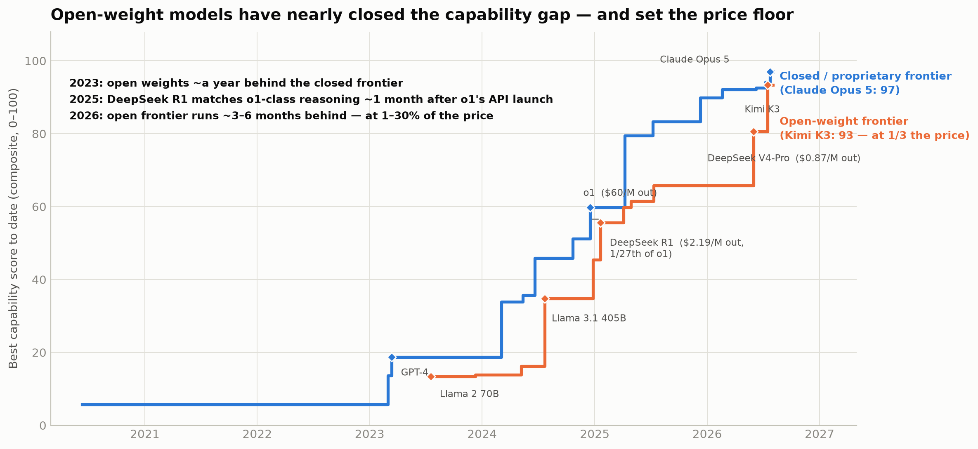
Appendix: The Open-Weight Catch-Up
Open-source models are the engine of the price collapse — and now trail the closed frontier by months, not years.
~3–6 mo
capability lag of the best open-weight model behind the closed frontier in 2026 — down from ~a year in 2023
1/27th
DeepSeek R1's output price vs OpenAI o1 at launch (Jan 2025: $2.19 vs $60 per 1M) — the 'DeepSeek shock'
$0.87
output price of open-weight DeepSeek V4-Pro (MIT license, 1M context) vs $25–50 for closed flagships
Open-weight examples in the dataset: Meta Llama 2 / 3.1 405B / 4 · DeepSeek V2, V3, R1, V3.2, V4-Pro (MIT) · Mistral Mixtral & Large 2/3 (Apache 2.0) · Qwen 3 (Apache 2.0) · Kimi K2 / K3 (modified MIT — K3 is the largest open-weight model ever at 2.8T params). Open-weight releases triggered the May-2024 China price war and keep resetting the industry price floor.
License status per model in data/models.csv (open_weights column; 'unverified' flagged). Lag measured on the same capability composite as Slide 2. Sources: SOURCES.md.
Notes:
Optional appendix if open source comes up. Both lines show the best capability score achieved to date, split by license: blue is closed/proprietary, orange is models whose weights you can download. Three beats. First, the gap: in 2023 Llama 2 was about a year behind GPT-4-class capability; DeepSeek R1 matched o1-class reasoning roughly one month after o1's API launch; in 2026 Kimi K3 sits a few points and a few months behind the closed frontier. Second, price: the open ecosystem sets the floor. DeepSeek V2 started the Chinese price war in May 2024; R1 undercut o1 by 27x; V4-Pro is an MIT-licensed, million-token-context frontier model at 87 cents per million output tokens — one to three percent of closed flagship prices. Third, nuance: open-weight does not mean free to serve — someone still runs the GPUs — and the very top of the leaderboard remains closed (Opus 5, GPT-5.6 Sol, Fable 5). Also note the counter-trend: the strongest open models, Kimi K3 and Qwen's flagships, now price UP toward closed-tier rates. For VetIntel: open-weight availability is the credible threat that keeps every closed vendor's pricing honest, and it is what makes self-hosted or private deployments of near-frontier capability plausible for data-sensitive workloads like ours.

