Slide 1
Hash tables Rabin-Karp algorithm based on hash calculation
Lecturer: Madyar Turgenbayev

Slide 2
Introduction to Hashing
Hashing: a technique to map data of arbitrary size to data of fixed size.
The resulting number is called a hash value or hash code.
Used for:
Fast data retrieval
Checking data integrity
Cryptography
String matching (→ Rabin–Karp)

Slide 3
What is a Hash Table?
A hash table (or hash map) is a data structure that stores key–value pairs and allows:
Average O(1) time for insertion, search, and deletion.
Key | Hash | Index | Value
"Alice" | 532 | 4 | Engineer
"Bob" | 198 | 2 | Designer
Formula: index = hash(key) mod table_size

Slide 4
Common Approach to Hashing
A frequently used approach to hashing is to represent the key as an integer value. If the key itself is not an integer (for example, it’s a string), the goal is to generate an integer representation of that key.
As a bit-level representation, the result is usually expressed as an integer derived from a certain range. Thus, the hash function produces an integer value within a fixed range, based on another integer (created from the key) that originally belongs to a much wider range.
"Hello world" → -832992604 → 100

Slide 5
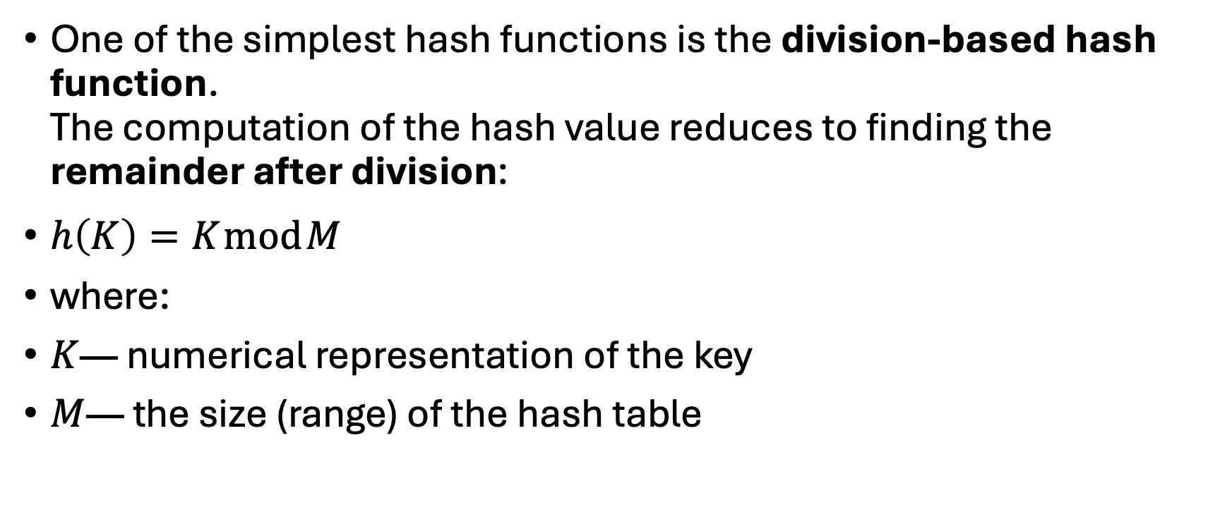
Division-Based Hash Function
One of the simplest hash functions is the division-based hash function. The computation of the hash value reduces to finding the remainder after division:
$h\left(K\right)=K mod M$
where:
$K$— numerical representation of the key
$M$— the size (range) of the hash table

Slide 6
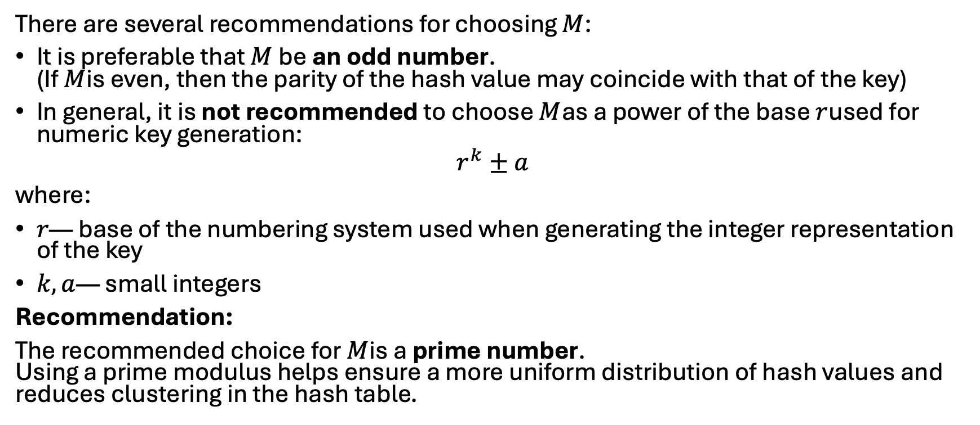

Choosing the Value of $M$
There are several recommendations for choosing $M$:
It is preferable that $M$be an odd number. (If $M$is even, then the parity of the hash value may coincide with that of the key)
In general, it is not recommended to choose $M$as a power of the base $r$used for numeric key generation:
$$r^{k}±a$$
where:
$r$— base of the numbering system used when generating the integer representation of the key
$k,a$— small integers
Recommendation:
The recommended choice for $M$is a prime number. Using a prime modulus helps ensure a more uniform distribution of hash values and reduces clustering in the hash table.

Slide 7
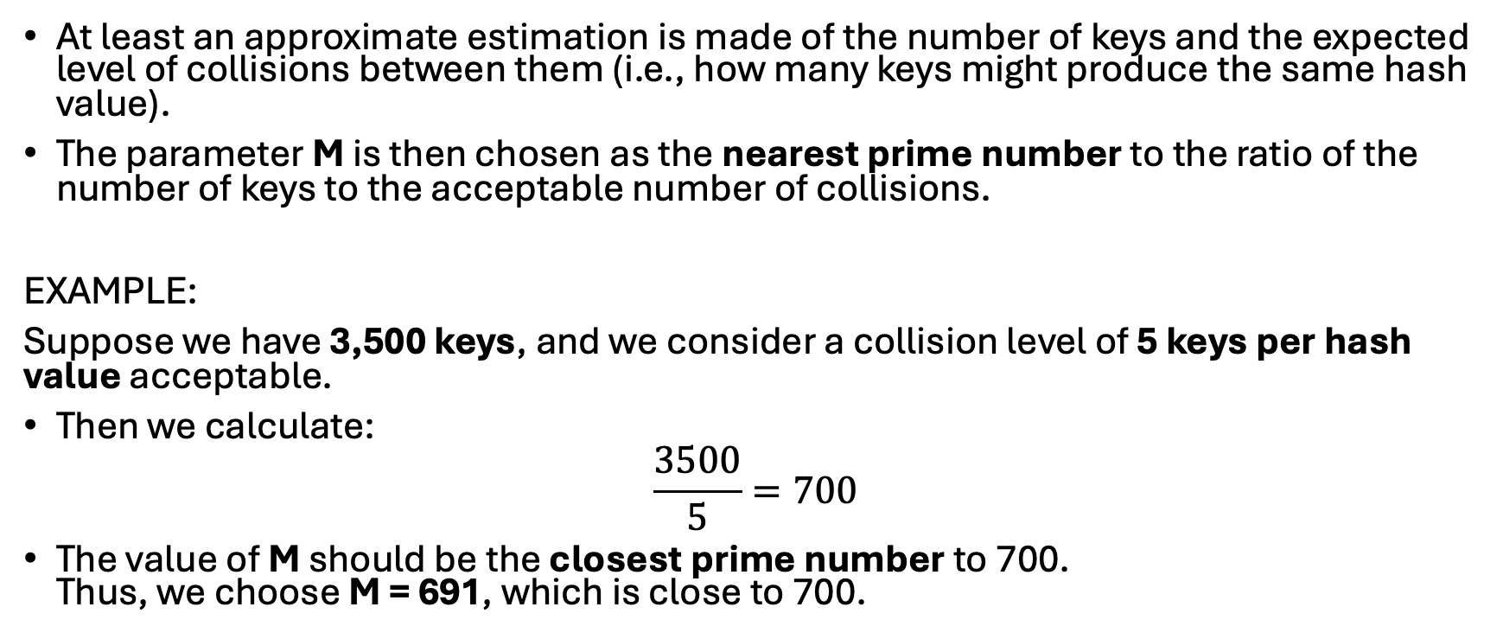
One of the Algorithms for Choosing M
At least an approximate estimation is made of the number of keys and the expected level of collisions between them (i.e., how many keys might produce the same hash value).
The parameter M is then chosen as the nearest prime number to the ratio of the number of keys to the acceptable number of collisions.
EXAMPLE:
Suppose we have 3,500 keys, and we consider a collision level of 5 keys per hash value acceptable.
Then we calculate:
$$\frac{3500}{5}=700$$
The value of M should be the closest prime number to 700. Thus, we choose M = 691, which is close to 700.

Slide 8
Collision Resolution Techniques
Chaining → Each index holds a linked list (or bucket) of values
Open Addressing → If a slot is occupied, find another one:
Linear probing - check the next slot sequentially until an empty one is found
Quadratic probing - check slots using quadratic offsets (1², 2², 3², …)
Double hashing - uses a second hash function to determine the step size

Slide 9
Hash table implementation demo

Slide 10
String Matching Problem
Goal: Find all occurrences of pattern P in text T.
Example:
T = "abracadabra"
P = "abra”
Naive approach: compare every substring → O(n × m) time.

Slide 11
Introduction to the Rabin–Karp Algorithm
Efficient String Matching Using Hashing
Key Points:
Problem: Find occurrences of a pattern P in a text T.
Rabin–Karp idea:
Represent each substring and the pattern as a hash value (integer).
Compare hashes first — only check characters when hashes match.

Slide 12
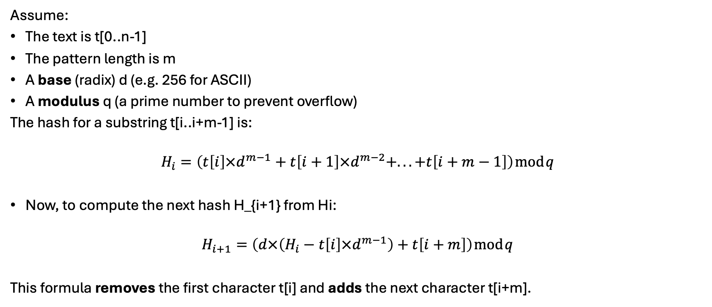
Hashing and Rolling Hash Technique
Assume:
The text is t[0..n-1]
The pattern length is m
A base (radix) d (e.g. 256 for ASCII)
A modulus q (a prime number to prevent overflow)
The hash for a substring t[i..i+m-1] is:
$$H_{i}=\left(t\left[i\right]×d^{m−1}+t\left[i+1\right]×d^{m−2}+...+t\left[i+m−1\right]\right) mod q$$
Now, to compute the next hash H_{i+1} from Hi:
$$H_{i+1}=\left(d×\left(H_{i}−t\left[i\right]×d^{m−1}\right)+t\left[i+m\right]\right) mod q$$
This formula removes the first character t[i] and adds the next character t[i+m].

Slide 13
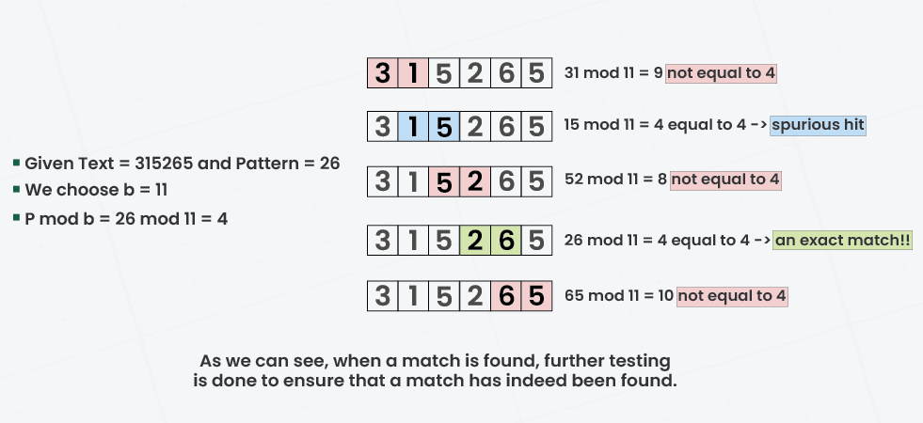

Slide 14
