Slide 1
SER 502 – Team 6 | Project 2
Project Implementation
Aditya Narasimhamurthy
Manit Singh Kalsi
Mohit Kumar
Richa Mittal

Slide 2
Lexer and Parser
Lexical analysis is handled by the Lexer, where it separates a stream of characters into different words or 'tokens‘.
Syntactical analysis is handled by the Parser. It receives the tokens/ input from the Lexer in the form of sequential source program instructions and breaks them up into parts defined in our grammar.
Notes:
Both are generated by ANTLR and both support the Array datatype

Slide 3
Abstract syntax tree
This is a tree representation of the abstract syntactic structure of source code written in a programming language.
Each node of the tree denotes a construct occurring in the source code.
The syntax is "abstract" in not representing every detail appearing in the real syntax.
For our example, the AST would look something like this:

Slide 4
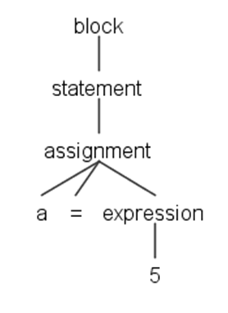
Abstract syntax tree

Slide 5
Abstract syntax tree
Using this tree, our next goal is to reach/ walk to each individual node programmatically and generate the intermediate byte code.
Made use of an inbuilt data type in ANTLR called ParseTree to parse each individual leaf/ non-leaf element.
Once every element was parsed, we created the intermediate byte code, which was then fed to the VM for execution.

Slide 6
Abstract syntax tree
By default, ANTLR generates a parse-tree listener interface that responds to events triggered by the built-in tree walker. .
To walk a tree and trigger calls into a listener, ANTLR’s runtime provides the class ParseTreeWalker.
To make a language application, we write a ParseTreeListener.

Slide 7
Abstract syntax tree
There are situations, however, where we want to control the walk itself, explicitly calling methods to visit children.
Option -visitor asks ANTLR to generate a visitor interface from a grammar with a visit method per rule.
The key “interface” between the grammar and our listener object is called JavaListener, and ANTLR automatically generates it for us.
It defines all of the methods that the class ParseTreeWalker from ANTLR’s runtime can trigger as it traverses the parse tree

Slide 8
Runtime - Implementation
Internally uses stacks, linkedlists and hashmaps to maintain the environment, symbol table and activation records
A symbol table is a data structure used by a compiler where each identifier in a program's source code is associated with information relating to its declaration or appearance in the source, such as its type, scope level and sometimes its location.
During execution, every function call is recorded and maintained on a stack.
In RAMM, the symbol table is implemented as a linked list of hash maps.

