Slide 1
Paws Up!
UCONN Bootcamp Project #3

Slide 2
Elevator Pitch
Paws Up! is a chat app design to engage the user to communicate with a large group of contacts in an easy and enjoyable way. The design is fresh and engaging looking to be intuitive and most of all not tiering to the eye.

Slide 3
Concept
Description
Artistic frontpage with a collage of images of pets, a header with title graphic and onclick buttons to the homepage and chat page.
Motivation for Development
Paws Up! – wants to provide the user a location where they can engage with other animal lovers and owners to share information, stories, news and product reviews that can benefit their four legged friends.
User Story
As a dog owner, I want to have access to information and anecdotes of how other pet owners have dealt with difficult situations or advise they can provide regarding medical issues, training, pet travel and other interesting topics.

Slide 4
Process
Technologies Used
MERN - MongoDB / Express / React / Node
Breakout of tasks/roles
Walter A. Joy IV - Backend
Félix A. Colón – React
Adsana Sayasith– Login/Node
Scott St.Germain- MongoDB
Challenges
We did not developed a strong enough original plan which caused us to work individually before agreeing on a strong design that we knew we could accomplish. For this reason we ended up with a frontend that was going to be too complicated to develop with the time we had available.
Successes
Our success was that after assessing out situation, we were able to refactor some of the original frontend code with a better backend code that gave us a final project. So we basically ended up developing one and a half projects.

Slide 5
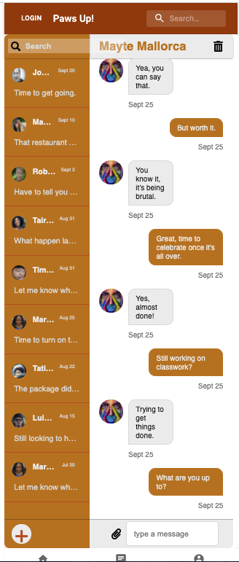
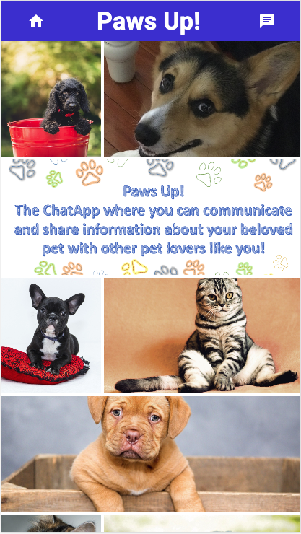
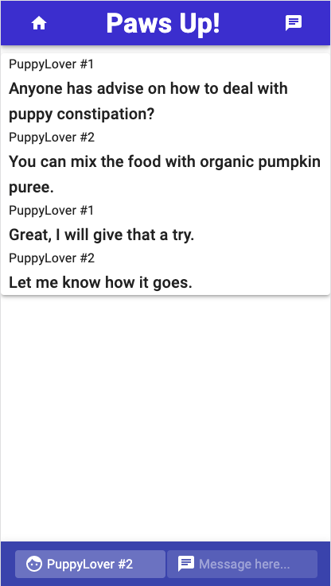
Demo
Original Design
Final Design -FrontPage
Final Design –Chat Page

Slide 6
Direction for Future Development
More items
We would like to add a left panel to the Chat page where the user can manage previous conversations.
Add photo upload capabilities so the user can share images of their pets.
Add a library or section with “pet of the week” where the users can vote for the best picture submitted.

Slide 7
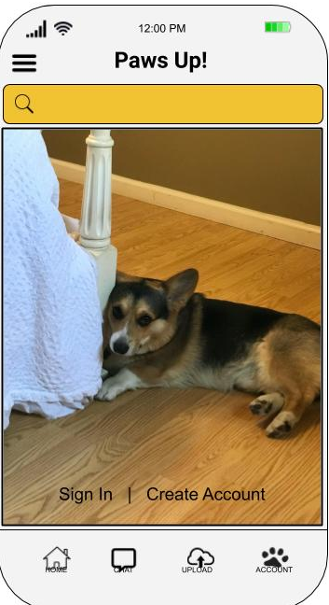
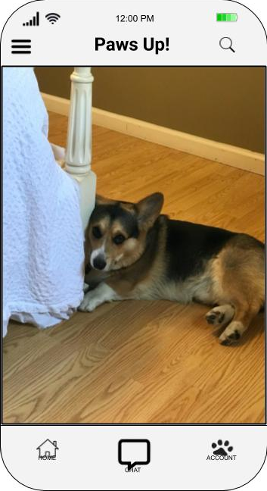
Links
Wireframe
Version #1
Version #2

