Slide 1
Use Git
Or any other version control system

Slide 2

Get GitHub Desktop
(or any other git client)

Slide 3
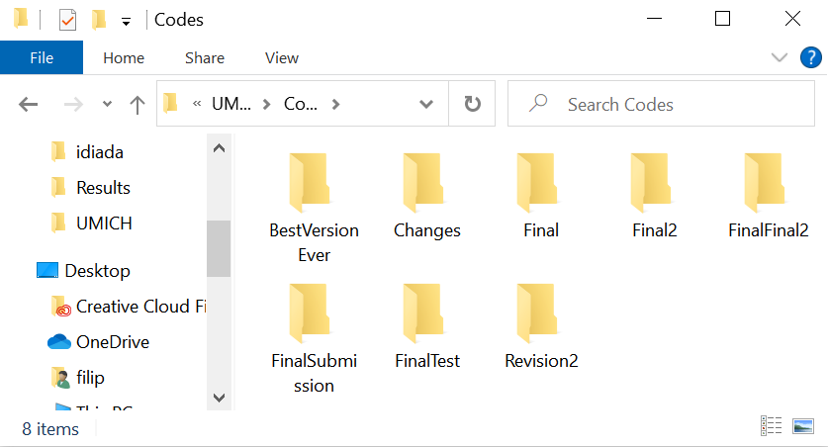
Get organized!

Slide 4

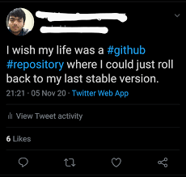
Prepare for a mistake!
Made a big oops?
Overwrote an important file?
The project JUST does not run?

Slide 5
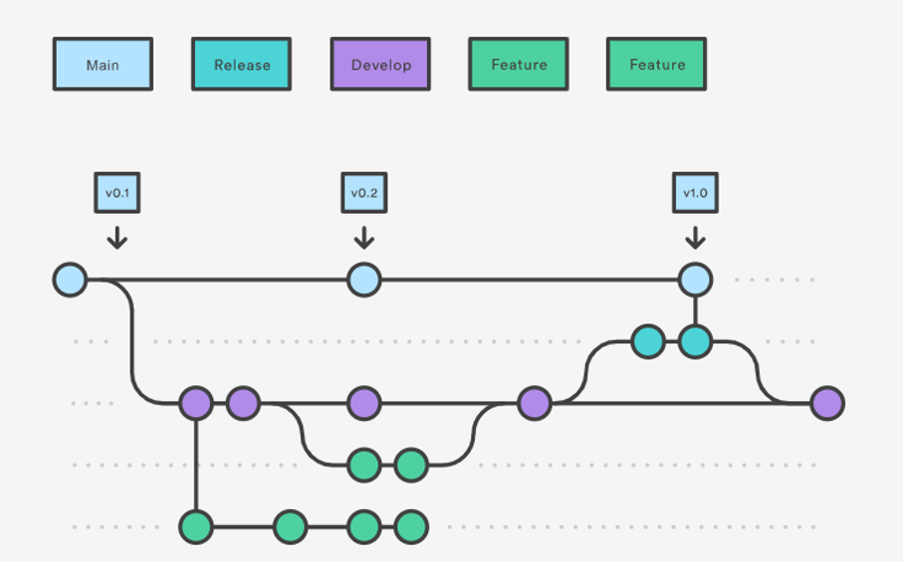
More versions of the same project
Some experiments are dead ends
Still good to keep track of them
Hell to maintain

Slide 6
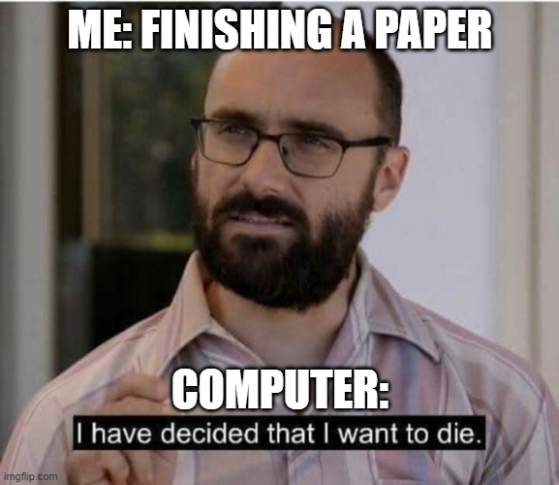
Get backed up!

Slide 7
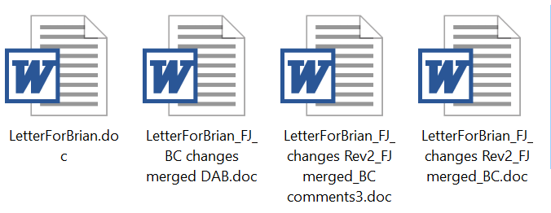

Collaborate!

Slide 8
Make your research public
Science must be repeatable
Describe methods, attach source code
  Bug in the methods or in the code
80 % of the modeling papers can’t be replicated without the source codes
  links to old, hard-to-find papers
  Missing equations
  Missing values
  Typos
“The model enclosed is the earliest I have in my files, so it may not duplicate what is in my paper.”
Undisclosed author,
personal communication,
01/05/2022

Slide 9
Version control system
Tracks all the revisions, creates safe „Checkpoints“
Allows organizing the project in multiple (concurrent) branches
Simplifies cooperation
Tag the release version and back it up!
“The model enclosed is the earliest I have in my files, so it may not duplicate what is in my paper.”
Undisclosed author, 01/05/2022

Slide 10
Version control systems
Source Code Control System (1972)
CVS (1985)
Subversion (SVN)
…
BitKeeper
GNU Bazaar
Mercurial (2005)
Git (2005)

Slide 11

Use Git!
an unpleasant or contemptible person.
"that mean old git"
Global information tracker (or goddamn idiotic truckload of ****)
Developed to support Linux core development in 2005
Most popular Version control system with collaboration
Don’t get lost in your versions, name them and store them!
Backup and recovery
Sharing and dissemination
It’s easy, it’s open-source, it’s free
It is a necessity!

Slide 12
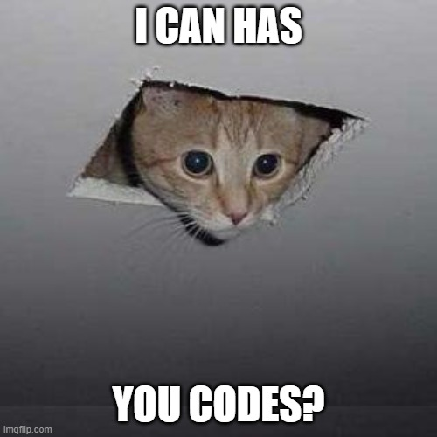
What to version control?
Anything plaintext, that you develop in time
  Track your progress, tag a release
Required data and supporting files
  Skip intermediate, generated files
Public stuff vs Private stuf (GitHub)
  Top secret stuff? (own Git server?)
Have codes? Make a repository!
Working on a codes? Commit and push!
“Publish only finished” ?
  A project is never final

Slide 13
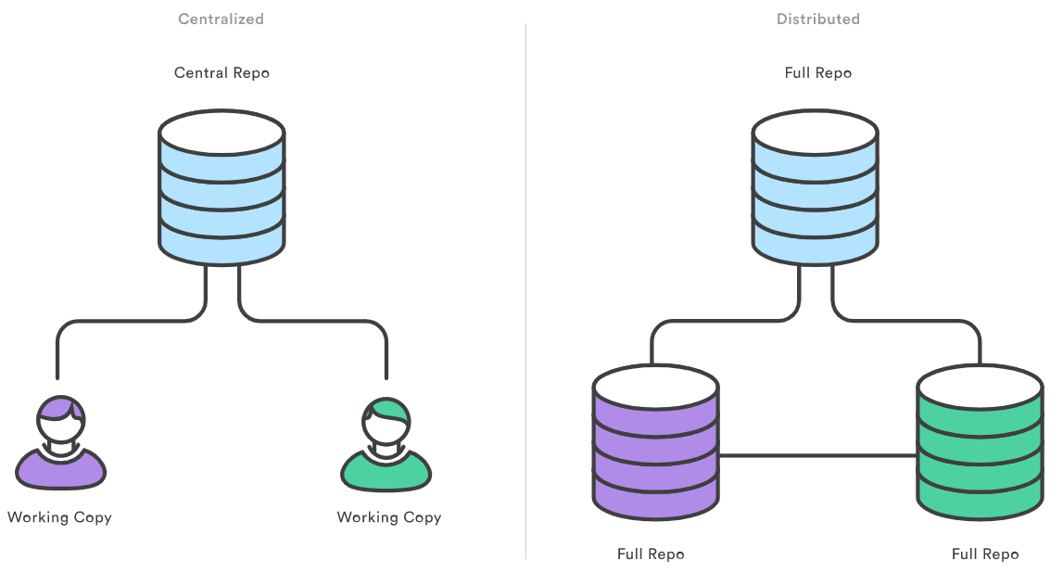

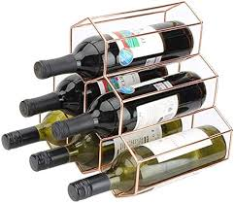

What is a Git Repository?
Repository: history and branches
Working copy: files on the drive
(usually in hidden subfolder, e.g. .Git)
Just a folder with some extras..

Slide 14
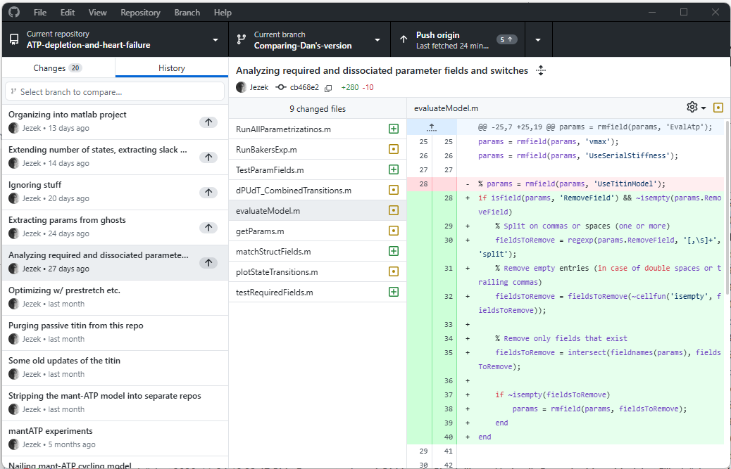
Repository log – take me to the past and back

Slide 15
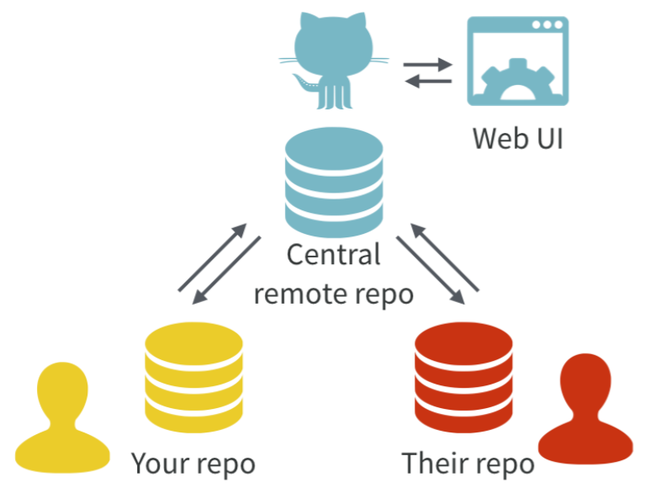
Centralized and distributed repositories and GitHub
Centralized repositories:
All history on ONE place
(CVS, SVN…)
Users pull working copies
Distributed repositories: Full history locally
(local repositories)
Users synchronize their versions using pull / push
        (Git, Mercurial…)
GitHub (GitLab) adds WebUI to the server
https://www.atlassian.com/git/tutorials/why-git
https://doi.org/10.7287/peerj.preprints.3159v2

Slide 16

Centralized and distributed repositories and GitHub
Centralized repositories:
All history on ONE place
(CVS, SVN…)
Users pull working copies
Distributed repositories: Full history locally
(local repositories)
Users synchronize their versions using pull / push
        (Git, Mercurial…)
GitHub (GitLab) adds WebUI to the server
https://www.atlassian.com/git/tutorials/why-git
https://doi.org/10.7287/peerj.preprints.3159v2

Slide 17
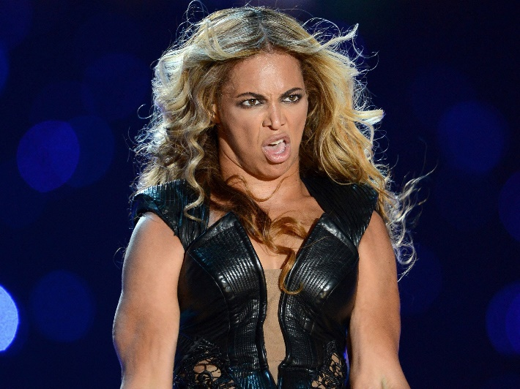
Distributed repositories
Everyone retains a copy of ALL history
  What has been done, can’t be undone*
  Careful with passwords etc. – Internet never forgets!
Synchronization
  1) Pull – update local repo
  2) Merge local – sort out the conflicts
  3) Push – update server, conflict-free
Pic of Beyonce, legally removed from the internet
* Terms and conditions apply – e.g. force push etc

Slide 18

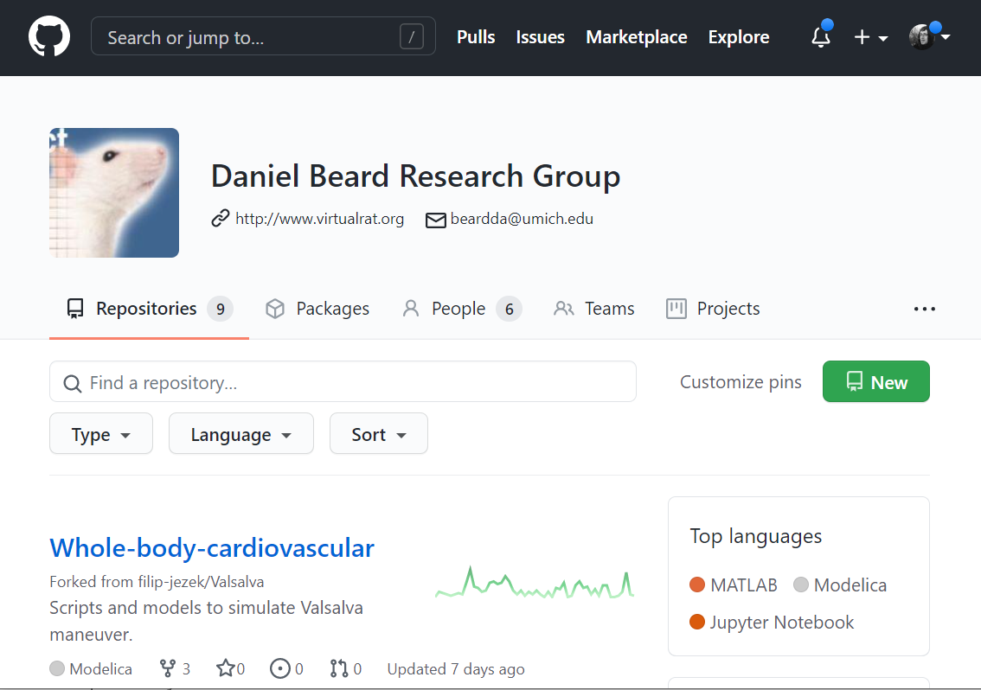
GitHub
A public, free git repository hosting (one of many)
Reliable, trusted, owned by Microsoft
Public repositories with unlimited collaborators
Limited private repositories
We already have https://github.com/beards-lab
UMICH has enterprise license https://its.umich.edu/communication/collaboration/github

Slide 19

GitLab
Open source repository hosting, Hosted by many free and paid services
Unlimited private repositories, collaborators, etc..
UMICH used to have one, now transferred to GitHub

Slide 20
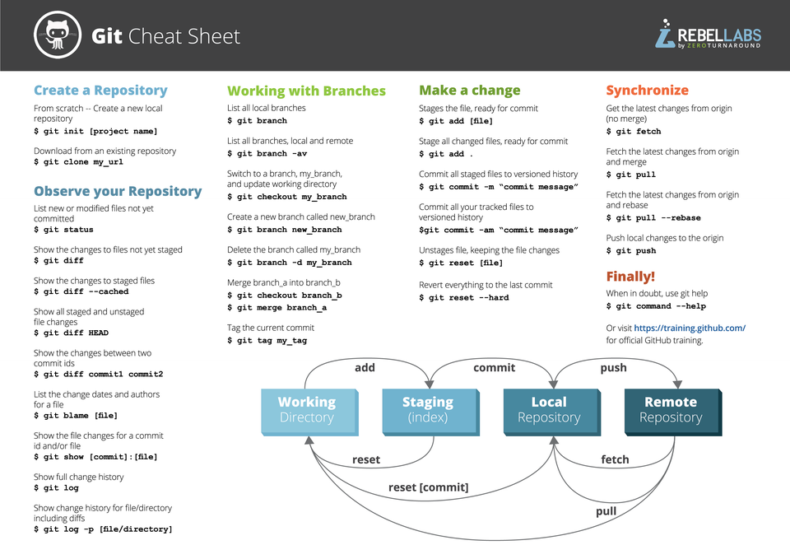
Client tools
http://git-scm.com/
downloads/guis
Command line?
  https://git-scm.com/
Windows
  TortoiseGit + Git for Windows https://tortoisegit.org/
  GitHub Desktop https://desktop.github.com/
MacOs
  GitHub Desktop https://desktop.github.com/
  …
Integrated into Matlab, VS Code…

Slide 21



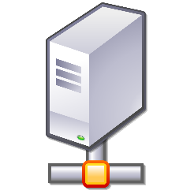

Process
DO THIS AS OFTEN AS POSSIBLE
File system
Local
Repository
Remote
Repository
Stage
Commit
Pull
Push
Do this for collaboration and backup

Slide 22
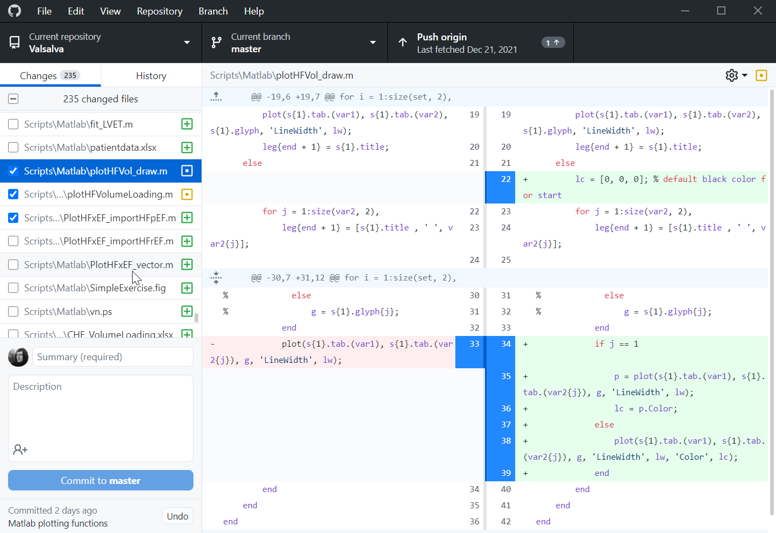
Process - stage
Selecting changes
  Adding new files
  Selecting changed files (or parts)

Slide 23
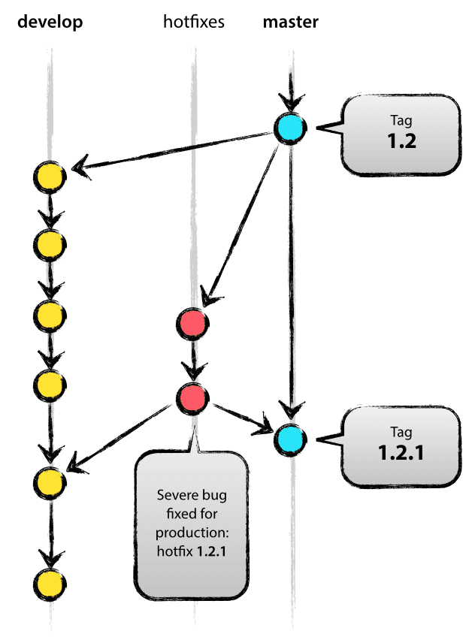
Process – COMMIT
Add a commit summary*
Commiting the changes into LOCAL repository
  Safe checkpoint
  On top of current BRANCH
  Or to a NEW branch
Roll back to any previous commit
Compare with any previous commit

Slide 24
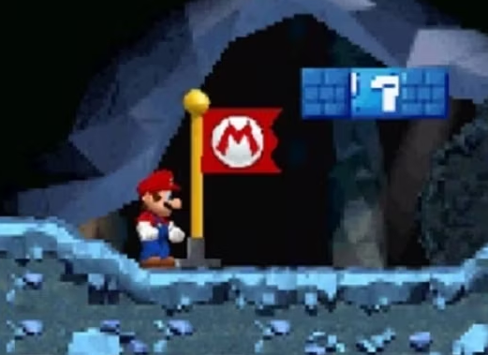
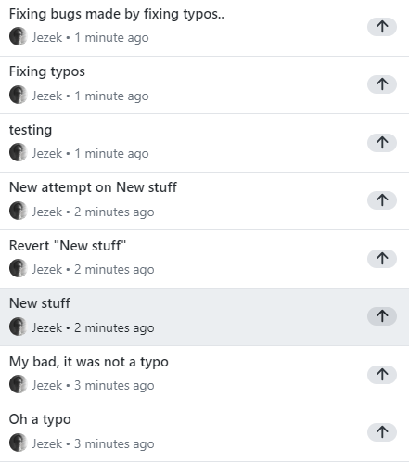
Process – COMMIT = safe checkpoint
DO NOT be afraid of dumb commits
All of them might be useful checkpoints
All opensource projects do that – it is no shame
You can use squash before pushing

Slide 25
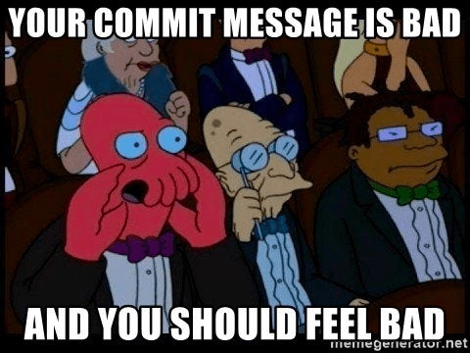
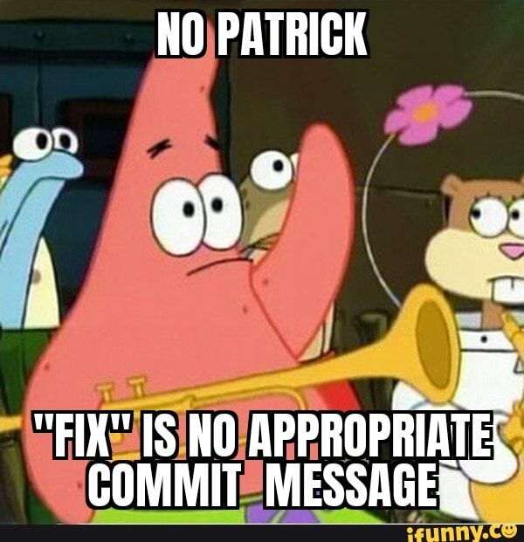
Process – COMMIT: Summary
Commit message (Summary) required
Try to be specific and concise,
your future self will thank you
E.g.
Fix typo in ReadMe
Adding project1 data files
Fix crashing during simulation
Use Description to provide further context, e.g.
Setting step size > 0.2 results in a crash

Slide 26
Process - PUSH
Pushing our LOCAL repository to the REMOTE repository
  Could have more remotes
  What if the REMOTE version is newer?
    Need to pull (aka fetch) first
    Merge and sort the conflicts on OUR side
Local
Repository
Remote
Repository
Pull
Push

Slide 27
Process - PULL
Pulling from the REMOTE server into LOCAL repository, updating the files
  Can have more remotes
  What if we made some changes?
Resolve conflicts, if present
(Fetch - just sync’s the repo, no merge)
Local
Repository
Remote
Repository
Pull
Push

Slide 28
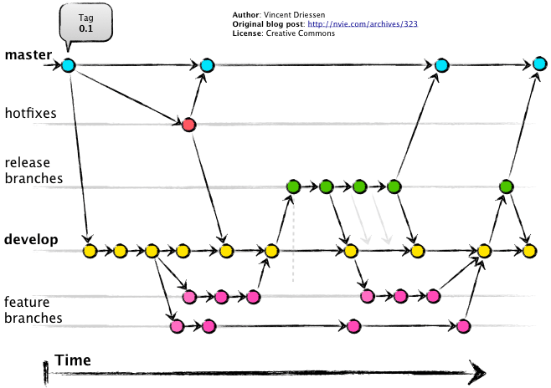
Branching
Each commit is a snapshot in time
  Everything is checksummed with a SHA hash, with a custom label
  (commit name)
  Has one or two parents
Branch is a pointer to a commit
  Most recent commit in a branch
  Default name:
  “master”, “main” or
  “CommitMcCommitFace:
Branches are meant to merge
Do not have to overuse with
GitHub

Slide 29
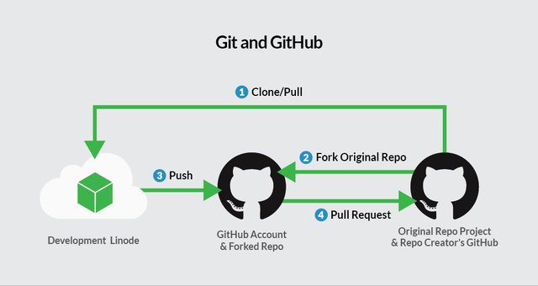
Collaboration
Collaborators in your group share the same remote
  Write access?
Outside collaborators for open-source project
  Use GitHub’s pull request features:
  Collaborator:
    Makes a copy (Fork) of the repo
    Commits his changes
    Issues pull request
  Maintainer:
    Reviews and merges the changes

Slide 30
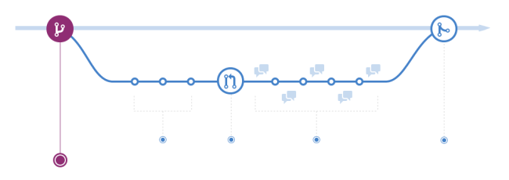
Pull requests
Open the code to wide public, incl. non-collaborators
  Still prevent them from messing your code
“Hey, I fixed your code, wanna merge?”
You are sharing your code, Bob checks it out (forks).
Fork is Bobs version (= Bob’s branch)
Bob makes some changes and commits to his repository (which is a branch of your repository).
Bob finalizes his codes.
Bob can’t rewrite your code,
issues a pull request
You check his changes and merge

Slide 31
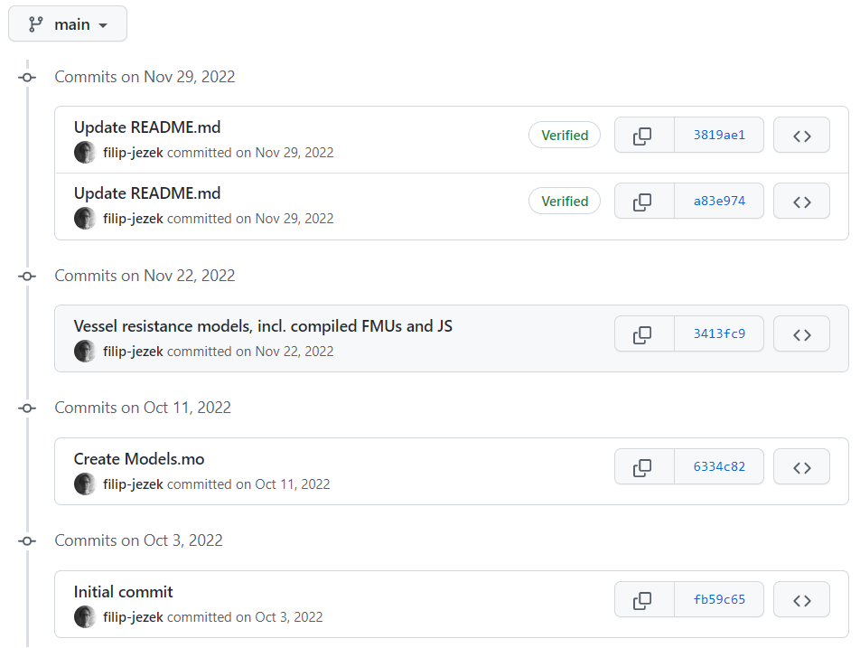
GIT: Get organized!

Slide 32
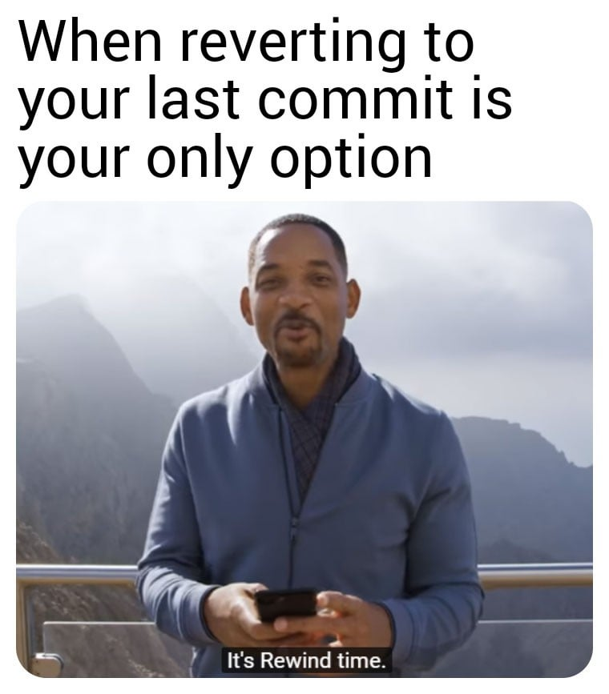
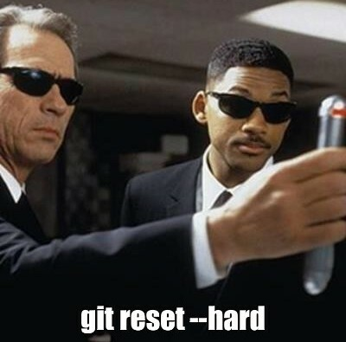
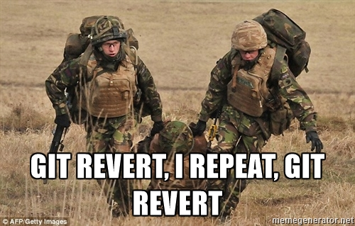
Git: Prepare for a mistake!
Made a big oops?
Overwrote an important file?
The project JUST does not run?

Slide 33
GIT: More versions of the same project
Hell to maintain?
Branches might merge back when successful, or die out

Slide 34

GIT: Get backed up!
GitHub:

Slide 35
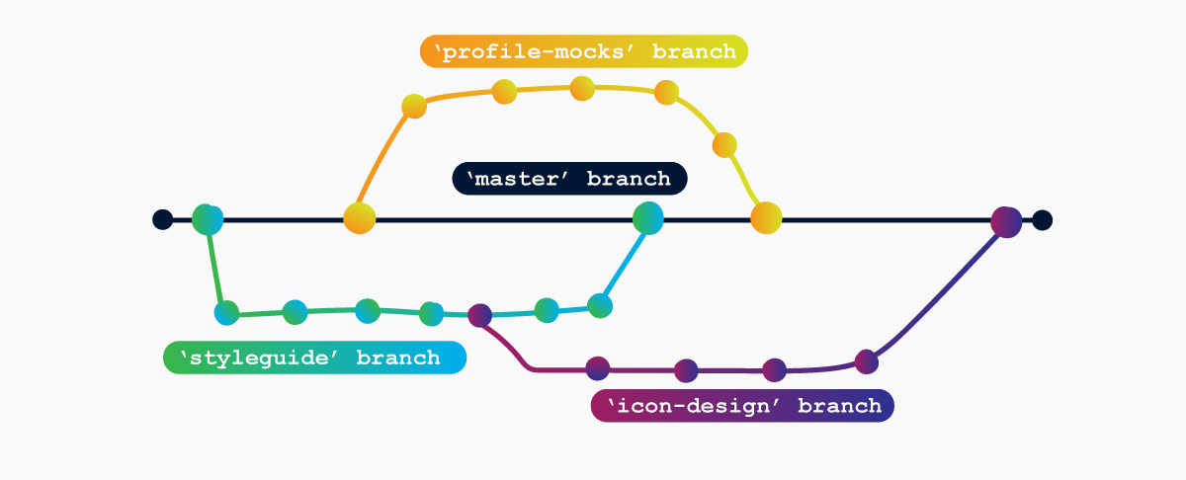
Git: Collaborate!
Invited collaborators
Pull requests from wide public

Slide 36
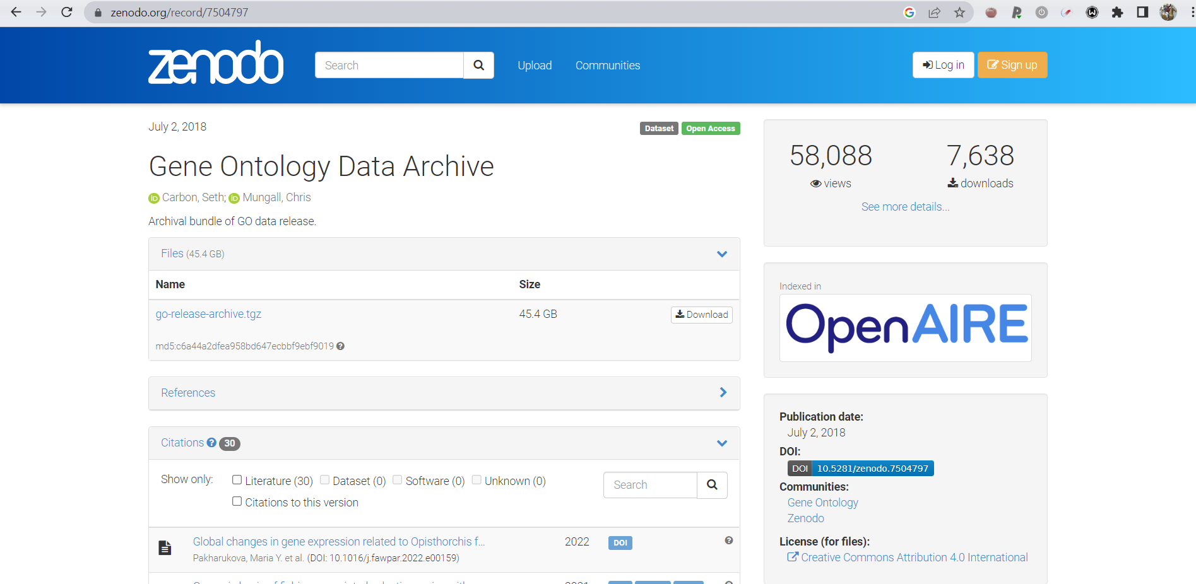
Git: Make your research public
A link to GitHub would do too
Dedicated storage repository - https://zenodo.org/ - pin a release

Slide 37
Hands on

Slide 38
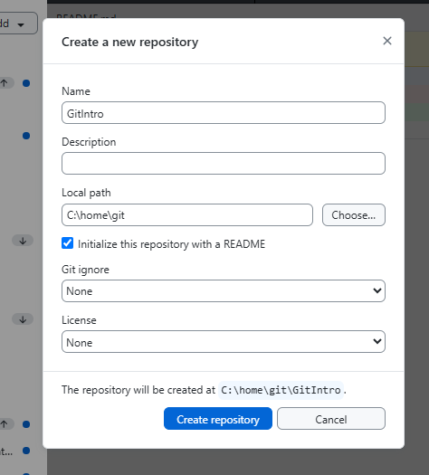
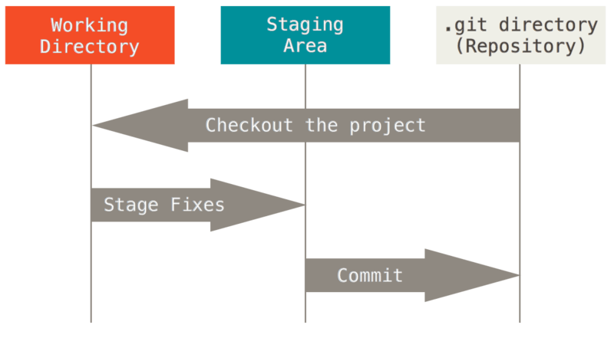
First commit, where we initialize
Initialize a new repository
Add a readme.md file, write down the “Hello world” line
Git commit
  Staging level
  Commit message
https://git-scm.com/book/en/v2

Slide 39
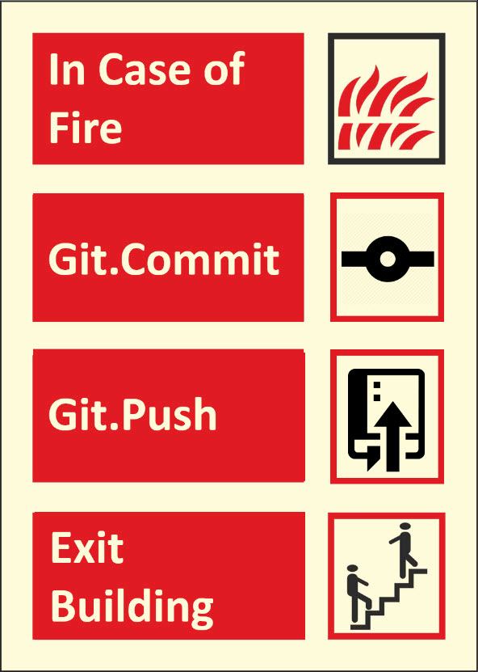
Second commit, where we extend and ignore
Add a line to the readme.md below the hello world:
“This is our testing repository”
Add data/topsecretfile.md
Add generatedfile.mat
Add .gitignore file
  Data/
  *.mat
Commit
Push (publish)

Slide 40


.gitignore
Commit only the sources,
not the products
  Ignore output and intermediate files
  NO secret data not to be shared
=> Ignore staging
.gitignore
  A specialized file stores what should be ignored at staging
  also versioned, can be ignored :)
  In any folder
  Names: topsecretfile.txt
  Wildcards: /*.mat
IGNORED FILES LIVE ONLY IN YOUR FOLDER
NO DISCARD
NO REVERT
NO CONTROL ON BRANCH SWITCH

Slide 41
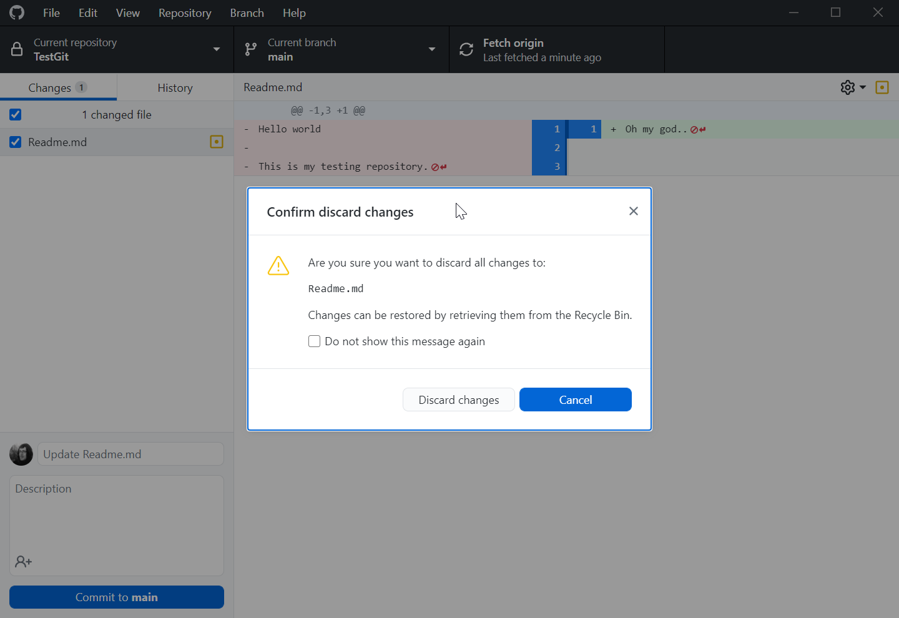
Third commit, where we mess up
Delete the content of the readme.md
  Discard changes
Mess up again and commit (locally)
  Undo commit (if it was not pushed)
    The files stay modified
  Reset to… (if it was not pushed)
    The files get reset too
After Push
  Revert the changes (not always convenient)
  Check out (always there)
  Make a branch on previous commit
  (Full working state)

Slide 42

That’s it!
… let’s see some advanced stuff with branching next time!

