Slide 1
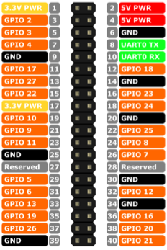
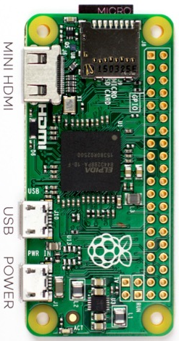
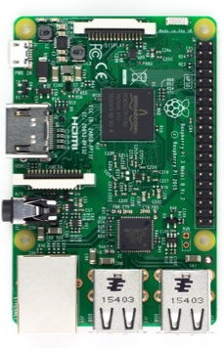
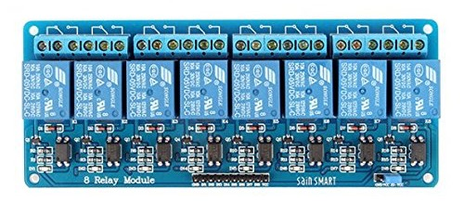
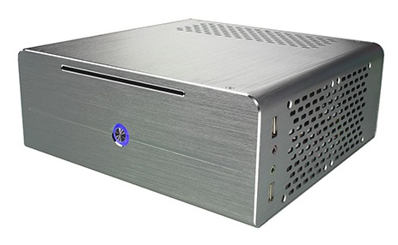
Power Outlet
USB Serial Adapter
USB
S-Video
EasyCAP
USB
MicroUSB
to USB
HDMI to S-Video Converter
HDMI
Wired to reset switch

