Slide 1
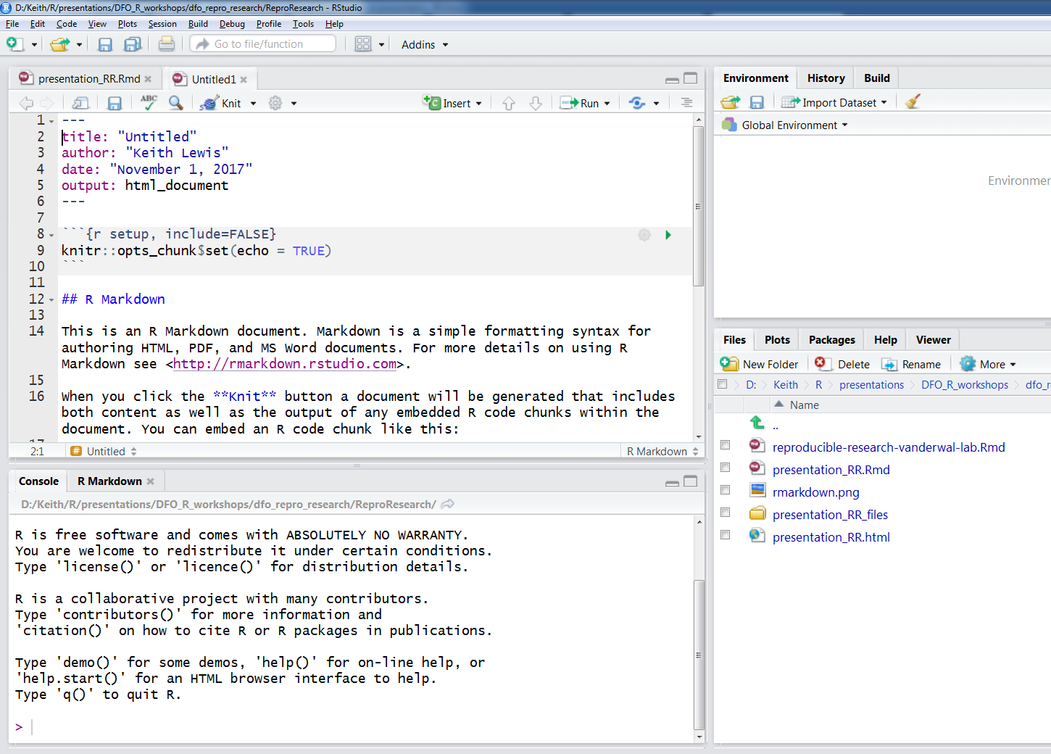
Knit button
YAML
R chunk
text chunk

