Slide 1
SM
Personal Software Process
for Engineers: Part I
Introduction to PSP and TSP

Slide 2
Lecture Topics
The need for change
PSPSM and TSPSM principles and objectives
What is the TSP?
The need for management support
What is the PSP and how does it help?
Course results
SM Personal Software Process, PSP, Team Software Process, and TSP are service marks of Carnegie Mellon University.

Slide 3
The Changing World of Software
Software now controls most business, government, and military systems.
  Factories are managed by software.
  Most advanced products are controlled by software.
  Finance, administrative, and business operations are largely run by software.
The cost, schedule, and quality of software is now a critical business concern.

Slide 4
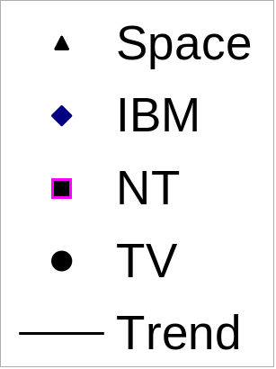
Software Products are Bigger
10,000,000
1,000,000
100,000
10,000
Size in KLOC
1,000
100
10
1
0
1960
1965
1970
1975
1980
1985
1990
1995
2000
Moore’s Law:
2X in 18 months
10X in 5 years
Years
Notes:
No changes.

Slide 5
Big Software Projects Usually Fail
With increased size, projects are more troubled.
Project Size | People | Time (Months) | Success Rate
Less than $750K | 6 | 6 | 55%
$750K to $1.5M | 12 | 9 | 33%
$1.5M to $3M | 25 | 12 | 25%
$3M to $6M | 40 | 18 | 15%
$6M to $10M | +250 | +24 | 8%
Over $10M | +500 | +36 | 0%
This is a problem of scale: current software practices do not scale up.
Standish: Chaos Reports, 1999

Slide 6
Why Projects Fail -1
Large and small software projects fail for four reasons.
Project commitments are often unrealistic.
The larger the project, the less influence we have.
If we don’t have anything to say, nobody will listen.
Larger projects are harder to control.
Today, few developers have personal plans.
Without a plan, you cannot know job status.
If you don’t know where you are, management can’t understand job status.
If management doesn’t understand job status, they can’t manage projects.

Slide 7
Why Projects Fail -2
Quality problems get worse with project size.
In software systems, if any part has quality problems, the system will have quality problems.
If the developers do not manage quality, their teams cannot manage quality.
When unmanaged, quality will always be poor.
To be effective, teams need leadership and coaching.
Leaders build team motivation and commitment.
Coaching develops team cohesion.
Cohesive, motivated, and committed teams do the best work.

Slide 8
The Need for Change
Many lives and businesses now depend on software.
We now need larger, more complex, and safer software systems on predictable schedules.
Without different software practices, this will not happen.
The Team Software Process (TSP) addresses this need.
The PSP provides the knowledge and skill that developers need to work on TSP teams.

Slide 9
Management Support -1
The initial TSP objective is to convince management to let your team be self directed.
A self-directed team
sets its own goals
establishes its own roles
decides on its own development strategy
defines its own processes
develops its own plans
measures, manages, and controls its own work
Self-directed teams do the best work.

Slide 10
Management Support -2
Management will support you as long as you
strive to meet their needs
provide regular reports on your work
convince them that your plans are sound
do quality work
respond to changing needs
come to them for help when you have problems

Slide 11
Management Support -3
Self-directed teams are a bargain.
Management will agree to your managing your own work as long as they believe that you are doing a superior job.
To convince them of this, you must
maintain precise and accurate plans
measure and track your work
regularly show management that you are doing superior
work
The PSP shows you how to do this.

Slide 12
PSP Principles -1
The quality of a software system is determined by the quality of its worst components.
The quality of a software component is governed by the individual who developed it.
The quality of a software component is governed by the quality of the process used to develop it.
The key to quality is the individual developer’s skill, commitment, and personal process discipline.

Slide 13
PSP Principles -2
As a software professional, you are responsible for your personal process.
You should measure, track, and analyze your work.
You should learn from your performance variations.
You should incorporate lessons learned into your personal practices.

Slide 14
What Does a PSP Provide?
A stable, mature PSP allows you to
  estimate and plan your work
  meet your commitments
  resist unreasonable commitment pressures
You will also
  understand your current performance
  be better equipped to improve your capability

Slide 15
What Does the PSP Provide?
The PSP provides
  a proven basis for developing and using an industrial-strength personal process
  a discipline that shows you how to improve your personal process
  the data to continually improve the productivity, quality, and predictability of your work

Slide 16
What is the PSP?
The PSP is a personal process for developing software or for doing any other defined activity. The PSP includes
defined steps
forms
standards
It provides a measurement and analysis framework for characterizing and managing your personal work.
It is also a defined procedure that helps you to improve your personal performance.

Slide 17
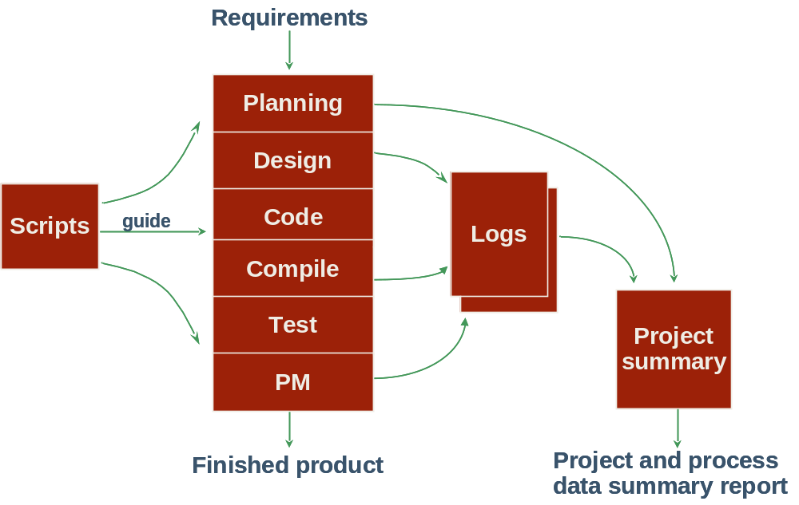
The PSP Process Flow

Slide 18
The Personal Software Process
The PSP process is designed for individual use.
It is based on scaled-down industrial software practice.
The PSP course demonstrates the value of using a defined and measured process.
It helps you and your organization meet the increasing demands for high quality and timely software.

Slide 19
Learning the PSP -1
The PSP is introduced in six upward-compatible steps.
You write one or more module-sized programs at each step.
You gather and analyze data on your work.
You use the results to improve your personal performance.

Slide 20
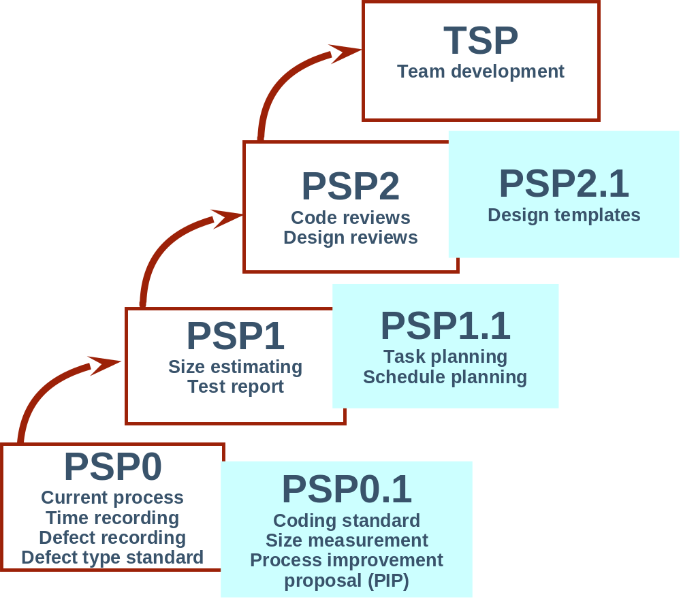
Learning the PSP -2

Slide 21
Learning the PSP -3
PSP0: You establish a measured performance baseline.
PSP1: You make size, resource, and schedule plans.
PSP2: You practice defect and yield management.

Slide 22
At Course Conclusion
You will have practiced the key elements of an industrial-strength software process.*
You will understand which methods are most effective for you.
You will do better work.
You will have long-term improvement goals.
*These are generally called CMMI level 5 processes.

Slide 23
Course Results
We now have data on over 30,000 programs written using the PSP.
The following charts show how others have improved during the PSP course.
  effort estimating
  compile and test time
  productivity

Slide 24
PSP Effort Estimating Accuracy
40
40
Majority are under-
estimating
Balance of over- and
underestimates
Much tighter balance
around zero
PSP 0
20
20
0
0
-
-
200%
200%
-
-
100%
100%
0%
0%
100%
40
100%
40
PSP 1
20
20
0
0
-
-
200%
200%
-
-
100%
100%
0%
0%
100%
40
100%
40
PSP 2
20
20
0
0
-
-
200%
200%
-
-
100%
100%
0%
0%
100%
100%

Slide 25
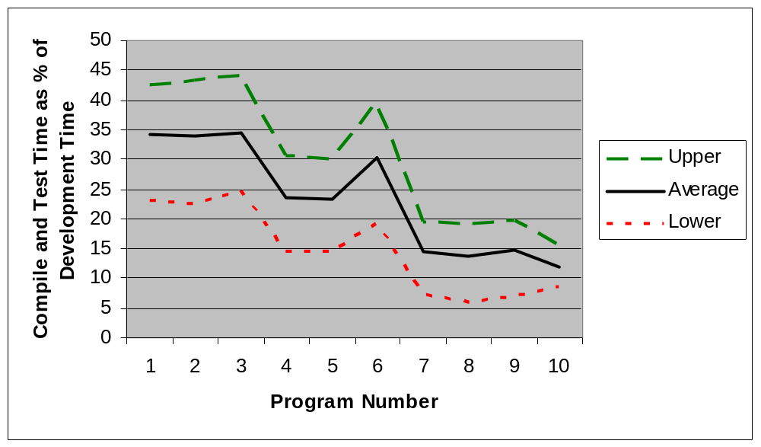
Compile and Test Time – 810 Engineers

Slide 26
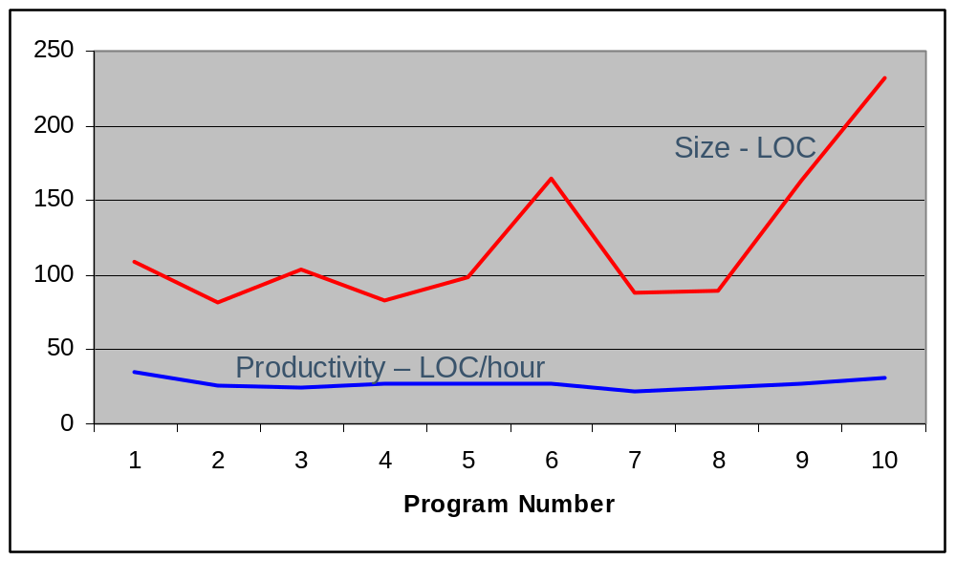
Size and LOC/hour – 810 Engineers

Slide 27
Messages to Remember
The PSP is a defined process that helps you do better work.
Once you have completed the course, you will know how to apply the PSP to your personal needs.
You will have the knowledge and skill to be on a TSP team.
With PSP0, the objective is to gather accurate and complete data on your work.

