Slide 1
Personal Software Process for Engineers: Part I
Tutorial: Using PSP0.1
SM

Slide 2
Tutorial Objectives
After this tutorial, you will
  understand the PSP0.1 process
  know how to use the PSP0.1 process scripts and forms
  be prepared to use PSP0.1 for program 2

Slide 3
PSP0.1 Objectives
The objectives of PSP0.1 are to help you to
  measure the size of the programs that you produce
  perform size accounting for the programs that you produce
  make accurate and precise size measurements

Slide 4
New Process Elements
There are two new process elements.
  process improvement proposal (PIP) form
  size counting and coding standards
The project plan summary has been expanded.
  a Program Size Summary section has been added
  planned time in phase is calculated based on historical time in phase percentage

Slide 5
PSP0.1 Process Script Additions
The additions to the PSP0.1 process scripts include new steps for
  estimating and reporting software size
  distributing development time over planned project phases
  using a size counting and coding standard
  recording process problems and improvement ideas

Slide 6
Process Improvement Proposal -1
To improve your process, you will need to capture process problems and propose improvements for future reference.
You will need to know
  any problems you have encountered in using the process
  any suggestions you have for process improvements
  your observations and findings from doing the assignments

Slide 7
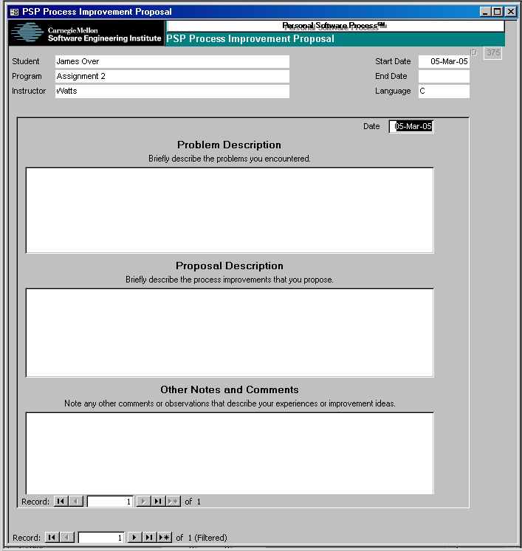
Process Improvement Proposal -2
You should complete a PIP form for each assignment.
The PIP holds process improvement information.
  date
  problem description
  proposed solution
  notes and comments

Slide 8
Coding and Counting Standards
Coding and size counting standards are needed to write the PSP programs.
These standards are
  tailored to your language and needs
  designed to make size counting easier
The coding standard defines quality-oriented exit criteria for the code phase.

Slide 9
PSP Software Size Measures
In the PSP, software size measures are used to
  relate the amount of product produced with
  effort expended to project total effort
  calculate productivity
  normalize defects
  project the total defects
Software size is measured in LOC.
To accurately relate size to effort, the different types of LOC in your program are counted separately.

Slide 10
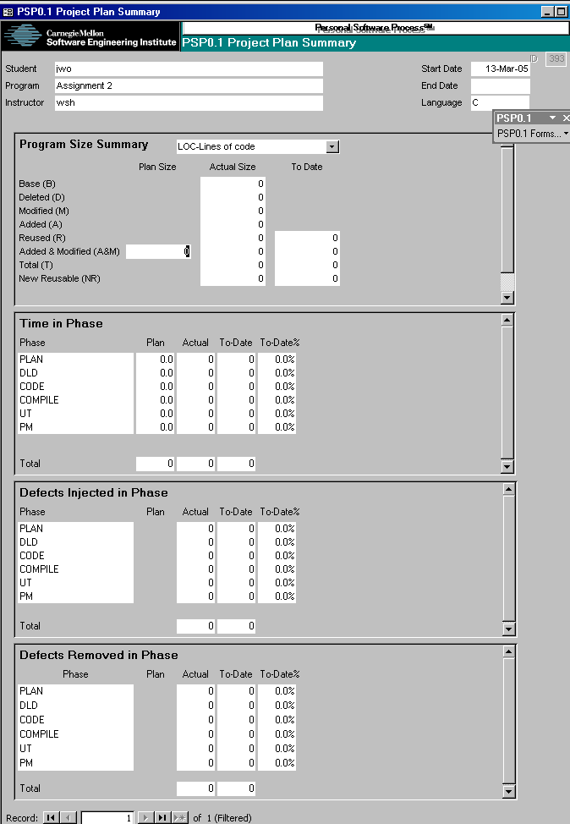
PSP0.1 Project Plan Summary
PSP0.1 adds the Program Size Summary for estimated and actual size data.
The types of size include
  base [B]
  deleted [D]
  modified [M]
  added [A]
  reused [R]
  added and modified [A+M]
  new reusable

Slide 11
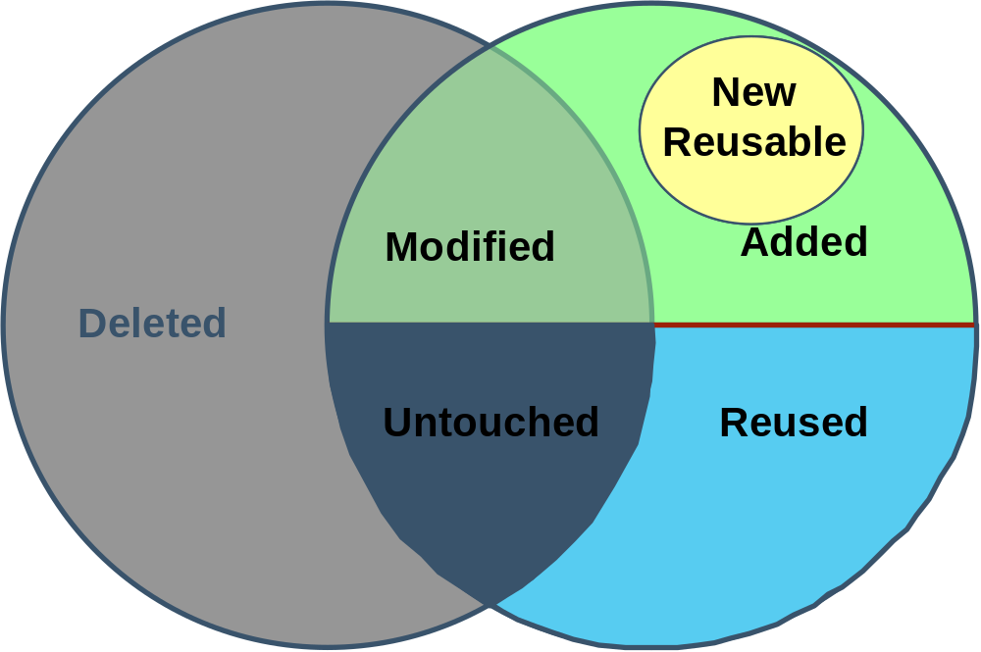
Program Size Type Relationships
Base program
New program
Added & Modified
Notes:
Possibly animate this diagram to introduce the pieces one at a time (new reused last)

Slide 12
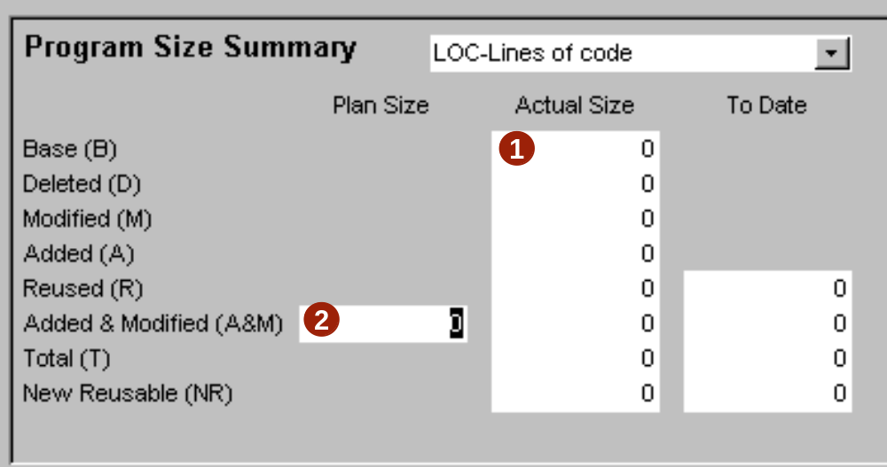
Estimating Size
During planning
  If this is an enhancement, measure the size of the base program and enter this in the Base (B) space under Actual.
  Estimate the added and modified size and enter this in the Total Added and Modified (A+M) space under Plan.

Slide 13
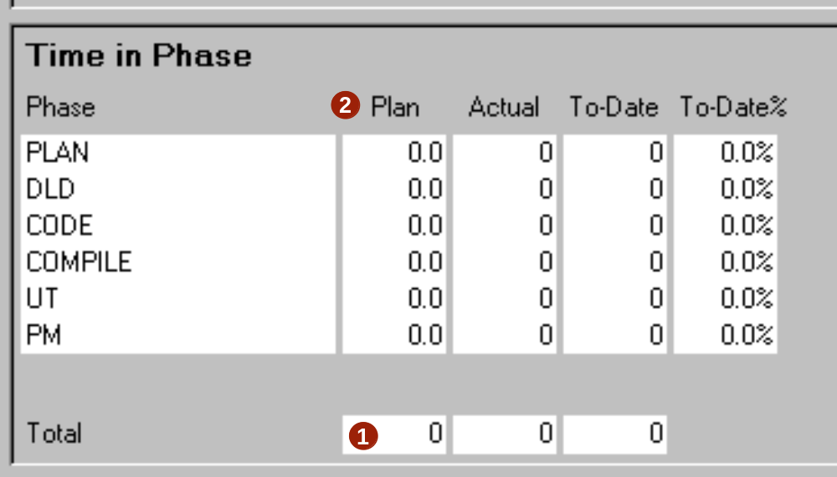
Estimating Development Time
During planning
  Enter estimated development time
  Planned time in phase is then calculated based on the percentage of time in phase for all completed projects

Slide 14
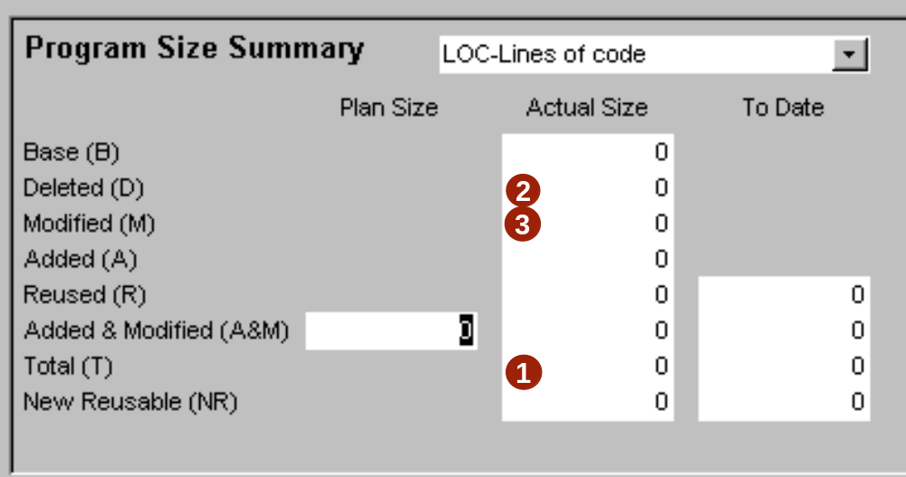
Recording Size -1
During postmortem
  Measure total program size and enter this in the Total Size (T) space under Actual.
  Count the deleted size and enter this in the Deleted (D) space under Actual.
  Count the modified size and enter this in the Modified (M) space under Actual.

Slide 15
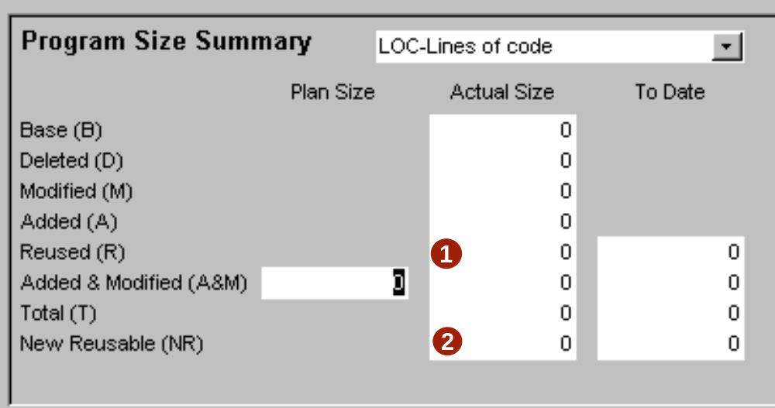
Recording Size -2
During postmortem
  Count the reused size and enter this in the Reused (R) space under Actual.
  Count or estimate the number of new and changed size that will be added to the reuse library and in the New Reusable space under Actual.

Slide 16
Message to Remember
Your principal objective is to measure and estimate the size of the programs that you produce so that you can effectively plan and manage your work.

