Slide 1
Personal Software Process for Engineers: Part I
Tutorial: Using PSP1.1
SM

Slide 2
Tutorial Objectives
After this tutorial, you will
  understand the new elements of PSP1.1
  know how to use the PSP1.1 scripts and forms
  be prepared to use PSP1.1 for program 4

Slide 3
PSP1.1 Objectives
The objectives of PSP1.1 are to introduce and practice methods for
  making resource and schedule plans
  tracking your performance against these plans
  judging likely project completion dates

Slide 4
New Process Elements
There are two new process elements.
  task planning template
  schedule planning template
These are typically used for projects that take several days or weeks.
They are not required for the PSP exercises.
The project plan summary has been expanded to include basic process statistics.

Slide 5
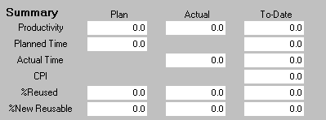
PSP1.1 Project Plan Summary
The summary section has been expanded to include
  Planned time
  Actual time
  CPI
  %Reused
  %New Reusable
These values are calculated automatically.

Slide 6
Measurement Definitions -1
Planned Time
  Plan: planned development time for this project
  To-Date: sum of planned development time for all completed projects + this project
Actual Time
  Actual: actual development time for this project
  To-Date: sum of actual development time for all completed projects + this project
Cost Performance Index (CPI)
  To-Date planned time / To-Date actual time

Slide 7
Measurement Definitions -2
%Reused: percentage of reused size for this project
  Reused / Total * 100
%New Reusable: percentage of new reusable code developed for this project
  New Reusable / Added and Modified * 100

Slide 8
Task and Schedule Plans
Task and schedule plans are used to estimate when work will be completed.
Tasks are entered on the task plan.
  each task in order
  planned hours
  actual hours
  date task completed
Schedule hours are entered on the schedule plan.
  planned hours for each schedule week
  actual hours for each schedule week

Slide 9
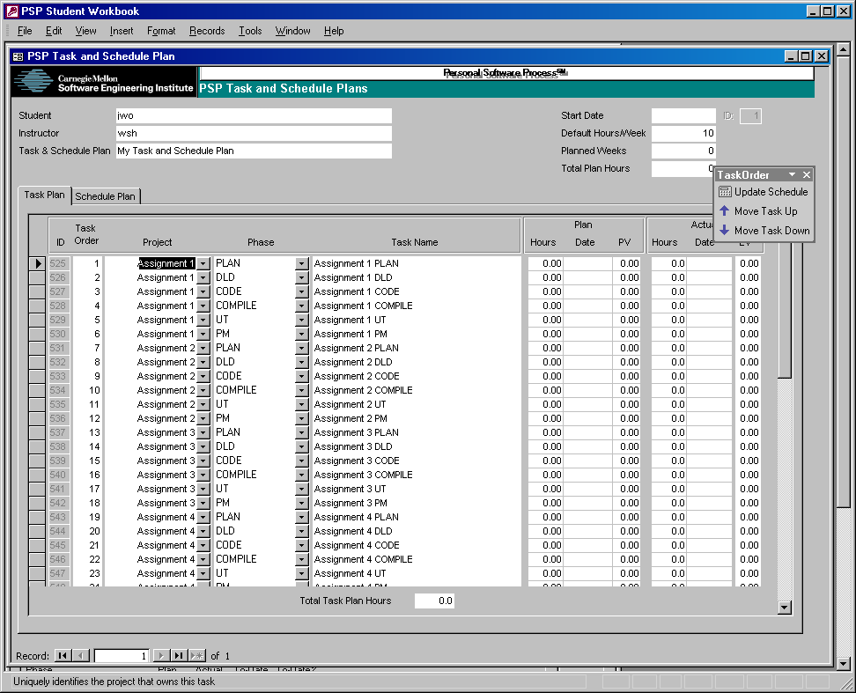
Task Plan -1
The phases of each project are automatically added to the task plan when the project is created.
Only the actual date completed needs to be entered, the other data are automatically calculated.

Slide 10
Task Plan -2
Use the task order menu to
  Update the task and schedule plan
  Change task order for the selected task or tasks

Slide 11
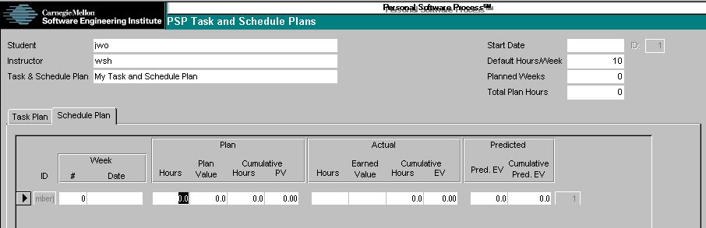
Schedule Plan
The planned hours for each schedule week must be entered.
Other data are calculated automatically.

Slide 12
Messages to Remember
Task and schedule planning templates are not required for small programs, but are helpful for longer tasks.
PSP1.1 gives you insight into your historical performance (CPI).

