Slide 1
3D Game Programming
OGRE3D
(Object-Oriented Graphics Rendering Engine)
黃世強
cswingo@cs.nctu.edu.tw
http://www.cs.nctu.edu.tw/~cswingo
Room 706
#ext. 56626

Slide 2
Teaching Assistants

Slide 3
Course content
Introduction to Game Development (3hr)
Game System Analysis (3hr)
The Game Main Loop (3hr)
3D Game Engine Training ( OGRE3D ) (6hr)
Game Mathematics (3hr)
Geometry for Games (3hr)
Advanced Scene Management System (3hr)
Terrain (3hr)
Game AI (9hr)
Game Physics (3hr)
Game FX (3hr)
Characters (3hr)
Network Gaming (3hr)
Introduction to MMOG Servers(3hr)
Audio (1hr)
The 2D Sprites (2hr)

Slide 4
Homework assignments, term project and exams
One term project,
  The students will be divided into teams ( 2~3 )
  Use OGRE to code a 3D real-time game
  A precompiled library MUST be used for the development of the term project and homework assignments.
  Library: http://www.cs.nctu.edu.tw/~cswingo/teaching/3DGamePro/lib.zip
  Use doxygen to document ALL programs:
  http://www.stack.nl/~dimitri/doxygen/download.html
Quizzes + Midterm
Programming homework assignments

Slide 5
Books
Junker, Gregory. Pro OGRE 3D programming / Gregory Junker ; [foreword by Steve Streeting]. Publisher Berkeley, Calif. : Apress, c2006
2. David H. Eberly. 3D Game Engine Design, Second Edition: A Practical Approach to Real-Time Computer Graphics (The Morgan Kaufmann Series in Interactive 3D Technology).
3. Erich Gamma ... [et al.]. Design patterns : elements of reusable object-oriented software. Publisher Reading, Mass. : Addison-Wesley, c1995.

Slide 6
Books
Tomas Moller (Author), Eric Haines (Author), Tomas Akenine-Moller (Author). Real-Time Rendering (2nd Edition). Natick, Mass. : A K Peters, c2002.
5. Game Programming Gems (1-6)
6. Finney, Kenneth C. 3D game programming all in one.
Publisher Boston, Mass. : Thomson Course Technology, 2007.

Slide 7
黃世強
Ph.D. (COMP, The Hong Kong University of
Science and Technology)
Expertise
  Computer Graphics
  Geometric Modeling
  Physically-based simulation
  Character Animation
  Collision Detection

Slide 8
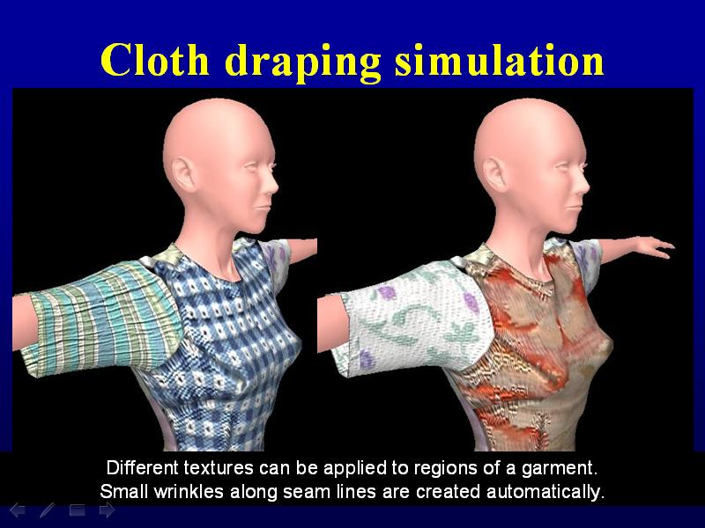
Research Results
Cloth draping simulation
Different textures can be applied to different regions of a garment.
Small wrinkles along seam lines are created automatically.

Slide 9
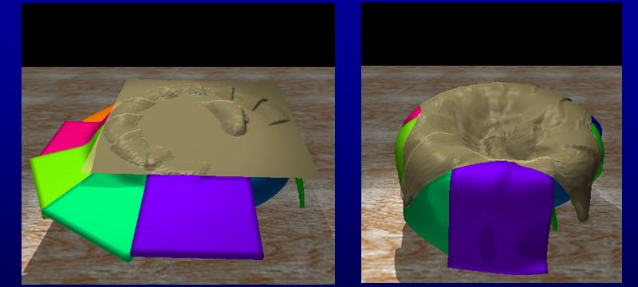
Multiple interacting objects
Interacting performance is achieved
for many deformable objects even though the contact regions are large.
This simulation was executed on a multicore machine.

Slide 10
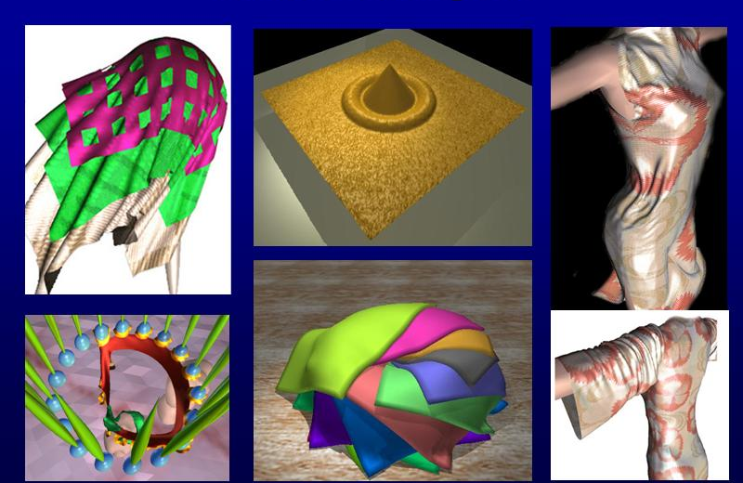
More examples

