Slide 1
Game AI
Path Finding

Slide 2
Introduction to Path Finding
A Common Situation of Game AI
Path Planning
  From a start position to a destination point
Most Popular Technique
  A* (A Star)
    1968
    A search algorithm
    Favorite teaching example : 15-puzzle
    Algorithm that searches in a state space for the least costly path from start state to a goal state by examining the neighboring states

Slide 3
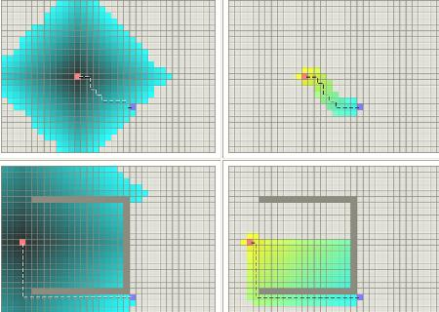
Dijkstra vs. A*
Without
ostacale
With
ostacale
By courtesy of : http://theory.stanford.edu/~amitp/GameProgramming/

Slide 4
Dijkstra vs. A*
Dijkstra: compute the optimal solution
Diskstra: search space much larger than A*
A*: simple
A*: fast
A*: “good” result
A*: employ heuristic estimate to eliminate many paths with high costs -> speedup process to compute satisfactory “shortest” paths

Slide 5
A*: cost functions
Goal: compute a path from a start point S to a goal point G
Cost at point n:
f(n) = g(n) + h(n)
g(n): distance from the start point to point n
h(n): estimated distance from point n to the goal point
f(n): current estimated cost for point n

Slide 6
A*: cost functions
The role of h(n)
  A major cost evaluation function of A*
  Guide the performance of A*
d(n): the actual distance between S and G
h(n) = 0 : A* is equivalent to Dijkstra algorithm
h(n) <= d (n) : guarantee to compute the shortest path; the lower the value h(n), the more node A* expands
h(n) = d (n) : follow the best path; never expand anything else; difficult to compute h(n) in this way!
h(n) > d(n) : not guarantee to compute a best path; but very fast
h(n) >> g(n) : h(n) dominates -> A* becomes the best first search (BSF)

Slide 7
A* Algorithm
  1
  2
  3
  4
  5
  6
  7
  8
  9
  10
  11
  12
  13
  14
  15
  16
  Add START to OPEN list
  while OPEN not empty
  get node n from OPEN that has the lowest f(n)
  if n is GOAL then return path
  move n to CLOSED
  for each n' = CanMove(n, direction)
  g(n') = g(n) + 1
  calculate h(n')
  if n' in OPEN list and new n' is not better, continue
  if n' in CLOSED list and new n' is not better, continue
  remove any n' from OPEN and CLOSED
  add n as n's parent
  add n' to OPEN
  end for
  end while
  if we get to here, then there is No Solution

Slide 8
A* Algorithm: Example
Show a grid map
Use Manhattan Distance to find the shortest path
from the start point to the goal point

Slide 9
A* Algorithm
State
  Location
  Neighboring states
Search Space
  Related to terrain format
  Grids
  Triangles
  Points of visibility
Cost Estimate
Path
  Typical A* path
  Straight path
  Smooth path
Hierarchical Path Finding

Slide 10
Search Space & Neighboring States (1/2)
Rectangular Grid
  Use grid center
Quadtree
  Use grid center
Triangles or Convex Polygons
  Use edge mid-point
  Use triangle center
Rectangular Grid
Triangles
Quadtree

Slide 11
Search Space & Neighboring States (2/2)
Points of Visibility
Points of Visibility

Slide 12
Cost Estimate
Cost Function
  g(n)
  h(n)
Cost evaluation examples:
  Travel distance
  Travel time
  Fuel consumption
  Enemy and friendly regions
  …
Estimate
  Distance to goal

Slide 13
Result Path
Typical A* Path
Straight Path
Smooth Path

Slide 14
Catmull-Rom Spline
Output_point = p1*(-0.5u³ +u² - 0.5u) +
p2*(1.5u³ – 2.5u² + 1) +
p3*(-1.5u³ + 2u² + 0.5u) +
p4*(0.5u³ – 0.5u²)
spline output_points
p2
p3
p1
p4

Slide 15
Hierarchical Path Finding
Break the terrain into sub-regions
  Room-to-room
  3D layered terrain
  Terrain LOD
Advantages:
  Speedup the search
  Solve the problem of layered path finding

Slide 16
Path Finding Challenges
Moving Goal
  Do you need to find path each frame ?
Moving Obstacles
  Prediction Scheme
Complexity of the terrain
  Hierarchical path finding
“Good” path for Game AI, e.g. avoid enemies

Slide 17
_x000b_http://blog.minstrel.idv.tw/2004/12/star-algorithm.html http://theory.stanford.edu/~amitp/GameProgramming/
References:

