Slide 1
Game AI
Steering Behavior &
Group Movement
(轉向行為 及 群體運動)

Slide 2
Introduction
References
  Craig W. Reynolds
  1987 “Flocks, Herds, and Schools: A Distributed Behavioral Model”, Siggraph’87 Proceedings
  1999 “Steering Behaviors for Autonomous Characters”, GDC Proceedings*
  www.red3d.com/cwr/steer
Autonomous Characters (自主角色)
  Autonomous agents
  NPCs in Games (Non-player characters, 非玩家角色)
Applications
  Robotics
  Artificial Intelligence (AI) (人工智能)
  Artificial Life

Slide 3
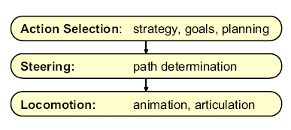
Motion Behavior ( 運動 行為 )
Action selection (行動選擇)
Steering (轉向)
Locomotion (運動, 移動)
A hierarchy of motion behavior

Slide 4
Action Selection (行動選擇 )
Game AI engine
  Finite state machine ( 有限狀態機 )
  Goals ( 目的 )
  Planning ( 規劃 )
  Strategy ( 策略 )
Scripting ( 腳本 )
Assigned by players

Slide 5
Steering ( 轉向 )
Path Determination
  Path finding or path planning
Behaviors
  Seek & flee ( 尋找 及逃離)
  Pursuit & evasion ( 追尋 及逃避 )
  Obstacle avoidance ( 障礙迴避 )
  Wander ( 徘徊 )
  Path following ( 路徑追蹤 )
  Unaligned collision avoidance ( 非排列碰撞迴避 )
  Ref: http://www.red3d.com/cwr/steer/
Group Steering

Slide 6
Locomotion
Character Physically-based Models
Movement
  Turn Right, Move forward, …
Animation
  Quaternion
Implemented / Managed by Game Engine

Slide 7
A Simple Vehicle Model (1/2)
A Point Mass
  Linear momentum
  No rotational momentum
Parameters
  Mass
  Position
  Velocity
    Modified by applied forces
    Max speed
      Top speed of a vehicle
  Max steering force
    Self-applied
  Orientation
    Car
    Aircraft

Slide 8
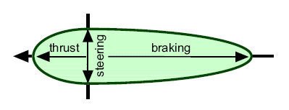
A Simple Vehicle Model (2/2)
Local Space
  Origin
  Forward
  Up
  Side
Steering Forces
  Asymmetrical
    Thrust ( 推力 )
    Braking ( 制動 )
    Steering (轉向 )
Velocity Alignment
  No slide (非滑動), spin ( 旋轉 ), …
  Turn

Slide 9
Euler Integration
Steer_force = Truncate(Streer_direction, Max_force)
Acceleration = Steer_force / mass
Velocity = Truncate(Old_velocity + Acceleration * Time_step, Max_speed)
New_position = Old_position + Velocity * Time_step

Slide 10
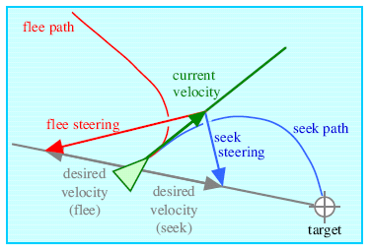
Seek & Flee Behaviors
Pursuit to a Static Target
  Steer a character toward to a target position
Seek Steering force
  desired_velocity = normalize(target - position)*max_speed
  steering = desired_velocity – velocity
“A moth buzzing a light bulb”
Flee
  Inverse of Seek
Variants
  Arrival
  Pursuit to a moving target

Slide 11
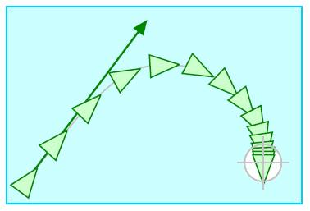
Arrival Behavior
A Stopping Radius
  Outside the radius, arrival is identical to seek
  Inside the radius, the speed is ramped down to zero
    target_offset = target – position
    distance = length(target_offset)
    ramped_speed = max_speed*(distance/slowing_distance)
    clipped_speed = minimum(ramped_speed, max_speed)
    desired_velocity = (clipped_speed/distance)*target_offset
    steering = desired_velocity – Velocity

Slide 12
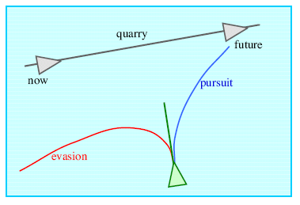
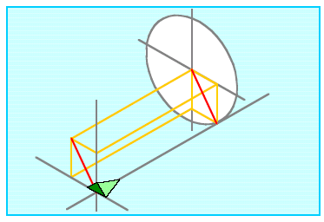
Pursuit & Evasion Behaviors
Target Character is Moving
Apply Seek or Flee to the Target’s Predict Position
Estimate the Prediction Interval T
  T = Dc
  D = distance(Pursuer, Quarry)
  c = turning parameter
Variants
  Offset pursuit
    “Fly by”

Slide 13
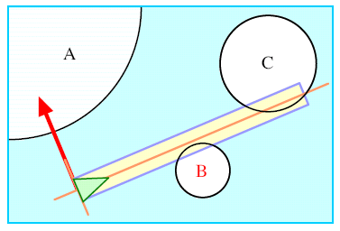
Obstacle Avoidance Behavior
Use Bounding Sphere
Collision avoidance
Probe
  A cylinder lying along forward axis
  Diameter = character’s bounding sphere
  Length = speed (means Alert range)
Find the most Threaten Obstacle
  Nearest intersected obstacle
Steering

Slide 14
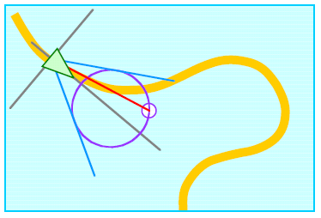
Wander Behavior
Random Steering
One Solution :
  Retain steering direction state
    Constrain steering force to the sphere surface located slightly ahead of the character
  Make small random displacements to it each frame
    A small sphere on sphere surface to indicate and constrain the displacement
Another one :
  Perlin noise
Variants
  Explore
  Forage

Slide 15
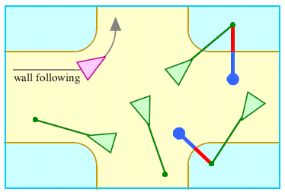
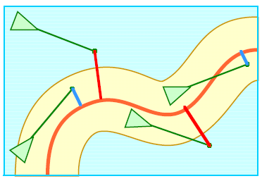
Path Following Behavior
A Path
  Spine
    A spline or poly-line to define the path
  Pipe
    The tube or generated cylinder by a defined “radius”
Following
  A velocity-based prediction position
    Inside the tube
      Do nothing about steering
    Outside the tube
      “Seek” to the on-path projection
Variants
  Wall following
  Containment

Slide 16
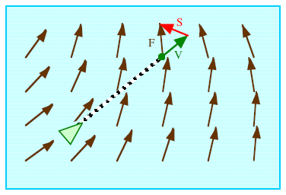
Flow Field Following Behavior
A Flow Field Environment is Defined
Virtual Reality
  Not common in games

Slide 17
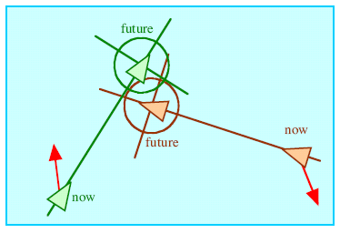
Unaligned Collision Avoidance Behavior
Turn Away from Possible Collision
Predict the Potential Collision
  Use bounding spheres
If possibly collide,
  Apply the steering on both characters
  Steering direction is possible collision result
    Use “future” possible position
    The connected line between two sphere centers

Slide 18
Steering Behaviors for Groups of Characters
Steering Behaviors Determining How the Character Reacts to the Other Characters within His Local Neighborhood
The Behaviors include
  Separation
  Cohesion
  Alignment

Slide 19
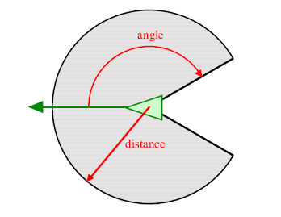
The Local Neighborhood of a Character
The Local Neighborhood is Defined
  A distance
  The field-of-view
    Angle
The Neighborhood

Slide 20
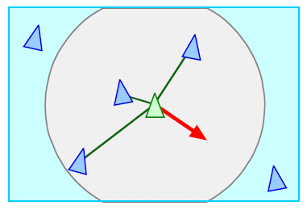
Separation Behavior
Make a Character to Maintain a Distance from Others Nearby
  Compute the repulsive forces within local neighborhood
    Calculate the position vector for each nearby
    Normalize it
    Weight the magnitude with distance
      1/distance
    Sum the result forces
    Negate it

Slide 21
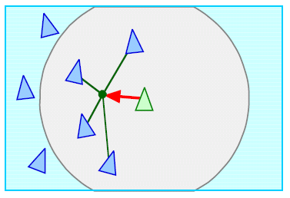
Cohesion Behavior
Make a Character to Cohere with the others Nearby
  Compute the cohesive forces within local neighborhood
    Compute the average position of the other nearbys
      Gravity center
    Apply “Seek” to the position

Slide 22
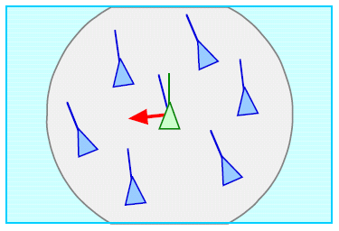
Alignment Behavior
Make a Character to Align with the Others Nearby
  Compute the steering force
    Average the velocity of all other characters nearby
    The result is the desired velocity
    Correct the current velocity to the desired one with the steering force

Slide 23
Flocking Behavior
Boids Model of Flocks
  [Reynolds 87]
Combination of
  Separation steering
  Cohesion steering
  Alignment steering
For Each Combination
  A weight for combing
  A distance
  An Angle

Slide 24
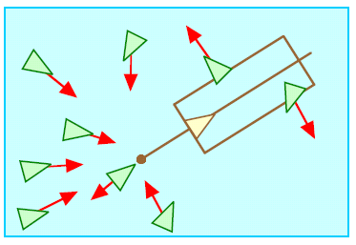
Leader Following behavior
Follow a Leader
  Stay with the leader
    “Pursuit” behavior (Arrival style)
  Stay out of the leader’s way
    Defined as “next position” with an extension
    “Evasion” behavior when inside the above area
  “Separation” behavior for the followers

Slide 25
Behavior Conclusion
A Simple Vehicle Model with Local Neighborhood
Common Steering Behaviors
  Seek
  Flee
  Pursuit
  Evasion
  Offset pursuit
  Arrival
  Obstacle avoidance
  Wander
  Path following
  Wall following
  Containment
  Flow field following
  Unaligned collision avoidance
  Separation
  Cohesion (凝聚)
  Alignment ( 隊列 )
  Flocking (集群活動 )
  Leader following
Combining Behaviors

