Slide 1
Characters

Slide 2
Introduction
The Characters are the Actors of the Games.
Three Types of Characters :
  Segmented
  Mesh
  Bone-skin
Root-base Concept
Production :
  3D animation tools
    3dsMax
    Maya
    Softimage
    …
  Motion capture (Mocap)
    For motion data
Base

Slide 3
A Segmented Character
A character is composed by a set of models with motion data to simulate a live creature in real world
Benefits
  Hierarchical structure
  Easy to implement in a scene tree
Drawbacks
  Segment-like

Slide 4
A Mesh Character
Vertex animation on skins
  Animated positional data on skins
  3D warping
Benefits
  Easy to implement
  Flexible mesh in animation
Drawbacks
  No hierarchy
  No keyframes
  Massive dataset

Slide 5
A Bone-skin Character
Bone-Skin Skeleton
  Hierarchical bones
  Skin deformation run-timely
Benefits
  Hierarchical structure
  Not segmented look
Drawbacks
  More complicated than the other solutions
  Skin deformation need more CPU cost than transformation only
Bone A
Skin
Bone B

Slide 6
Motion Data
Euler Angles
Angular Displacement
Quaternion
  Slerp
Converted into (4x4) matrix for computation

Slide 7
Optical Motion Capture
Data Acquired
  From skin to joint (Mocap)
  From joint to skeleton (Post-processing)
  From skeleton to skin (In-game)
Device
The Shooting Plan

Slide 8
Data Acquirement During the Mocap
Raw Data (Positional Data)
Bio-Data
Joint
End Point

Slide 9
Bone-skin Implementation In Game
Skeletons
Skin
Bone-Skin
Skeletons

Slide 10
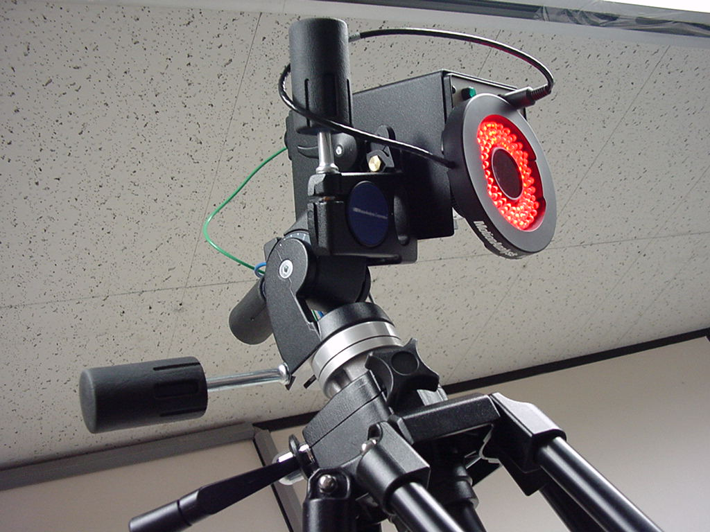
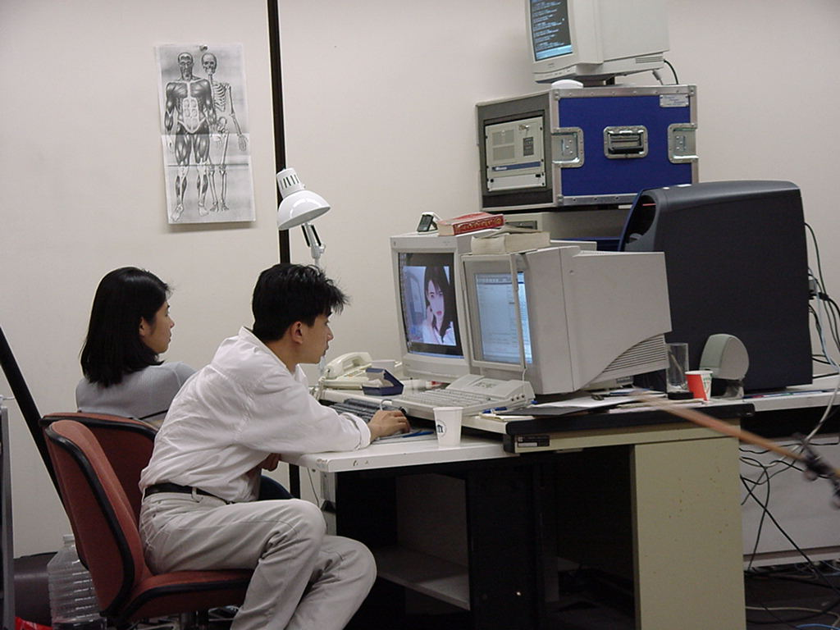
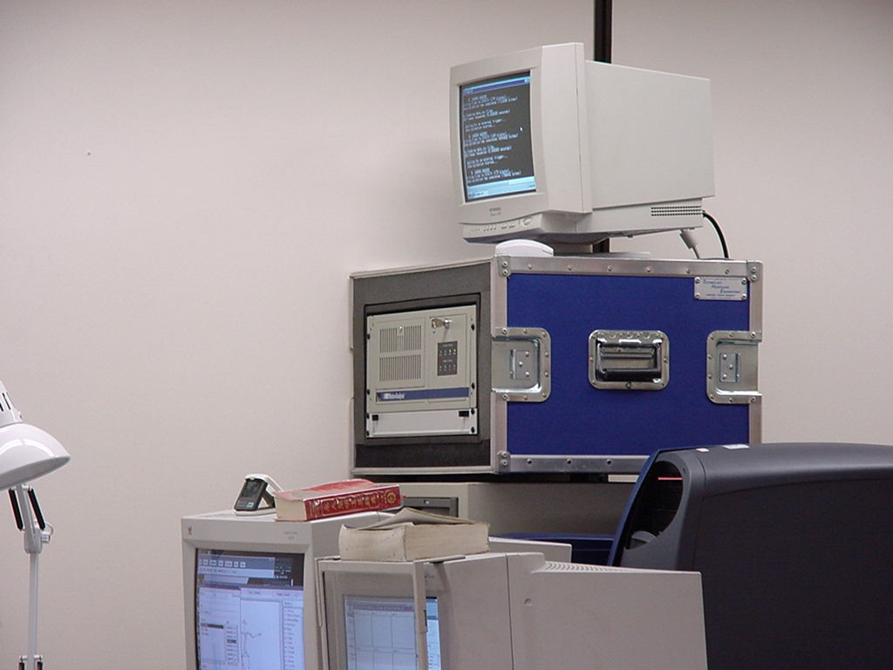
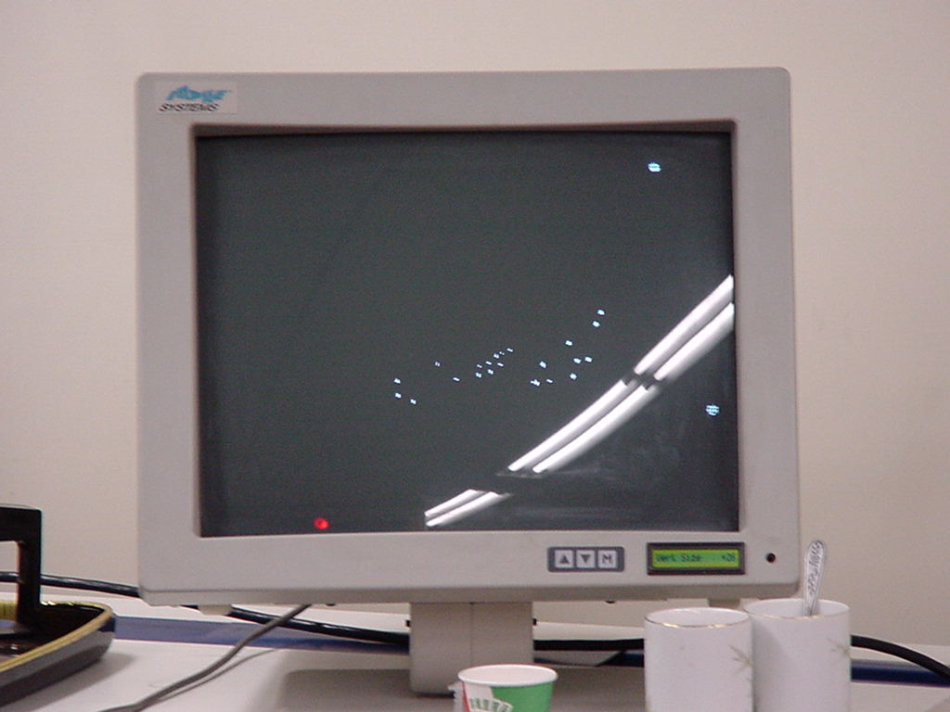
Mocap Devices

Slide 11
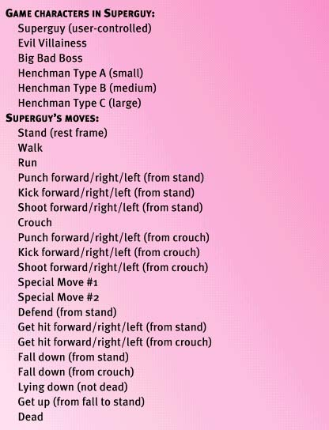
Planning a Mocap Shoot
Starting Out – Reviewing the Animation List and Flowchart

Slide 12
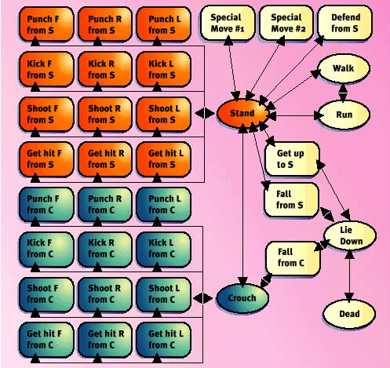

Slide 13
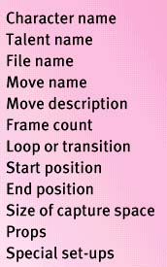
Creating a Shot List
  Create a Database
  File Names
  Preliminary Shot List
A Data Record of Shot List

Slide 14
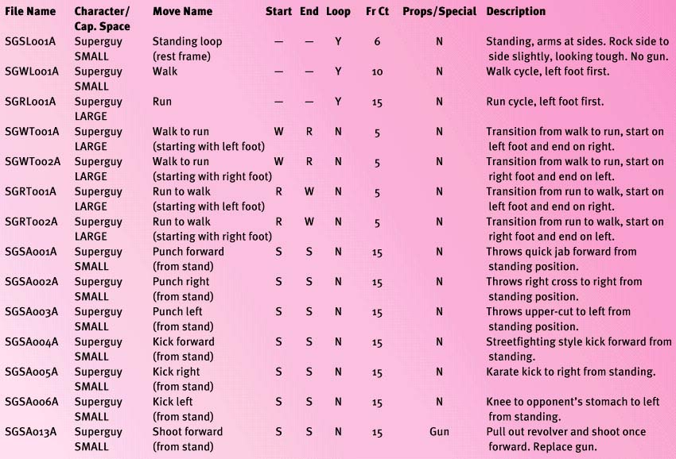
A Shoot List

Slide 15
Getting Ready for the Shoot
  When to Shoot ?
  Find a Studio
  Make Sure No Technical Blocks
  Casting
Preparing a Shooting Schedule
  Organize the Shot List
  Daily Schedule
  Do You Need a Rehearsal Day ?
Take Care of Your Performer

Slide 16
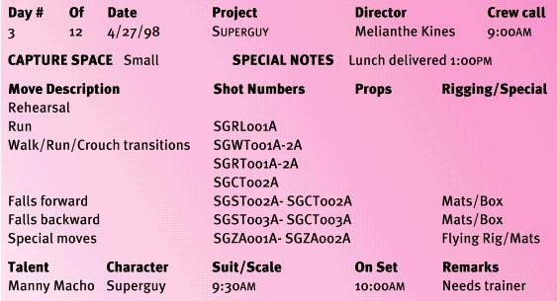
A Daily Schedule

Slide 17
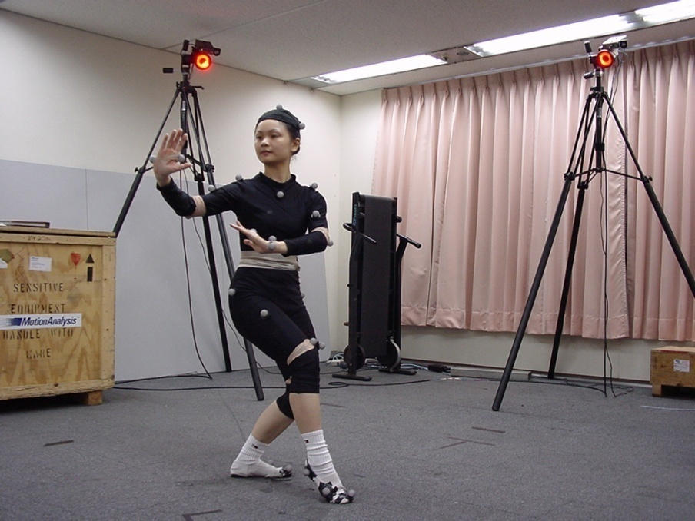
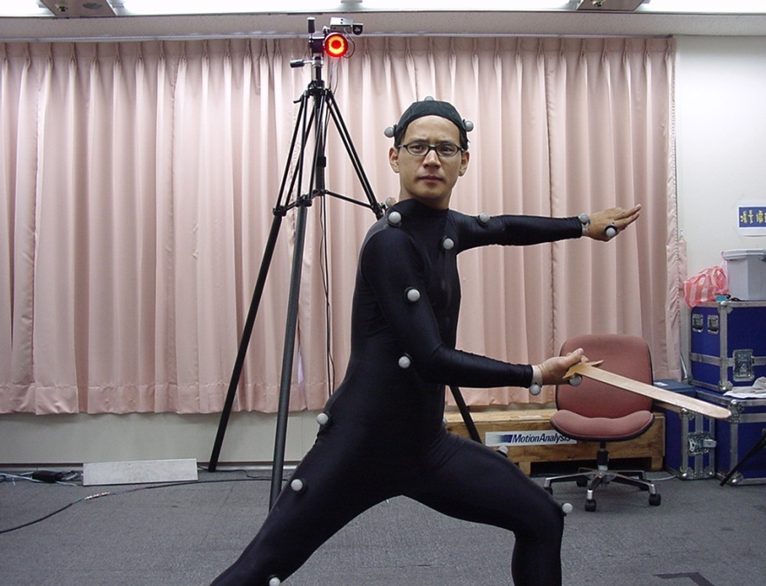
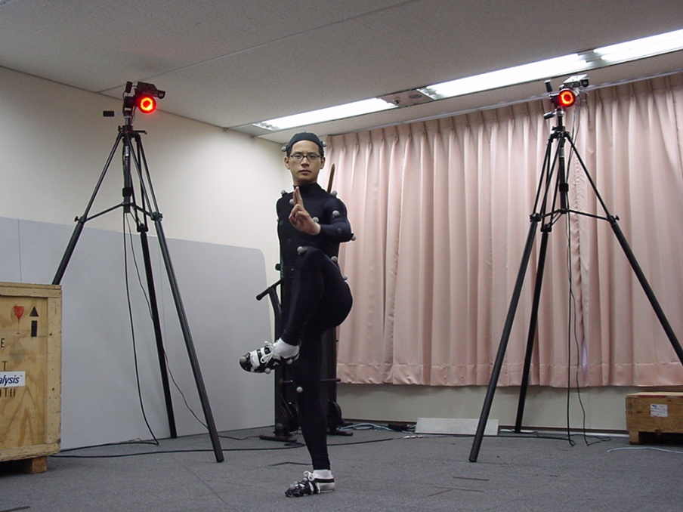
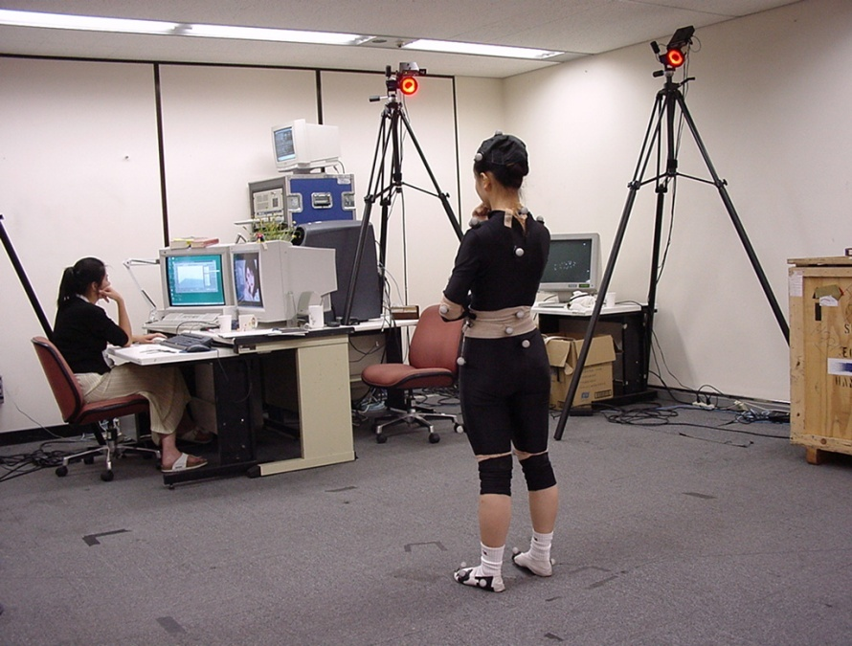

Slide 18
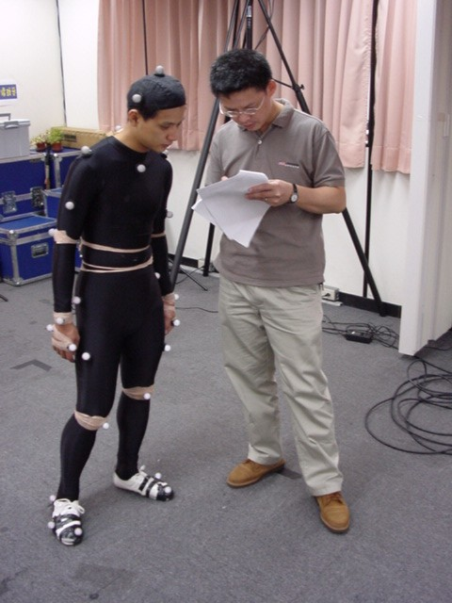
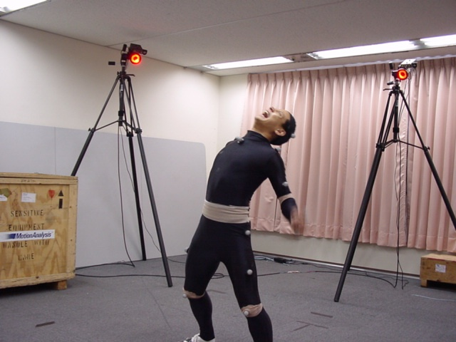
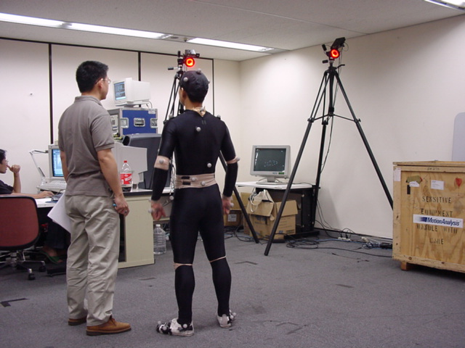

Slide 19
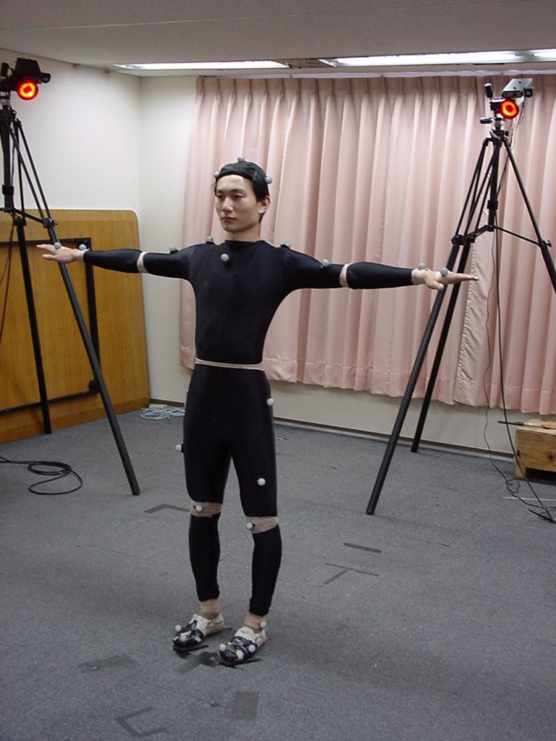
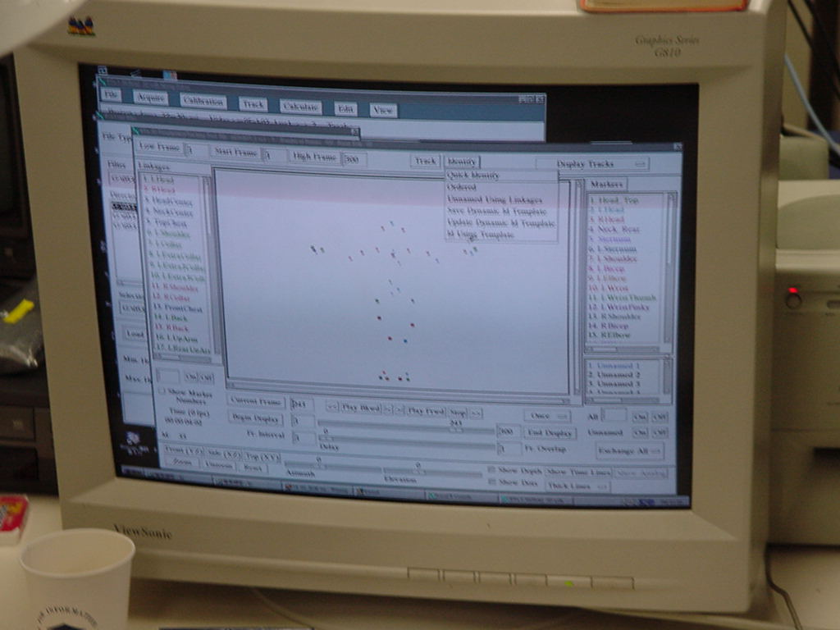
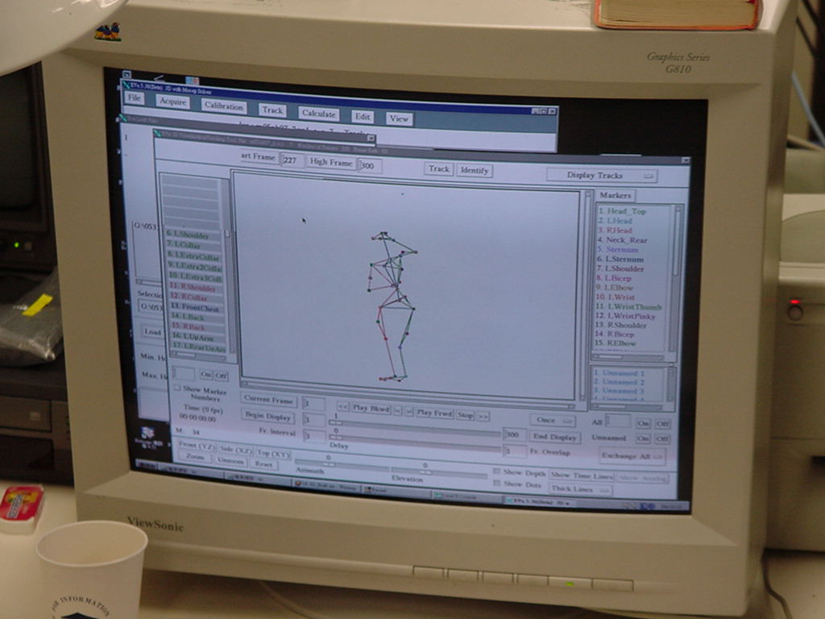
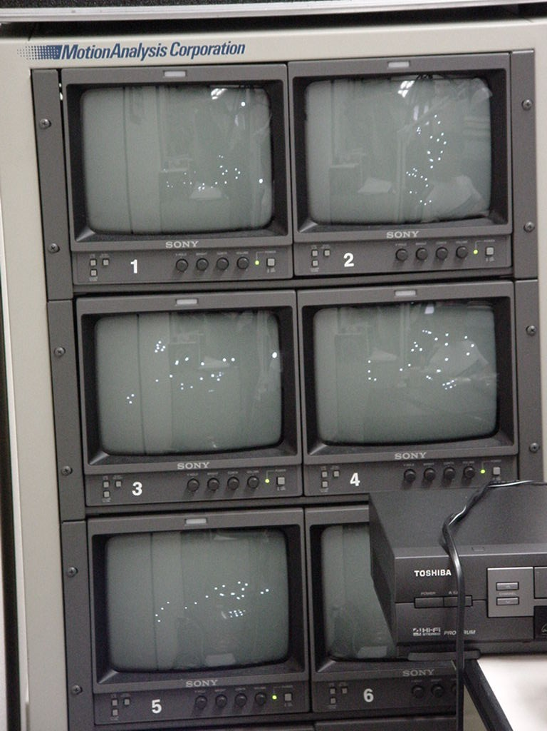
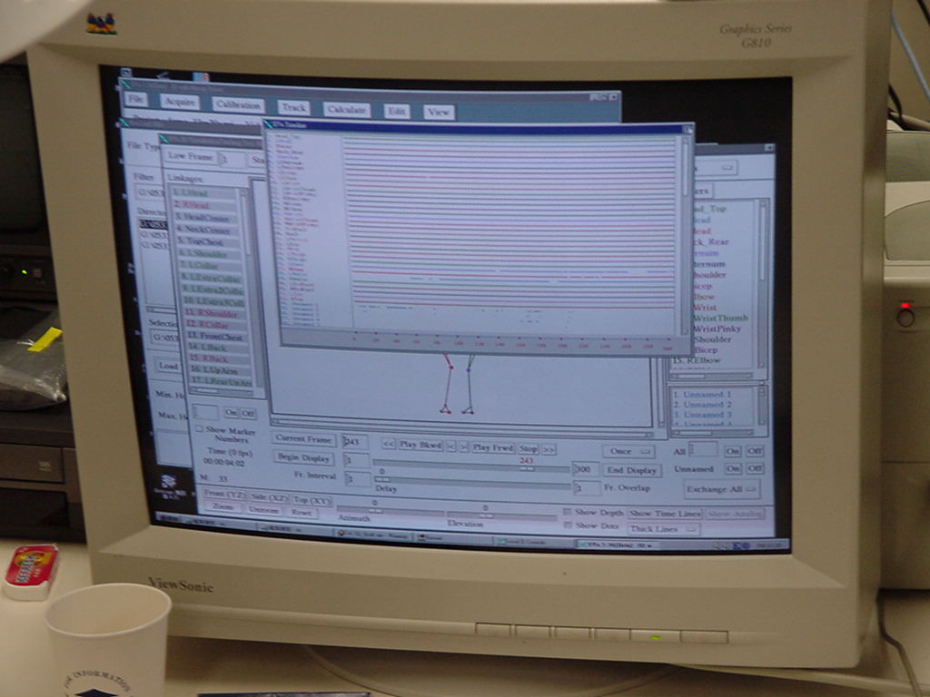

Slide 20
Perform motion capture for a ball ?

Slide 21
Motion for Characters
Apply motion data on bones
  A : parent node
  B : child node
(x,y,z,θ,axis)
A
(θ,axis)
Joint = pivot(p_{x},p_{y},p_{z}) in A
B
<v’> = <V> [R_{B}][T_{B}][R_{A}][T_{A}]
From pivot
From position
The above formula is in the left-hand form (Direct3D).
What is the formula in the right-hand form (OpenGL)?

Slide 22
Motion Editing
To Create More Animation from Limited Ones
Run-time or Pre-processing
Issues :
  Motion re-targeting
    Run-time
    http://www.cs.wisc.edu/graphics/Gallery/Retarget/
  Re-key-framing (key-frame: http://en.wikipedia.org/wiki/Key_frame)
    Pre-processing
  Interpolation
    Run-time
  Motion blending
    Run-time

Slide 23
Poses
A set of frame data to describe the character’s motion
Walk, Run, Attack, …
Keyframed or Non-keyframed
walk
run
attack
fall

Slide 24
A Pose Definition Example
start_frame
end_frame
walk
raw_start_frame
raw_end_frame
cut_frame
Parameter {
raw_start_frame
raw_end_frame
start_frame
end_frame
cut_frame
play_speed
length
transition_mode
}

Slide 25
Play a Pose
walk
0
4
8
Frame 5.3
If the motion data is in quaternion form
Get the motion data on frame 5 & 6
Convert the data into quaternion format
Apply slerp(5, 6, 0.3) to get the interpolation on frame 5.3
Convert the result of step 3 into a rotation matrix
Apply the matrix to the object for its transformation

Slide 26
Pose Connection
cut_frame
Pose 1
start_frame
Pose 2
length

Slide 27
Pose Blending
Motion blending in run-time
Quaternion is used
“Blend Tree”
  Cross fade
  Countinuous blending
  Feather blending
  Drawback: Not working well if the transitions are from not similar animations
  Ref: http://www.gamasutra.com/features/20030704/edsall_02.shtml

Slide 28
Blend Tree
Reference
  Game Developers Conference 2003
  Proceedings CD, Programming Track
  “Animation Blending : Achieving Inverse Kinematics and More”
  Jerry Edsall
  Mech Warrior blend tree
Walk
Forward
Motion
Fall Transition
Run
Fall
Down

Slide 29
Cross Fade
1
Pose 1
0
1
Pose2
0

Slide 30
Continuous Blending
1
Pose 1
0
1
Pose 2
0

Slide 31
Feather Blending
左右搏擊
Pose 1
Pose 2
Pose 3

Slide 32
Skin Deformation
Weights to Assign the Influences of the Deformation by Bones on Skin Vertices
  1-weight
  2-weight
  N-weight
CPU cost
It’s Very Good for GPU to Perform the Calculation Using Vertex Shader

Slide 33
Bone A
(root object)
base
base
Bone B
(Bone A’s child)
Apply motion data to bones
Convert the vertex from “base” space to its associated bone’s space using the natural pose’s inverse transformation
Multiple the influence weight
Accumulate all influences
Then the vertex is deformed by the bone in “base” space

Slide 34
A two-weight skin vertex example
M_{b} = R_{b}T_{pivot}
M_{a} = R_{a}T_{position}
M_{vb} = M_{nb}⁻¹ M_{b}M_{a}
M_{va} = M_{na}⁻¹M_{a}
v_{in_base} = v_{s}*w_{a}M_{va} + v_{s}*w_{b}M_{vb}

