Slide 1
Project: closest pair problem vs data stream
劉承順

Slide 2
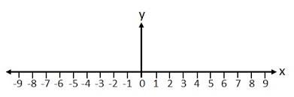
Simplify
If we can solve the closest pair problem, we can solve the problem “find minimum difference between any two elements in an unsorted array”.
Method: just let the elements in the array have y-axis value 0.
Then the distance of the closest pair is the minimum difference.

Slide 3
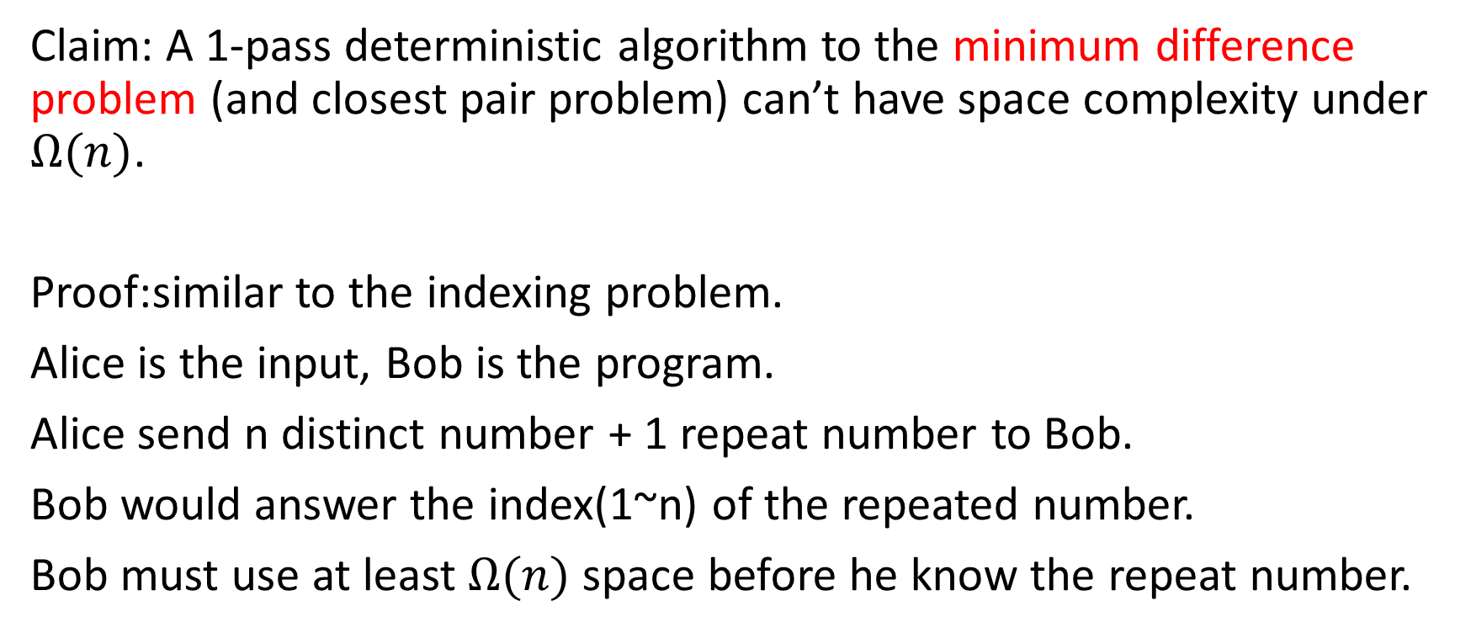
Hardness proof
Claim: A 1-pass deterministic algorithm to the minimum difference problem (and closest pair problem) can’t have space complexity under $Ω(n)$.
Proof:similar to the indexing problem.
Alice is the input, Bob is the program.
Alice send n distinct number + 1 repeat number to Bob.
Bob would answer the index(1~n) of the repeated number.
Bob must use at least $Ω(n)$ space before he know the repeat number.

Slide 4
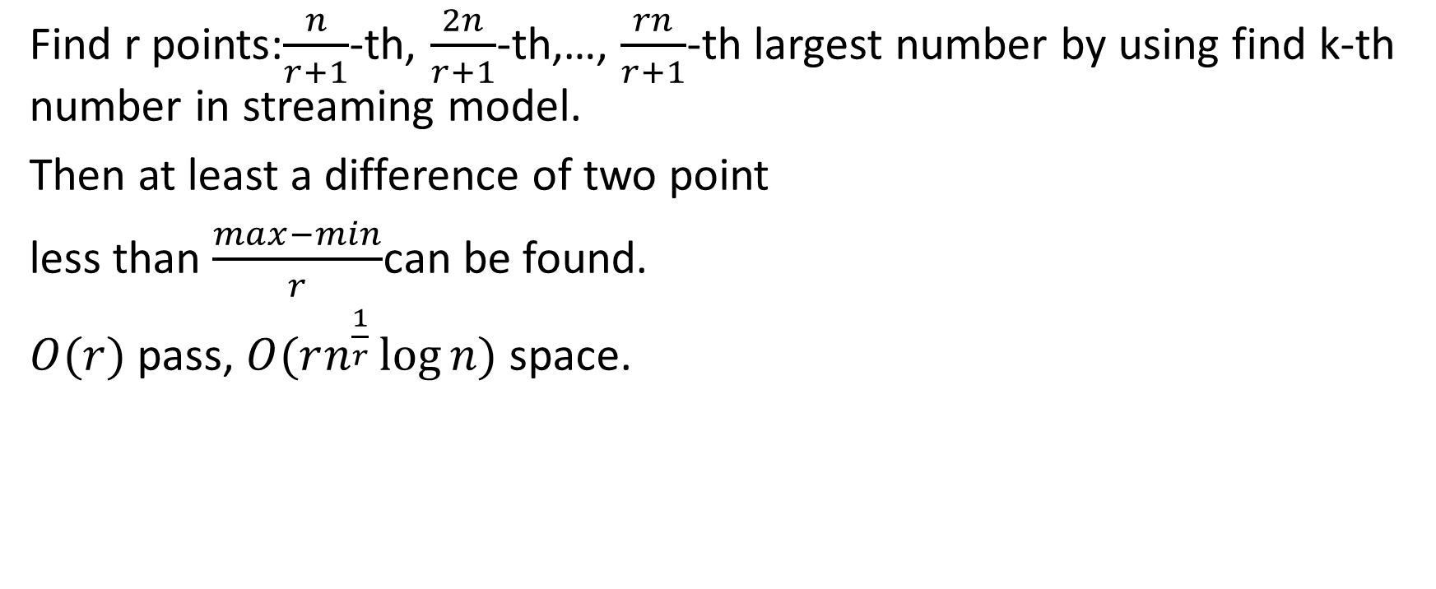
approximate of minimum difference problem
Find r points:$\frac{n}{r+1}$-th, $\frac{2n}{r+1}$-th,…, $\frac{rn}{r+1}$-th largest number by using find k-th number in streaming model.
Then at least a difference of two point
less than $\frac{max−min}{r}$can be found.
$O(r)$pass, $O(rn^{\frac{1}{r}}\log{n})$ space.
min
r parts
max

