Slide 1
Streaming Algorithms proposal
0656124 劉承順

Slide 2
Closest Pair problem
一群點當中，距離最近的兩個點叫作「最近點對」。
Deterministic algorithm runs in O(nlogn).
divide and conquer:把平面切割成左右兩側，答案分為「最近點對在左側」、「最近點對在右側」、「最近點對橫跨兩側」三種情形。

Slide 3
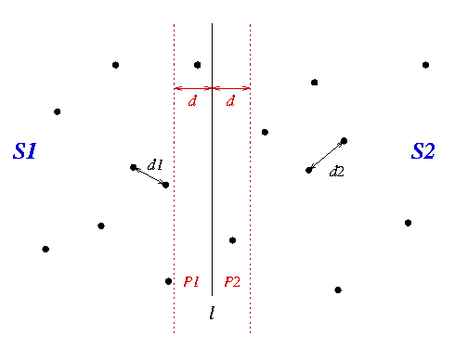

Slide 4
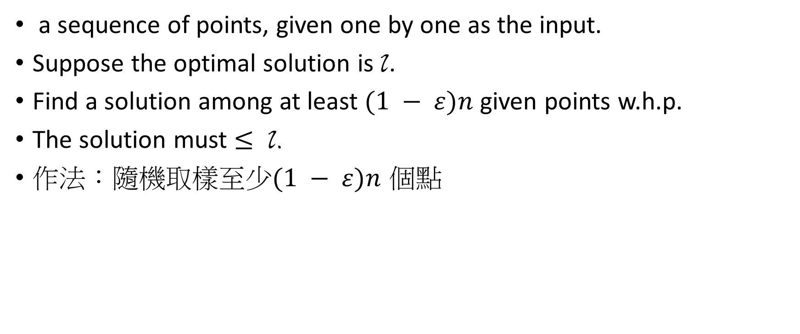
Streaming model
a sequence of points, given one by one as the input.
Suppose the optimal solution is l.
Find a solution among at least $(1 − ε)n$ given points w.h.p.
The solution must $≤$ l.
作法：隨機取樣至少$(1 − ε)n$ 個點

Slide 5

problems
Time complexity
space complexity
in $R^{2}$? $R^{3}$?

