Slide 1


Real-Time Foosball Detection
Applied Data Scientist Project
a.y. 2024-2025
Niusha Parsa
Sina Hamedani Sepehr Alemzadeh

Slide 2
Design

Slide 3
Purpose of the Project
Provide Real-time, accurate tracking of Foosball Gameplay
Show how AI and machine learning can track fast player movements
Create an interactive system to enhance foosball understanding and enjoyment.

Slide 4
Potential Applications
AI Technology Demonstration
Collaborative Research and Development:
Educational use in AI and Computer vision
Enhanced Gaming Experience
Product Development for Gaming Companies
Sports Analytics, Research and Training
Events and Competitions
Data Insights for Manufacturers

Slide 5
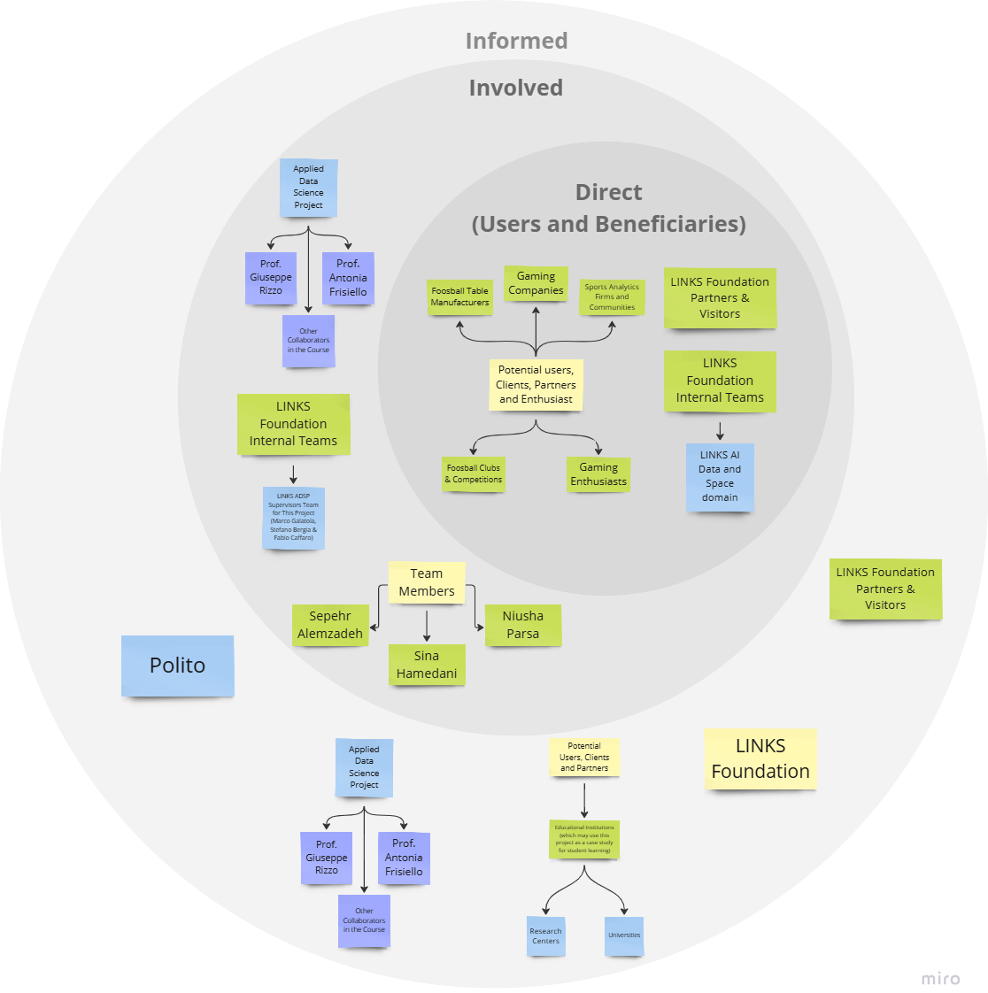
Target Users
(Direct Stakeholders)
LINKS Foundation Internal Team (LINKS AI Data and Space Domain)
LINKS Foundation Partners and Visitors
Potential User, Clients, Partners and Enthusiasts (Gaming enthusiasts, sports analysts, ets.)

Slide 9
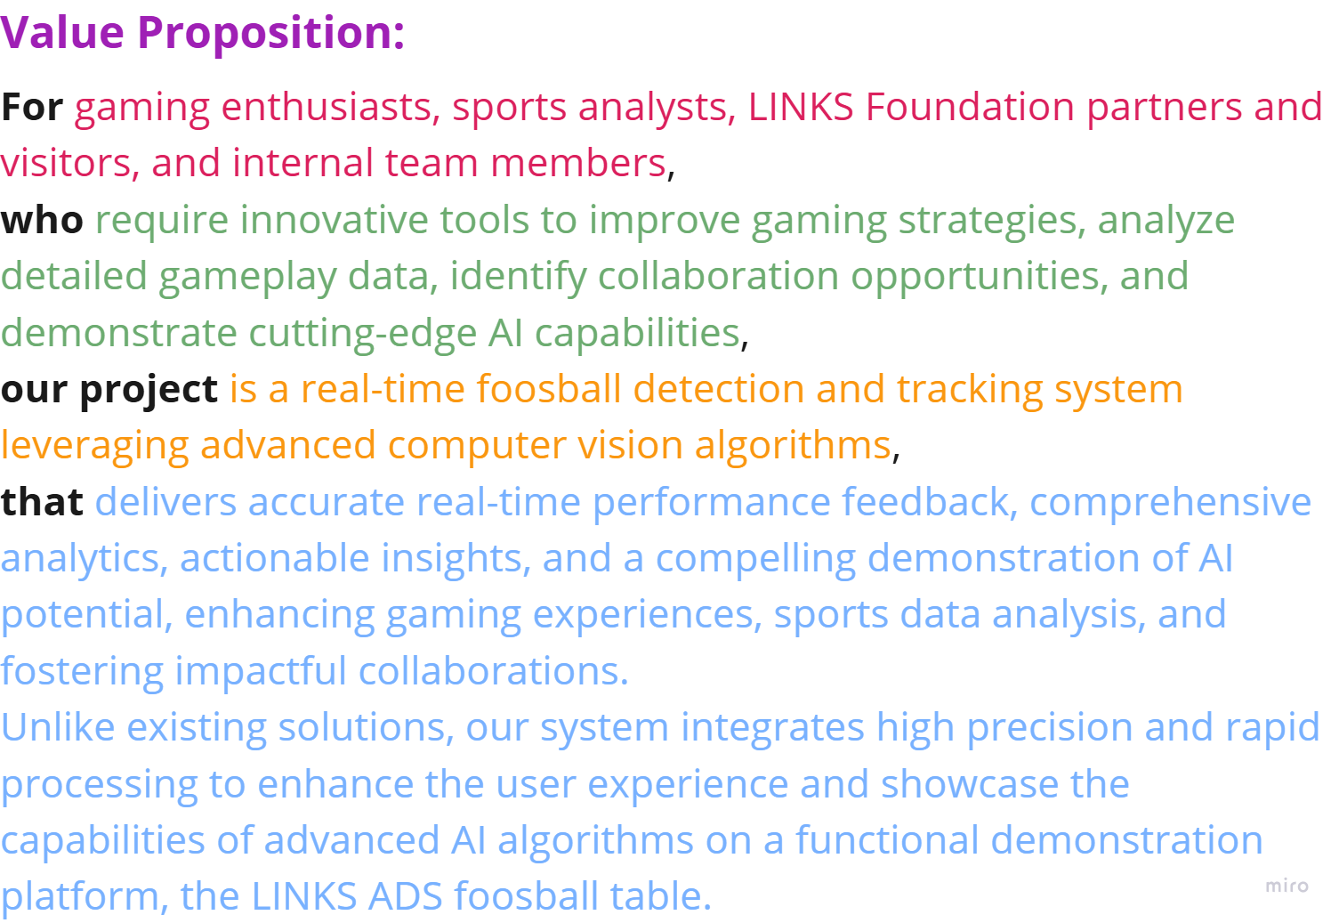

Slide 10
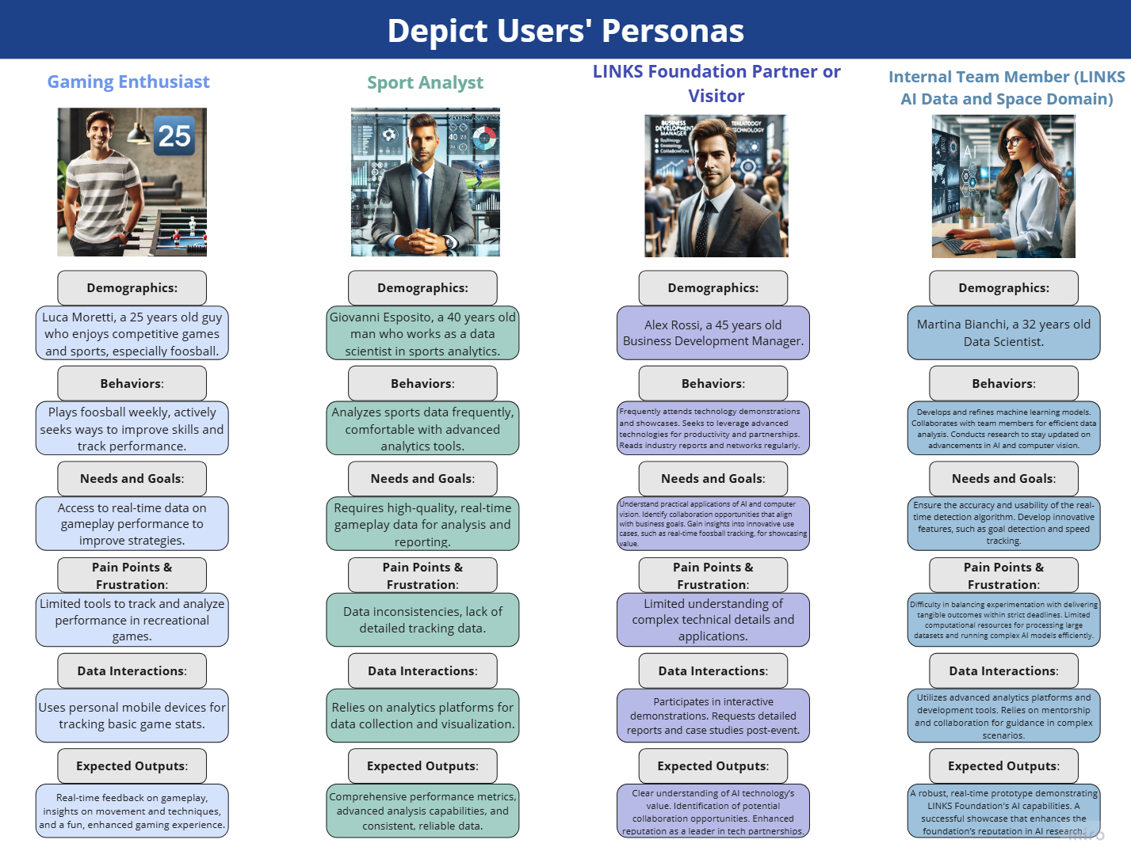

Slide 11
System’s Operating Process
User Action
System Execution
System output
Live track of Foosball
Check Game Stats
Detect &Track Objects
Generate Insights
Real-time Gameplay Analytics
Summary report of performance
Access Key moments
Analyze Movement & Interactions
Detailed Replays

Slide 12
Results and Outputs
Improved experience for foosball fans and industry
providing precise, real-time gameplay analysis
Results
A robust system capable of detecting foosball gameplay actions
Visualization tools that display live data insights
Outputs

Slide 13
Incorporating SDG with Foosball project
SDG 17: Partnerships for the Goals
Collaborate with other organizations
SDG 9: Industry and Innovation
Serves as a model for similar applications in other sports.
Create training programs & simulations
Developing educational applications
SDG 4: Quality Education

Slide 14
Manage

Slide 15
Work Breakdown Structure (WBS)
WP Number | WP Title | Start Week | End Week
1 | Design & Management | 0 | 2
2 | Literature review on detection models | 3 | 5
3 | Development | 6 | 8
4 | Communication | 9 | 10

Slide 16
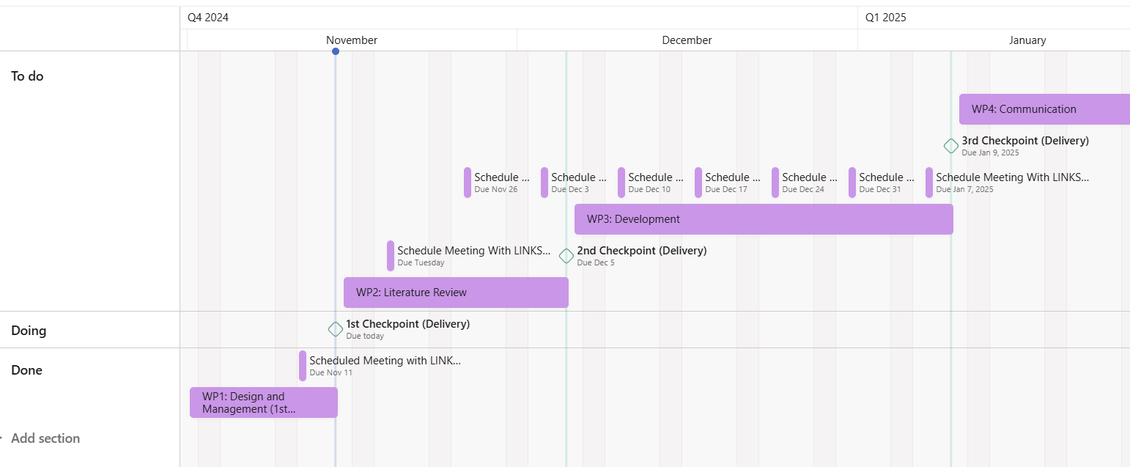
Gantt

Slide 17
Work Package - Design and Management
Work Package Number | 1
Work Package Title | Design & Management
Start Week | 0
End Week | 2
Objectives | 1.Define the project objectives, outcomes, and deliverables. 2.Plan all necessary activities and allocate resources effectively
Description of work | T1.1 Design
 | Setting up a clear framework to ensure the project goals are measurable and achievable
 | T1.2 Management
 | Divide the project into manageable work packages

Slide 18
Work Package - Literature Review
Work Package Number | 2
Work Package Title | Literature Review
Start Week | 3
End Week | 5
Objectives | Aim some research to evaluate and understand how these models can be adapted or combined to detect real-time interactions in foosball gameplay accurately
Description of work | T2.1 Object Detection
 | Research existing object detection models tailored for sports applications Explore models that can identify players, foosball rods, and the ball within fast-paced gameplay

Slide 19
Work Package - Development
Work Package Number | 3
Work Package Title | Development
Start Week | 6
End Week | 8
Objectives | 1.implement, test, and validate the foosball detection model in real-world conditions. 2.Optimize the model for performance, ensuring it can handle the rapid interactions typical in foosball gameplay and refine the system based on testing feedback
Description of work | T3.1 Testing & Validation
 | Ensure the foosball detection model accurately detects player actions, ball movement, and other critical elements
 | T3.2 Optimization & Fine-Tuning
 | Optimize the model’s computational efficiency and responsiveness to handle rapid interactions in foosball gameplay

Slide 20
Work Package - Communication
Work Package Number | 4
Work Package Title | Communication
Start Week | 9
End Week | 10
Objectives | effectively communicate the results, insights, and contributions of the Foosball Detection project by providing both written(research paper) and verbal(final presentation)
Description of work | T4.1 Paper
 | document the research methodology, model development, challenges, and outcomes of the Foosball Detection project in a structured format
 | T4.2 Final Presentation
 | summarize and present the main findings of the Foosball Detection project in a concise format that can be easily understood

Slide 21
Thank you

