Slide 1


ONTOLOGY ALIGNMENT CLASSIFIER
BASED ON NLP
APPLIED DATA SCIENCE
Era Alcani
Francesco Dal Cero
Francesco Mastrosimone

Slide 2
TABLE OF CONTENTS
01 PROJECT OVERVIEW
02 RESEARCH HYPOTHESIS
03 SYSTEM DESIGN
04 DATA ENGINEERING
05 EVALUATION & RESULT
06 CONCLUSIONS

Slide 3
PROJECT OVERVIEW
01

Slide 4
PROJECT CONTEXT AND SOLUTION
THE CHALLENGE: SEMANTIC INCONSISTENCY
Context: Healthcare evidence is scattered across isolated "data silos".
Problem: Different terms (e.g., Fatigue vs. Asthenia) prevent meaningful integration of this data.
THE SOLUTION: AI SEMANTIC ENGINE
Goal: Develop an AI-powered engine to automatically harmonize fragmented data into structured evidence.
Impact: Replaces manual "brittle scripts" with a scalable, automated pipeline.

Slide 5


OBJECTIVES AND RESEARCH PERSPECTIVE
THE GOAL: AUTOMATED HARMONIZATION
To replace manual, brittle scripts with a robust framework that transforms raw attributes into high-confidence clinical evidence.
THE RESEARCH OBJECTIVES
SYSTEM LEVEL: Build a reusable framework for interpretable ontology alignment.
RESEARCH LEVEL: Evolve from simple string matching to capturing actual clinical meaning and context.

Slide 6
RESEARCH HYPOTHESIS
02

Slide 7
RESEARCH HYPOTHESIS
Efficiency and Ambiguity (H1)
Question: Do we always need complex deep learning models to align clinical terms?
Hypothesis: No. Model complexity should match semantic ambiguity: deterministic rules handle clear cases, while deep models are needed only for ambiguous or synonymous terms.
Architecture (H2)
Question: How do we balance high accuracy with scalability?
Hypothesis: Efficiency demands a "Filter-then-Rank" architecture. Scalability is achieved by filtering candidates with a fast retriever before applying expensive deep semantic scoring.
Data Strategy (H3)
Question: Is random training data sufficient for clinical accuracy?
Hypothesis: No. To generalize well, the model must be explicitly trained on "Hard Negatives"—tricky, similar-looking concepts—rather than just random non-matches.

Slide 8
SYSTEM DESIGN
03

Slide 9
SYSTEM DESIGN - MODULAR OVERVIEW
Supervised pair builder of two ontologies
Train Scoring Model
Load and Standardize
Inference Engine
Compile Artifacts
Single ontology
Reusable across studies – build once, run many times

Slide 10
SYSTEM WORKFLOWS & ENTRY POINTS
1
2
3
Ontology loading & standardization
Reference alignment loading
Training dataset construction
Model fine-tuning
Unified ontology representation
Exact-match lookup structures
Candidate retrieval indices
Semantic representations (for hybrid retrieval)
Training
Offline Preprocessing
From standardized ontology
Inference
Exact match shortcut
Candidate selection
Neural scoring

Slide 11
RETRIEVAL PIPELINE: PRE-SCORING DECISIONS
H1
Retrieval operates on offline-compiled ontology artifacts
Exact Match Shortcut
Constant-time lookup on labels & synonyms
Deterministic resolution for unambiguous cases
Maximal score, no neural model invocation
Hybrid Candidate Selection
Lexical retrieval via subword inverted index
IDF-weighted lexical evidence
Semantic retrieval via embedding similarity
Unified top-k candidate pool for neural scoring
Hybrid retrieval mitigates structural candidate selection errors that cannot be recovered by downstream neural models

Slide 12
NEURAL SCORING: FINAL ALIGNMENT DECISION
H2
Joint encoding of attribute and candidate class
Full contextual interaction via Transformer attention
Produces a continuous semantic alignment score
Final ranking and top-1 match selection
Neural scoring focuses on precision, after recall has been ensured by hybrid retrieval

Slide 13
DATA ENGINEERING
04

Slide 14
ONTOLOGY LOADER FRAMEWORK
Load & standardize one or more ontologies into a unified representation
Ontology A
Unified Representation
IRIs & hierarchy
Labels & synonyms
Definitions & descriptions
Structural axioms
Ontology Loader
Ontology B
Symbolic retrieval & exact match
Rich textual input for model

Slide 15
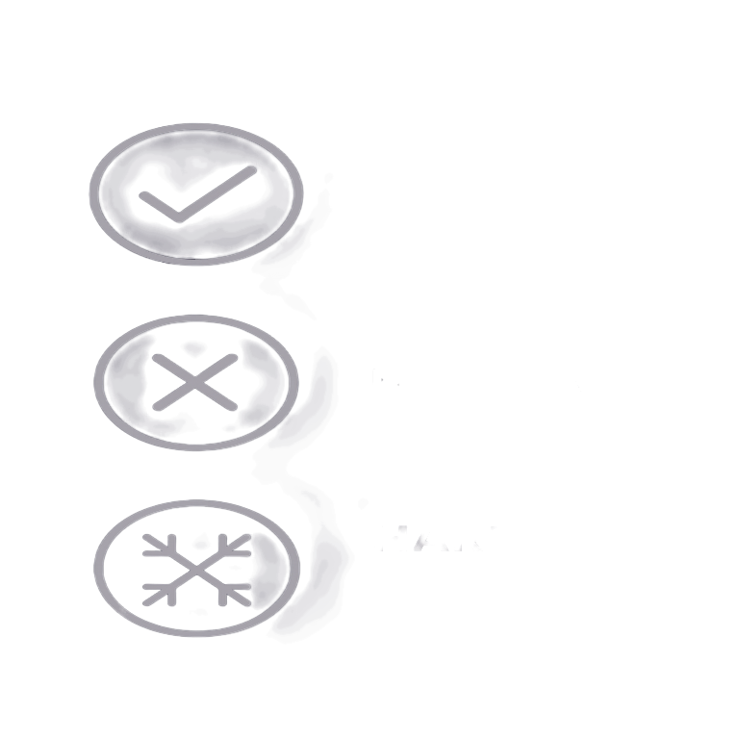
DATASET CONSTRUCTION
H3
Convert ontologies and reference alignments into a supervised dataset. Each sample is a concept–concept pair labeled as match or non-match.
A training sample can be:
POSITIVE = gold-standard alignment
NEGATIVE = unrelated concept pair
HARD NEGATIVE = semantically confusing non-match

Slide 16
EVALUATION & RESULTS
05

Slide 17
EVALUATION SETUP
Supervised dataset of 1365 pairs
25%
50%
75%
100%
ENVO
POSITIVES
RANDOM NEGATIVES
SWEET
HARD NEGATIVES
1. Retrieval quality (Recall-oriented)
Is the correct ontology class present among the retrieved candidates?
2. Final decision quality (Precision-oriented)
Is the top-ranked prediction selected by the neural scorer correct?
136 attributes from SWEET ontology

Slide 18
MODEL COMPARISON
All models trained on the same dataset with hard negatives enabled
Models are evaluated under two retrieval modes: Lexical and Hybrid
Model selection in based on Precision
SciBERT
PubMedBERT
L: 0.6667
H: 0.6232
BERT_base
L: 0.5942
H: 0.5652
L: 0.5652
H: 0.5797
Domain-specific pretraining consistently improves semantic alignment performance.
SciBERT achieves the best overall results and is selected as the reference model.
Lexical retrieval yields higher precision on this dataset due to strong lexical overlap.
Hybrid retrieval improves robustness by recovering semantically related candidates when lexical signals fail.

Slide 19
ABLATION STUDY: HARD NEGATIVES
H3
Ablation setup (SciBERT)
Same model, same training pipeline, same splits.
Only change: Hard Negatives ON vs OFF.
Retrieval Mode | Precision HN | Precision NO HN
Lexical | o.6667 | 0.6522
Hybrid | 0.6232 | 0.5942
Accuracy HN | Recall HN | Accuracy NO HN | Recall NO HN
Threshold = 0.999345 |  | Threshold = 0.997826
0.9562 | 0.9565 | 0.8905 | 0.8551
Key result
Hard negatives improve top-1 precision, with a larger gain under Hybrid retrieval, where candidates are more semantically confusable.
Secondary analysis (thresholding)
When calibrated for binary decisions, hard negatives improve match/no-match reliability, especially Recall (fewer false negatives).

Slide 20
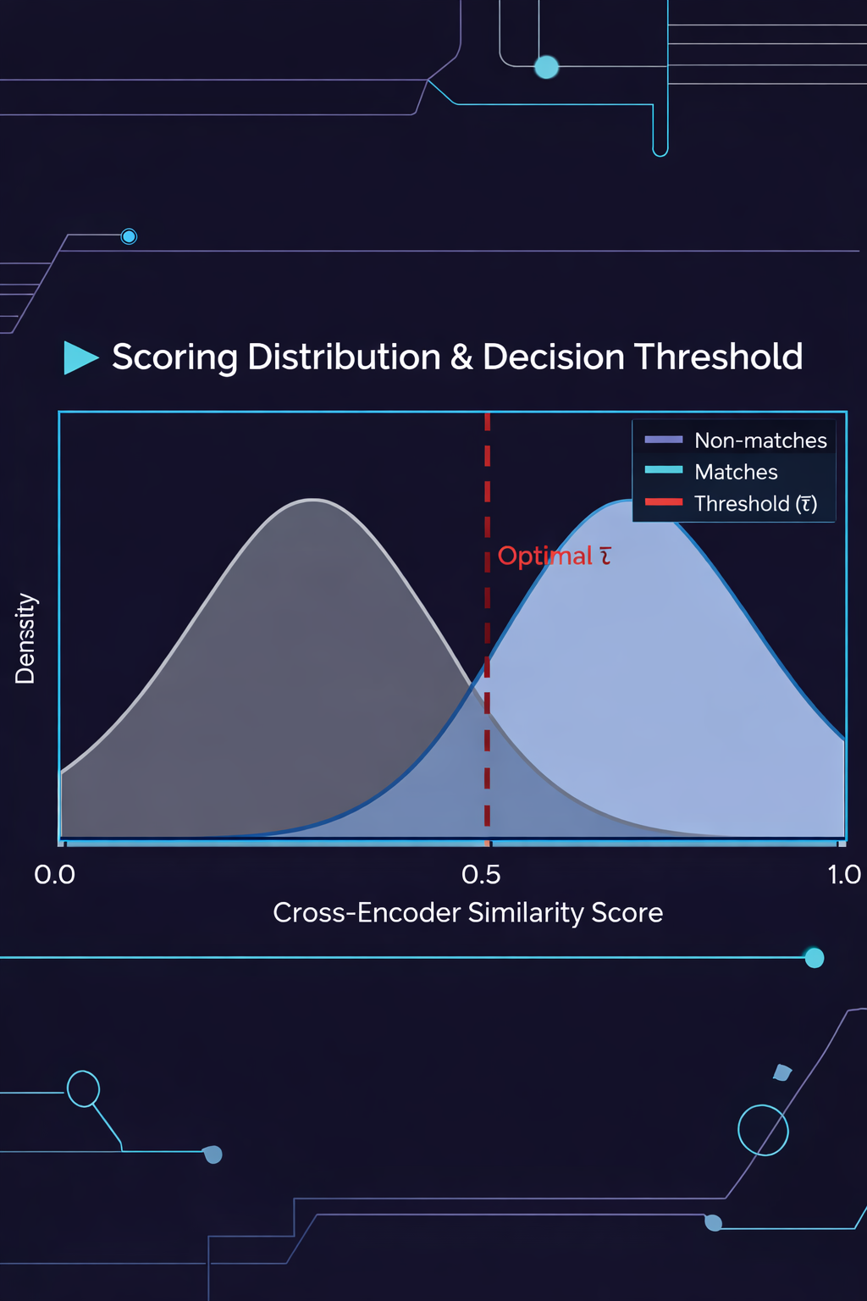
THRESHOLDING & BINARY DECISION (Secondary Analysis)
METHODOLOGY (THE HOW)
PURPOSE & CONTEXT (THE HOW)
SETUP:
Focuses on pairwise attribute–class classification
Raw output: Continuous similarity scores (logits/probabilities).
BINARY CONVERSION:
Scores are converted into hard decisions (Match / No-Match).
THRESHOLD SELECTION (𝜏):
Optimized on Validation Set.
Objective: Maximize Accuracy.
Applied uniformly to Test Set.
GOAL: Calibration & Interpretability
Assess the discriminative power of the model in isolation
Understand model confidence distribution
SCOPE LIMITATION
Not used for end-to-end inference.
Density
0.0
Cross-Encoder Similarity Score
1.0

Slide 21
END-TO-END INFERENCE: EXACT vs HYBRID RETRIEVAL
H1
RETRIEVAL SOURCE DISTRIBUTION
PERFORMANCE BREAKDOWN
H2
Exact Match: ~39%
Hybrid Retrieval: ~61%
EXACT MATCH
High precision for identical labels.
Very limited coverage; fails on synonyms or rephrasing.
HYBRID RETRIEVAL
Higher recall via semantic embeddings.
Ensures the correct class is "caught" for the neural model.
KEY INSIGHT
While deterministic shortcuts provide easy wins, Hybrid Retrieval is essential for a scalable, robust, and domain-agnostic alignment system.

Slide 22
CONCLUSIONS
06

Slide 23
CONCLUSIONS
WHAT WE VALIDATED
We empirically evaluated a modular ontology alignment pipeline combining exact matching, hybrid candidate retrieval, and neural semantic scoring. Our results show that retrieval design and data construction critically shape downstream alignment performance.
KEY INSIGHTS FROM EVALUATION
Domain-specific cross-encoders outperform generic models in semantic ranking tasks. Hard negative mining improves robustness on semantically ambiguous cases. Hybrid retrieval mitigates structural errors that cannot be recovered by neural scoring alone.
FINAL VERDICT
Accurate ontology alignment does not rely on a single component. It emerges from a carefully engineered interaction between retrieval strategies, data design, and neural models, each addressing complementary sources of error.

Slide 24
THANK YOU
ANY QUESTIONS?

