Slide 1


ONTOLOGY ALIGNMENT CLASSIFIER
BASED ON NLP
APPLIED DATA SCIENCE
Era Alcani
Francesco Dal Cero
Francesco Mastrosimone

Slide 2
TABLE OF CONTENTS
01 PROJECT OVERVIEW
02 RESEARCH HYPOTHESIS
03 SYSTEM DESIGN
04 DATA ENGINEERING
05 EVALUATION & RESULT
06 CONCLUSIONS

Slide 3
PROJECT OVERVIEW
01

Slide 4
PROJECT CONTEXT AND SOLUTION
THE CHALLENGE: SEMANTIC INCONSISTENCY
Context: Healthcare evidence is scattered across isolated "data silos".
Problem: Different terms (e.g., Fatigue vs. Asthenia) prevent meaningful integration of this data.
THE SOLUTION: AI SEMANTIC ENGINE
Goal: Develop an AI-powered engine to automatically harmonize fragmented data into structured evidence.
Impact: Replaces manual "brittle scripts" with a scalable, automated pipeline.

Slide 5


OBJECTIVES AND RESEARCH PERSPECTIVE
THE GOAL: AUTOMATED HARMONIZATION
To replace manual, brittle scripts with a robust framework that transforms raw attributes into high-confidence clinical evidence.
THE RESEARCH OBJECTIVES
SYSTEM LEVEL: Build a reusable framework for interpretable ontology alignment.
RESEARCH LEVEL: Evolve from simple string matching to capturing actual clinical meaning and context.

Slide 6

USER PERSONA
GOALS
Automation: Reduce manual review of 1000s of attributes.
Scalability: Pipeline must handle daily data spikes.
Accuracy: Needs “Scientific” context, not just keywords.
PAIN POINTS
Synonym Trap: Keyword search misses obvious matches.
Maintenance Difficulty: Can’t retune every single week.
Noisy Data: Raw inputs are full of typos and errors.
Name: Elias Vance
Role: Data Engineer
Company: Repertorio
“I need a pipeline that cleans messy data automatically so i can focus on structure”
THE REPERTORIO SCENARIO
“Elias receives 50k raw attributes daily. He needs a ‘Filter-then-Rank’ system to act as a gatekeeper- automating the easy 60% and flagging the hard 40%”

Slide 7
RESEARCH HYPOTHESIS
02

Slide 8
RESEARCH HYPOTHESIS
Efficiency and Ambiguity (H1)
Question: Do we always need complex deep learning models to align clinical terms?
Hypothesis: No. Model complexity should match semantic ambiguity: deterministic rules handle clear cases, while deep models are needed only for ambiguous or synonymous terms.
Architecture (H2)
Question: How do we balance high accuracy with scalability?
Hypothesis: Efficiency demands a "Filter-then-Rank" architecture. Scalability is achieved by filtering candidates with a fast retriever before applying expensive deep semantic scoring.
Data Strategy (H3)
Question: Is random training data sufficient for clinical accuracy?
Hypothesis: No. To generalize well, the model must be explicitly trained on "Hard Negatives"—tricky, similar-looking concepts—rather than just random non-matches.

Slide 9
SYSTEM DESIGN
03

Slide 10
SYSTEM DESIGN - MODULAR OVERVIEW
Supervised pair builder of two ontologies
Train Scoring Model
Load and Standardize
Inference Engine
Compile Artifacts
Single ontology
Reusable across studies – build once, run many times

Slide 11
SYSTEM WORKFLOWS & ENTRY POINTS
1
2
3
Ontology loading & standardization
Reference alignment loading
Training dataset construction
Model fine-tuning
Unified ontology representation
Exact-match lookup structures
Candidate retrieval indices
Semantic representations (for hybrid retrieval)
Training
Offline Preprocessing
From standardized ontology
Inference
Exact match shortcut
Candidate selection
Neural scoring

Slide 12
INFERENCE PIPELINE
H2
Input Attribute
Lexical Search
Exact Match?
No
Candidate Retrieval
Cross-encoder
(Re-Ranking)
Final prediction
Merge Candidates
Yes
Return Match
Semantic Search
STAGE A
STAGE B

Slide 13
DATA ENGINEERING
04

Slide 14
DATA PIPELINE: From Ontology to Supervised Training
ONTOLOGY STANDARDIZATION
Process: Parses heterogeneous OWL/RDF files into a Unified View.
Normalization: Maps diverse metadata (IRI, Labels, Synonyms, Definitions) into a standardized, ontology-agnostic schema.
Goal: Ensures the model sees consistent input regardless of the source format.
SUPERVISED DATASET CONSTRUCTION
Structure: Converts data into pairwise samples (Attribute, Concept, Label).
Positives: Drawn from Gold Standard alignments.
Negatives:
Random: For broad coverage.
Hard Negatives: Mined from semantically close "near-miss" candidates.
KEY OUTCOME
Balanced Training Set: The pipeline ensures a 1:1 ratio of positives to negatives, preventing class imbalance and forcing the model to learn fine-grained semantic distinctions.

Slide 15
EVALUATION & RESULTS
05

Slide 16
EVALUATION SETUP & METRICS
Hits@K
Retrieval Recall
(Is the correct answer in the shortlist?)
ENVO-SWEET
Primary Benchmark & Tuning
SUPERVISED DATASET
Positives: Reference Alignments
Negatives: Random + Hard Negatives
Precision@1
Automation Utility
(Is the top prediction correct?)
FLOPO-TO
Unseen Domain: Biodiversity
MRR
Ranking Quality
(How high is the correct match?)

Slide 17
MODEL SCREENING & SELECTION
SciBERT
PubMedBERT
62% Precision
Winner: Best Ranking
BERT_base
60% Precision
Good Recall, lower Precision
58% Precision
Baseline Performance
The Insight: All models were equally good at finding candidates (Recall ∼ 70%), but SciBERT achieved the highest Precision@1 and MRR, indicating a stronger ability to rank the correct concept at the top.
The Reason: While both models are trained on scientific papers, SciBERT covers a broader range of domains, whereas PubMedBERT is strictly biomedical. This wider scope gave SciBERT a slight edge in handling the mixed terminology of our dataset.

Slide 18
BASELINES & EVALUATION CONVENTION
H1
H2
EXACT MATCH (Reference)
LEXICAL MODE (Baseline)
Definition: Strict resolution via label or synonym matching only.
Constraint: Attributes with no direct correspondence are treated as incorrect.
Role: Captures the proportion of cases resolvable deterministically.
Metric: Precision@1: 0.6119
Definition: Integrates Exact Match with Subword-based Lexical Retrieval.
Ranking: Uses SciBERT Cross-Encoder for re-ranking.
Constraint: Semantic Retrieval is DISABLED.
Metrics: Precision@1: 0.6716
KEY INSIGHTS
Structured lexical retrieval combined with discriminative re-ranking provides a ~6% gain over pure exact matching. This isolates the contribution of ranking before we introduce Dense Semantic Search.

Slide 19
ABLATION STUDY: HARD NEGATIVES
H3
Training Configuration | Precision@1
SciBERT (Standard) | 0.6866
SciBERT (NO HN) | 0.64 (-5% Drop)
Training Configuration | Hits@20
SciBERT (Standard) | o.70
SciBERT (NO HN) | 0.70 (Unchanged)
Why Precision Drops?
Without Hard Negatives, the model gets confused by "Near-Misses". It treats related concepts as correct, lowering the automation score.
Why Recall Stays Same?
Hard Negatives don't help the model find candidates. They only teach the model how to rank the shortlist correctly. Thus, the search ability (Hits@20) remains identical.

Slide 20
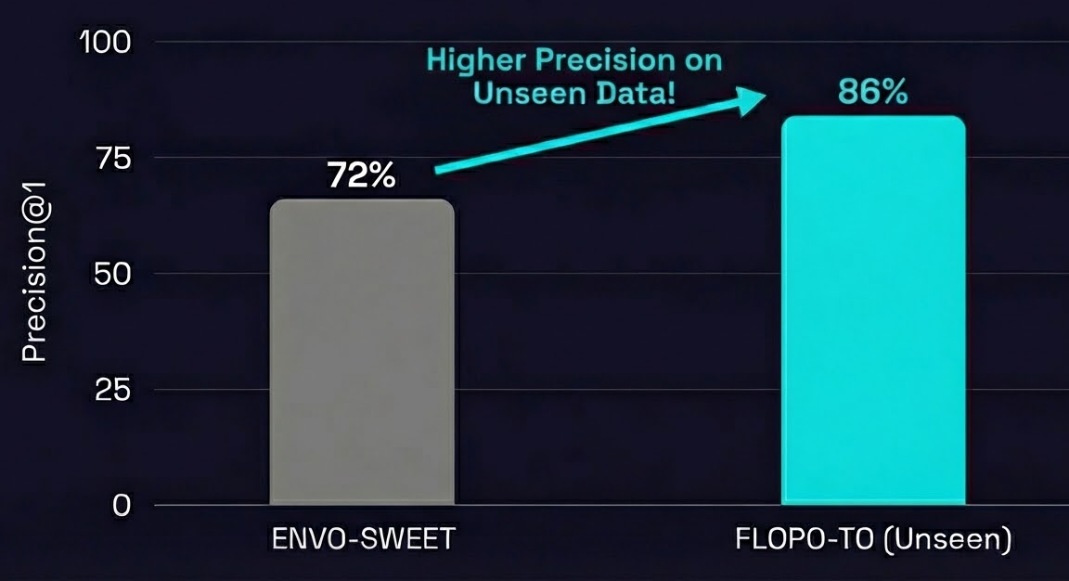
OPTIMIZATION & ZERO-SHOT GENERALIZATION
OPTIMIZATION
ZERO-SHOT ON FLOPO-TO
Config:
Hybrid Retrieval (Lexical + Semantic) + Hard Negative Training
Result (ENVO-SWEET)
Achieved best overall performance: *Precision@1: 0.72 * Hits@20: 0.78
Dataset
FLOPO-TO (Unseen Domain: Biodiversity).
Metrics
Precision@1: 0.86.
Hits@20: 0.92.
Key Insight
The system achieves even higher precision (0.86) on an unseen domain than on the training set. This proves the model learned general alignment logic, rather than just memorizing the specific training data .

Slide 21
CONCLUSIONS
06

Slide 22
CONCLUSIONS
Scalability via "Filter-then-Rank" Design
High accuracy is achieved without high latency by combining Deterministic Shortcuts with targeted SciBERT scoring. This ensures the system is computationally viable for real-time production use.
The Critical Role of Hard Negatives
Standard training is insufficient for fine-grained ontology alignment. Mining "Hard Negatives" is essential to prevent the model from confusing near-miss concepts.
Strong Zero-Shot Generalization
The system is not limited to its training data. It achieved superior performance on the unseen FLOPO-TO dataset, proving that it learns general alignment logic rather than just memorizing specific terminologies
Alignment quality emerges from the interaction of System Design (Filtering), Data Strategy (Hard Negatives), and Model Choice (SciBERT)—not from any single component in isolation.

Slide 23
THANK YOU
ANY QUESTIONS?

