Slide 1




AI-Based Ballpark Quotation Tool
Automating R&D Cost Estimation for IVECO/FPT Industrial
Team:
Nida Ejaz
Temur Kuchkorov
Javokhirbek Parpikhodjaev

Slide 2
Table of Contents
Challenge
Project Objective
Value Proposition
Research Questions
Method
Experiments
Live Demo
Conclusion

Slide 3

CHALLANGE & PROJECT OBJECTIVE

Slide 4
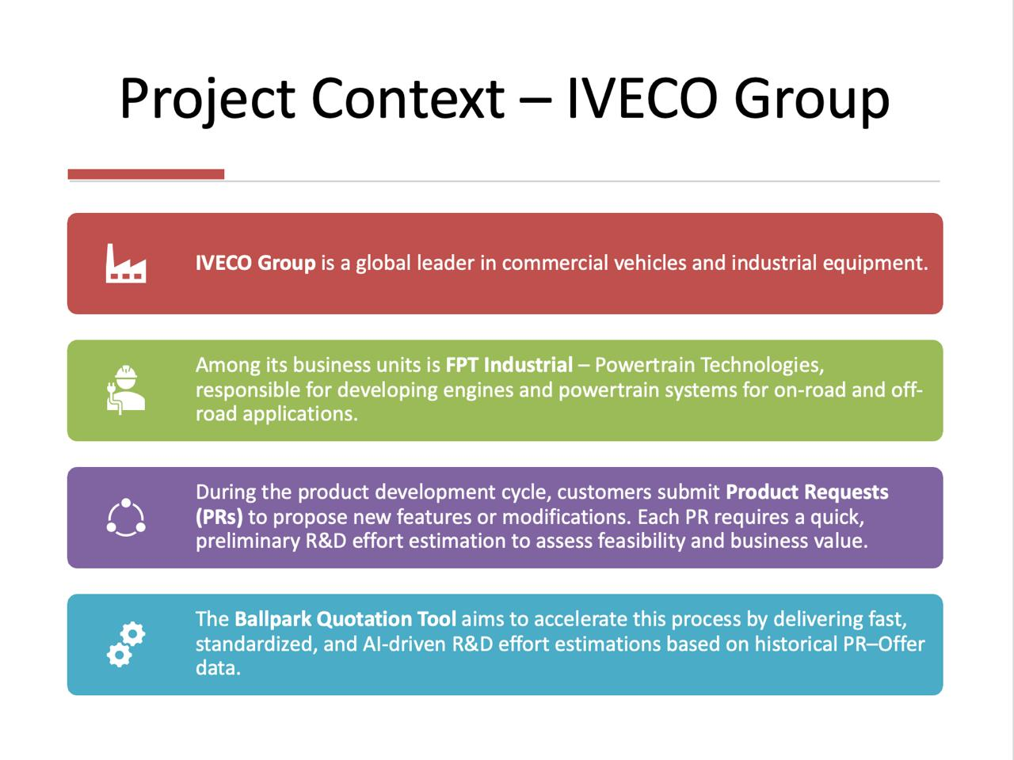
IVECO Group

Slide 5
Problem Statement
Manual Intensity: Analyzing PR Excel files is slow and requires deep expert knowledge.
Fragmented Data: There is no centralized database linking historical PRs with their final R&D Offers.
HIGH DEPENDENCY: The process relies heavily on individual expert knowledge, creating a risk of knowledge loss.
Inconsistency: Different Customer Managers provide different quotes for similar requests.

Slide 6
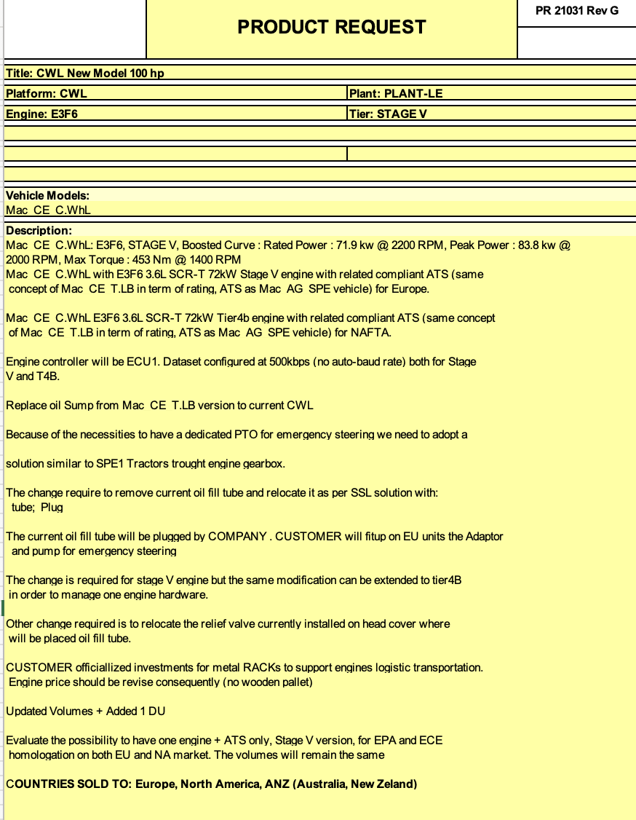
Product Request Input: Excel File

Slide 7
Project Objective
Develop an AI-based tool for fast ballpark R&D estimations
Automatically extract key information from PR Excel files
Use historical PR–Offer pairs as training data
Predict function-level R&D effort breakdown
Allow Customer Managers and Function Owners to refine results

Slide 8
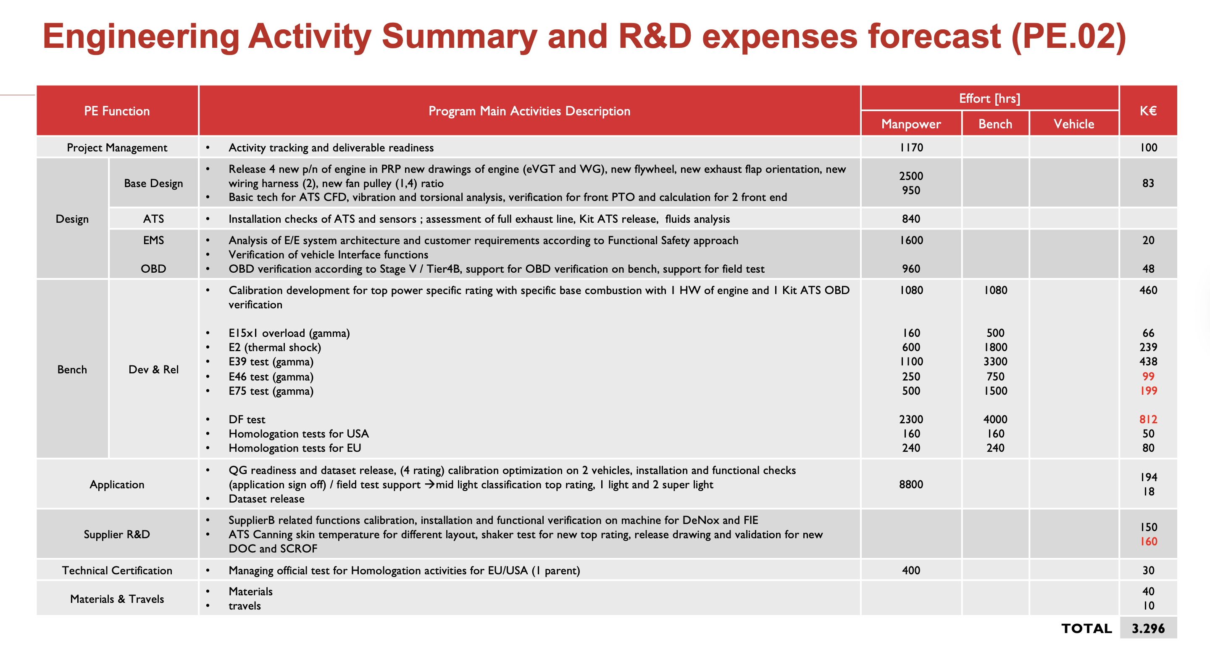
Proposed Quote Function Level R&D

Slide 9
Value Proposition
For the Customer Manager:
Speed: Instant preliminary estimations replace days of manual analysis.
Accuracy: Data-driven predictions improve consistency across all quotations.
Efficiency: Drastic reduction in manual workload, allowing focus on high-value tasks
For the Business:
Agility: Faster "Go/No-Go" decisions accelerate the sales cycle.
Standardization: A unified process across all functions and departments

Slide 10


Sustainable Development Goal
SDG 9: Industry, Innovation and Infrastructure
Enhancing industrial capability through digitalization and AI-driven automation.
SDG 12: Responsible Consumption and Production
Reducing "Engineering Waste" by minimizing duplicated efforts and optimizing resource planning

Slide 11
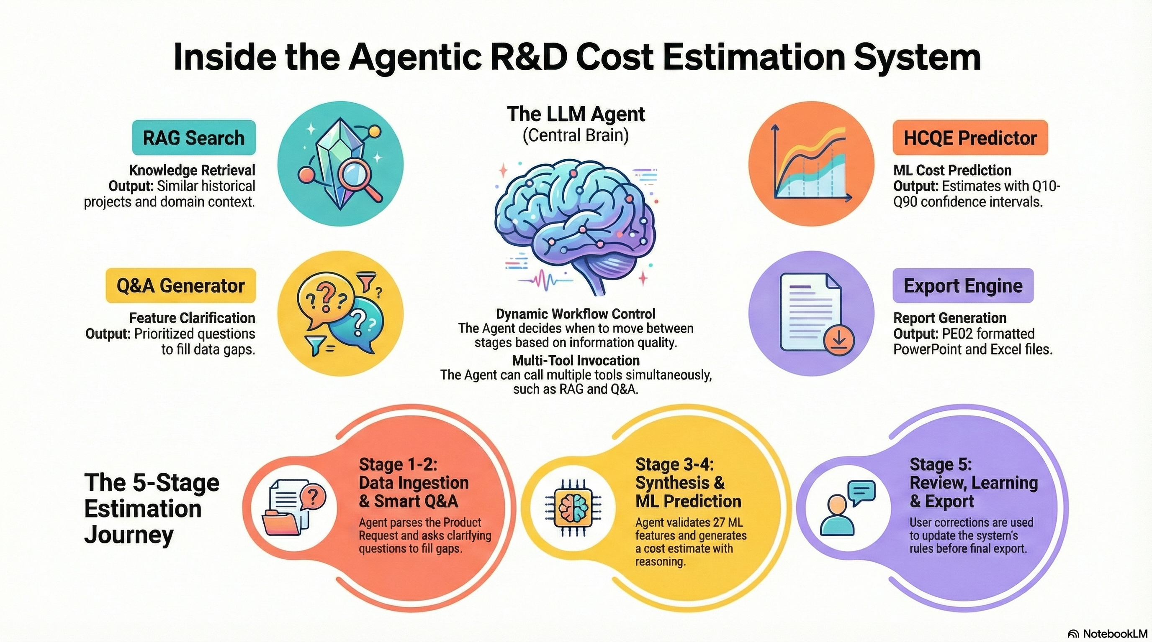
LLM Based Pipeline and Interface for Tool

Slide 12
RESEARCH QUESTIONS

Slide 13
Research Questions
RQ1 - How the tool transform raw text into activity type and activity effort?
RQ2 - The tool find PR similarities: can we measure the accuracy of the search engine?
RQ3 - Is a standalone regression model sufficient for business decision-making?
RQ4 - How much tool is good in predicting activity type?
RQ5 - How much tool is good in estimating effort intensity (hrs)?
RQ6 - How much tool is good in estimating cost?

Slide 14
Methodology

Slide 15
RQ: 1
Methodology
From Text to Estimation Content
Data Ingestion (Text to Features):
Input: Raw Product Request (Excel/pptx).
Parsing: LLM extracts 27 structured features.
Transformation: Categorical data is encoded; numerical data is normalized.
Hybrid Processing Engine:
Path A (Prediction): HCQE Model predicts Effort Intensity & Cost based on feature complexity.
Path B (Context): RAG Engine retrieves historical analogies.
Output: DeepSeek Agent synthesizes the prediction with historical context into a business report

Slide 16



RQ: 2
RAG System
Contextualized Cost Justification
Beyond Numerical Guesses
Retrieval from Qdrant
Our AI tool doesn't just provide cost figures; it offers depth and justification, moving beyond mere numerical predictions.
The Retrieval Augmented Generation (RAG) system actively searches and retrieves the top-3 most similar 'Reference Projects' from our Qdrant vector store.
Providing Context & Confidence
These retrieved projects provide invaluable historical context, enabling the AI to justify the estimated cost and enhance stakeholder confidence.

Slide 17
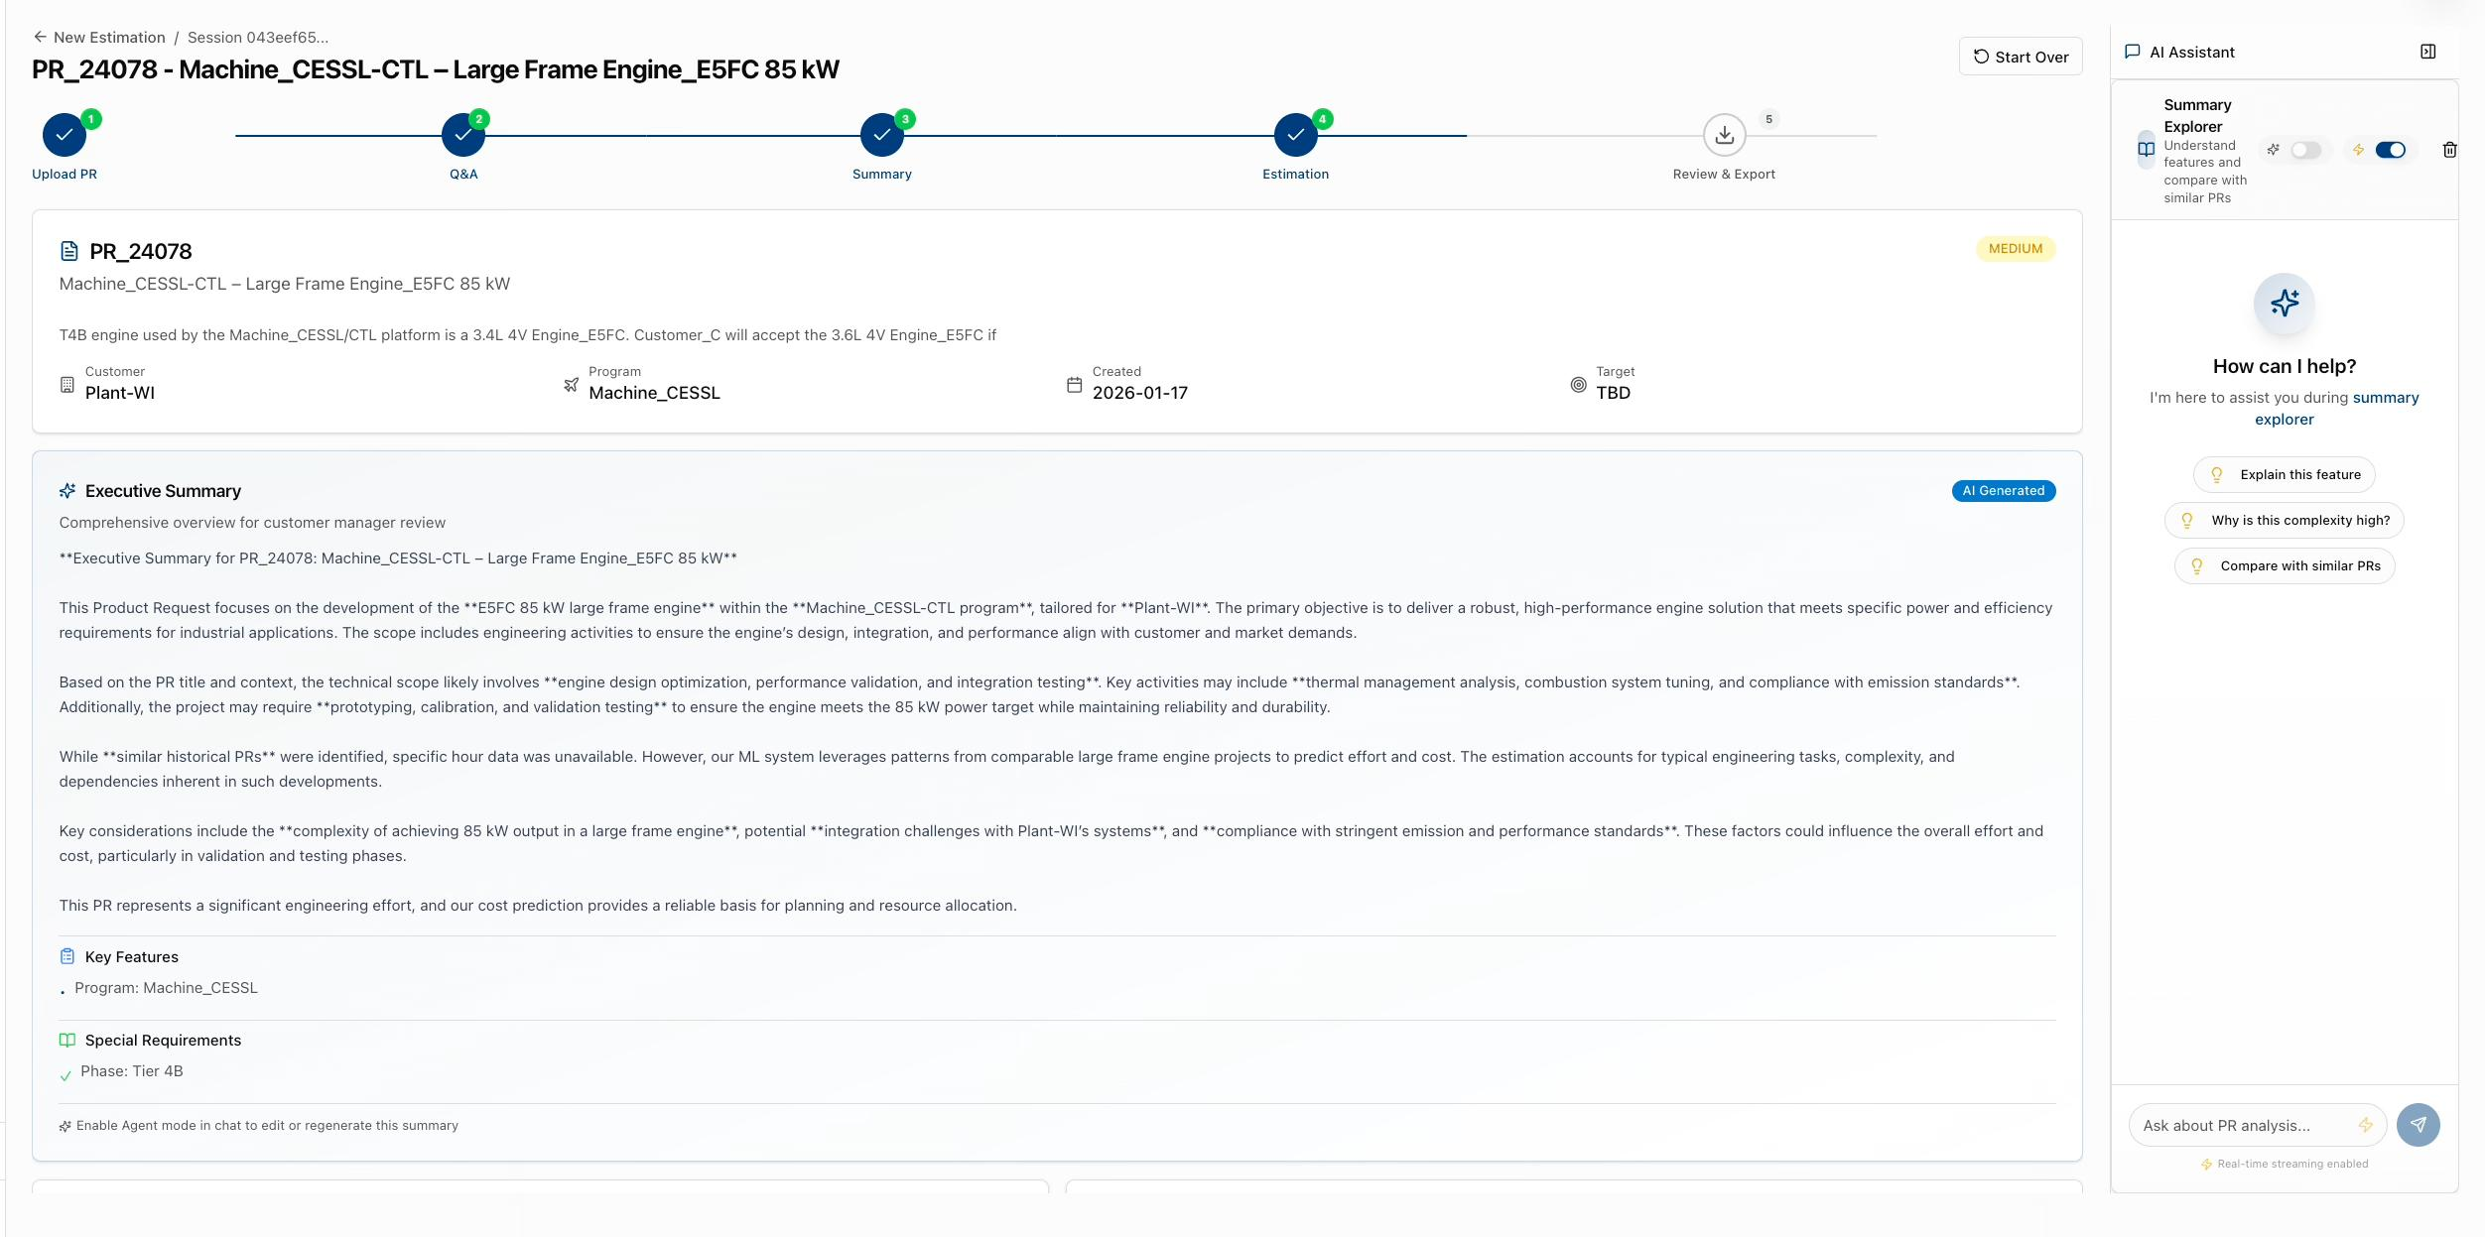
Summarized Input with LLM

Slide 18
The Analyst Agent
DeepSeek V3 Reasoning Layer
Role: Synthesis & Reasoning (not just numerical output)
Input: ML predictions + RAG context + historical patterns
Processing: DeepSeek V3 analyzes and synthesizes all signals
Output: Business-ready report explaining "Why" the cost is high
Intelligence Features:
Flags risks and anomalies (e.g., "Calibration hours 2x historical average")
Provides confidence intervals and uncertainty bounds
Generates executive summary with key drivers
Recommends mitigation strategies for high-risk areas
Value: Transforms raw predictions into actionable business intelligence

Slide 19
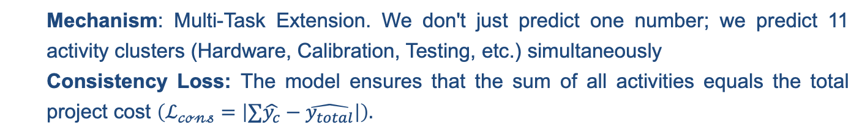
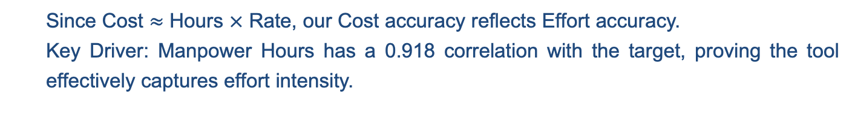
RQ: 3-6
Methodology
The Mathematical Engine: HCQE & Multi-Tasking
Effort Intensity Prediction (Hours)
Since Cost $≈$ Hours $×$ Rate, our Cost accuracy reflects Effort accuracy.
Key Driver: Manpower Hours has a 0.918 correlation with the target, proving the tool effectively captures effort intensity.
Activity Type Prediction
Mechanism: Multi-Task Extension. We don't just predict one number; we predict 11 activity clusters (Hardware, Calibration, Testing, etc.) simultaneously
Consistency Loss: The model ensures that the sum of all activities equals the total project cost $\left(ℒ_{𝒸ℴ𝓃𝓈}=\left|∑\hat{y_{c}}−\hat{y_{total}}\right|\right).$

Slide 20
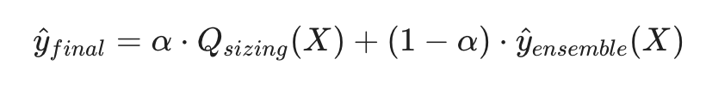
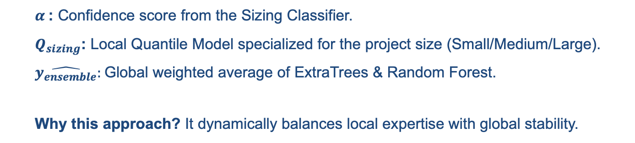

RQ: 3-6
Methodology
Core Algorithm: Hierarchical Conformal Quantile Ensemble
The Hybrid Formula:
Components:
$α$: Confidence score from the Sizing Classifier.
$Q_{sizing}$: Local Quantile Model specialized for the project size (Small/Medium/Large).
$\hat{y_{ensemble}}:$Global weighted average of ExtraTrees & Random Forest.
Why this approach? It dynamically balances local expertise with global stability.

Slide 21
Model Benchmarks

Slide 22
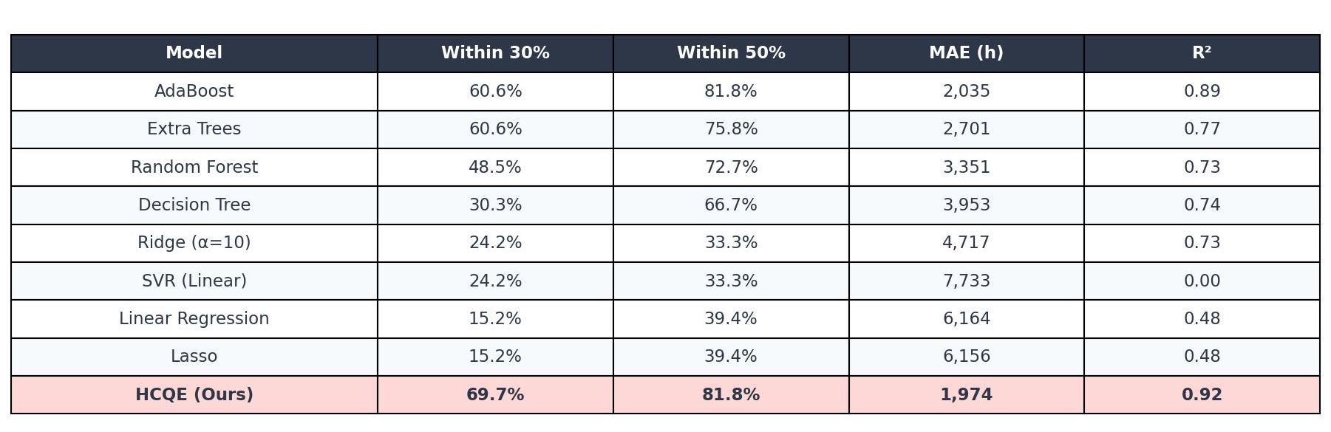
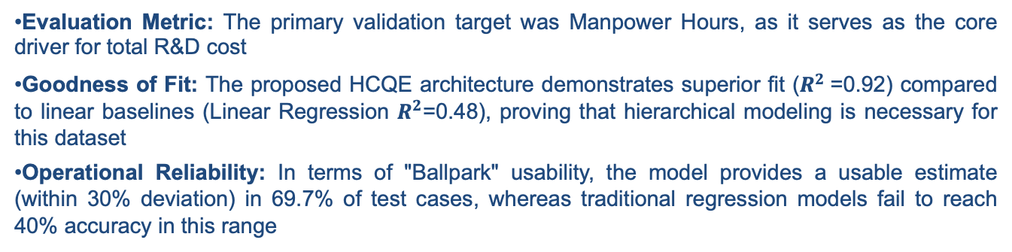
Model Benchmarking: R&D Effort Prediction (Hours)
RQ: 5
Evaluation Metric: The primary validation target was Manpower Hours, as it serves as the core driver for total R&D cost
Goodness of Fit: The proposed HCQE architecture demonstrates superior fit ($R^{2}$=0.92) compared to linear baselines (Linear Regression $R^{2}$=0.48), proving that hierarchical modeling is necessary for this dataset
Operational Reliability: In terms of "Ballpark" usability, the model provides a usable estimate (within 30% deviation) in 69.7% of test cases, whereas traditional regression models fail to reach 40% accuracy in this range

Slide 23
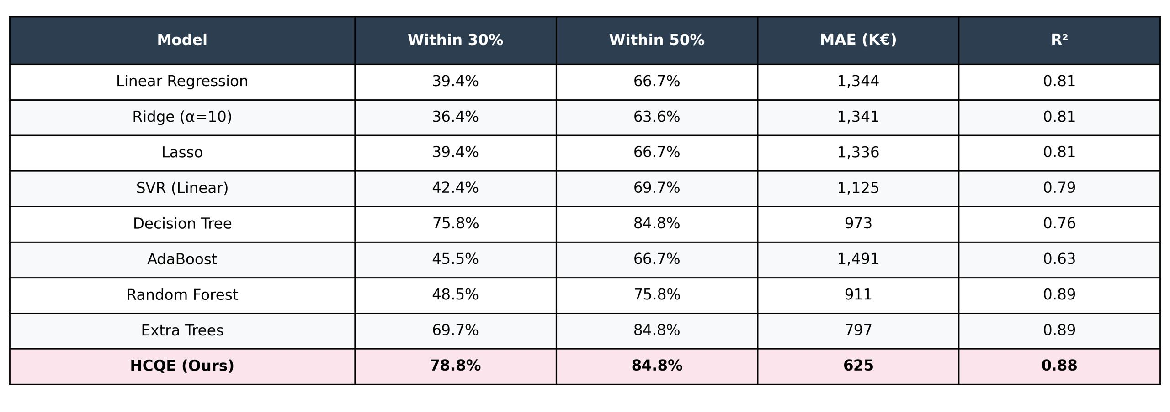
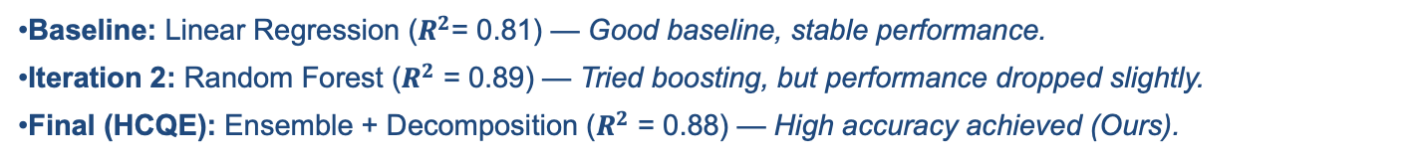
Model Benchmarking: R&D Effort Prediction (Price)
RQ: 6
Baseline: Linear Regression ($R^{2}$= 0.81) — Good baseline, stable performance.
Iteration 2: Random Forest ($R^{2}$ = 0.89) — Tried boosting, but performance dropped slightly.
Final (HCQE): Ensemble + Decomposition ($R^{2}$ = 0.88) — High accuracy achieved (Ours).

Slide 24
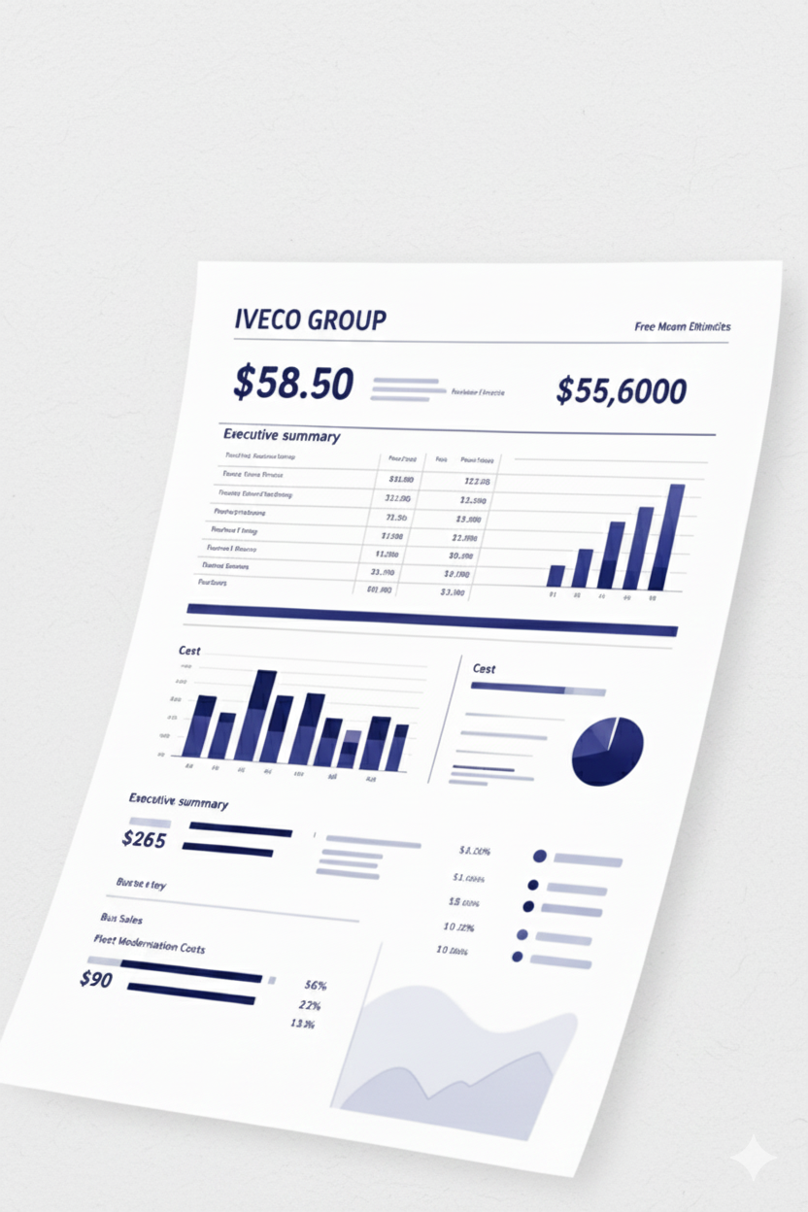
Comprehensive
Output: The Excel Report
The final output of our AI-Based Ballpark Quotation Tool is a detailed, user-friendly Excel report, designed to provide comprehensive insights briefly.
Executive Summary
Detailed Cost Breakdown
Confidence Intervals
Clearly defined confidence levels for the estimation, providing a realistic range and aiding in strategic decision-making.

Slide 25
Limitations & Future Work
Limitations
The system is trained on a limited amount of historical product request data, which may lead to variability in prediction accuracy across different project types.
The current feature extraction pipeline relies on a specific LLM; performance may vary when deployed in environments using alternative enterprise LLMs.
Future Work
As additional historical data become available, the framework can be retrained to improve accuracy and uncertainty calibration.
Future work includes validating the feature extraction pipeline with enterprise-standard LLMs and further integrating the tool into industrial workflows.

Slide 26
Conclusion
Objective:
This project aimed to support early-stage R&D quotation at IVECO Group by enabling faster and more consistent ballpark cost estimations from semi-structured Product Requests.
Method:
A hybrid pipeline combining LLM-based feature extraction, a hierarchical predictive model for effort and cost estimation, and a retrieval-augmented mechanism for contextual justification was designed and evaluated.
Effectiveness:
Experimental results on historical PR–Offer data show that the proposed approach can estimate R&D effort and cost with measurable accuracy while improving consistency and explainability compared to fully manual processes.

Slide 27


THANK YOU

