Slide 1



AI-Based Ballpark Quotation Tool
Checkpoint 1: Design & Management Plan
Team:
Nida Ejaz
Temur Kuchkorov
Javokhirbek Parpikhodjaev

Slide 2
Table of Contents
Project Context
  IVECO Group & FPT Industrial overview
Problem Statement
  Challenges in the current quotation process
The Solution: Ballpark Quotation Tool
  Value Proposition & Objectives
  AI-driven approach
Stakeholder Analysis
  Users & Needs (User Persona)
Project Management
  WBS, Gantt & Roadmap
Checkpoint 1

Slide 3
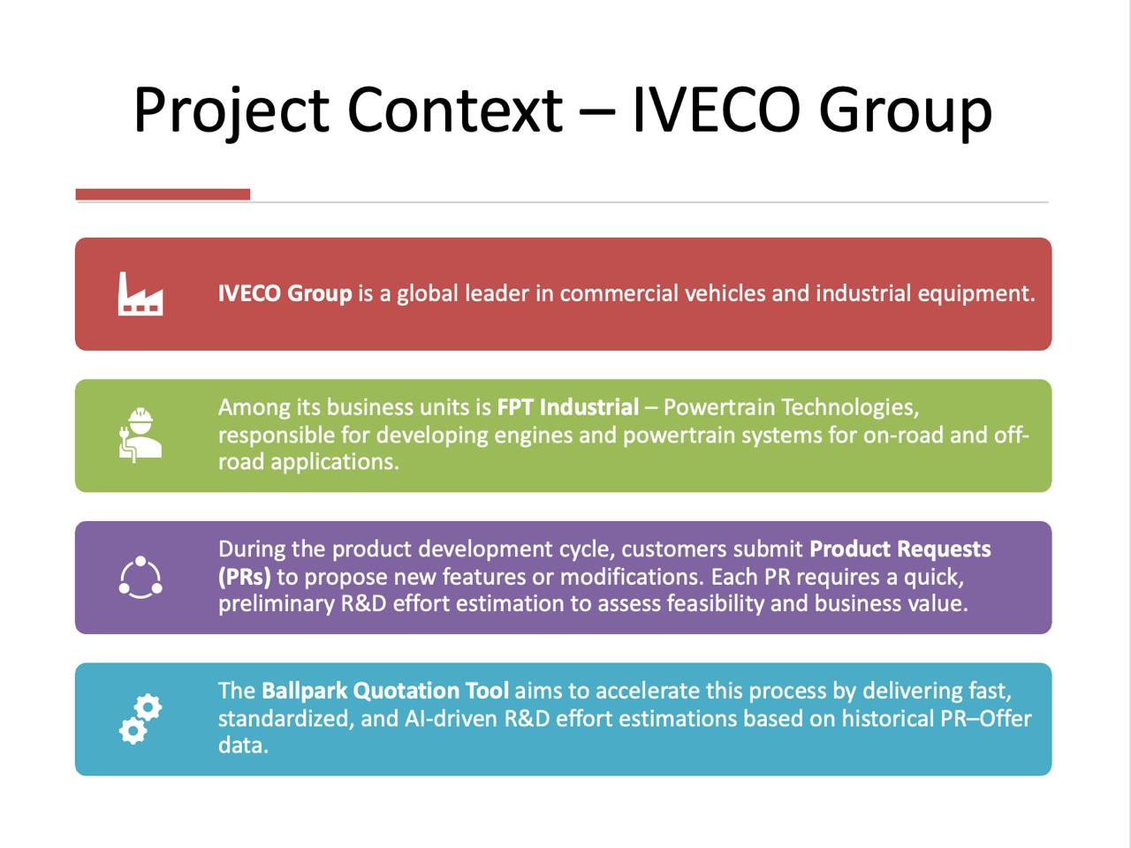
IVECO Group

Slide 4
Problem Statement
Manual Intensity: Analyzing PR Excel files is slow and requires deep expert knowledge.
Fragmented Data: There is no centralized database linking historical PRs with their final R&D Offers.
HIGH DEPENDENCY: The process relies heavily on individual expert knowledge, creating a risk of knowledge loss
Inconsistency: Different Customer Managers provide different quotes for similar requests

Slide 5
The Solution: AI-Based Ballpark Quotation Tool
Development of an automated, data-driven system to provide fast and reliable R&D effort estimations, reducing manual workload for Customer Managers.
Automatically extracts technical specifications from PR Excel files
Utilizes a structured database of past PR-Offer pairs to inform estimations
Predicts R&D effort broken down by function for high accuracy
Interface for managers to review, refine, and validate AI output before final submission.

Slide 6
Value Proposition
For the Customer Manager:
  Speed: Instant preliminary estimations replace days of manual analysis.
  Accuracy: Data-driven predictions improve consistency across all quotations.
  Efficiency: Drastic reduction in manual workload, allowing focus on high-value tasks
For the Business:
  Agility: Faster "Go/No-Go" decisions accelerate the sales cycle.
  Standardization: A unified process across all functions and departments

Slide 7


Sustainable Development Goal
SDG 9: Industry, Innovation and Infrastructure
  Enhancing industrial capability through digitalization and AI-driven automation.
SDG 12: Responsible Consumption and Production
  Reducing "Engineering Waste" by minimizing duplicated efforts and optimizing resource planning

Slide 8
Project Objectives & Roadmap
Data Foundation
Modeling Strategy
Decision Support
Consolidating historical PRs & Offers.
Effort forecasting per function
Data-driven estimation model
Suggesting historical projects as benchmarks.
Interface for manager validation & model refinement
Extracting data from raw Excel files

Slide 9
Stakeholders Map
External
Indirect
Direct
Senior Management
Suppliers
Project Mentors
Platform Engineering
Customers
Customer Manager
AI & Data Team
Database Engineers
Developers
Function Owners
AI & Data Team

Slide 10

User Persona
GOALS & Needs
Demographics
John
Customer Manager
41 years old, works at
FPT Industrial
Reduce quotation time from days to minutes. Ensure consistent pricing across markets. Minimize manual Excel data entry.
Behavior & Habits
Data Can Produce/Use
Constantly receives complex Product Requests (PRs) in Excel format containing unstructured technical data
Can use: Historical Offers, Technical Product Specifications
Can produce: Validated Ballpark Estimations, Feasibility Reports
Pain Points & Frustrations
Expected Outputs
1) Struggling to find historical "PR-Offer" pairs scattered across local files
2) The manual analysis of Excel files is too slow for urgent commercial opportunities
An AI-driven dashboard that parses PR files and generates a preliminary cost breakdown by function (Design, Testing, Calibration), highlighting similar historical cases for validation

Slide 11
User Journey
Receives PR and realizes that manual estimation is time-consuming.
Uploads PR to the Ballpark Tool and receives an AI-generated estimate
Continues using the tool for consistent and efficient estimations
Awareness
Decision
Loyalty & Advocacy
Consideration
Delivery & Use
Searches past cases, but struggles with inconsistent or missing data
Engages with Function Owners to validate/refine the estimate before sending it to the customer

Slide 12
User Requirement
Functional Requirements: | Non-functional:
Data Ingestion & Preparation Upload PR Excel files Extract key PR data (NLP) Structured PR–Offer database Core R&D Cost Prediction Function-level R&D cost prediction Retrieve similar historical PRs Decision support indicators (past matches) Review & Output Human review and refinement Export final estimation (Excel/PDF) | Performance & Accuracy Fast predictions Consistent and accurate Usability & Transparency Easy to use Explainable outputs System Integrity Secure internal access Maintainable & scalable

Slide 13

Functional Diagram
Input: PR Excel + Database
Process: NLP → Features → Model → Review
Output: R&D estimation + similar cases
input
processing
Output & Review
PR Parsing & NLP Extraction
Final Output: Validated R&D Estimation & Feasibility Report
Product Request (PR) Excel – User Upload
Human Review (Customer Manager + Function Owners)
PR–Offer DB & Feature Engineering
Function-Level Effort Prediction
Historical PR–Offer Database
Similar Case Retrieval

Slide 14
Manage - Work breakdown structure
WP1 — Design and Management
  Duration: 1 Nov 2025 → 19 Nov 2025
  T1.1 Define Value Proposition
  T1.2 Set Objectives
  T1.3 Identify Stakeholders
  T1.4 Functional Diagram
  T1.5 Design and Management Plan
  T1.6 Prepare Checkpoint 1 presentation
WP2 — Data Collection and Preparation
  Duration: 20 Nov 2025 → 30 Nov 2025
  Tasks:
  T2.1 Collect historical PR–Offer Excel files
  T2.2 Clean and structure data
  T2.3 Design PR–Offer database
  T2.4 Explore PR text and fields
WP3 — Model Development
  Duration: 1 Dec 2025 → 10 Dec 2025
  Tasks:
  T3.1 NLP for PR extraction
  T3.2 Feature engineering
  T3.3 Regression model for function-level effort prediction
  T3.4 Similar-case retrieval module
  T3.5 Evaluation & refinement
  T3.6 Prepare Checkpoint 2 presentation
WP4 — Deployment and Delivery
  Duration: 11 Dec 2025 → 7 Jan 2026
  Tasks:
  T4.1 Meeting with IVECO for feedback
  T4.2 Project Deployment
  T4.3 Prepare Checkpoint 3 presentation
  T4.4 Final technical report

Slide 15
Manage - Gantt
 |  | NOV |  |  |  | DEC |  |  |  | JAN
 |  | W1 | W2 | W3 | W4 | W1 | W2 | W3 | W4 | W1 | W2 | W3
Project Management
Project Definition
Design Plan
Management Plan
Data Preparation
Data Collection
Data Cleaning
Model Development
Model Selection and Training
Model Evaluation
Communication
Meetings with Iveco
Checkpoint preparation
Final Presentation
: Completed
CP1
(19/11/2025)
CP2
(10/12/2025)
CP3
(07/01/2026)

Slide 16


THANK YOU

