Slide 1
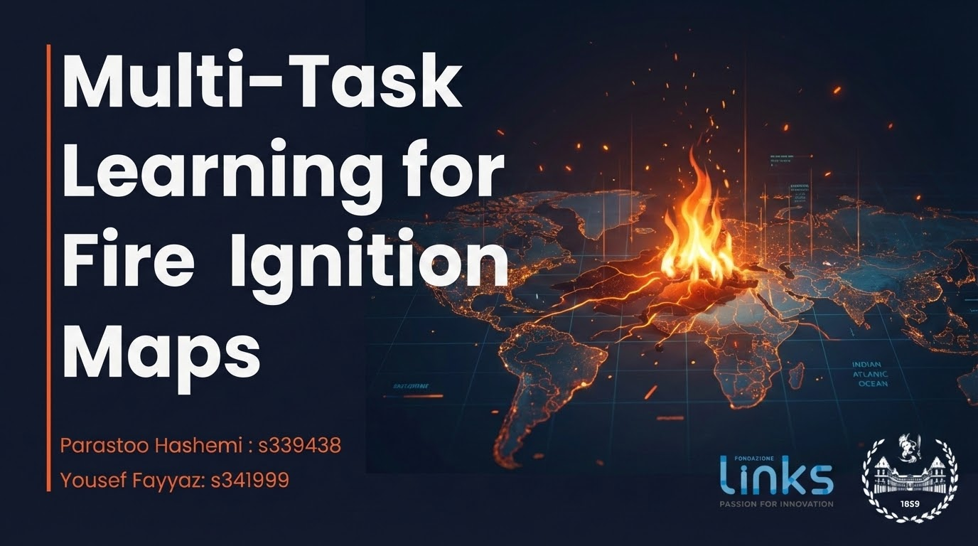
Notes:
Good morning everyone. My name is Parastoo Hashemi, and my teammate Yousef Fayyaz, we’re here to present the our project titled “Multi-Task Learning for Fire Ignition Maps.”

Slide 2
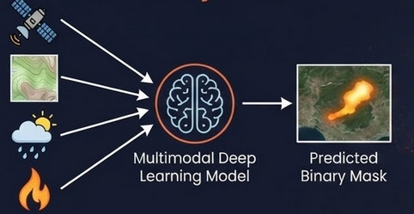
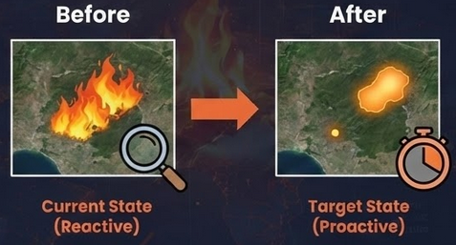
Project Objective
Core Objective
To develop a multimodal deep learning model capable of Predicting the final burned area extent right at the moment of ignition, using only pre-fire multimodal data that fused into a multimodal model
Input: Pre-fire environmental data (Satellite, Topography, Weather) + Ignition Point.
Output: Predicted binary mask of the final burned area.
The Paradigm Shift
Current State (Reactive): Remote sensing is primarily used for post-event damage assessment.
Target State (Proactive): To estimate the spread of fire immediately to allocate resources immediately during the "Golden Hour".
Notes:
Our project aims to predict the final burned-area extent right at the moment it starts, using only pre-fire environmental information. Traditionally, remote sensing is reactive: it tells us what burned after the event.
Our goal is proactiv, we estimate spread immediately, when decisions still matter. Technically, the model fuses multiple pre-fire data sources and outputs a burned-area mask.

Slide 3




Value Proposition
Response Efficiency
Innovation & Scalability
Environmental Impact
The multimodal AI system generalizes across regions where Sentinel-2, Landsat, DEM, ERA5, and infrastructure layers are available.
The framework can be replicated globally, providing a reusable template for data-driven wildfire risk management.
Proactive predictions reduce environmental losses by enabling faster response before uncontrolled spread.
Fewer hectares burned → lower CO₂ emissions, preserved ecosystems, and reduced long-term regeneration costs.
Early burned-area forecasts help Civil Protection allocate firefighting teams, helicopters, and ground units efficiently.
Better situational awareness during the first critical hours improves containment and reduces operational risk.
Notes:
This work is meaningful for three main reasons.
First, environmental impact: earlier predictions can reduce burned area and environmental damage.
Second, response efficiency: earlier predictions allow civil protection agencies to position resources before the event.
Third, scalability: because all data sources are globally available, the same framework can be transferred to other fire-prone region.

Slide 4
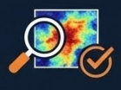
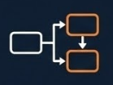
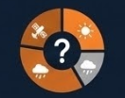
Research Questions
Can pre-fire multimodal data predict final burned area with sufficient accuracy to support early emergency decisions?
Does auxiliary-task learning improve spatial segmentation performance compared to single-task models?
What is the relative contribution of satellite, meteorological, and topographical modalities?
Notes:
Our research revolves around three key questions:
Can multimodal data predict the final burned area accurately enough to support early emergency decisions?
does adding an auxiliary task, such as land-cover segmentation, improve predection?
And finally, which data modalities matter most?

Slide 5

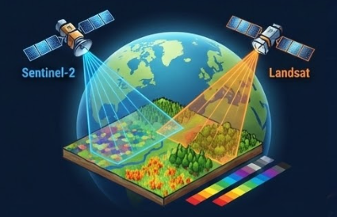
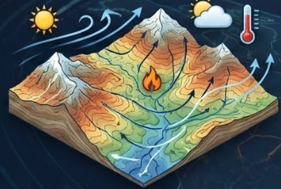
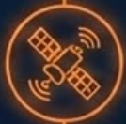




Pre-Fire Data:
We will use a catalog of 2152 fires happened in Piemonte region (Italy) in 2012-2024. For each fire event, the following data are available
Satellite Imagery (Sentinel-2 & Landsat)
Environmental Drivers (DEM & ERA5)
Sentinel-2 Imagery: 12-band multispectral, 10-20m res.
captures immediate pre-fire condition
(vegetation & fuel availability)
Topograph (DEM): Terrain , slopes and valleys (30m res).
Fire Behaviour is influenced by slope and elevation.
Landsat Imagery: Extra spectral info (SWIR/NIR)
Sensitive to vegetation moisture and fuel dryness.
Complementary spectral response for fuel characterization.
ERA5 weather: Temperature & wind at ignition time.
Meteorological conditions are key drivers of fire expansion.
wind affect direction and speed of the fire.
Notes:
Our dataset consists of about 2 Thousand wildfire events of the Piemonte Rather than listing inputs, I’ll focus on why each modality is included.
Sentinel-2 provides high-resolution information about vegetation condition and fuel availability.
Landsat imagery complements this information,
topography information from a DEM is included because fire behavior is influenced by slope and elevation. ERA5 weather data provides wind conditions at ignition time, which affect the direction and speed of fire spread.

Slide 6
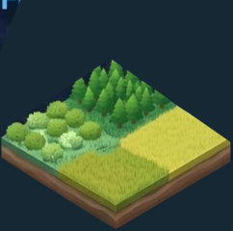
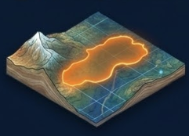

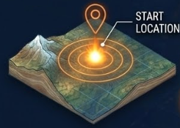
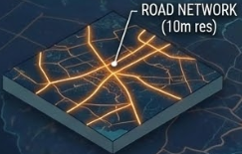
Ground-Truth Fire Labels
BURNED AREA MASK & IGNITION DATA
Land cover and Roads
Land cover map: Categorical mask of vegetation types (Forest, Shrub, Grassland, etc.).
why needed? Critical for estimating fuel type, Assists the model in differentiating propagation potential based on available fuel.
Burned Area Mask: Shape of the area that actually burned,
Binary Segmentation ( pixel-level supervision)
(1 = burned, 0 = unburned)
why needed? Serve as a target label for supervised learning segmentation
Roads: Binary road mask (10m resolution).
why needed? Captures both human-caused ignition likelihood and fire break potential.
Ignition Data: The exact location where the fire started. (Binary marker), derived from Civil Protection point data.
why needed? The model learns how the fire is likely to spread from that specific starting position.
Notes:
For ground truth, burned-area masks and ignition points.
The burned-area mask provides pixel-level supervision, while the ignition point marks where the fire starts. Data also include land-cover maps because different vegetation types behave differently as fuel.
Finally, road network. Roads are important because many fires start near human activity, and they act as barriers.

Slide 7
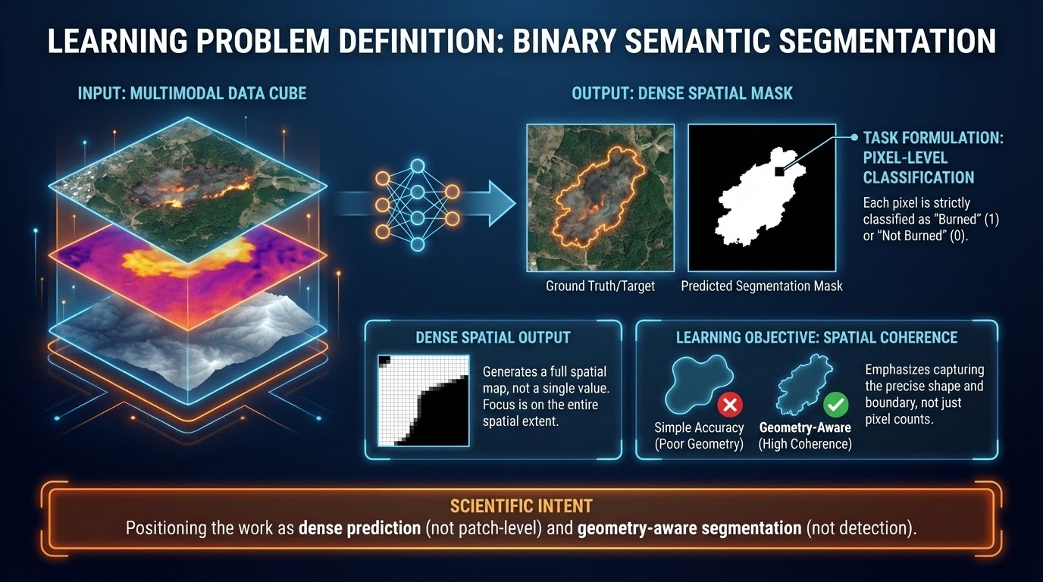
Notes:
we formulate this task as binary semantic segmentation
The input is a multimodal data cube , where layers are aligned into an unified representation.
the output is a spatial masks, each pixel is classified as burned or not-burned. this is a geometry-aware learning problem. We care about spatial coherence , boundries and shape.
This formulation ensures that model outputs are usable for decision-making rather than simple event detection.

Slide 8
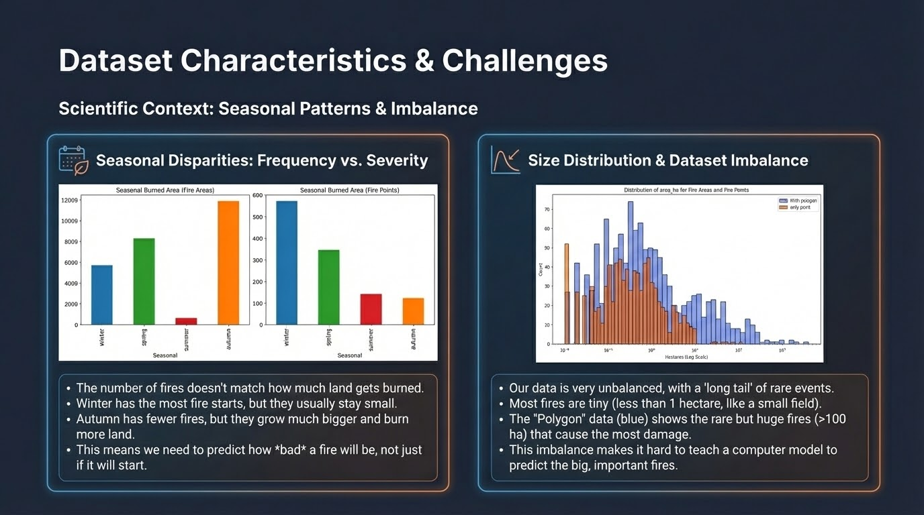
Notes:
Aim:
To show HOW dataset statistics 📈 influenced our modeling choices
On the left:
Compare fire frequency with burned area across seasons
Winter: many fires, small
Autumn: fewer, much large
=> frequency / severity: not aligned
On the right:
Fire-size distribution
Follows a long-tail distribution
Most fires : small
Large fires: rare ==> major of damage
=> Extreme class imbalance
accuracy(evaluation metric): insufficient
Model can look strong by predicting background
IOU primary EM we handle extreme class imbalance by combining BCE + Dice loss.

Slide 9
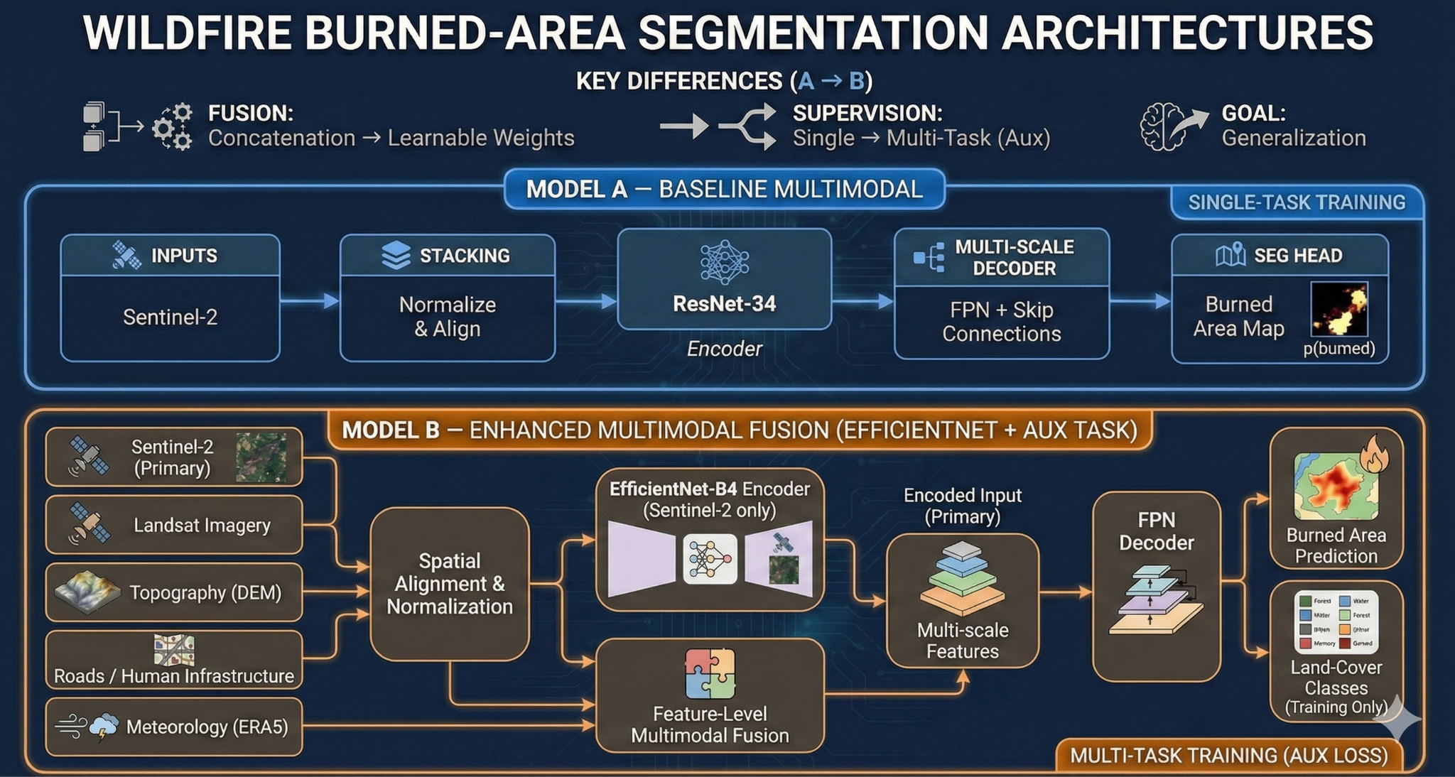
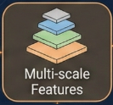




Multi-modal Feature Pyramid Network
z
Sentinel-2 (only)
the fused feature pyramid
Notes:
This slide summarizes our proposed architecture and the baseline used for comparison. We propose a Multi-Modal Feature Pyramid Networ Sentinel-2 is the primary spatial backbone to preserve high-resolution structure.
Sentinel-2 inputs are encoded with a strong encoder, producing multi-scale feature maps. All inputs are first spatially aligned and normalized, then projected into the Sentinel feature space. 1) This ensures that fusion happens between comparable spatial representations, not raw heterogeneous inputs.
2) Fusion is performed at the feature level and across multiple scales, 3) using learnable weights, allowing the model to control the influence of each modalityt.
The fused feature pyramid is decoded using an FPN to produce burned-area predictions. Most importantly, During training, we add an auxiliary land-cover segmentation task, which regularizes the shared encoder by enforcing fuel-aware features, so it becomes Multi task.
The baseline preserves the same inputs, alignment, fusion strategy, and decoder, but the type of encoder is different and also removed the auxiliary task and trains only on burned-area segmentation.

Slide 10
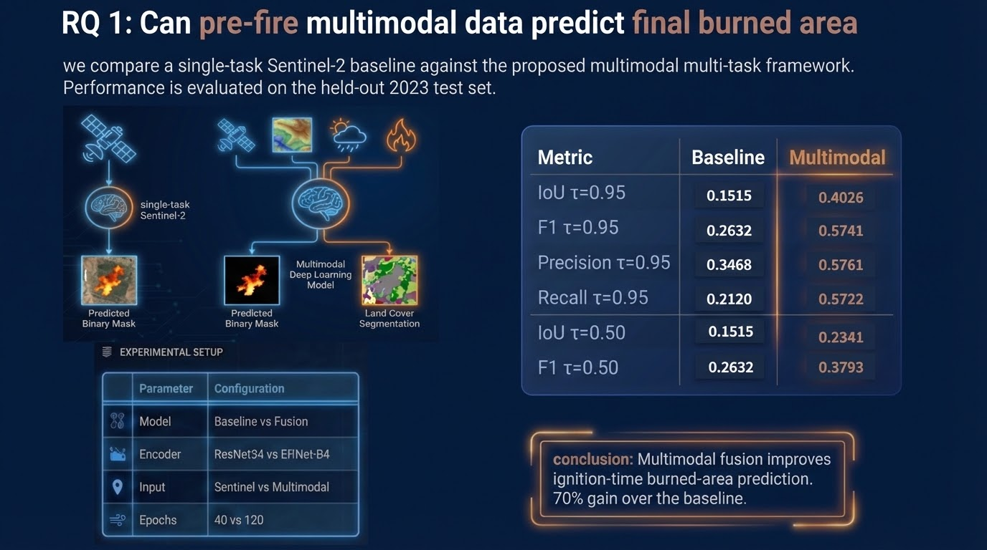
Notes:
This slide answers RQ1: whether pre-fire multimodal data can predict final burned area.
We compare a Sentinel-2 baseline with our multimodal, multi-task model on a held-out 2023 test set.
The results show consistent improvements across IoU, F1, precision, and recall at both strict and relaxed thresholds.
For example, IoU at a 0.95 threshold increases from 0.15 to 0.40, corresponding to about a 70 percent relative gain.
This demonstrates that fusing complementary pre-fire data significantly improves ignition-time burned-area prediction.”

Slide 11
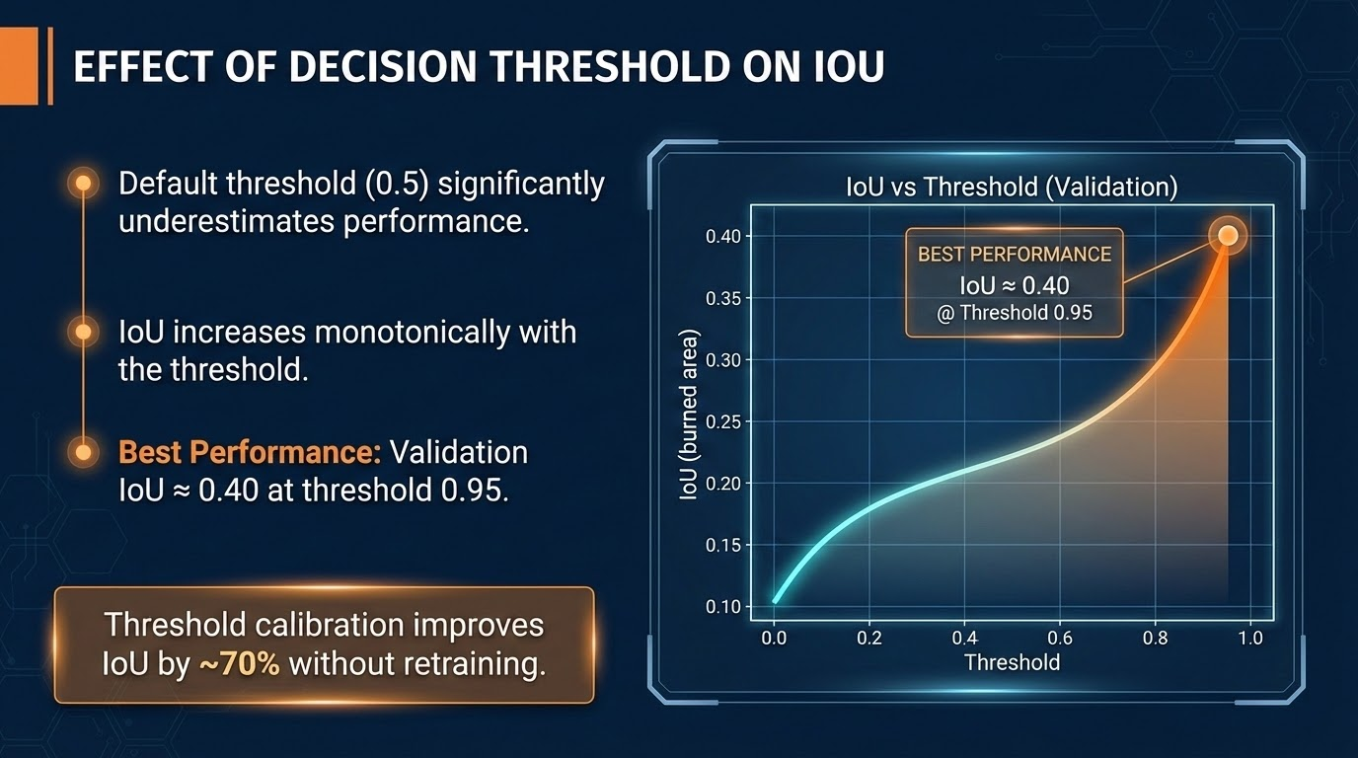
Notes:
This slide shows why the default threshold of 0.5 is misleading for this task.
When we sweep the threshold on the validation set, IoU consistently improves as the threshold increases. The best performance—around 0.40 IoU—is reached at a high threshold of 0.95.
The key point is that this gives us a large gain, about 70%, without retraining the model. It’s purely a calibration effect.
By using a higher threshold, we keep only the most confident predictions, which improves spatial overlap with the true burned area. This makes threshold calibration a simple and effective way to improve operational performance.

Slide 12
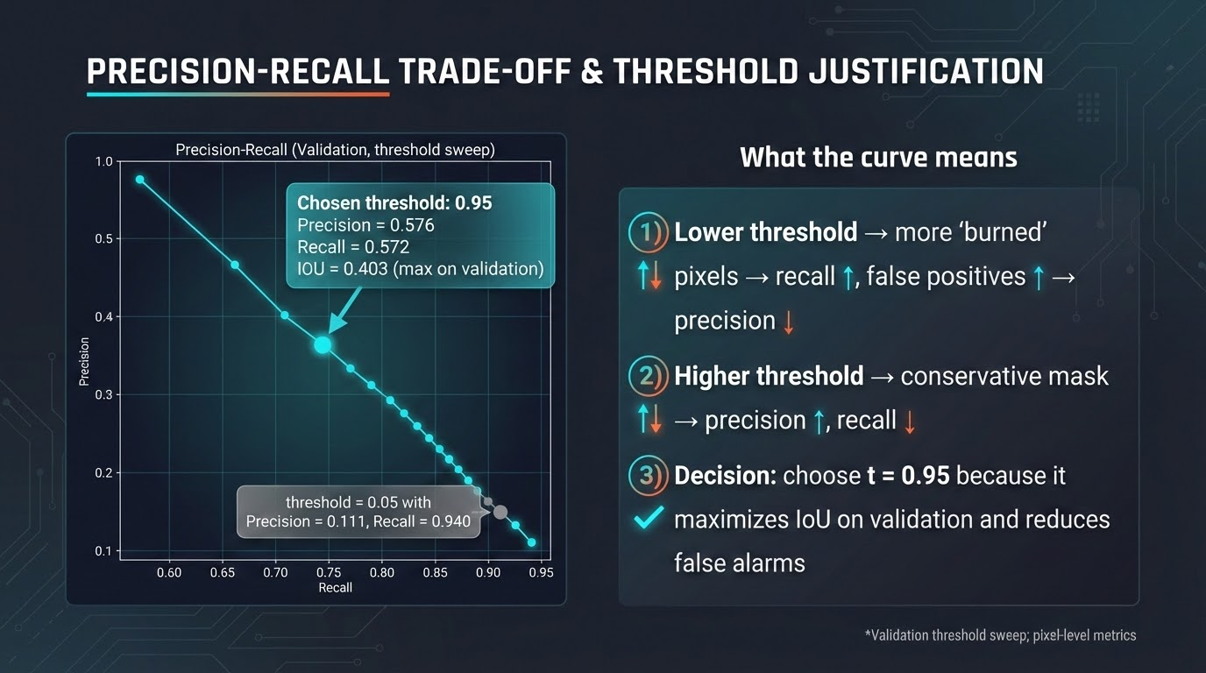
Notes:
This slide explains the threshold trade-off.
At low thresholds, the model labels many pixels as burned. Recall is high, but this also creates many false positives. As the threshold increases, the model becomes more conservative: fewer pixels are predicted as burned, but precision improves.
For early response, false alarms are costly because they can misdirect resources. That’s why we select a high operating threshold of 0.95.
This choice prioritizes spatial accuracy and clean predictions, rather than trying to capture every possible boundary. The goal is reliable decision support, not maximum recall.

Slide 13
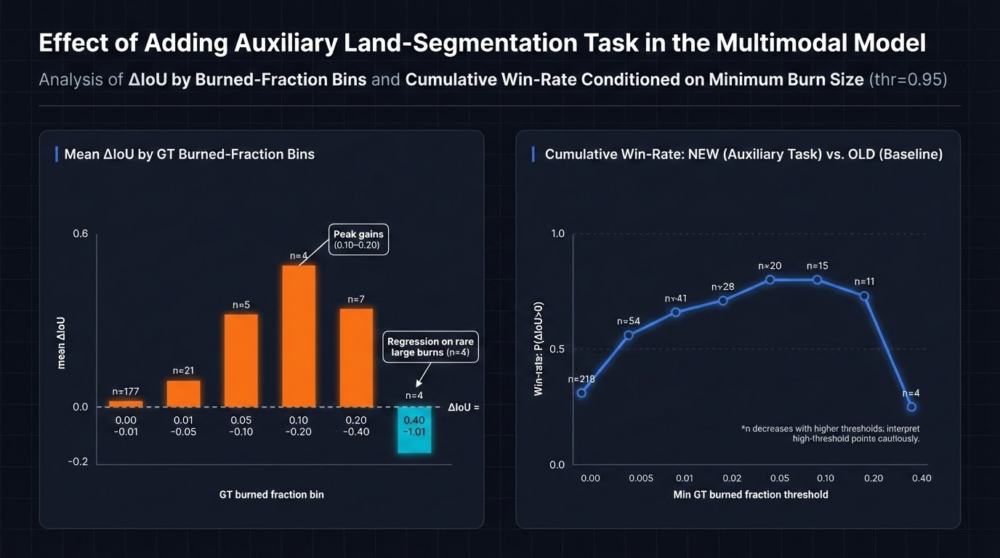
Notes:
This slide shows the effect of adding an auxiliary land-segmentation task to the model.
On the left, we measure performance change across different burned-area sizes. The biggest improvements appear in small to medium fires, especially in the mid-range burned fractions. These cases benefit the most from the auxiliary task, likely because spatial context matters more when the signal is subtle.
On the right, the cumulative win-rate confirms this trend. Across most thresholds, the new model outperforms the baseline more often than not.
Performance drops only for very large burns, but those cases are rare. Overall, the auxiliary task consistently improves spatial segmentation, especially where the problem is hardest.

Slide 14
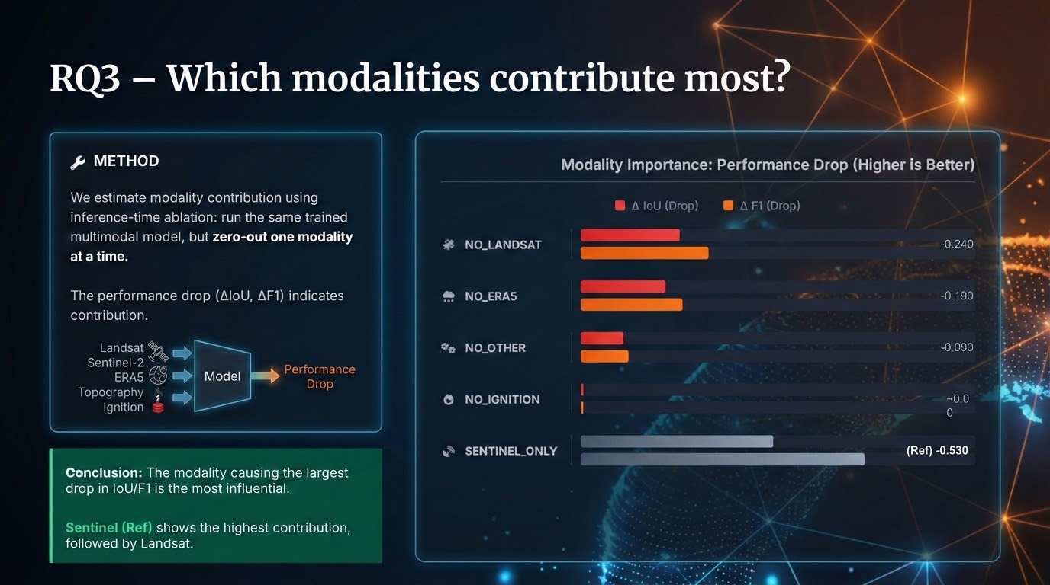
Notes:
This slide answers RQ3 by analyzing how different data modalities contribute to model performance.
We apply inference-time ablation, where the trained multimodal model is kept fixed and one modality is removed at a time. The resulting drop in IoU and F1 indicates that modality contribution
The results show that removing Landsat causes the largest degradation, followed by ERA5, while other inputs have a smaller effect.
The Sentinel-only bar is a single-modality baseline, not an ablation, and shows the gap between Sentinel alone and the full multimodal system.
Overall, Sentinel provides a strong core signal, and Landsat and ERA5 contribute the most complementary gains.

Slide 15

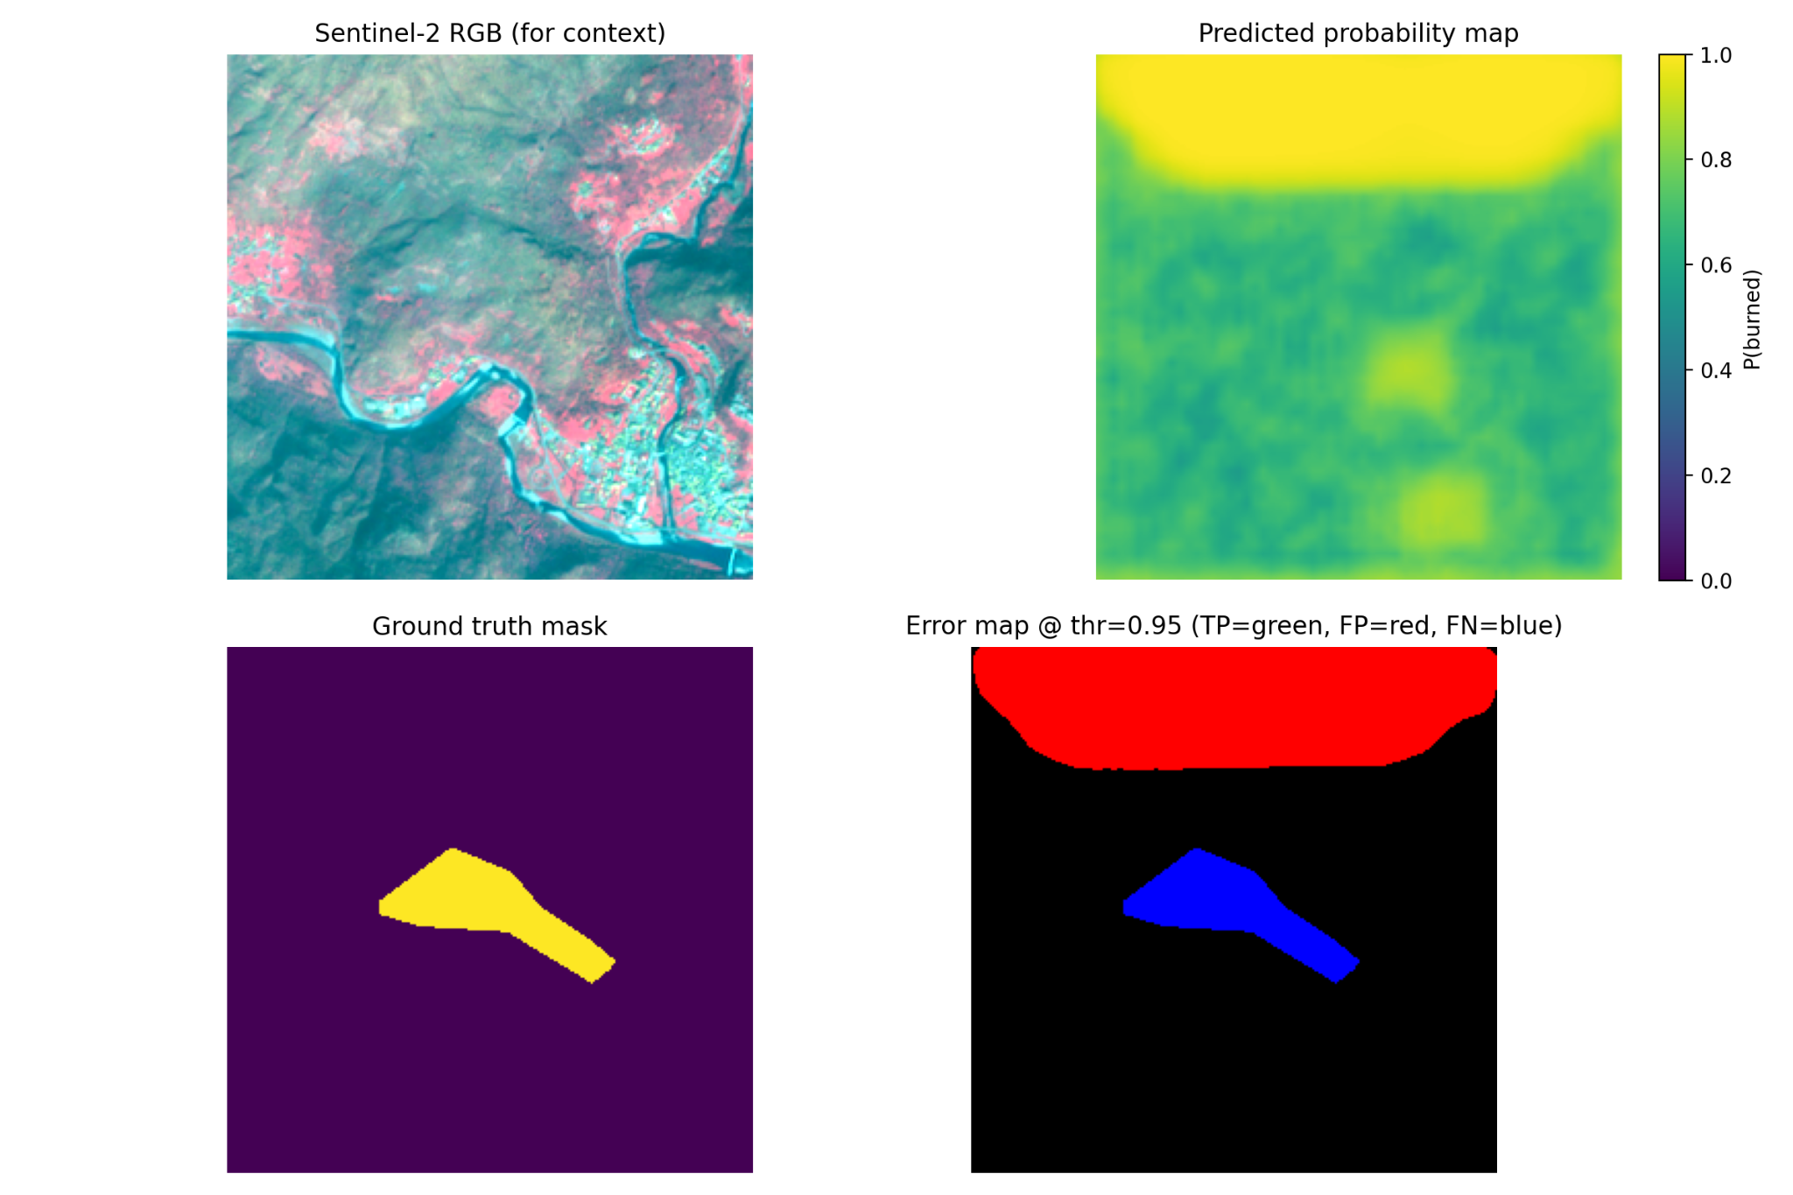
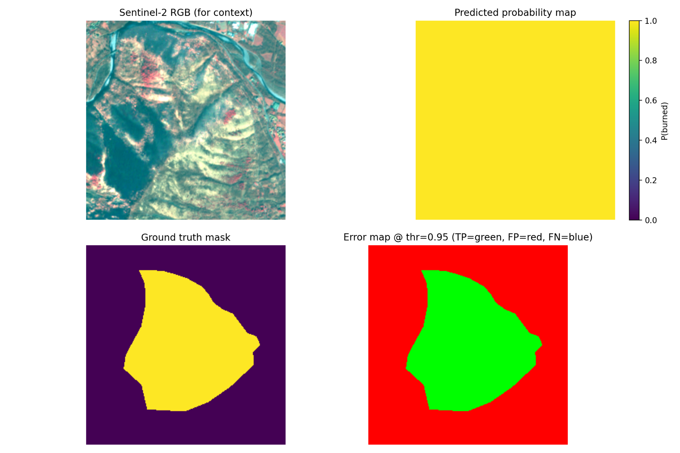

QUALITATIVE EVALUATION
SMALL / DIFFICULT FIRE
LARGE / WELL-DETECTED FIRE
Model shows conservative behavior, avoiding noise.
Large fires are detected with high spatial coherence.
Notes:
This slide shows qualitative examples to make the results more concrete.
Each case has four views: the Sentinel-2 image for context, the predicted probability map, the ground-truth burned mask, and the error map at a threshold of 0.95.
On the left, we see a small and difficult fire. The model behaves conservatively—it focuses on the most confident burned region and avoids spreading into noise. This means some edges are missed, but false alarms are reduced.
On the right, for a large fire, the model captures the shape very well, with strong spatial coherence. This is important because large fires have the highest impact, and this is where the model performs best

Slide 16
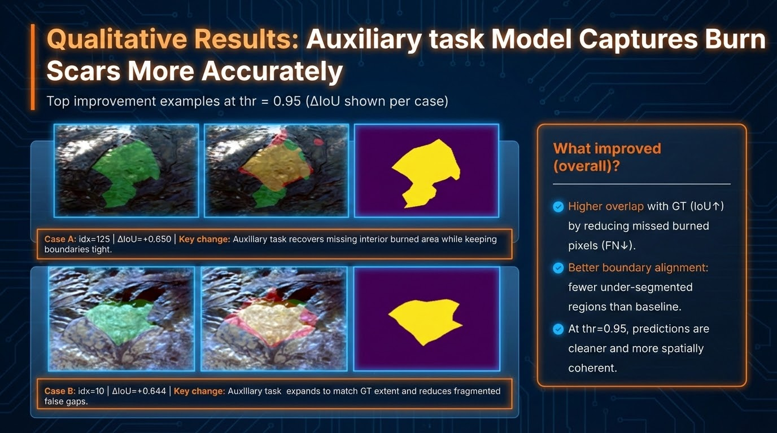
Notes:
“This slide shows qualitative examples of how the auxiliary task improves the predictions.
On the left, you see the baseline model, and in the middle, the model with the auxiliary task. The yellow mask on the right is the ground truth.
The key improvement is that the auxiliary model recovers missing burned areas, especially inside the fire region, while keeping the boundaries tight. In both examples, the baseline under-segments and leaves gaps.
With the auxiliary task, the predicted burn scars are more complete, better aligned, and more spatially coherent. This directly explains the IoU gains we saw in the quantitative results and shows that the improvement is structural, not just numerical.”

Slide 17
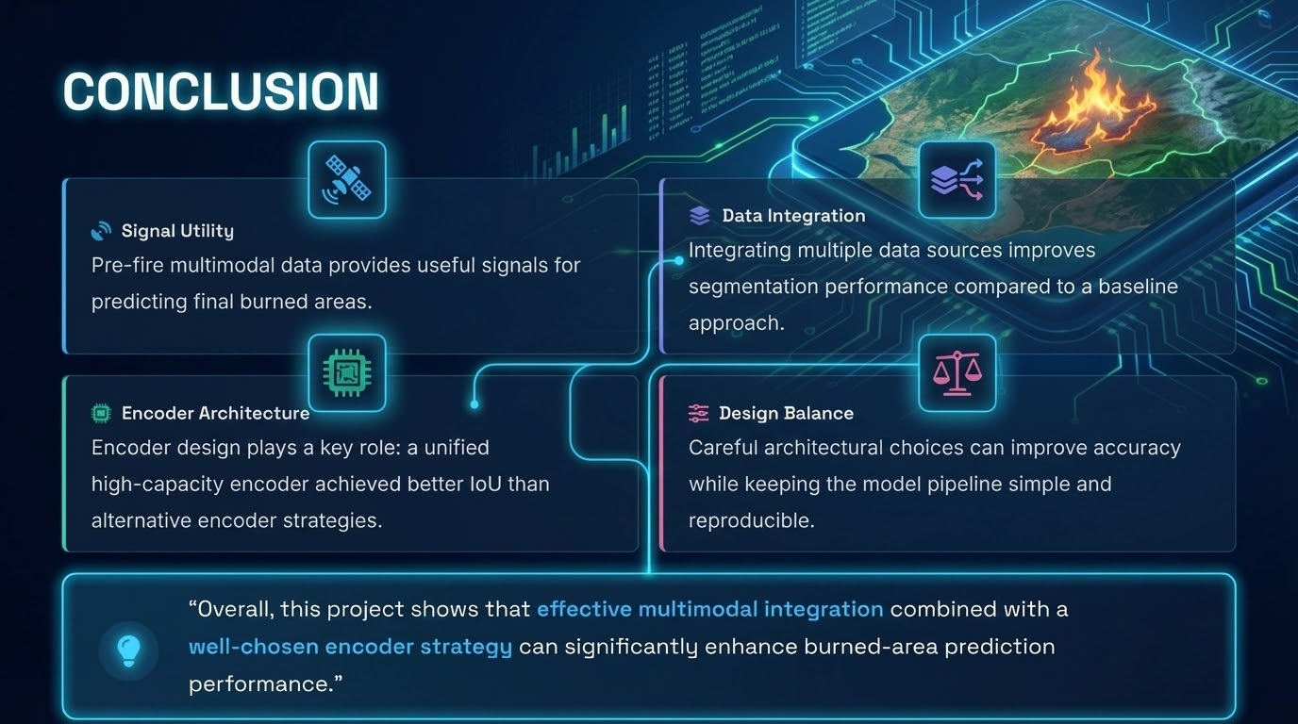
Notes:
I’ll finish with the main takeaways.
First, pre-fire multimodal data clearly contains useful information for predicting the final burned area. Second, combining multiple data sources consistently improves segmentation performance compared to a simple baseline.
Third, architecture choices matter. A unified, high-capacity encoder performed better than alternative encoder designs. At the same time, we were careful not to overcomplicate the model.
So the key message is this: effective multimodal integration, paired with a well-chosen encoder, leads to more accurate and reliable burned-area prediction, while keeping the system practical and reproducible.”

Slide 18
