Slide 1


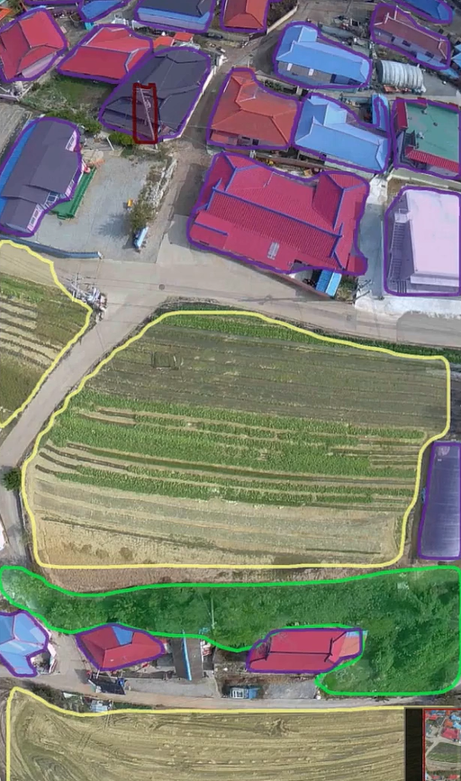
Open Vocabulary Semantic Segmentation
Bridging Computer Vision and Language for Adaptive Earth Observation
Abedal Salam AL ASHI ABOU SHOUSHE - 336648
Hassan MAATOUK - 343952
Hassan JABER - 338920

Slide 2





Motivation & Value Proposition
Environmental Monitoring
Disaster Management
Urban Planning
Essential for tracking ecological changes, deforestation, and climate impact.
Informing sustainable development and infrastructure growth.
Rapid assessment of damage from floods, fires, and seismic events.
We require models that possess strong generalization capabilities to correctly identify and segment categories outside their initial training set.
Adaptive Land Monitoring: Enables continuous monitoring without the need for constant, expensive retraining cycles.
Vision-Language Connection: Leverages multimodal models to fuse visual features with semantic language understanding.
Actionable Insights: : real-time environmental analysis, rapid disaster response, and dynamic urban development tracking.

Slide 3
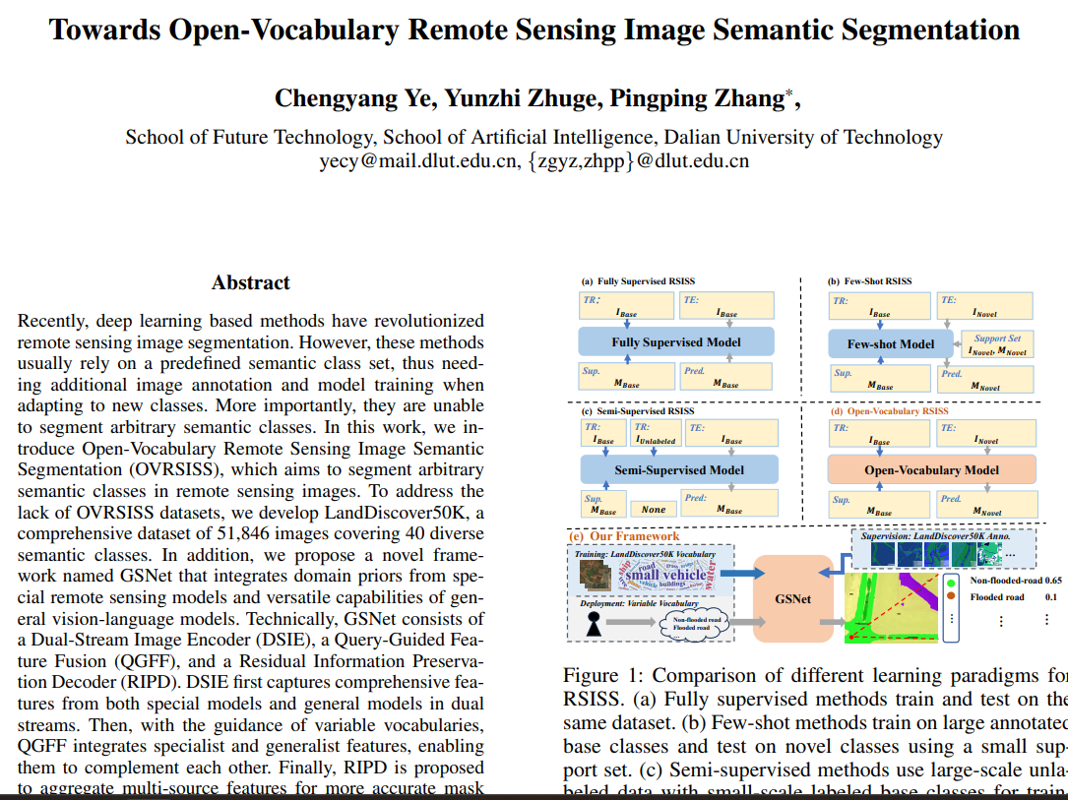

Slide 4
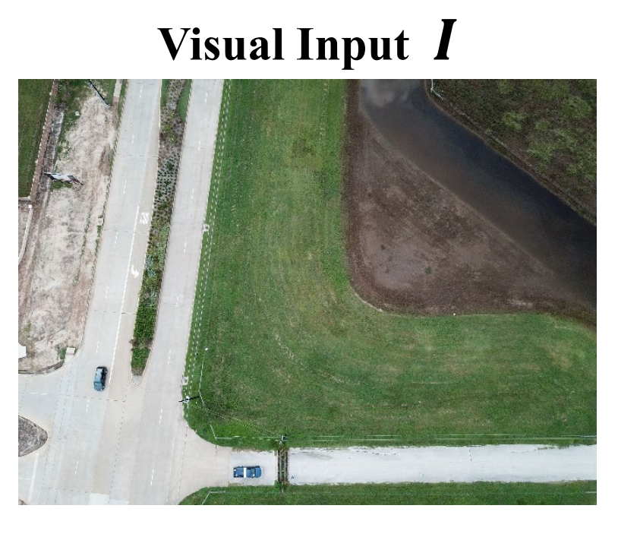
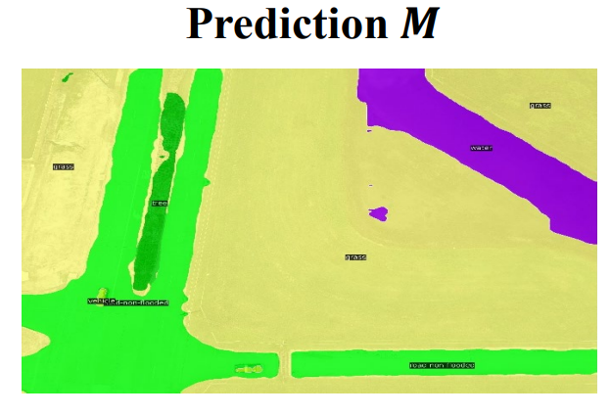
GSNet: Existing Architecture
CLIP ViT
Fusion
Decoder
DINO
Backbone
Generalist Visual Encoder (CLIP-based) -> Provides semantic understanding aligned with text.
Specialist Visual Encoder (DINO-based) -> Provides spatial and domain-specific features for RS images.
Fusion + Decoder -> Combines both streams to produce the final segmentation map.

Slide 5
Research questions

Slide 6
Research Questions: Model Replacement Options
DINO replacement:
RQ1: Does DINOv3-SAT zero-shot performance match or exceed custom DINOv1 (LandDiscover50k) without fine-tuning?
RQ2: Can smaller models (300M parameters) pretrained on satellite data match larger models (6.7B) when both are trained on identical remote-sensing datasets?
CLIP replacement:
RQ3: If replacing the CLIP ViT backbone with a CNN variant, which architecture families are viable (ResNets, ConvNeXt, EfficientNet)?
RQ4: How does the backbone type influence alignment with textual embeddings and segmentation quality?
GSNet training:
RQ5: How do different training strategies (Freeze, Attention, Full) for CLIP and DINOv3 affect the generalization and adaptability of GSNet across diverse remote sensing datasets?

Slide 7
Specialist Backbone Replacement
Should the DINOv3 specialist backbone be used as-is; or adapted to the LandCover 50K dataset?
If adaptation is needed:
Full fine-tuning: Does end-to-end training offer meaningful gains despite high computational cost?
Partial fine-tuning: Would tuning only later layers provide a balance between cost and performance?
Parameter-efficient fine-tuning: Could methods like LoRA or adapters deliver domain adaptation with limited compute?
Zero-shot (as-is): Does using DINOv3-SAT pretrained features directly, without any adaptation, match or exceed fine-tuned performance on LandCover 50K?
What are the trade-offs between using pretrained specialist features vs. task-specific adaptation?

Slide 8

Methodology and Experiments

Slide 9

Methodology
Unchanged Components:
Unchanged Components:
Fusion module: Query-Guided Feature Fusion (QGFF)
Decoder: Residual Information Preservation Decoder (RIPD)
Experimental Configurations:
Experimental Configurations:
Experiment 1: DINOv3 ViT-L/16 + Fine-tuning
Experiment 2: Fine-tuned DINOv3 ViT-L/16 + CLIP ViT-B/16 (Old)
Experiment 3: DINOv1 ViT-B/16 (Old) + CLIP ResNet-101
Experiment 4: Fine-tuned DINOv3 ViT-L/16 + CLIP ViT-L/14

Slide 10
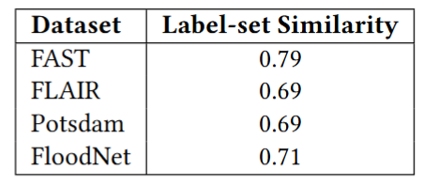
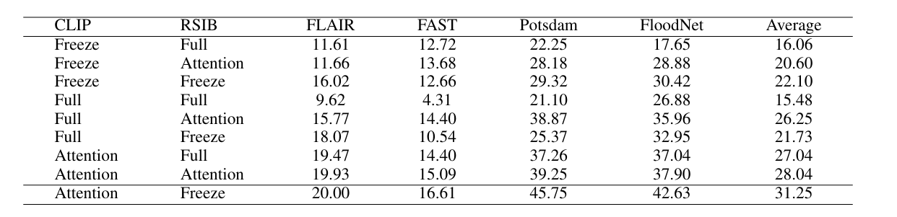
Experiments
Datasets
Datasets:
Training: LandDiscover50K.
Testing: FLAIR, FAST, ISPRS Potsdam, FloodNet.
Evaluation Metrics:
Mean IoU (mIoU): Measures segmentation accuracy.
the overlap be-tween the semantic categories in LandDiscover50K and those in the validation datasets
Paper Results:
Paper Results:
‘attention’
means fixing all the parameters except for the attention projection layers for ‘query’ and ‘value’

Slide 11
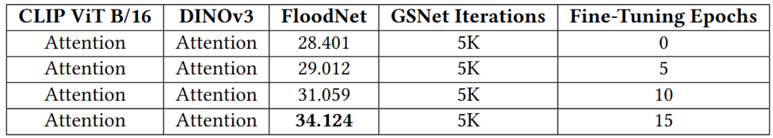
Experiment 1:
Setup:
Backbone: DINOv3 ViT-L/16 pretrained on SAT-493M satellite dataset
Strategy: Fine-tune last 2 layers (layers 23-24) for 15 epochs
Baseline: Frozen DINOv3 features (0 epochs)

Slide 12
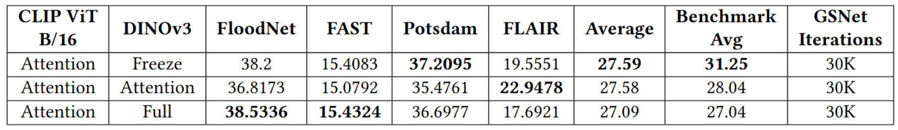
Experiment 2:
Fine-tuned DINOv3 + CLIP ViT-B/16
Setup:
DINO Backbone: Fine-tuned DINOv3 ViT-L/16 (from Experiment 1)
CLIP Backbone: CLIP ViT-B/16 (Old version, frozen)
Training: 30K GSNet iterations
Strategy: Compare different CLIP fine-tuning approaches (Freeze vs Attention vs Full)

Slide 13
Experiment 3:
Setup:
DINO Backbone: DINOv1 ViT-B/16 (Old version)
CLIP Backbone: CLIP ResNet-101 (CNN-based)
Experiment Failed: CLIP CNN (ResNet-101) disastrously underperformed across all datasets
Fail cause: CNN convolutional features incompatible with ViT patch embeddings in fusion module
Required architectural changes to fusion module (QGFF) → outside project scope
Decision: Did not proceed with CNN-based CLIP variants.

Slide 14
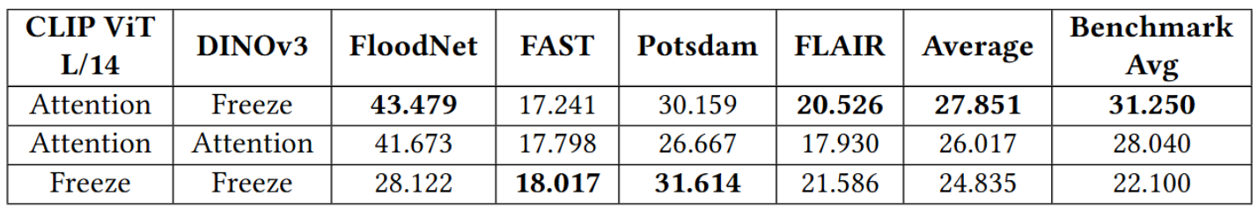
Experiment 4
Setup:
DINO Backbone: Fine-tuned DINOv3 ViT-L/16 (from Experiment 1, 15 epochs)
CLIP Backbone: CLIP ViT-L/14 (Large model, 303M vision parameters)
Strategy: Test larger CLIP model for improved performance

Slide 15
Conclusion
Key Insights:
Larger pretrained models (e.g., CLIP ViT-L/14) with minimal fine-tuning achieved competitive results, validating efficiency trade-offs between model capacity and training effort.
Attention-based fine-tuning consistently outperformed frozen and full fine-tuning, balancing pretrained knowledge preservation and task-specific learning.
CLIP ViT significantly outperformed ResNet-101, highlighting the need for improved fusion and decoder designs to better integrate CNN features.
Future Directions:
Optimize larger models (e.g., CLIP ViT-L/14) with tailored strategies for diverse remote sensing tasks.
Redesign fusion and decoder architectures to effectively integrate CNN and ViT features.

Slide 16
Thank You!
Any Questions?
Abedal Salam AL ASHI ABOU SHOUSHE - 336648
Hassan MAATOUK - 343952
Hassan JABER - 338920

