Slide 1


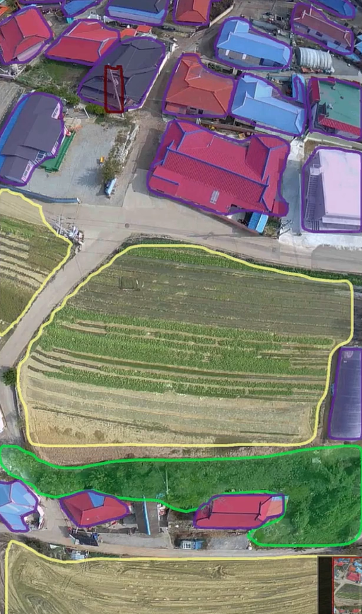
Open Vocabulary Semantic Segmentation
Bridging Computer Vision and Language for Adaptive Earth Observation
Abedal Salam AL ASHI ABOU SHOUSHE - 336648
Hassan MAATOUK - 343952
Hassan JABER - 338920

Slide 2
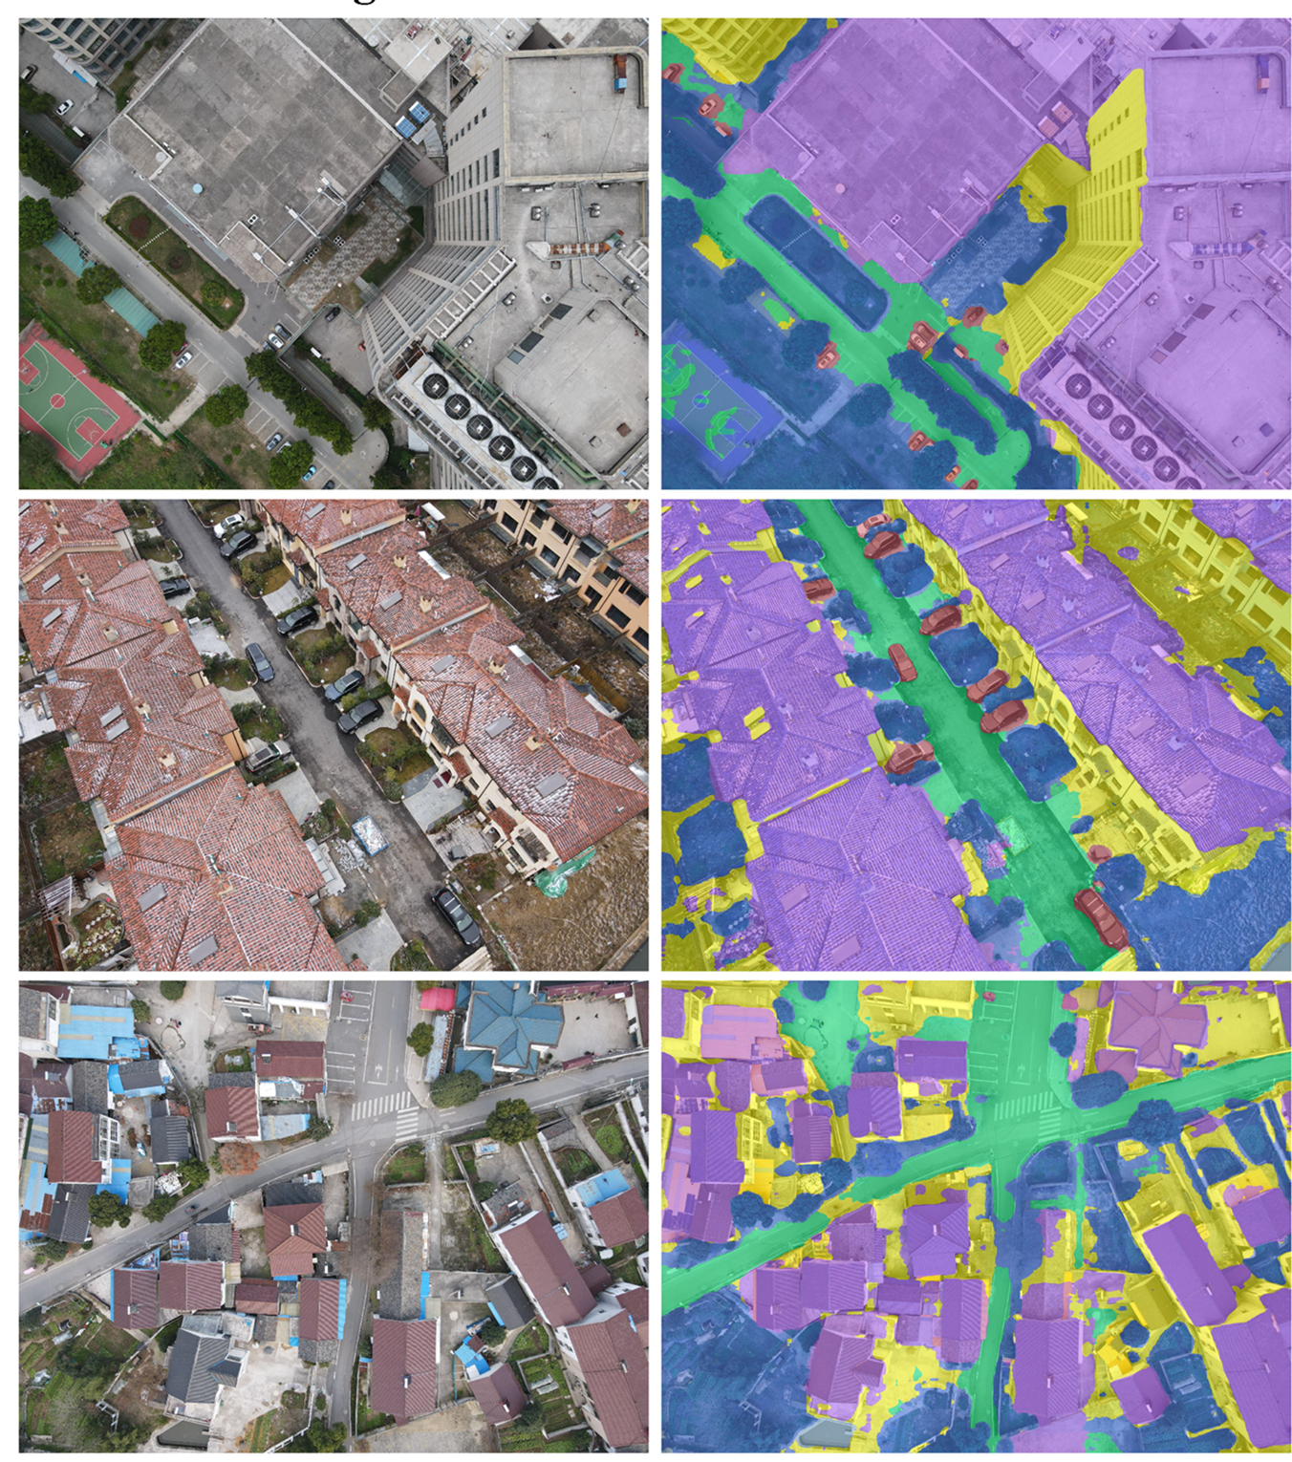
Introduction
Semantic segmentation is the task of assigning a class label to every pixel.
Traditional models are closed set: they can only classify the categories they were trained on.
Open vocab segmentation extends this by linking visual features with text embeddings

Slide 3

Value Proposition
& Project Objectives

Slide 4





Motivation & Current Gap
Environmental Monitoring
Disaster Management
Urban Planning
Essential for tracking ecological changes, deforestation, and climate impact.
Informing sustainable development and infrastructure growth.
Rapid assessment of damage from floods, fires, and seismic events.
We require models that possess strong generalization capabilities to correctly identify and segment categories outside their initial training set.

Slide 5
Value Proposition
Adaptive Land Monitoring
Enables continuous, on-the-fly monitoring without the need for constant, expensive retraining cycles.
Vision-Language Connection
Leverages multimodal models to fuse visual features with semantic language understanding.
Actionable Insights
Supports critical applications: real-time environmental analysis, rapid disaster response, and dynamic urban development tracking.

Slide 6
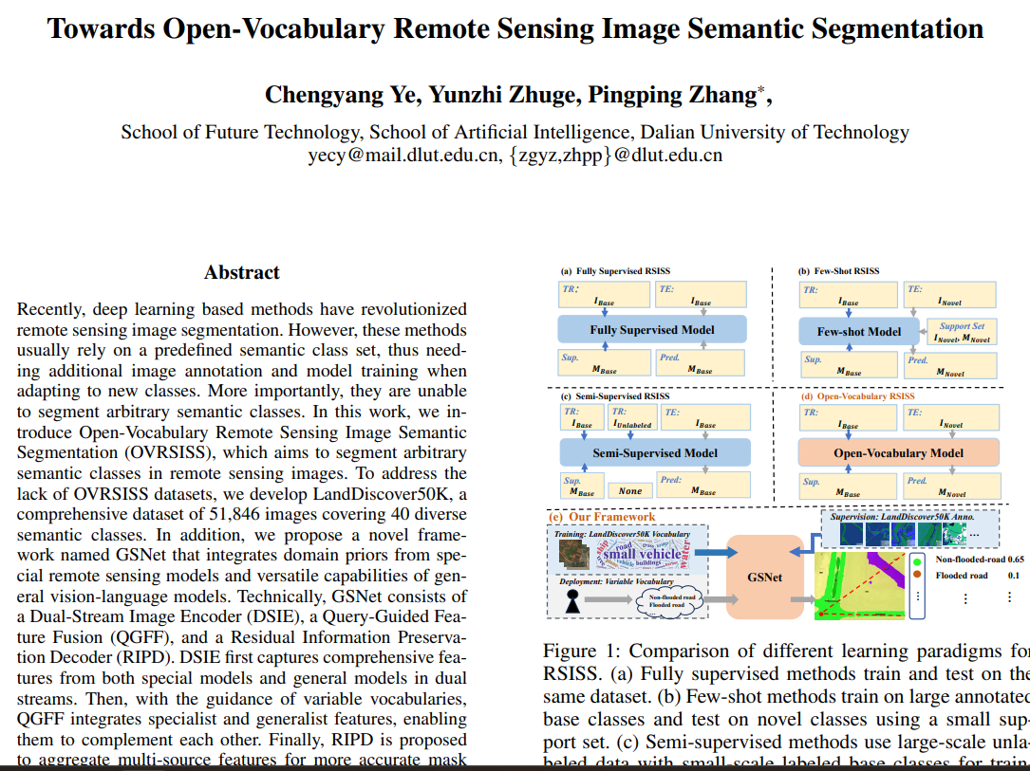

Slide 7
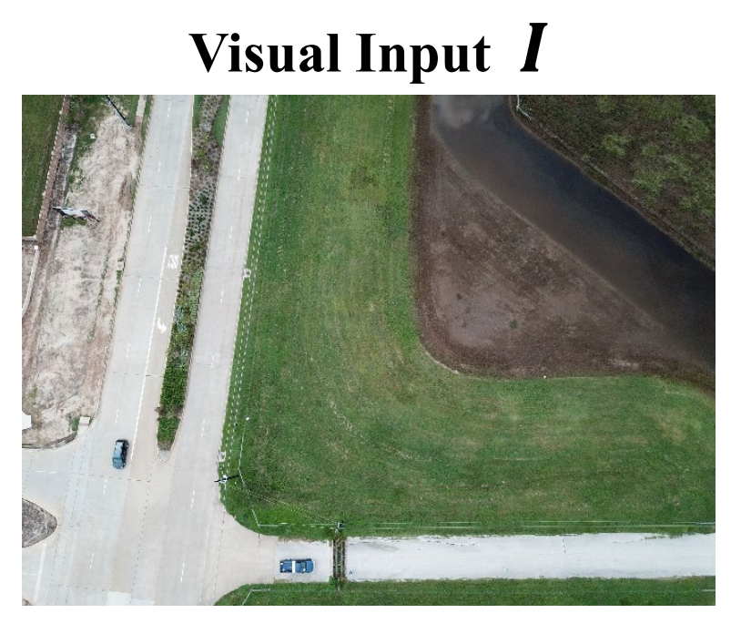
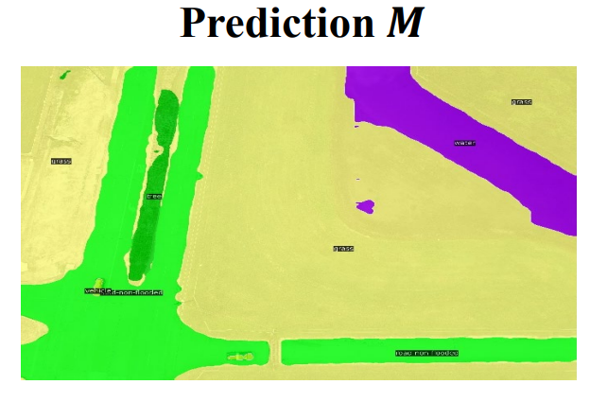
GSNet: Existing Architecture
CLIP ViT
Fusion
Decoder
DINO
Backbone
Generalist Visual Encoder (CLIP-based) -> Provides semantic understanding aligned with text.
Specialist Visual Encoder (DINO-based) -> Provides spatial and domain-specific features for RS images.
Fusion + Decoder -> Combines both streams to produce the final segmentation map.

Slide 8
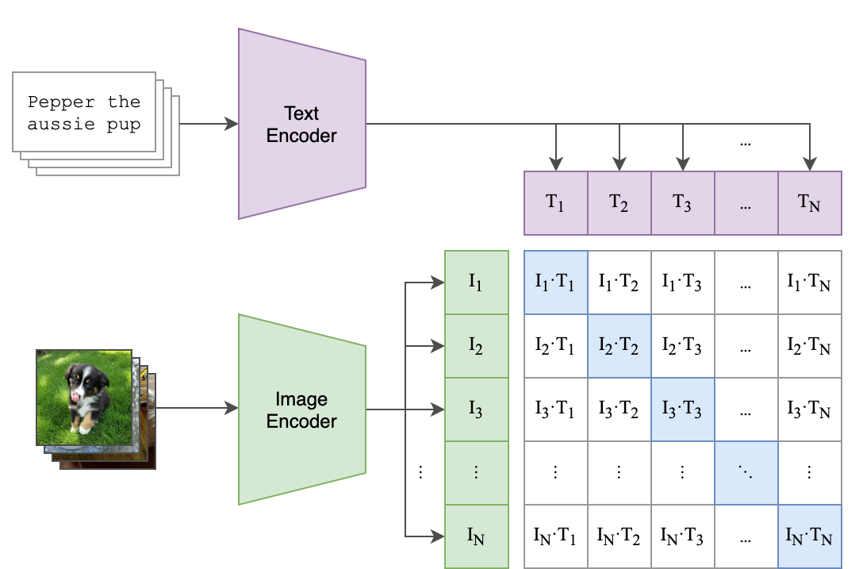
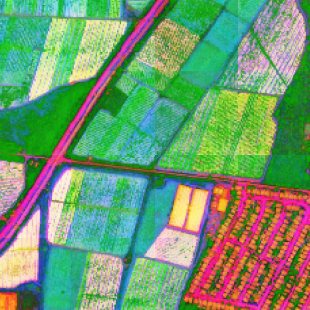
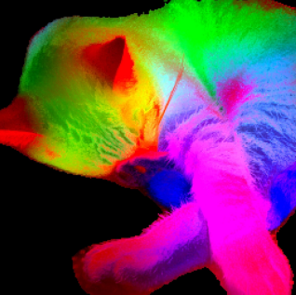
Role of CLIP and DINO in GSNet
CLIP
DINO
Vision-Language Bridge
Self-Supervised Learning
Connects visual features to human-readable class names
Enables zero-shot classification
Role in GSNet: Provides semantic understanding of what we're segmenting
Discovers meaningful features automatically
More robust to variations than supervised models
Role in GSNet: Provides spatial/geometric understanding of image structure

Slide 9
Hypotheses & research questions

Slide 10
Hypothesis
H1: Architecture Matters
DINOv3 will outperform DINOv1 through improved semantic richness. CNN-based CLIP will achieve superior edge accuracy in segmentation compared to ViT-based CLIP despite reduced model complexity.
H2: Size Impact
Smaller, CNN-CLIP variants (e.g., ResNet50, ResNet101) will achieve comparable performance to larger ViT backbones with improved computational efficiency.
H3: Foundational Models Replaces Custom Pretraining
Off the shelf DINOv3-SAT will match or exceed the authors' custom DINOv1 (LandDiscover50k) performance while eliminating expensive pretraining infrastructure.

Slide 11
Research Questions: Model Replacement Options
CLIP replacement:
RQ1: If replacing the CLIP ViT backbone with a CNN variant, which architecture families are viable (ResNets, ConvNeXt, EfficientNet)?
RQ2: How does the backbone type influence alignment with textual embeddings and segmentation quality?
RQ3: What adapter/fine-tuning strategies minimize training overhead when aligning CNN-based CLIP with remote-sensing classes?
DINO replacement:
RQ4: Does DINOv3-SAT zero-shot performance match or exceed custom DINOv1 (LandDiscover50k) without fine-tuning?
RQ5: Can smaller models (300M parameters) pretrained on satellite data match larger models (6.7B) when both are trained on identical remote-sensing datasets?
RQ6: What adapter/downsampling strategies best align mismatched feature map dimensions between CLIP and DINO?

Slide 12
Specialist Backbone Replacement
Should the DINOv3 specialist backbone be used as-is; or adapted to the LandCover 50K dataset?
If adaptation is needed:
Full fine-tuning: Does end-to-end training offer meaningful gains despite high computational cost?
Partial fine-tuning: Would tuning only later layers provide a balance between cost and performance?
Parameter-efficient fine-tuning: Could methods like LoRA or adapters deliver domain adaptation with limited compute?
Zero-shot (as-is): Does using DINOv3-SAT pretrained features directly, without any adaptation, match or exceed fine-tuned performance on LandCover 50K?
What are the trade-offs between using pretrained specialist features vs. task-specific adaptation?

Slide 13

Development choices

Slide 14
CLIP Backbone Replacement
ResNet-101 (CLIP CNN variant)
Chosen model:
Why This Choice
Provides a different architectural compared to ViT (strong locality + hierarchical features).
Good benchmark to evaluate CNN vs ViT behavior inside GSNet.
Proven, stable architecture with well-known performance characteristics.
Lightweight enough to be integrated without heavy compute requirements.
01
02
03
04

Slide 15
DINO Backbone Replacement
DINOv3 ViT-L/16 (300M)
Chosen model:
Distilled and pretrained on SAT-493M (large satellite-image dataset)
Why This Choice
Pretrained on remote-sensing domain, giving strong feature alignment compared to natural-image DINO.
Large capacity, better representation of fine-grained land-cover patterns.
300M variant balances performance and deployment efficiency; the 6.7B variant introduces unnecessary parameter overhead that contradicts size impact and efficiency gains.
Modern self-supervised model known for strong transfer in segmentation tasks.
Promising upgrade over the original GSNet backbone.
01
02
03
04
05

Slide 16

Maintaining the core Architecture
Unchanged Components:
Fusion module: Query-Guided Feature Fusion (QGFF)
Decoder: Residual Information Preservation Decoder (RIPD)
Backbone Output Differences:
New backbones produce different embedding dimensions
ResNet-101
→ Output: convolutional feature map
→ 512-dimensional features (no projection needed)
DINOv3 ViT-L/16
→ Output: patch embeddings
→ 1024-dimensional patches (projected to 512-dim)
Both backbones are adapted to produce 512-dimensional features compatible with the existing QGFF fusion module

Slide 17
Thank You!
Any Questions?
Abedal Salam AL ASHI ABOU SHOUSHE - 336648
Hassan MAATOUK - 343952
Hassan JABER - 338920

