Slide 1


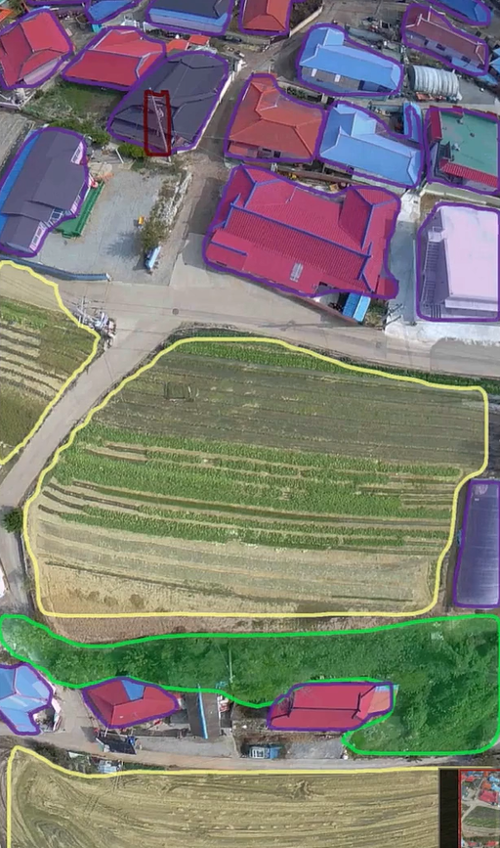
Open Vocabulary Semantic Segmentation
Bridging Computer Vision and Language for Adaptive Earth Observation
Abedal Salam AL ASHI ABOU SHOUSHE - 336648
Hassan MAATOUK - 343952
Hassan JABER - 338920

Slide 2
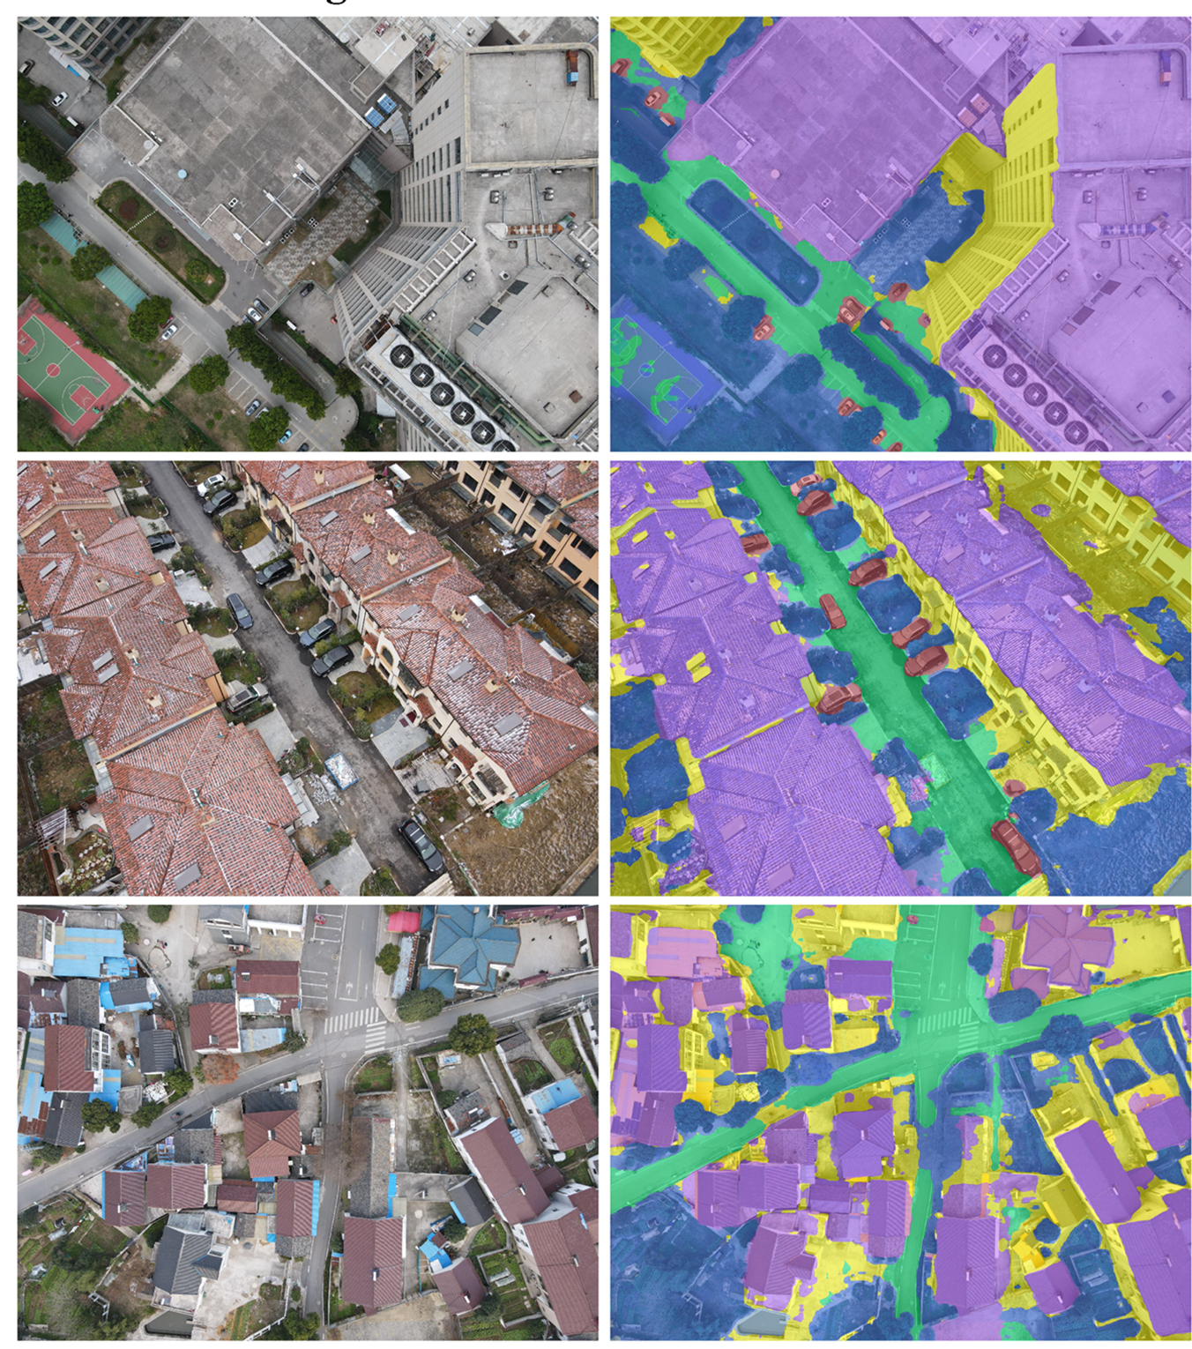
Introduction
Semantic segmentation is the task of assigning a class label to every pixel.
Traditional models are closed set: they can only classify the categories they were trained on.
Open vocab segmentation extends this by linking visual features with text embeddings

Slide 3
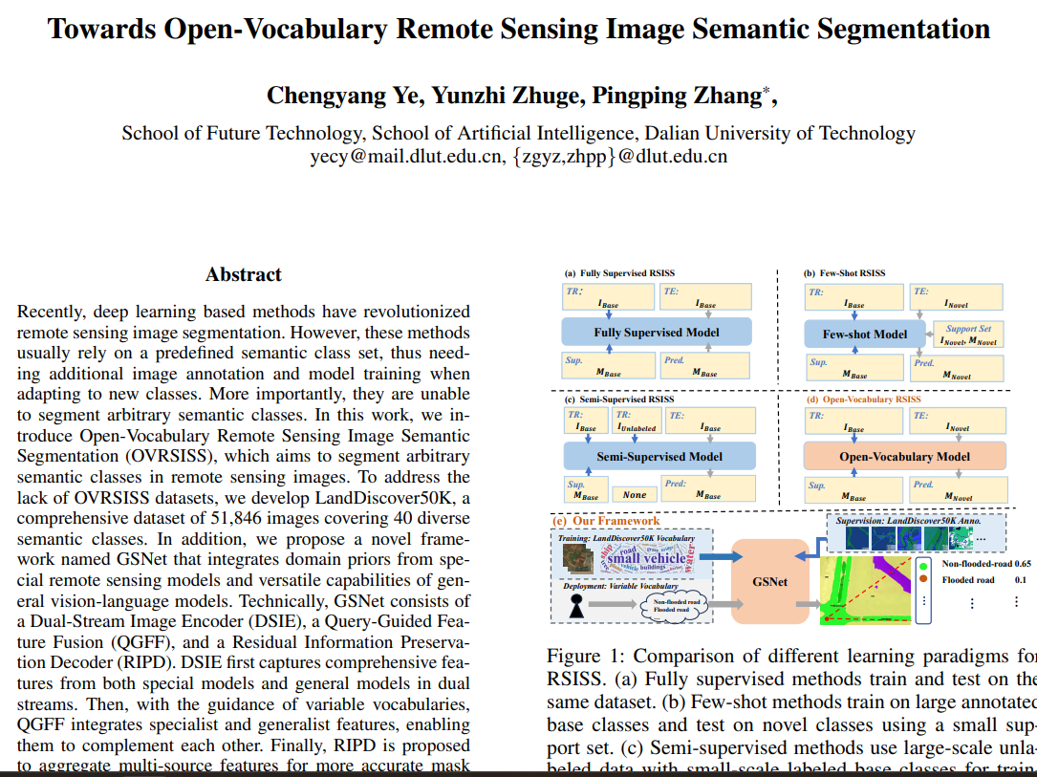

Slide 4

Project Value Proposition

Slide 5





Motivation
Environmental Monitoring
Disaster Management
Urban Planning
Essential for tracking ecological changes, deforestation, and climate impact.
Informing sustainable development and infrastructure growth.
Rapid assessment of damage from floods, fires, and seismic events.
The Earth’s surface is ever-changing, requiring models that can keep pace with new and evolving land types.

Slide 6
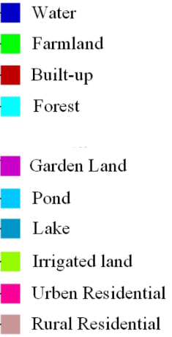
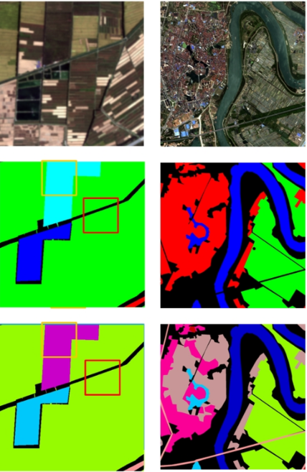
Limitations
closed set models cannot label unseen land cover types
retraining is costly and impractical for dynamic environments
we need models that generalize to unseen categories
Input Image
Closed-Set Segmentation
Unseen Region
Labeled as Unknown
We require models that possess strong generalization capabilities to correctly identify and segment categories outside their initial training set.

Slide 7
Value Proposition
Adaptive Land Monitoring
Enables continuous, on-the-fly monitoring without the need for constant, expensive retraining cycles.
Vision-Language Connection
Leverages multimodal models (like CLIP) to fuse visual features with semantic language understanding.
Actionable Insights
Supports critical applications: real-time environmental analysis, rapid disaster response, and dynamic urban development tracking.

Slide 8

Project Design

Slide 9
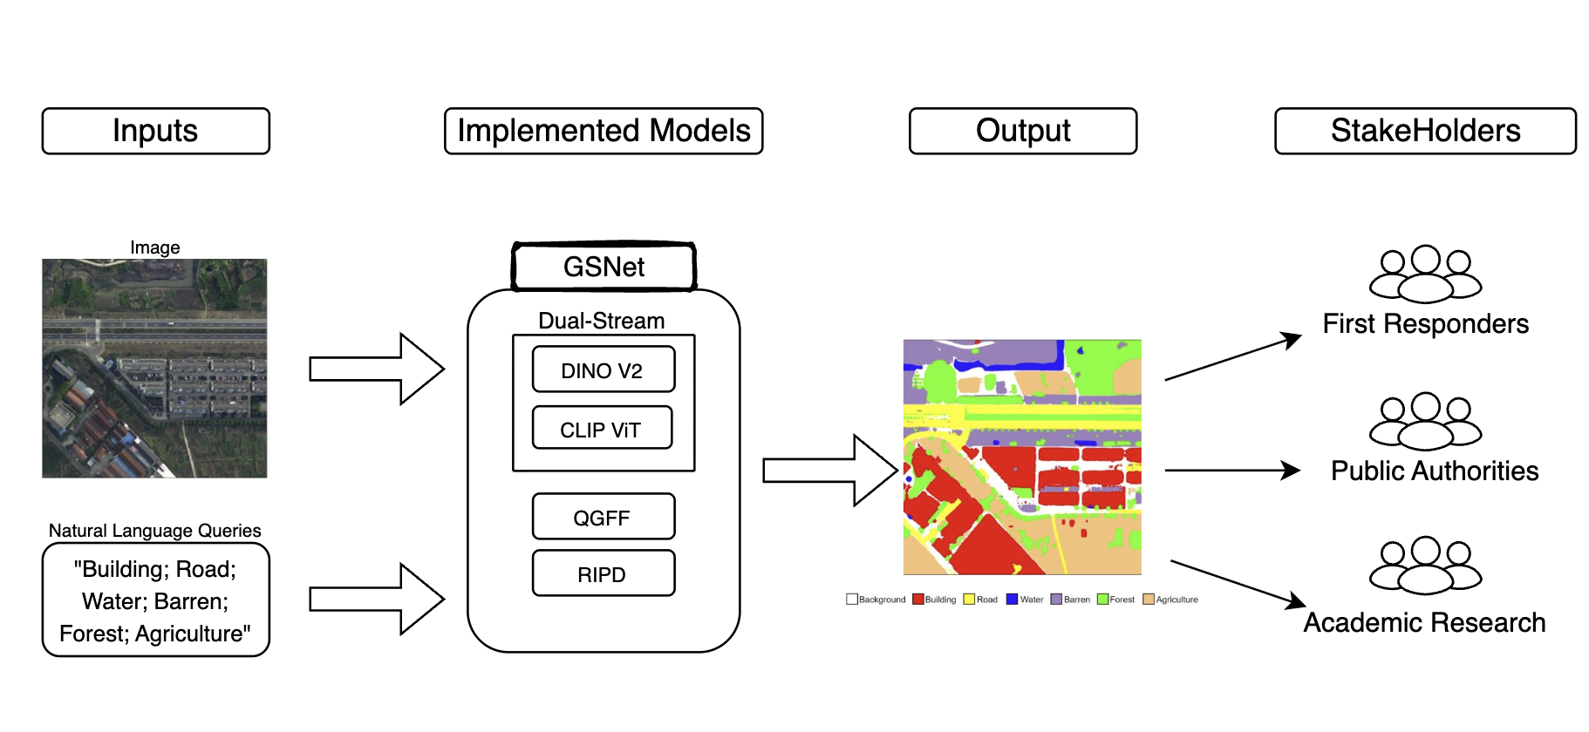
Functional Diagram

Slide 10
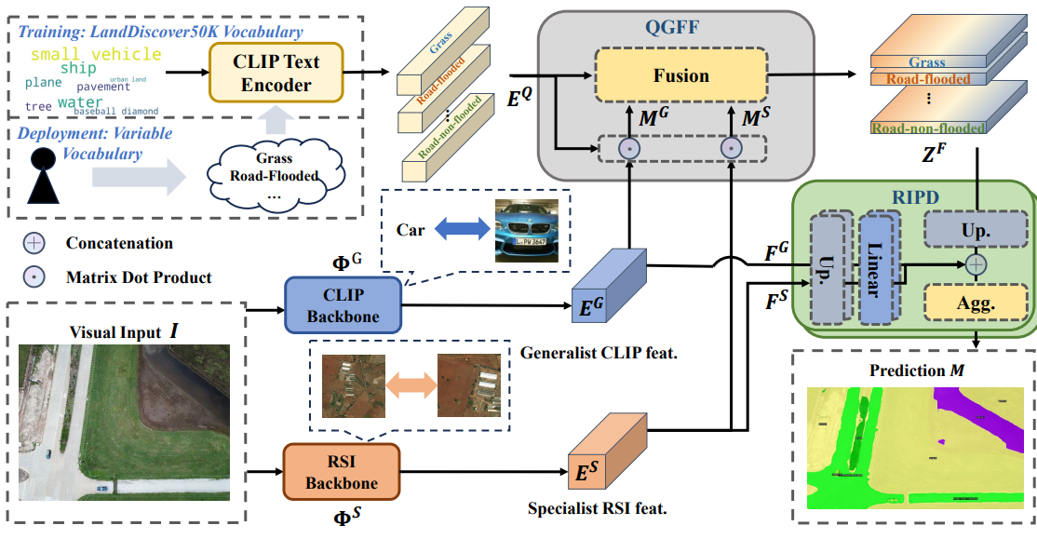

Slide 11
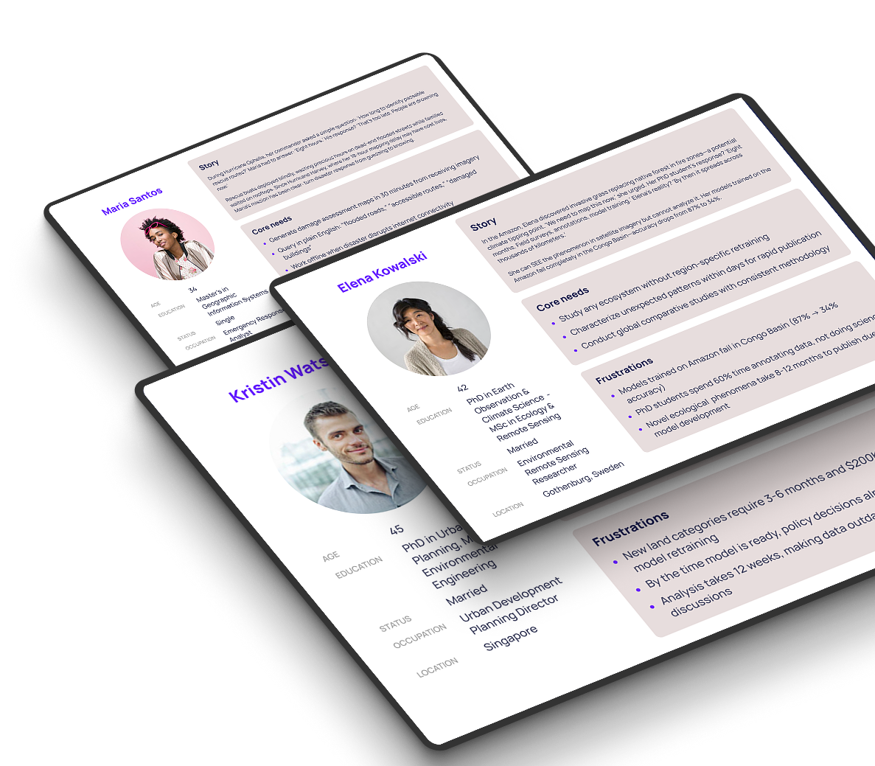
User Personas

Slide 12
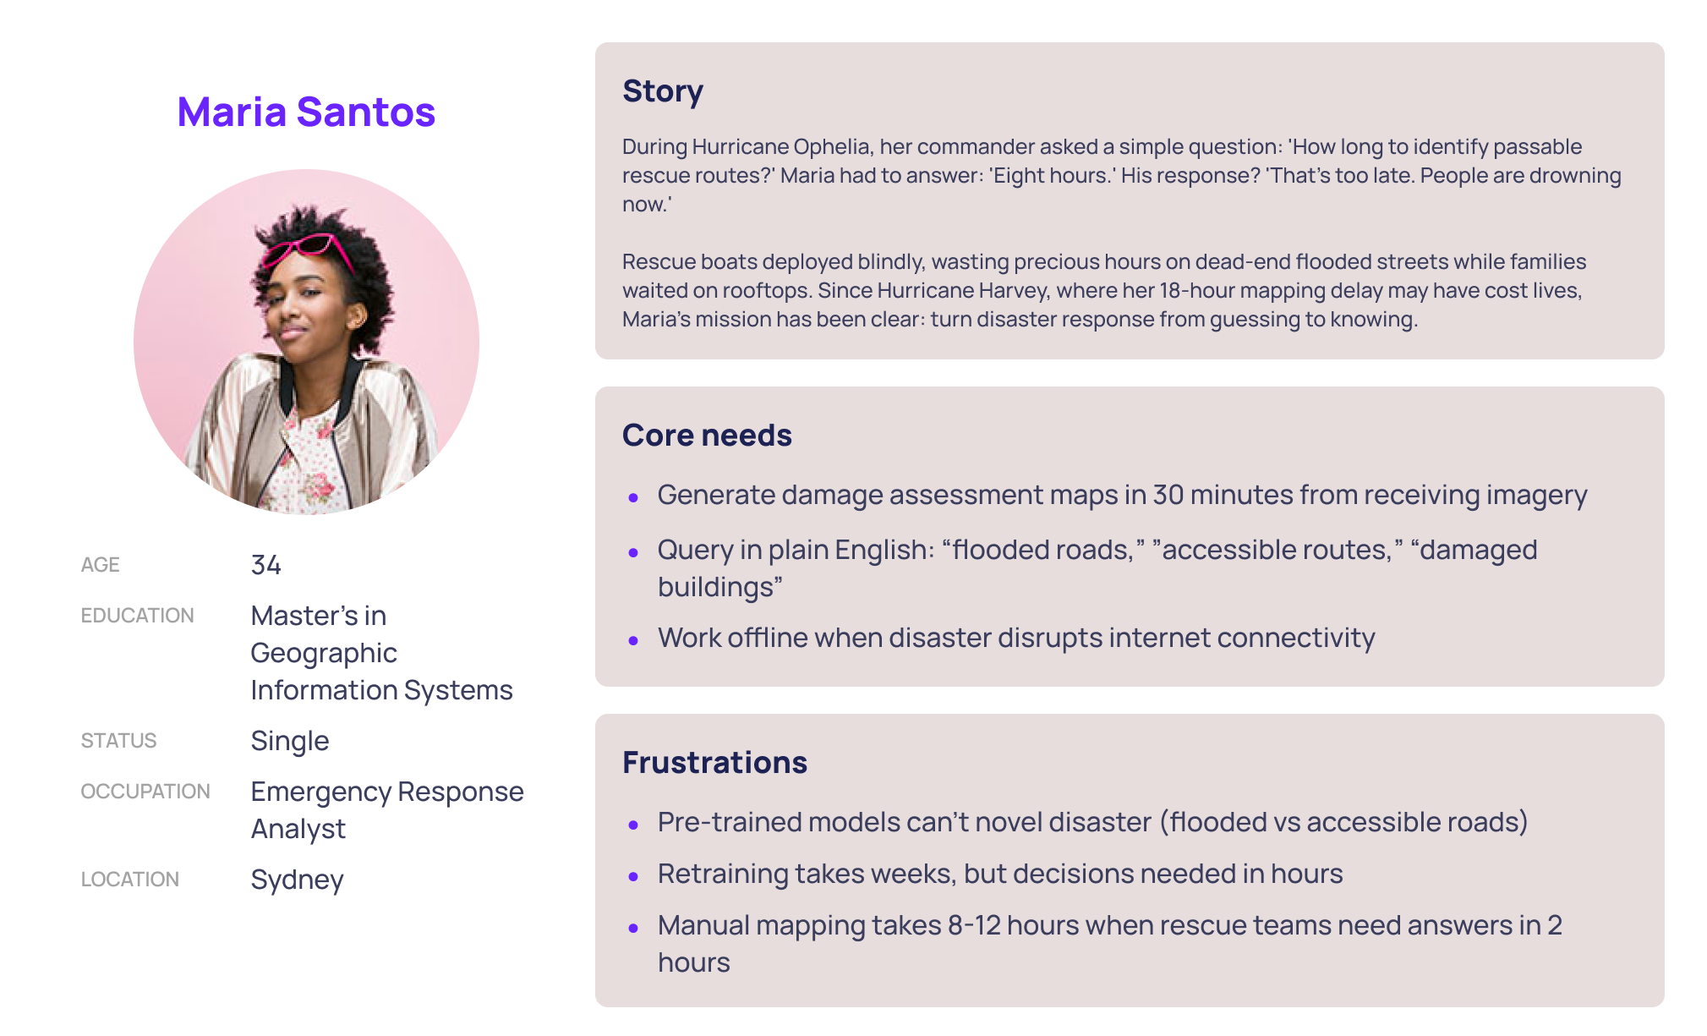

Slide 13
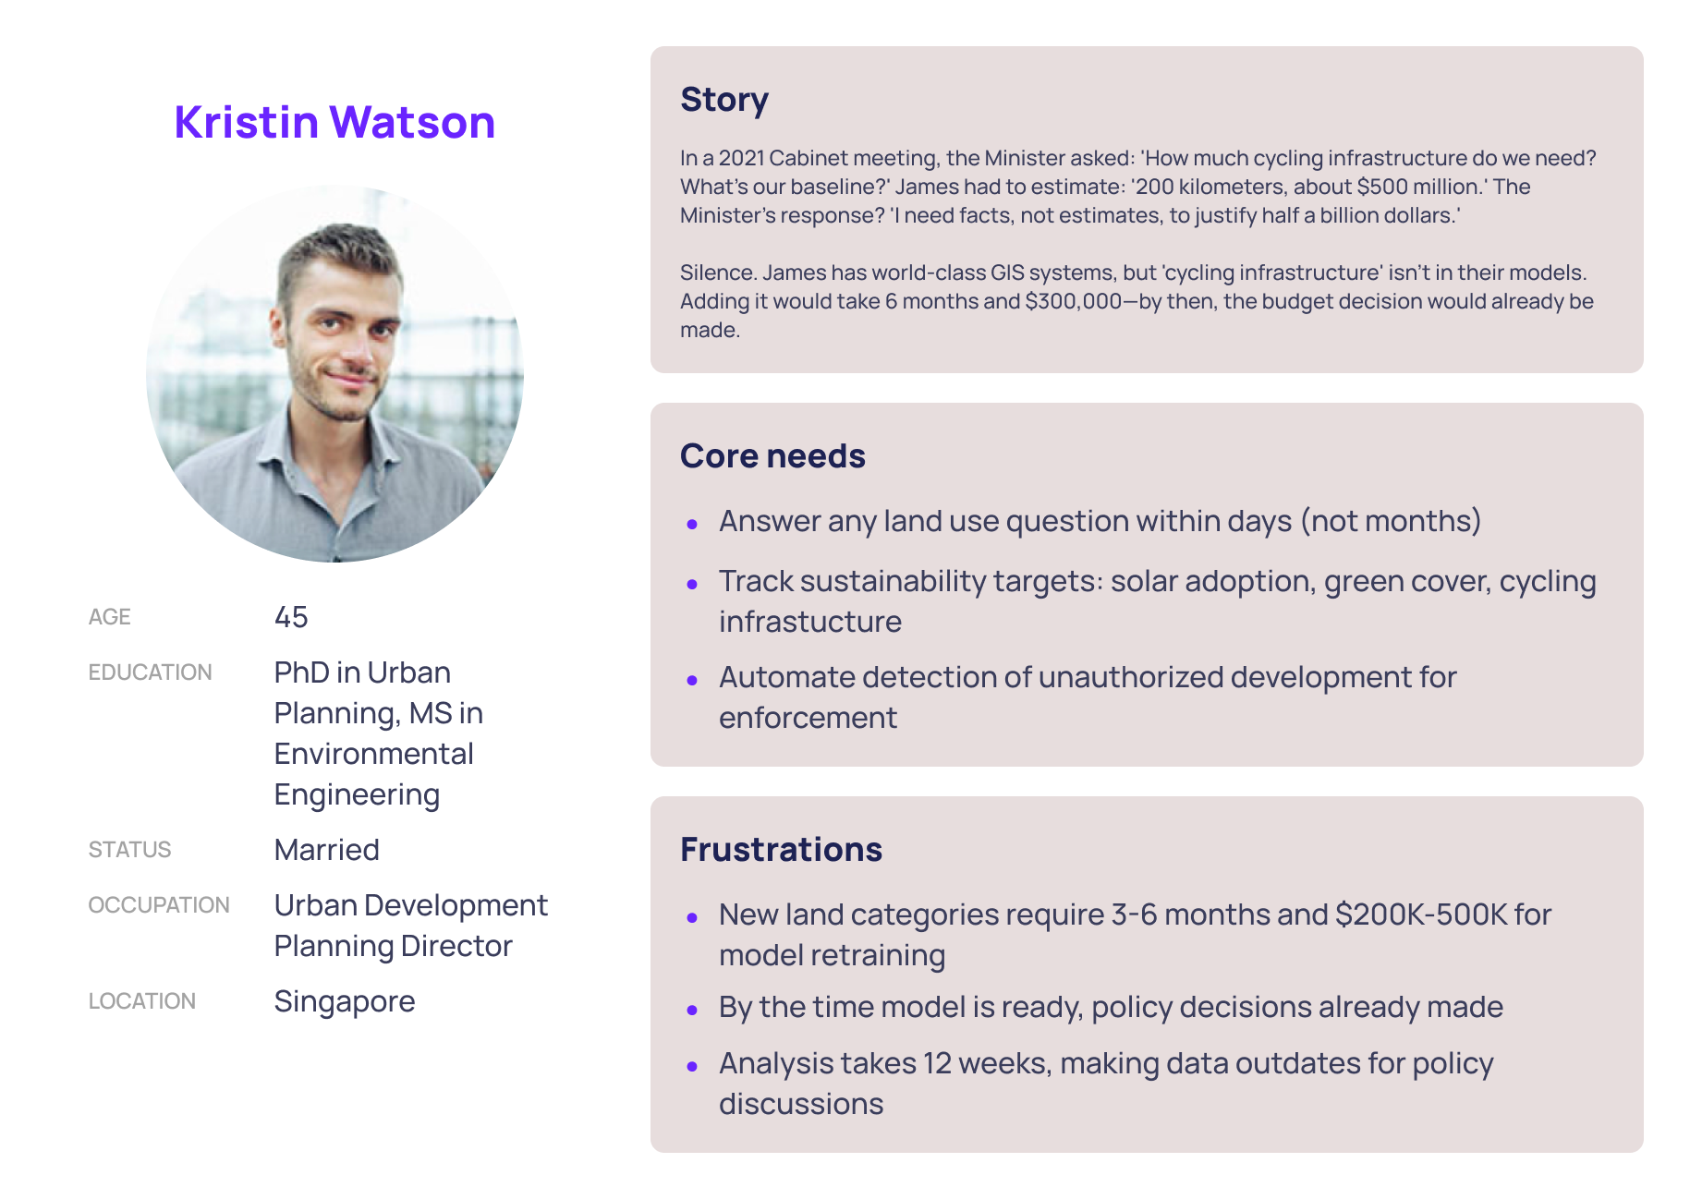

Slide 14
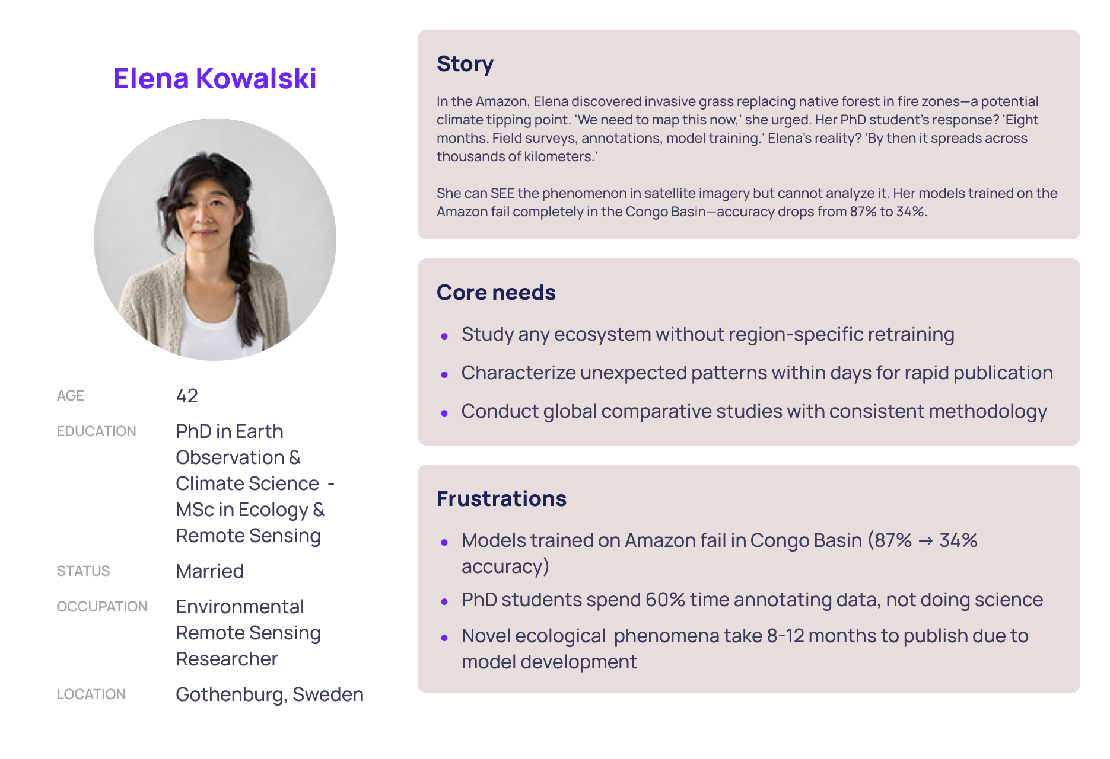

Slide 15

Management Plan

Slide 16
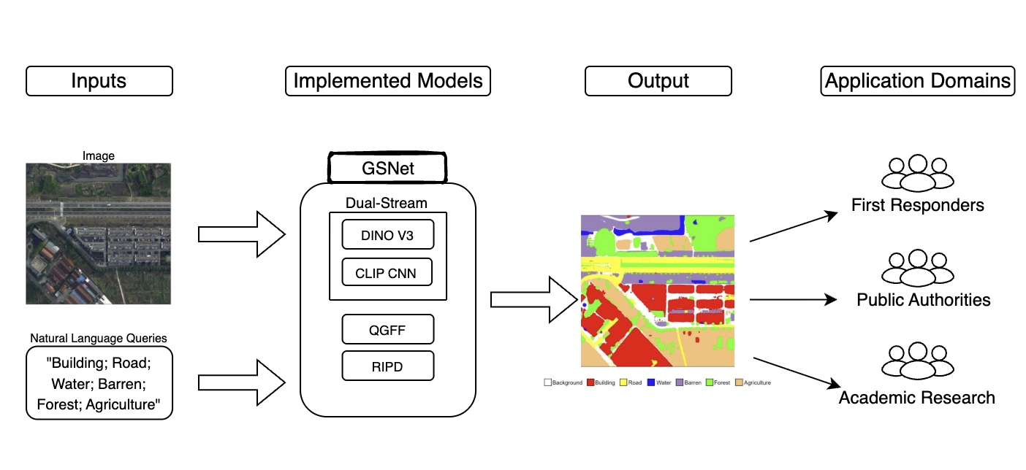
New Functional Diagram

Slide 17
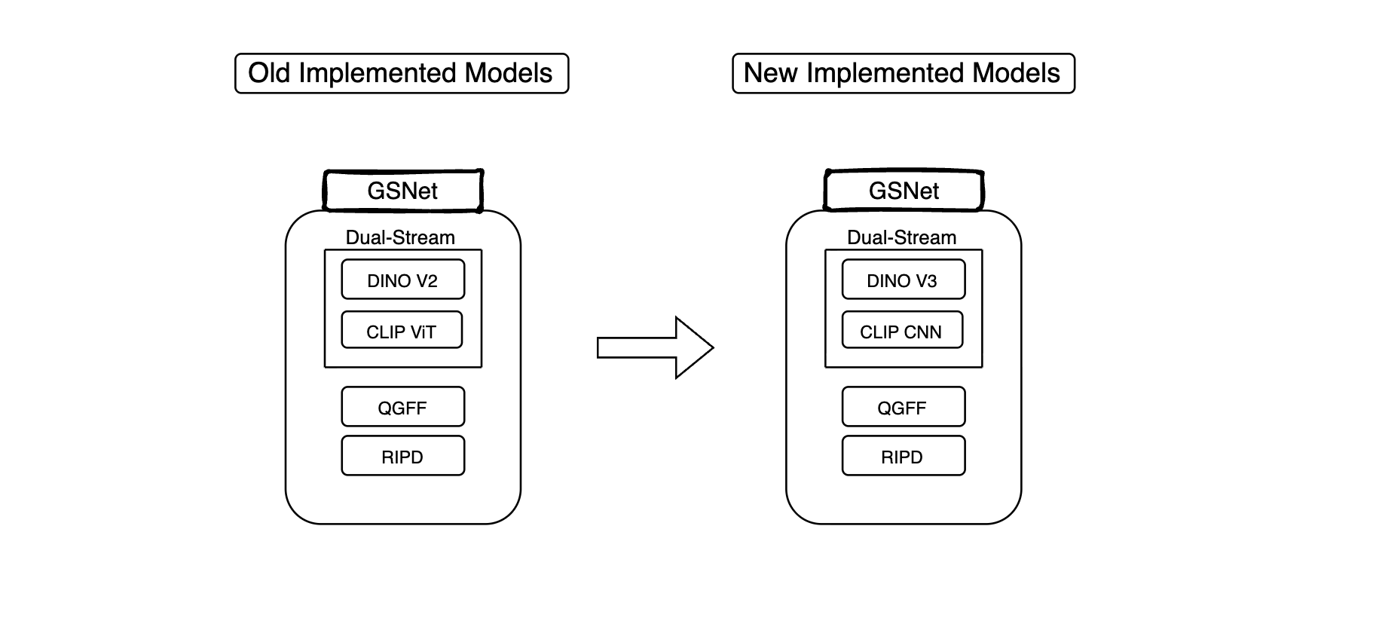

Slide 18
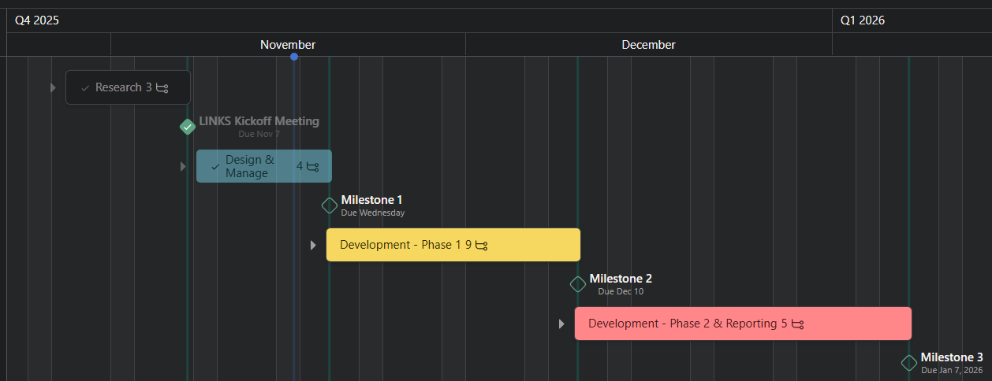
Timeline/Gantt Chart
Project Management Tool: Asana.com

Slide 19
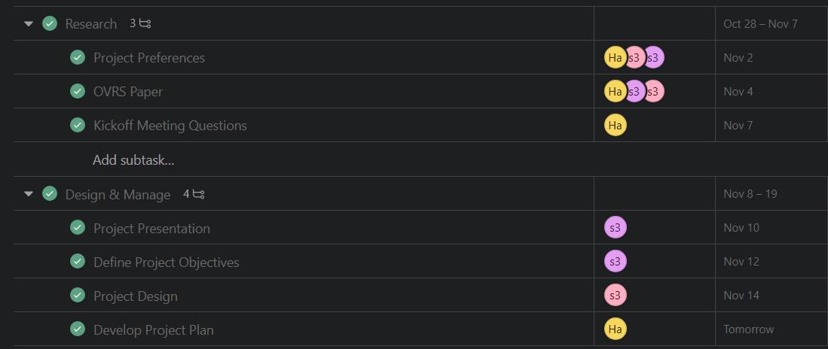
Milestone Breakdown
Done Tasks:

Slide 20
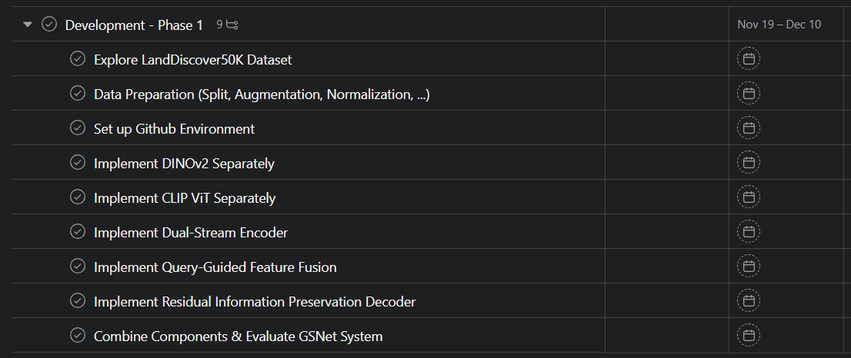
Milestone Breakdown
Upcoming Phases:

Slide 21
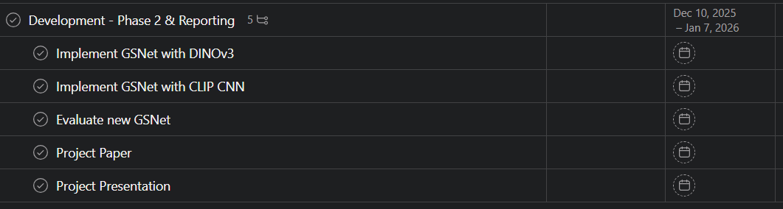
Milestone Breakdown
Upcoming Phases:

Slide 22
Thank You!
Any Questions?
Abedal Salam AL ASHI ABOU SHOUSHE - 336648
Hassan MAATOUK - 343952
Hassan JABER - 338920

