Slide 1

Shot recognition in padel match videos
Applied Data Science Project, Checkpoint 1
Alessandro de Stasi, Gianbattista Busonera, Gabriele Tebano
Mentor: Giacomo Blanco, LINKS Foundation
11 November 2026
Notes:
Good morning. We are Team 1: Alessandro, Gianbattista and Gabriele, mentored by Giacomo Blanco from LINKS Foundation. Our project is Padelyst: shot recognition in padel match videos.

Slide 2
Padel is one of the fastest-growing sports in the world
CONTEXT
91,234
padel courts worldwide
August 2026
~14,000
new courts in one year
worldwide
~10,000
courts in Italy
second only to Spain
417
courts in the province of Turin
138 clubs
Sources: FIP, World Padel Report 2026 (courts worldwide and by country). FIP Research Department, via Quotidiano Piemontese, 29 Sep 2025 (province of Turin).
Notes:
Everybody knows padel, right? It's one of the fastest-growing sports in the world: today there are more than 91,000 padel courts, almost 14,000 more than a year ago. Italy is second only to Spain, with around 10,000 courts, and the province of Turin alone has more than 400.
Quick show of hands: who here has played at least once? ... Exactly.
So padel is no longer a niche. And most of the people on those courts are not professionals: they are amateurs who play for fun, every week.

Slide 3
The feedback is in the video, but no amateur rewinds a whole match
THE PROBLEM
937
shots in 22 minutes of play, across two finals
All the labelled footage there is. Our count, PadelTracker100
Slow
Finding one smash means rewinding an hour of footage
1
Tedious
Turning it into statistics by hand is even worse
2
Lost
So amateurs skip it, and lose the feedback entirely
3
Notes:
If you want to get better at padel, the best feedback you can get is your own match. What did I actually play? How many smashes did I go for, how many backhands did I miss? The answer is in the video. But getting it out means rewinding, again and again, for an hour of footage. It's slow, it's boring, and turning it into statistics is even worse. Professionals pay analysts to do it. An amateur simply doesn't, and loses that feedback entirely.
And that's a pity, because an amateur with that feedback would engage much more directly with the sport: improve faster, train on what really matters, and probably enjoy the process more.

Slide 4
VALUE PROPOSITION
For padel players and coaches tired of rewinding, Padelyst is your padel analyst that finds and names every shot of a match, so training starts from what really happened on court.
Notes:
So this is what we promise. For padel players and coaches tired of rewinding, Padelyst is your padel analyst that finds and names every shot of a match, so training starts from what really happened on court.

Slide 5
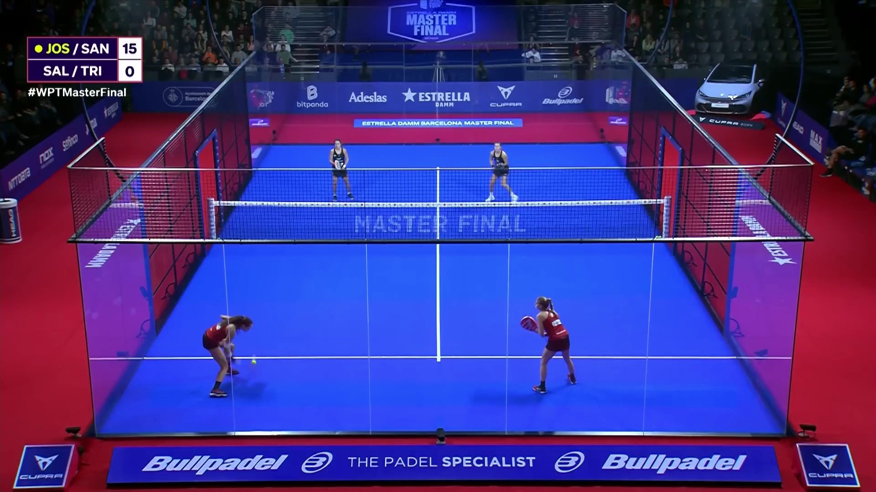
FROM VIDEO TO SHOTS
Available today
Match video
1
Match video
2
Ball
This project
3
Players
4
Poses
5
When: a shot
6
Which: its type
We start from a match video
One fixed camera, the broadcast view of a professional final
Illustration drawn from the PadelTracker100 annotations, women's final, frame 704
Notes:
Here is what we want to build. We start from a match video.

Slide 6
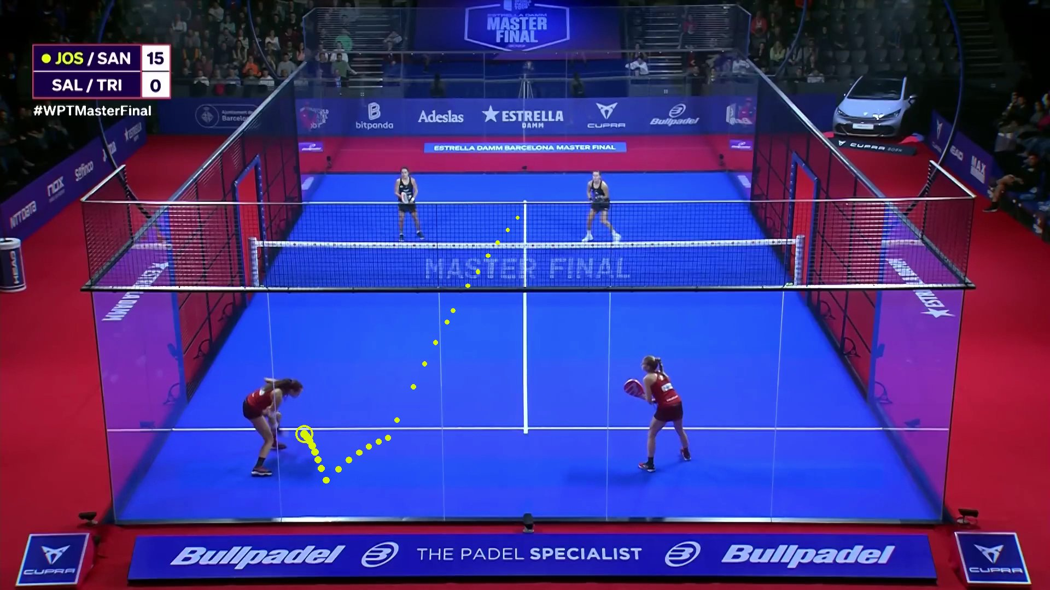
FROM VIDEO TO SHOTS
Available today
1
Match video
Ball
2
Ball
This project
3
Players
4
Poses
5
When: a shot
6
Which: its type
The ball is tracked
Given: where the ball is, frame by frame (last year's project)
Illustration drawn from the PadelTracker100 annotations, women's final, frame 704
Notes:
Last year's project already tracks the ball: that is the only input we get besides the video.

Slide 7
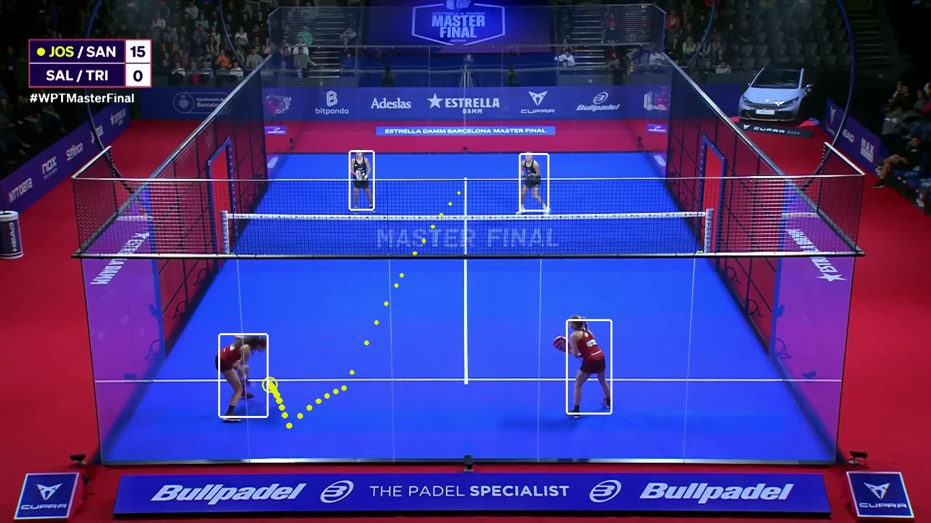
FROM VIDEO TO SHOTS
Available today
1
Match video
2
Ball
This project
Players
3
Players
4
Poses
5
When: a shot
6
Which: its type
We find the players
A bounding box for each of the four players
Illustration drawn from the PadelTracker100 annotations, women's final, frame 704
Notes:
Everything else is ours. First, we find the four players.

Slide 8
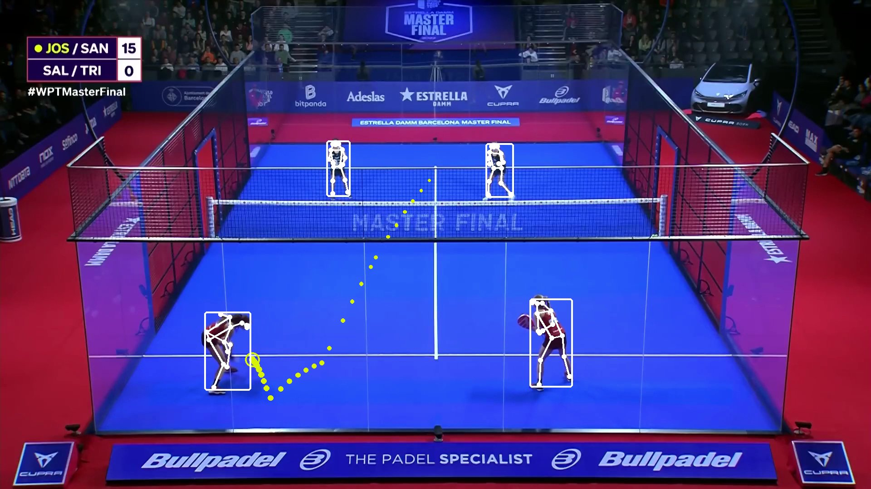
FROM VIDEO TO SHOTS
Available today
1
Match video
2
Ball
This project
3
Players
Poses
4
Poses
5
When: a shot
6
Which: its type
We estimate their poses
Body keypoints per player: arms, legs, torso
Illustration drawn from the PadelTracker100 annotations, women's final, frame 704
Notes:
For each player we estimate the pose: where the arms, the legs, the torso are, frame by frame.

Slide 9
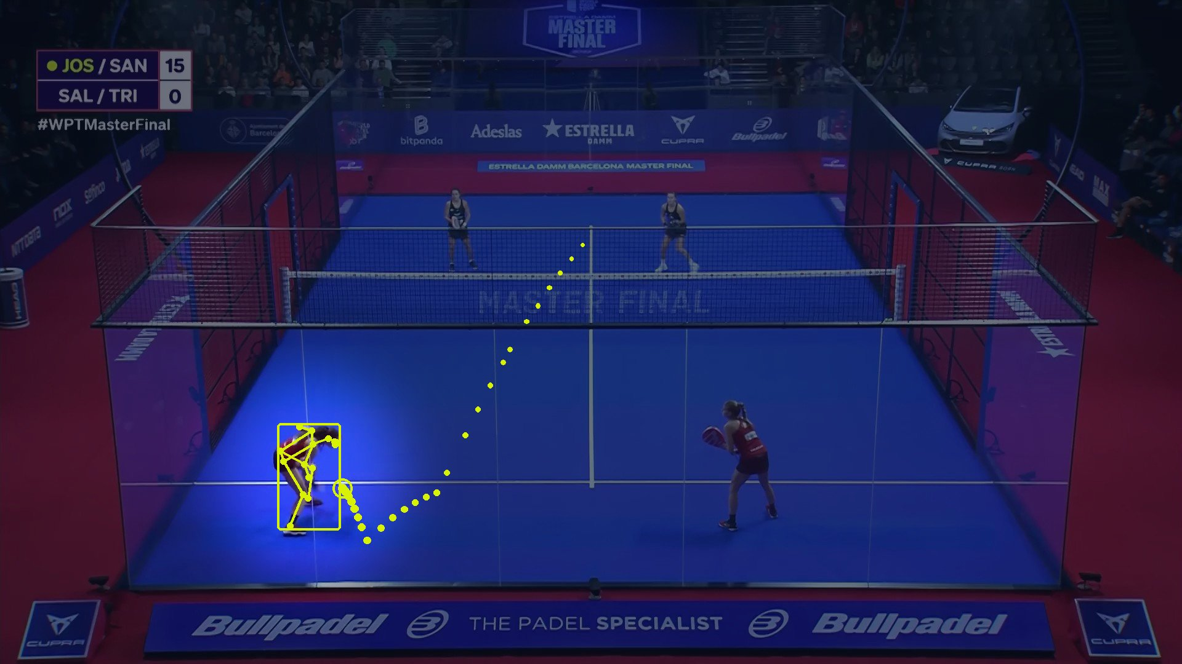
FROM VIDEO TO SHOTS
Available today
1
Match video
2
Ball
This project
3
Players
4
Poses
When: a shot
5
When: a shot
6
Which: its type
When is a shot played?
SHOT AT 0:23
Find the moment of every shot in the match
Illustration drawn from the PadelTracker100 annotations, women's final, frame 704
Notes:
Then: when is a shot played?

Slide 10
FROM VIDEO TO SHOTS
Available today
1
Match video
2
Ball
This project
3
Players
4
Poses
5
When: a shot
Which: its type
FOREHAND!
6
Which: its type
Which shot is it?
One of six: forehand, backhand, smash, serve, dropshot, other
Illustration drawn from the PadelTracker100 annotations, women's final, frame 704
Notes:
And finally: which shot is it? Forehand, backhand, smash, serve, dropshot, or other.

Slide 11
Found and named, the shots turn into statistics
THE SOLUTION
Shots per type, women's final
The first minute, filtered on smash
Forehand
152
Forehand
Backhand
Smash
Serve
Other
Backhand
124
Smash
116
Serve
34
0:00
1:00
Other
34
11 smashes in one minute
Each one a click away: no rewinding.
Dropshot
2
Real labels from the women's final (PadelTracker100), used here as a stand-in for the output of our model. Our count.
Notes:
Once every shot is found and named, the rewinding is over: you get your shots counted by type, and you can jump straight to every smash you played.
Every shot found. Every shot named. No more rewinding.

Slide 12
Players, coaches and clubs are our direct users
STAKEHOLDERS
PROJECT
Direct users
INDIRECT
Players
See their own game, shot by shot
DIRECT USERS
Coaches
Train from evidence, not memory
Padelyst
Court owners
A premium service on their courts
Performance analysts
Stop tagging shots by hand
Notes:
Who has a stake in this? Think of it as a racket, with Padelyst as the ball at the centre. Closest to it, our direct users: players, coaches, and the clubs that own the courts, plus performance analysts who today tag shots by hand.

Slide 13
Around them, those who use the statistics or bring us to clubs
STAKEHOLDERS
PROJECT
Indirect
INDIRECT
Academies
Follow development programmes
DIRECT USERS
Federations, tour organisers
Official statistics
Padelyst
Broadcasters, media
Shot statistics for coverage
Camera vendors, booking platforms
The channel to reach clubs
Notes:
Around them, indirect stakeholders: academies, federations and tour organisers who want official statistics, broadcasters, and the smart-camera vendors and booking platforms that are the channel to reach clubs.

Slide 14
And the project itself: mentor and university
STAKEHOLDERS
PROJECT
Project
INDIRECT
LINKS Foundation
Mentoring and reviews
DIRECT USERS
Politecnico di Torino
Course and assessment
Padelyst
Notes:
And finally the project itself: LINKS and Politecnico.

Slide 15
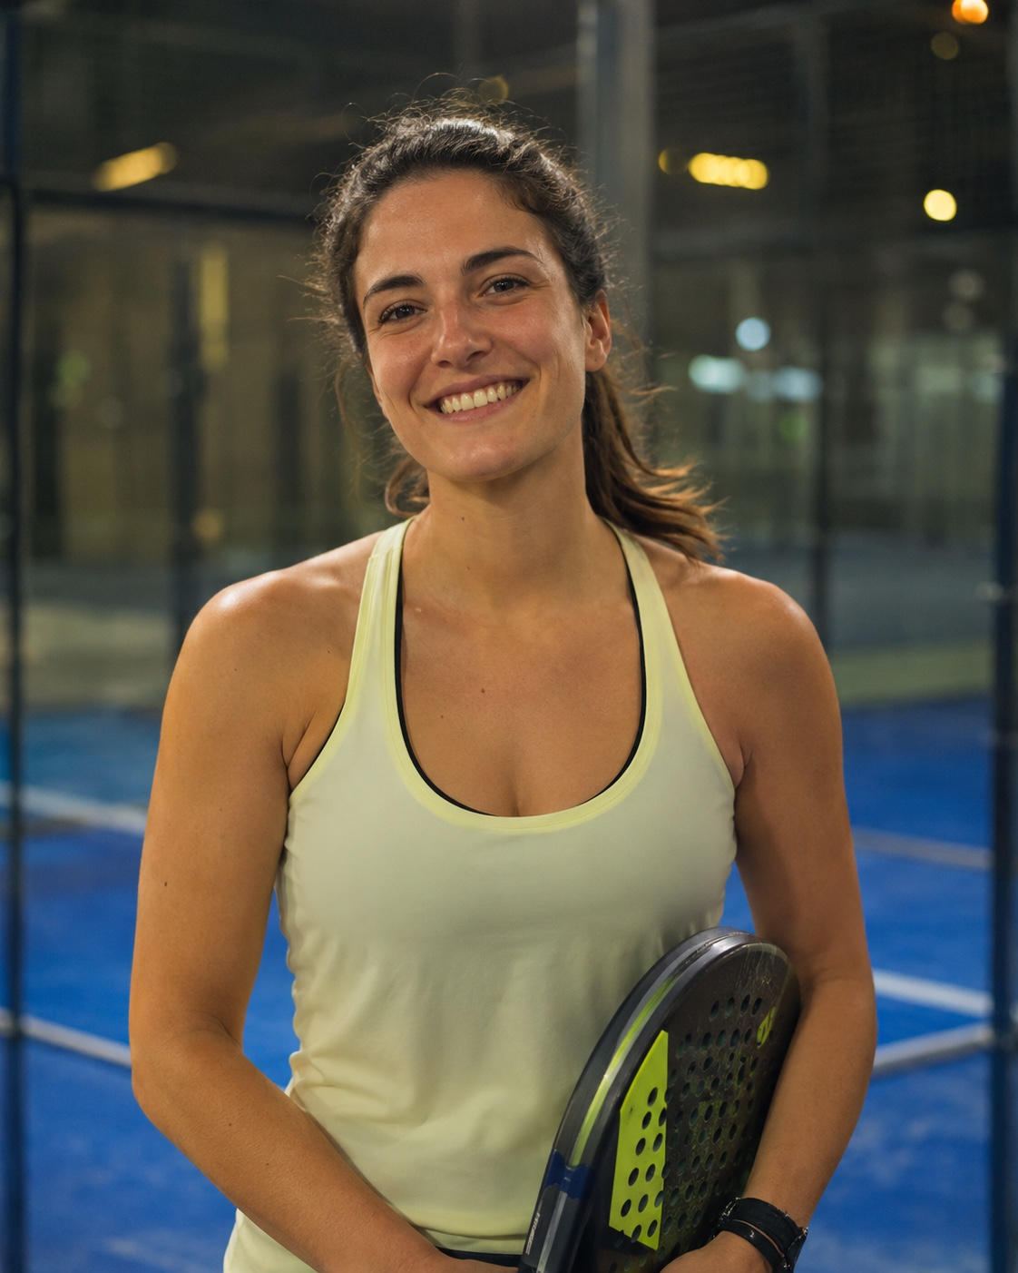
Giulia wants to improve, but has no time to study her matches
PERSONAS
Giulia, 29
Amateur player, nurse on shifts
PLAYS
2–3 times a week, lessons with an instructor, club tournaments
TODAY
Films on her phone from a bad angle, only for highlights
PAIN
Videos fill her phone; no time for statistics
NEEDS
Her shot statistics, without rewatching or storing video
Fictional person, built on our use cases. AI-generated photo.
Notes:
Three people make this concrete.
Giulia is 29 and works as a nurse on rotating shifts. She plays two or three times a week, takes lessons with an instructor, and competes in her club's local tournaments: she genuinely loves the sport and wants to get better. Sometimes she records her matches on her phone, but only to watch the highlights: from that angle you can barely see her strokes, and certainly not her technique. The videos fill up her phone, and she has no time to work out statistics on her own game.

Slide 16
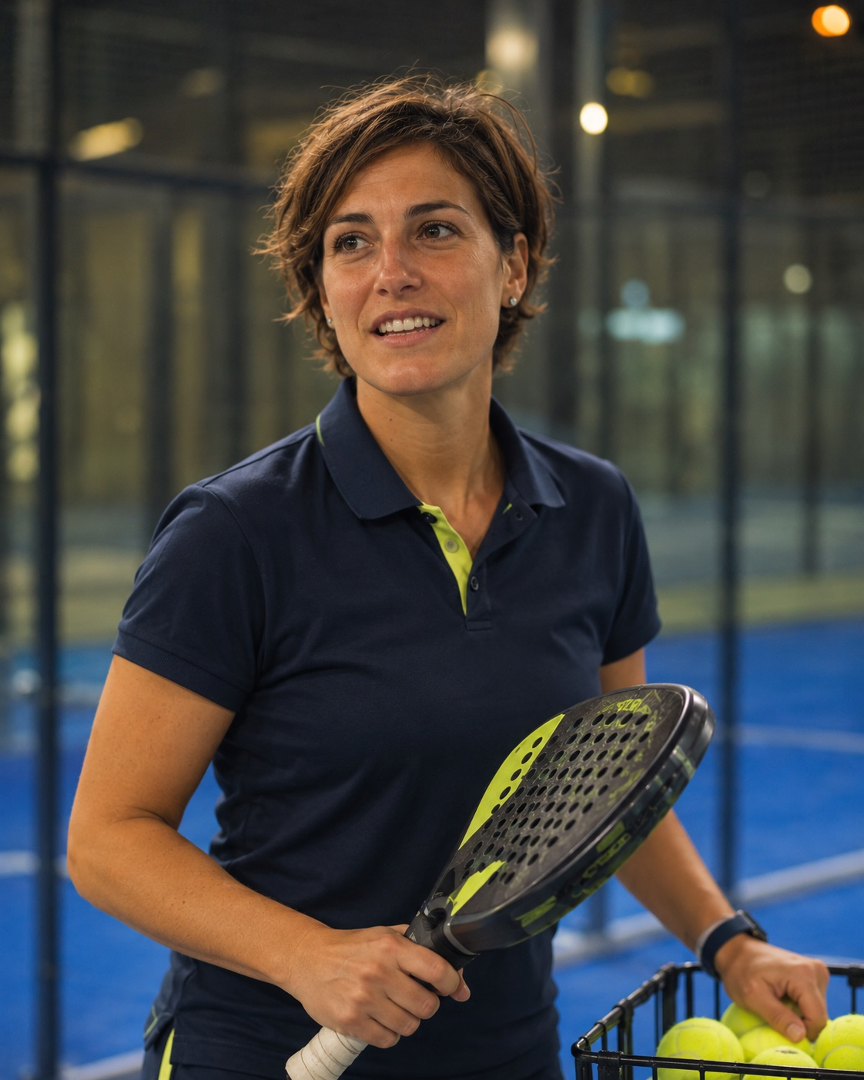
Elena coaches fifteen players, with little time for each
PERSONAS
Elena, 38
Giulia's coach, same club
WORKS
~15 players, one-on-one once a week, a training plan each
TODAY
Judges technique only in the little time she has
PAIN
Flaws in technique or form go unnoticed
NEEDS
A player's shots one after another: type counts, court position
Fictional person, built on our use cases. AI-generated photo.
Notes:
Her instructor is Elena, 38, a coach at the same club. Elena follows about fifteen players, and meets each of them one-on-one once a week to give them a training plan. With so little time per player, she can miss a flaw in their technique or their form. What she needs is to see a player's shots one after another, with statistics: how many of each type, and where on the court they are played.

Slide 17
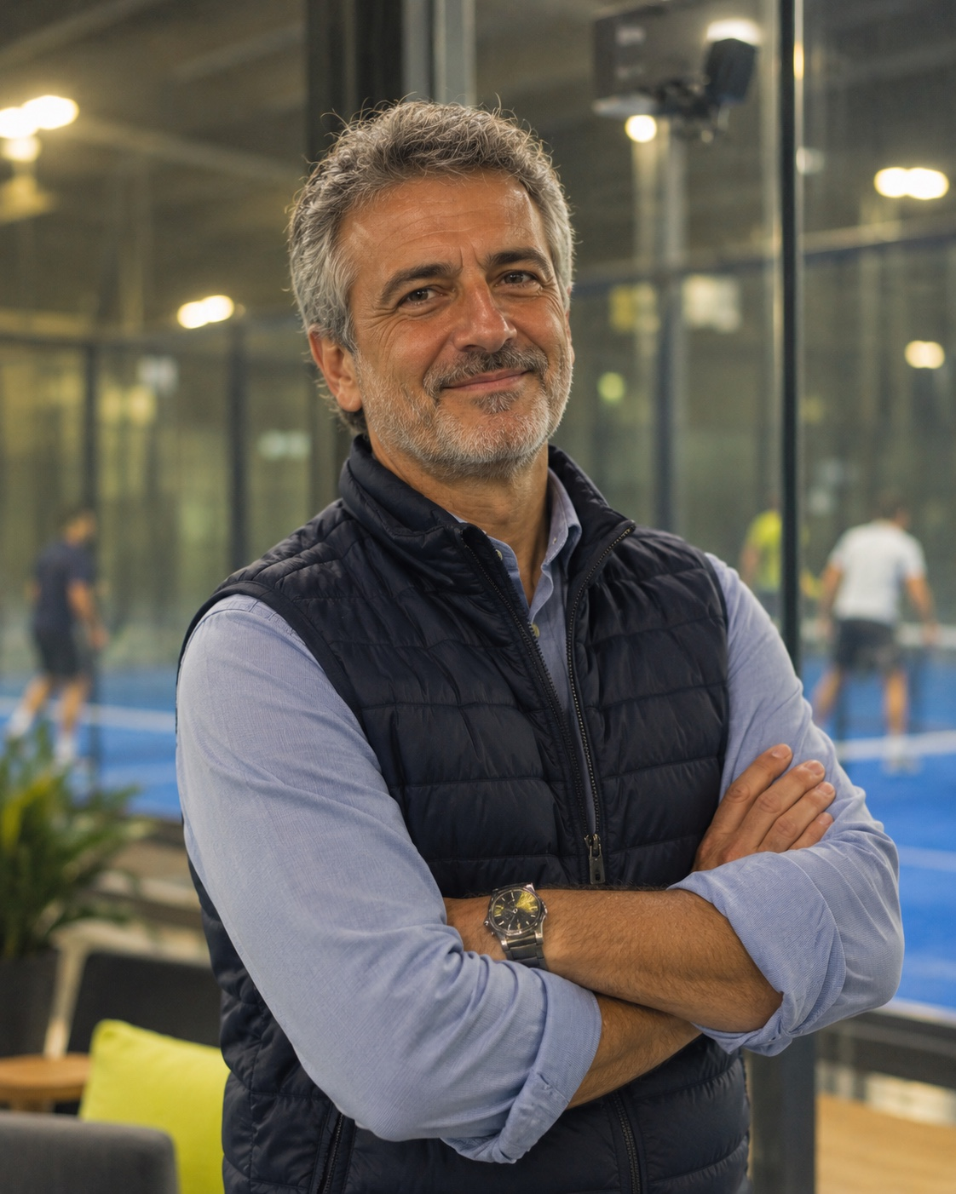
Marco can sell analysis, if it costs him one camera
PERSONAS
Marco, 52
Owner of the club
RUNS
Several courts, members on monthly or yearly plans
OFFER
Camera courts rented at a premium to players who want analysis
PAIN
No technical staff to run anything complex
NEEDS
One camera with the right framing, plus the engine
Fictional person, built on our use cases. AI-generated photo.
Notes:
And the court they play on belongs to Marco, 52, who owns the club. He can equip a few courts with a camera and our engine, and rent them at a premium to the players who want a detailed analysis, while beginners and occasional players keep the standard plans. For Marco, the only technical cost is one camera with the right framing, and the engine that computes the statistics.

Slide 18
We contribute to two Sustainable Development Goals
IMPACT
3
Good health and well-being
9
Industry, innovation and infrastructure
Clear feedback on their own game gives players a reason to keep playing, and keep moving.
Target 3.4: promote mental health and well-being
The first reference for shot recognition in padel: open data, publishable code and method.
Target 9.5: enhance research and technological capabilities
Source: United Nations, Transforming our world: the 2030 Agenda for Sustainable Development.
Notes:
Two Sustainable Development Goals. Goal 3, good health and well-being: padel gets people moving, and clear feedback on their own game gives them a reason to keep playing.
Goal 9, industry, innovation and infrastructure: this will be the first reference for shot recognition in padel, built on open data, with code and method that can be published.

Slide 19
Every block we build is a requirement
REQUIREMENTS
Detect the four players
Estimate their poses
Detect when a shot is played
Classify: six types
Attribute to the player
Output a shot log
MUST
Match video
one fixed camera
Player detection
4 boxes per frame
Pose estimation
keypoints per player
Shot detection
when
Classification + attribution
which type, which player
Shot log
frame, player, type
Ball positions
given, per frame
SHOULD
built by us
given
Analytics
Court homography
image to court
TRAINING AND TEST ONLY
Dataset annotations of boxes, poses and shots: not available once installed
Place each shot on the court
Filter by type and by player
Count shots per type, player, match
Link each shot to its video time
Notes:
What must the system do? From the video and the ball position, it must find the four players, estimate their poses, detect when a shot is played, name it as one of the six types, and tell who played it. The output is a shot log: frame, player, shot type.
It should also place each shot on the court, filter and count shots by type and by player, and link every shot to its moment in the video.
Put together: the system receives only the match video and the ball positions. Everything in the white boxes is ours. Out comes the shot log, and with the court homography it becomes the analytics our users see.
The dataset annotations of boxes, poses and shots are used only to train and test our blocks: once installed in a club, the system will not have them.

Slide 20
Offline, reproducible, and robust to our own mistakes
REQUIREMENTS
Reproducible
Same split, same script, every time
Offline
A whole match processed, no manual step
Robust
Survives the mistakes of our own detectors
Light
Stores frames and labels, no images
NON-FUNCTIONAL REQUIREMENTS
Notes:
On the non-functional side: everything reproducible, a whole match processed offline with no manual step, and robust to the mistakes of our own detectors.

Slide 21
What could come later, and what we won't build
REQUIREMENTS
COULD
WON'T
A confidence score per shot
Export the log as a table
Real time: live broadcasts already have far more advanced systems
User interface
Our target is the local club, with a small budget: nobody there needs statistics live.
Notes:
And what it won't do: real time. Live broadcasts already have far more advanced systems. We target local clubs, with small budgets, where nobody needs the statistics live.

Slide 22
Two numbers we answer to: when a shot happens, and which one it is
KPIs
WHEN
TARGET 0.80
WHICH
TARGET 0.75
F1
on shot events
67%
of frames contain no shot
F1
class-weighted
5 of 937
shots are dropshots: rare classes must still count
Precision alone rewards silence; recall alone rewards calling "shot" on every frame. F1 balances the two.
Class weights set with LINKS from the cost of each error for our users, before results.
No baseline exists. No reference results for padel shot recognition: whatever we reach will be the first.
Notes:
Two numbers we answer to. First: when is a shot played? We score it with F1 on shot events. Precision alone would reward a model that stays silent unless it's certain, and misses most shots. Recall alone would reward a model that says "shot" on every frame. F1 balances the two. Our target is an F1 of 0.80.
Second: which shot is it? Here we use a class-weighted F1, and our target is 0.75. Since no baseline exists for padel shot recognition, these targets are our own bar, not a comparison with anyone. The class weights make sure that rare shots, like the dropshot, still count: we'll set them with LINKS, from the cost of each error for our users, before we see any results.
Whatever we reach, it will be the first reference for this task.

Slide 23
What could go wrong, and how we plan to handle it
RISKS
RISK
MITIGATION
1
Errors add up along our chain
A wrong box gives a wrong pose, and a missed shot
Check every block on the annotations, to see where errors start
2
Players leave the court, glass reflects them
A player hitting outside, or a reflection that looks like one
Track four identities over time; use the court geometry
3
Who hit it?
Two players close to the ball
Combine the ball's change of direction with each player's pose
4
Rare and noisy labels
Dropshot: 5 of 937 shots; 13 shots shorter than 5 frames
Report every class, never hide one; write down each cleaning rule
5
Only professional matches, few shots
937 shots from two finals; no amateur ground truth to test on
A known obstacle from day one: transfer to amateur clubs may suffer, and we state it
Label counts: our analysis of the PadelTracker100 labels.
Notes:
What could go wrong? First, errors add up along our chain: a wrong box gives a wrong pose, and that becomes a missed shot. We'll check every block against the annotations, to see where errors start.
Second, padel is played inside glass: players sometimes leave the court to play a shot, and the glass reflects them, so a reflection can look like a player hitting the ball. We'll track four identities over time and use the court geometry.
Third, who hit it? With two players close to the ball, attribution is not trivial: we'll combine the ball's change of direction with each player's pose.
Fourth, the labels: dropshots are only 5 out of 937 shots, and some labels are noisy. We'll report every class, and write down every cleaning rule.
Finally, all our data comes from two professional finals: 937 shots in total, and no amateur match with ground truth to test on. So transfer to an amateur club is an obstacle we know about from day one, and we will state it as a limit.

Slide 24
Every shot found.
Every shot named.
No more rewinding.
Thank you. Questions?
SOURCES
Dataset: PadelTracker100, Zenodo, CC BY 4.0, doi 10.5281/zenodo.17020011
Courts: FIP, World Padel Report 2026; FIP Research Dept., via Quotidiano Piemontese, 29 Sep 2025
Sustainable Development Goals: United Nations, 2030 Agenda
Project scope: LINKS Foundation, Shot Recognition in Padel Matches Videos
All other figures: our analysis of the dataset labels
Alessandro de Stasi, Gianbattista Busonera, Gabriele Tebano | Mentor: Giacomo Blanco, LINKS Foundation
Notes:
Every shot found. Every shot named. No more rewinding. Thank you, we're happy to take questions.

