Slide 1
Predicting VLA
Failures
Can we tell a robot is going to fail before it does?
Proposed workflow • Preliminary experiments • Next milestones
Khan Adil Rashid (S352292) | Kumari Sakshi (S362932)
Mentors: Stefano Berti and Paolo Didier Alfano
Notes:
Introduce the project as an early warning system for robot-task failure. Mention that a small pretrained policy is used because large GR00T inference is difficult under available GPU constraints.

Slide 2
The problem: robots can fail without warning
Why would early failure prediction be useful?
A robot receives a task
Something goes wrong
We want an early warning
A camera image and a language instruction are used to select robot actions.
The grasp may miss, the object may slip, or the final placement may be incorrect.
A separate monitoring model predicts failure before the attempt ends.
Goal: predict the final outcome from the first part of a robot’s trajectory.
ADSP • Predicting VLA Failures
02
Notes:
The project is not about teaching the robot to manipulate objects. It is about creating a monitoring model to assess a robot policy as it operates.

Slide 3
What does “early” prediction mean?
Show only the beginning of the attempt and hide the rest
Example: observe the first 20% of an episode
10%
20%
30%
40%
50%
60%
70%
80%
90%
100%
VISIBLE TO DETECTOR
HIDDEN FUTURE
Prediction at step 12 of 60: “Will this whole attempt eventually fail?”
Test several windows, e.g. 10%, 20% and 30%.
ADSP • Predicting VLA Failures
03
Notes:
For offline evaluation, the first x% is defined from total episode duration. In live use total duration may be unknown, so fixed step budgets or online risk scores are preferable.

Slide 4



Sustainability impact
Energy and time efficiency
Less material waste
An early warning could prevent unproductive robot movements and repeated attempts.
Stopping or asking for help earlier could reduce dropped objects and damaged materials.
More reliable workplaces
Warnings could help operators intervene earlier when robots work near people.
ADSP • Predicting VLA Failures
04
Notes:
Potential sustainability benefits: earlier failure warnings could avoid unnecessary robot actions, reduce the risk of wasted materials, and help workers intervene. These benefits remain hypothetical until measured. The links are SDG 9 (primary), SDGs 12 and 8 (potential).

Slide 5




Who benefits
Robotics researchers and engineers
Operators in industry and warehouses
Evaluate VLA policies and know when one is about to fail, without watching every video.
Get an early warning to stop the robot, step in or retry before the task goes wrong.
Supermarket and retail staff
Data collectors
Work alongside robots and get an alert only when help is needed.
Automatically separate successful from failed rollouts.
ADSP • Predicting VLA Failures
05
Notes:
Industry and retail users are the target setting. The project tests the idea in simulation only.

Slide 6
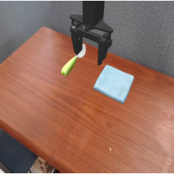
Our Simulation Environment and Robot Policy
A feasible alternative to GPU-heavy GR00T
SimplerEnv: the simulator
Octo-Small: the robot policy
Provides ready-made robot manipulation tasks, camera observations and task-completion checks.
A small, pretrained generalist policy that predicts robot actions from observations and instructions.
Why this choice?
Lower stated model VRAM (<2 GB) and both successes and failures in the spoon task.
Model VRAM is not the total simulator memory requirement; Colab compatibility must be tested.
ADSP • Predicting VLA Failures
06
Notes:
GPU constraint comes from IIT lead discussion. Model memory in mentor table is not the same as total memory of simulation+rendering. A pretrained checkpoint is loaded, not pretrained by us.

Slide 7
Why Octo-Small on the spoon task
Model | Spoon on towel | Carrot on plate | Stack block | Eggplant in basket | Average | VRAM
Octo-Base | 12.5 | 8.3 | 0.0 | 43.1 | 16.0 | <2 GB
Octo-Small | 47.2 | 9.7 | 4.2 | 56.9 | 29.5 | <2 GB
SpatialVLA | 16.7 | 25.0 | 29.2 | 100 | 42.7 | ~10 GB
pi0, Bridge-Uniform | 63.3 | 58.8 | 21.3 | 79.2 | 55.7 | 6.7 GB
pi0, Bridge-Beta | 84.6 | 55.8 | 47.9 | 85.4 | 68.4 | 6.7 GB
Success rate (%) on the four WidowX / Bridge tasks. Source: ECCV 2026, Poster #3187.
Balanced classes: 47% success on the spoon task: successes and failures in similar numbers.
ADSP • Predicting VLA Failures
07
Notes:
A failure detector needs both successes and failures. Octo-Small on the spoon task is close to 50%, so data are balanced, and the model is light enough for free Colab. Our own 100 rollouts gave 37% (95% CI 28-47%), consistent with the table's 47.2%.

Slide 8
Our first benchmark task
“Put the spoon on the towel” in the WidowX / Bridge scene
Task goal
Robot must move the spoon onto the towel.
Episode setup
60 steps per rollout; 24 initial scene configurations.
Why start here?
Simple to explain, inspect and label; useful for testing early failure detection.
ADSP • Predicting VLA Failures
08
Notes:
The 60 step and 24 scene claims originate from the supplied teammate PPT. Treat them as provisional until backed by scripts or data.

Slide 9
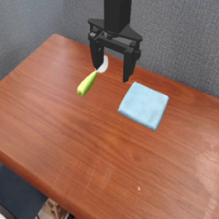
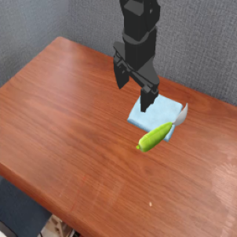

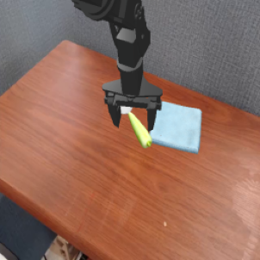
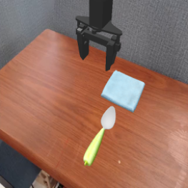
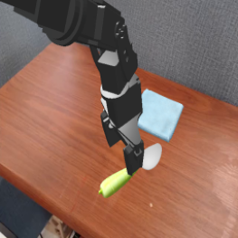
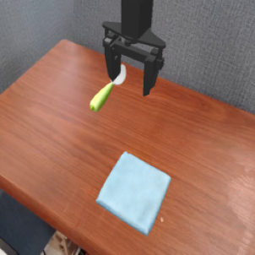
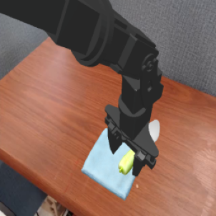
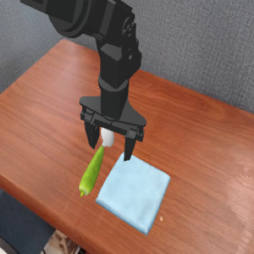
What success and failure look like
Success
Step 0
Step 60
Failure: no grasp
Step 0
Step 60
Spoon ends on the towel
Gripper closes without holding the spoon
Failure: not placed
Step 0
Step 60
Failure: late success
Step 0
Step 24
Step 60
Spoon is picked up but does not end on the towel
Spoon reaches the towel (step 24), then is lost by step 60
ADSP • Predicting VLA Failures
09
Notes:
Top row: scene 0, a successful run. Bottom row: scene 1, the gripper closes at the wrong place and never holds the spoon. A failure detector should flag the bottom row before step 60.

Slide 10
Initial Results
Preliminary pilot run: 100 rollouts on one task
100
37
63
rollouts reported
successful episodes
failed episodes
37% success
63% failure
Preliminary results for one task, not a measure of Octo-Small performance in general.
Raw data: shared Google Sheet
ADSP • Predicting VLA Failures
10
Notes:
Quote from teammate draft: 100 episodes on spoon/towel, 37 successes and 63 failures. No raw data was uploaded for independent verification. Repeated scenes need grouped splitting.

Slide 11
What is inside the 63% of failures
Failure types in our 100 rollouts of Octo-Small on “put the spoon on the towel”
34
26
3
No grasp
Grasped, not placed
Success, then lost
34 episodes · 54% of failures
26 episodes · 41% of failures
3 episodes · 5% of failures
The spoon is never held: the gripper closes on nothing or in the wrong place.
The spoon is picked up but does not end on the towel: it falls or is released elsewhere.
The spoon reaches the towel at some step, but it is not there at step 60.
WHERE IT BREAKS
WHERE IT BREAKS
WHERE IT BREAKS
Approach and grasp
Carry and place
End of the episode
Each type leaves a different signature in the gripper, grasp and object signals.
ADSP • Predicting VLA Failures
11
Notes:
Breakdown of the 63 failed episodes out of 100: 34 no grasp (54%), 26 grasped but not placed (41%), 3 success then lost (5%). Labels are derived from the simulator's grasp and success signals. Percentages are computed on the 63 failures.

Slide 12



Failure detection approaches
Policy uncertainty
Visual-feature classifier
Hidden Markov chain
We generate multiple possible actions from the same observation.
A pretrained image encoder plus a classifier predicts success or failure from frames.
Analyzes the sequence of robot behavior, such as approaching, grasping and placing the object, to identify unusual patterns
Input: sampled actions
Input: saved images
Input: gripper and grasp signals
ADSP • Predicting VLA Failures
12
Notes:
Octo uses a diffusion action head, so repeated sampling from the same observation gives a natural uncertainty estimate. Methods are compared on the same labelled rollouts.

Slide 13
How we evaluate the detector
Same held-out scenes; failures are the positive class
AUROC
Ranks failure episodes above successful ones
AUPRC
Precision-recall trade-off, useful when classes are imbalanced
Recall
How many true failures are detected
Precision
How often a failure warning is correct
False-alarm rate
How often a successful episode gets flagged
Earliness
At what step the first reliable warning appears
ADSP • Predicting VLA Failures
13
Notes:
Do not claim model scores yet. Accuracy alone misleading because 63% failures; use AUROC, precision/recall, false alarms and time. AUPRC can also be helpful for imbalance.

Slide 14
Roadmap
Step-by-step implementation plan after feasibility testing
1
Environment
Run Octo-Small + SimplerEnv reliably
2
Data
Validate and extend rollout records
3
Baseline
Train a simple predictor on early data
4
Comparison
Approaches evaluation on held-out scenes
5
Report
Analyze failures, earliness and limitations
Optional later: more tasks / more seeds / policy features / online warning demonstration.
ADSP • Predicting VLA Failures
14
Notes:
The timescale is deliberately unspecified until access to compute and source data are confirmed. This is a proposed sequence, not a claim that all items are complete.

Slide 15
Thank you for
your attention
Notes:
Close with decisions needed: simulator-policy choice, availability of pilot data/source, compute, and agreed minimal scope.

