Slide 1
Lost and Found Portal
By-
Shubham Beniwal 2013CSB1033
Sukhmaninder Singh Tuli 2013CSB1034
Ankit Dahiya 2013CSB1005
Anshul Rajput 2013CSB1006

Slide 2
Acknowledgement
This project was made under the guidance of Dr. Nitin Auluck and with the help of Ashu Kaushik Sir. We are very thankful to the faculty that they helped us through the project work with such an ease and made our learning a fun experience. Finally we are grateful for their cooperation that they provided to us.

Slide 3

HOME PAGE-home.php
To open our project enter the following address in the browser window-
localhost/hey/home.php
Home page of our project will appear in the browser.

Slide 4
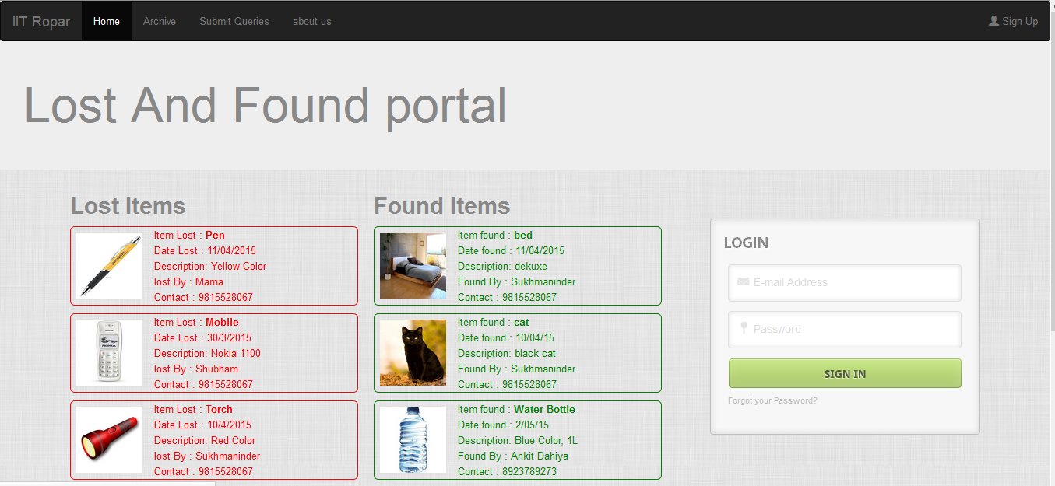
Home Page

Slide 5
The home page consists of the following parts-
Top Menu-Consists of buttons which can direct the user to various parts of our website . This is part of every page of our portal . But if you are not logged in ‘Archive’ and ‘Submit queries’ would not open and redirect you to the home page.
Item List- On the left side of the page is the list of latest five reports of both lost and found items.
Login form-On the right side of the page is the login form.If one has already subscribed as a user of our portal , can enter its registered mail and password and log in.Through this he can unlock more features of our portal like submitting queries and viewing archive.

Slide 6
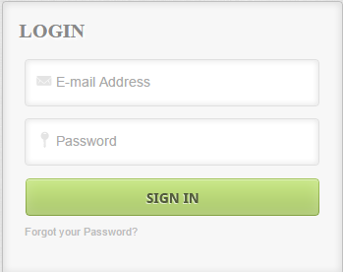
If you are already subscribed but have forgotten your password you can click
“Forgot your Password?”
Text given at the end of the login box . This will lead you to the page of password recovery . Recovery procedure is explained in later sections.
Login form

Slide 7

REGISTRATION PAGE-registration.php
You can navigate to this page by clicking on the Sign Up tab given in the top menu.
You can also open this page by typing
localhost/hey/registration.php
Address in the browser.

Slide 8
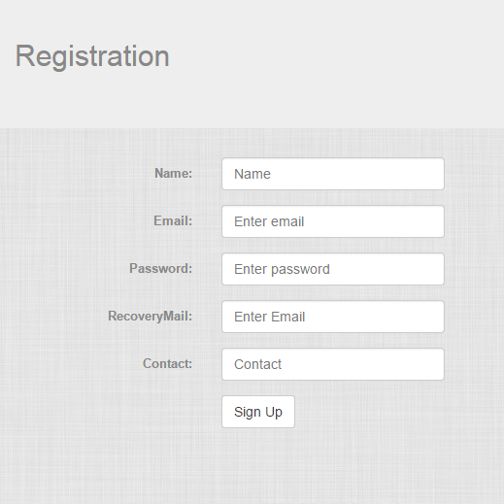
Registration Page
If you are not registered as the member of our portal .You can register on this registration page.
To register as a member-
Fill the details asked in the form.
You cannot leave tabs empty.
The registration mail should have domain iitrpr.ac.in or else error will be displayed.
In the recovery mail entry, fill the mail to which you want us to send the details during password recovery.
Once you are registered the details you enterd are stored in our data base you can use your mail and password to login at home .And than you will be able to view archive and Submit queries.

Slide 9
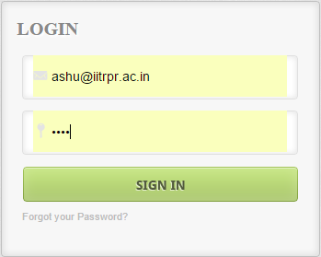
Submit Queries-entry.php
Once you are logged in as a member this page is automatically opened , with the logged in member’s mail displaying at the top.
From other pages click Submit Queries tab to open this page.
For example if Ashu sir logged in as follows-

Slide 10

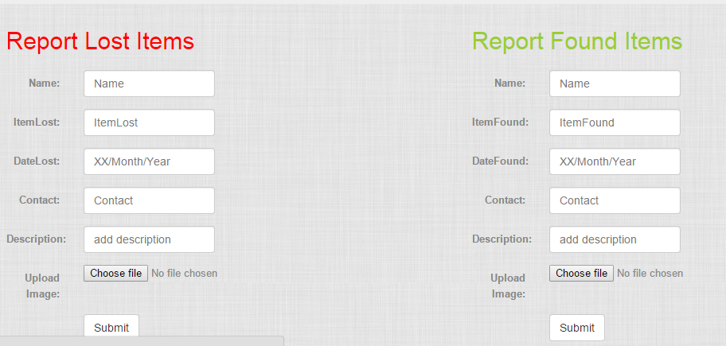
The entry page is opened , the following two forms are displayed. And name of ashu sir’s id at the top.
Now sir can log out by clicking the logout button.

Slide 11
The query forms-
One can report for a lost item or found item by entering the details in these forms.
Once you enter the details with optional photo and clicked submit, your entry is stored in our data base and you can see your reported data in the archive as well as the home page.
The user are expected to use their power of unrestricted submission responsibly. It is requested not to submit ‘multiple of the same item’ or ‘false entry to fool others’.

Slide 12
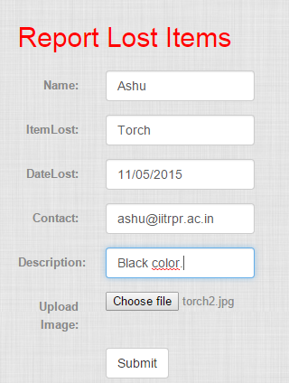
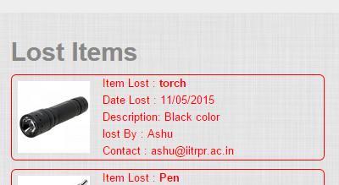
Example submission-
Suppose Ashu sir have lost a torch, he will fill the “Report lost items” form as follows. And the entry of this lost item torch is displayed in the list of lost items , at the top(As latest entry).
Entry displayed in the lost items list
Form filled to report lost item -torch

Slide 13

Archive Page-archive.php
As the name suggests, this is the page where archive of all the lost and found item reported at our website can be viewed.
Both lost and found item list displays 4 items initially.
When you click load more tab at the end of the page 4 more items are displayed.
This list has a button for each reported item. For the found item for the lost item.
By clicking these button, one who has submitted the entry can delete that particular entry.

Slide 14

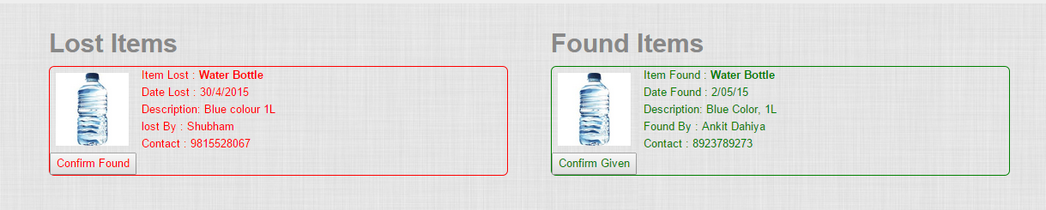
Search
The top menu of archive and submit queries page consists of an additional feature-Search Box.
The search box can be used to search the archive to find an item.
For example entering “bott” in our archive displays following result.
Searching “bott” in search box.
Result of search “bott”

Slide 15
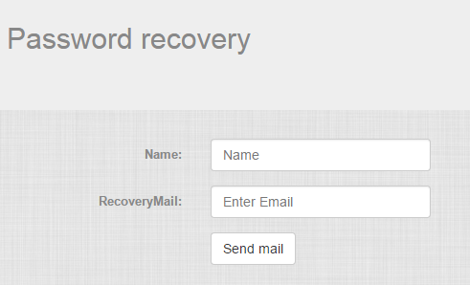
Password recovery -
If you are a registered member but have forgotten your password , you can begin the password recovery procedure by clicking on “Forgot your password?” text in login box.
For successfully recovering your password you must know your username and recovery mail, submitted during registration . And enter them in the form , click send mail button.
Password will be sent to your recovery mail.

Slide 16
Future Enhancements
We plan on to make a chatting system that enables the users to message the person of interest and discuss whatever they want.
We also plan on adding smart search to make it easy for the users to search for relevant things.
A notification system can be added that sends message to the person who lost some object and the same object is found by any other person so that he can check for the object when notified.

