Slide 1
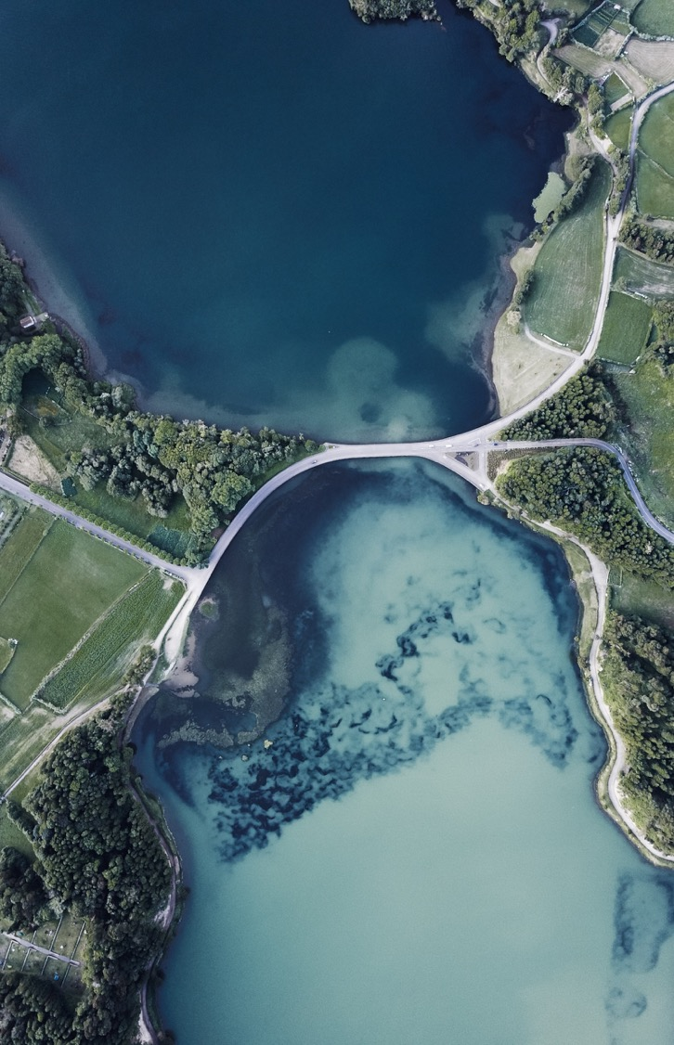
Capstone project: Expat Location Engine

Slide 2

Business Problem
Every year a great number of professionals change their home for mid or long term periods, accompanied most of the time by their families. For a newcomer in the town it is very difficult to make the decision on which side of the city to set foot and find an appropriate venue.
Your company name

Slide 3
Problem Statement
A young professional gets an international assignment for a 2 years period
Needs:
Doesn’t Need:
Affordable
Easy connectivity/ commuting
Descent neighbourhood
Basic amenities
Not an expensive area
Not far away from the working place
Not a remote area
Low crime rate and middle class earning society
Your company name

Slide 4
Data
DATA USED:
Local Pensylvania data from opensocrata
DATA PREPARATION:
Get rid of null values, duplicate rows, data wrangling and formatting
GEOCODE LOCATION:
Fetch location information from nomanitum using geocoder library
FOURSQUARE API:
Fetch venues and amenities using API

Slide 5
MEthodology
K-Means Clustering will be used to cluster the amenities
The neighbourhoods will be clustered using similar characteristics criteria
Preferences will be considered e.g. Shooping Malls, Banks, Restaurants, Cinema, etc
Look for the best combination for living near by

Slide 6
MEthodology
K-Means Clustering will be used to cluster the amenities
The neighbourhoods will be clustered using similar characteristics criteria
Preferences will be considered e.g. Shooping Malls, Banks, Restaurants, Cinema, etc
Look for the best combination for living near by

Slide 7
Results
Based on the amenities available in each area, the combinations are divided in 4 clusters:
Cluster 1: group of venues near to parks, shooping malls, grocery, bank
Cluster 2: group of venues near to restaurants and cinemas
Cluster 3: group of venues mostly near to food joints and super markets
Cluster 4: group of venues near to pubs, nightlife clubs, malls, banks and entertainment places

Slide 8
Discussion
Without the initial data exploration and methodology phase, it could not be possible to figure out what are top amenities in the neighborhood that helps in making the decision for living in that area.
Though the data has gone through exploratory analysis, some of the issues can be found during actual run of data. E.g. few locations didn't return geo location and few others didn't return any result for FourSquare API and couldn't find nearby venues.

Slide 9
Conclusion
Data Science is a highly iterative process which needs going back and forth to tune the data as needed.

Slide 10

Thank You

