Slide 1
Project StockWeb AI
AI Stock Portfolio Management App with predictive power
Sept 20, 2018

Slide 2
Team Members
Sonia Cheng
Adrian Sung
Timothy Lo

Slide 3
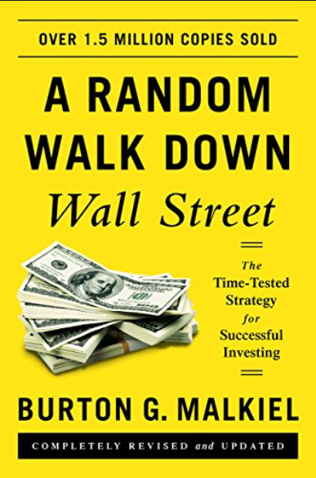

Background
“Stock market prices are highly unpredictable and volatile.”
This means that there are no consistent patterns in the data that allow you to model stock prices over time near-perfectly.
1. Top firms like Morgan Stanley and Citigroup hire
quantitative analysts to build predictive models.
2. By some estimates, 70% of total trade volume on Wall
Street are placed by software and algorithms.

Slide 4
Problem Statement
Can we leverage deep learning and statistical models to help investors to predict stock trend and price?
The answer is absolutely YES !!

Slide 5
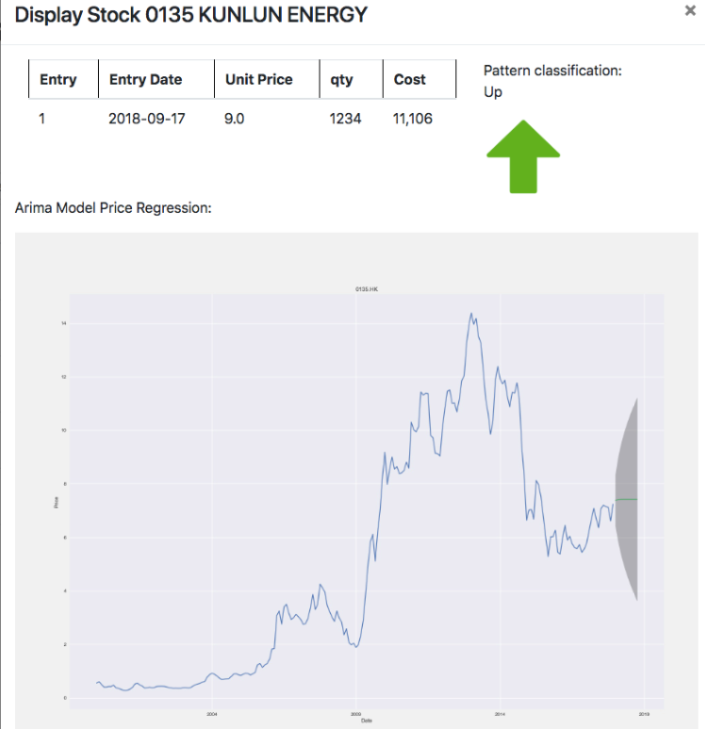


Solution
Price Trend Prediction:
Long short-term Memory (LSTM) Neural Network
To predict the price trend of a stock for the upcoming day
(Up, Down or Neutral)
Qty
Libraries: Keras/Tensorflow
Training Time: 10 minutes
(for 3000 stock patterns)
Train Score: 83.0%
Test Score: 85.0%
Price Prediction:
Autoregression Integrated Moving Average (ARIMA) model
To forecast the price of a stock for the next 10 months

Slide 6
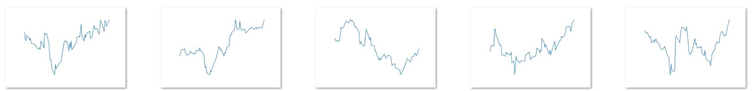


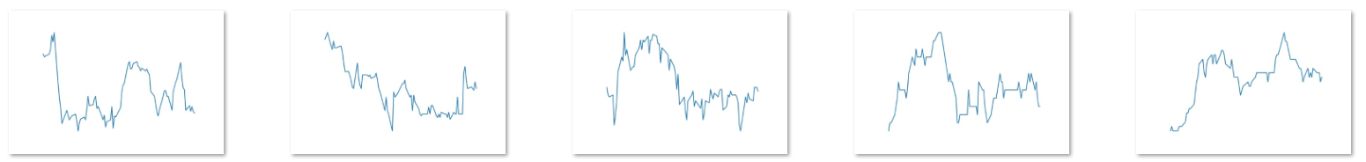
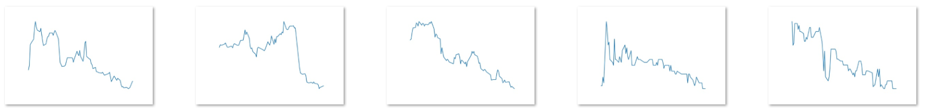

Price Trend Labelling
Up
Neutral
Down

Slide 7
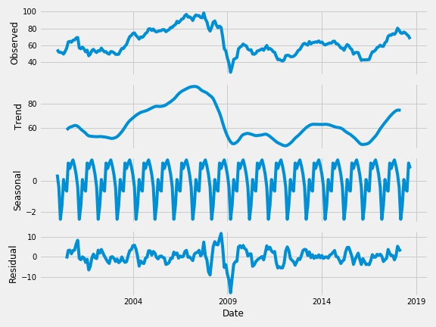
HSBC (0005.HK)

Slide 8
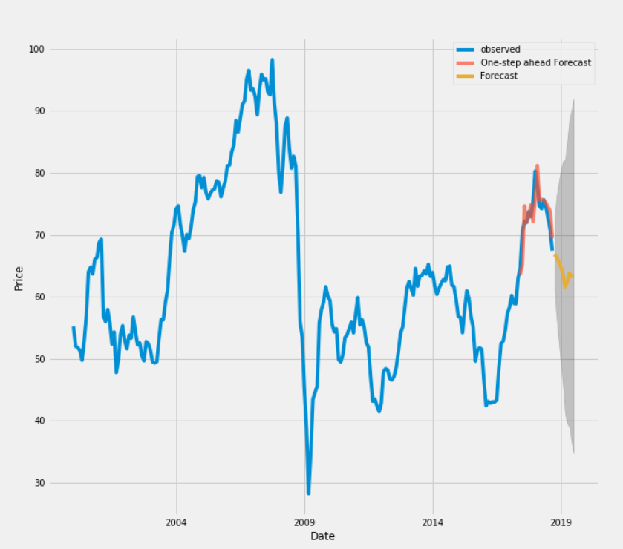
HSBC price forecast

Slide 9
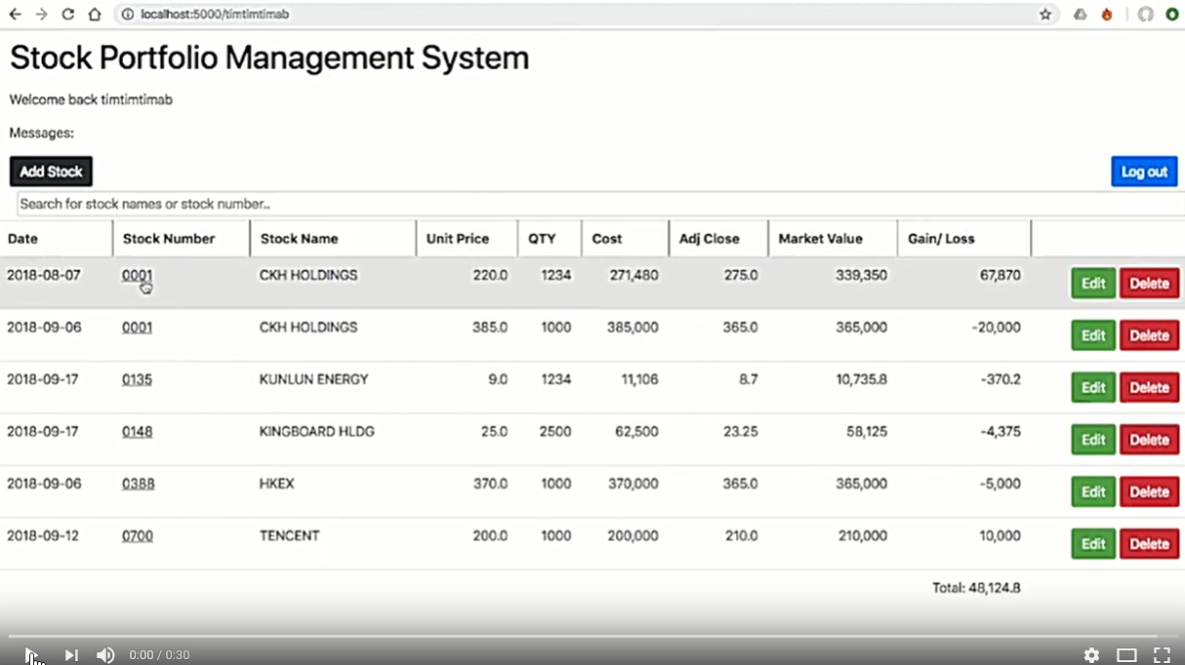

Live Demo

Slide 10
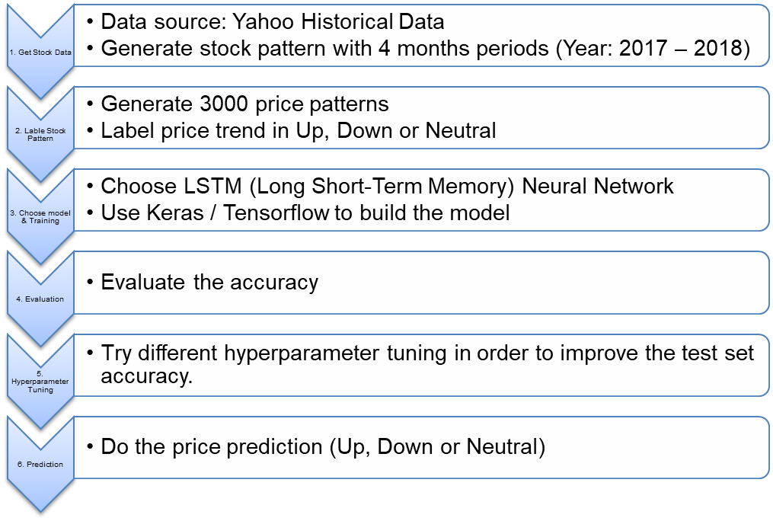

Appendix : Our process – Price Trend Classification

